Slide 1
Interconnection Networks

Slide 2
Applications of Interconnection Nets
Interconnection networks are used everywhere!
Supercomputers – connecting the processors
Routers – connecting the ports – can consider a router as a parallel machine with the ports/linecards as the processors!
Clusters of machines
Internet (loosely coupled network)

Slide 3
INs in Supercomputers
PE
PE
PE
PE
PE
Mem
Mem
Mem
Mem
Mem
PE
PE
PE
PE
PE
Network
Network
Memory
Memory
Memory
Dance-Hall Model
Of Supercomputers
Distributed memory Model
Of Supercomputers

Slide 4
INs in Routers
Network
Input Line card
Output Line card
Input Line card
Output Line card
Input Line card
Output Line card
Input Line card
Output Line card
Input Line card
Output Line card
Input Line card
Output Line card
Control
Processor

Slide 5
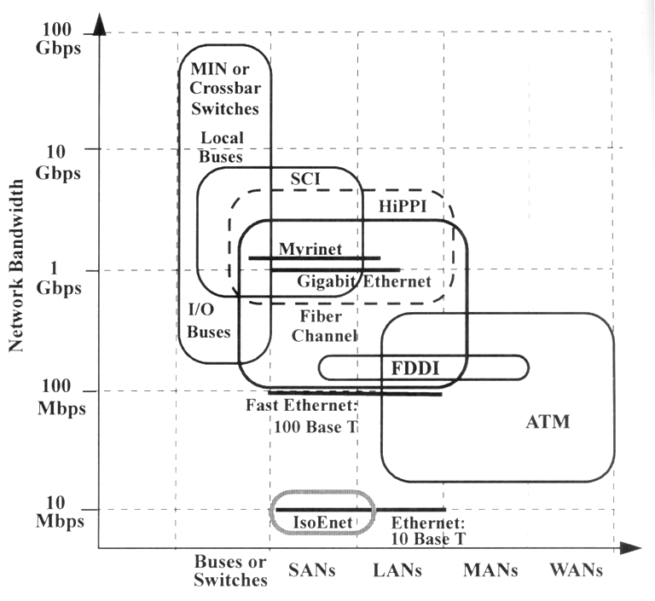
Generations of Interconnection
Networks
10 Gigabit Ethernet

Slide 6
Example Intercon. Networks
Mesh Network
Communication Links
Processing Element
(CPU + Mem + other)

Slide 7
Example Intercon. Networks
Torus Network
Communication Links
Wrap around Connections
Processing Element
(CPU + Mem + other)

Slide 8
Example Intercon. Networks
Tree Network
Control Element
Communication Links
Processing Element
(CPU + Mem + other)

Slide 9
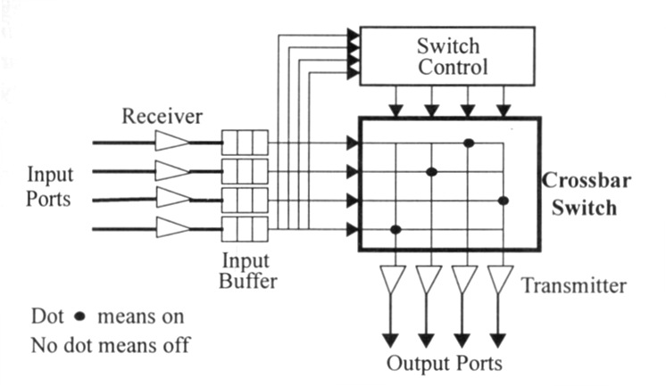
Crossbar Network
Simplest and most flexible switch architecture
Can establish n connections between n inputs and n outputs
Each X-point can be switched on/off by controller
Number n is often called the degree of the switch
`

Slide 10
Classes of Interconnection Nets
Connectivity and control can be used to divide INs into two classes: static and dynamic
Static networks – that don’t change dynamically (e.g., trees, rings, meshes (not crossbars))
Dynamic networks – that change interconnectivity dynamically – use switched channels

Slide 11
Static Networks
Topological properties particularly important for static networks
Node degree: number of edges incident on a node
Network diameter: diameter D of a network is the maximum path length between any two nodes -- the path length is measured in terms of links traversed

Slide 12
Dynamic Networks
Dynamic networks can be split into
Shared media designs
Switched media designs
Cost increases when converting from shared media to switched design
Switched Links Design
Shared Media Design

Slide 13
Switched Networks
Switched networks can be: circuit switching or packet (cell) switching
Circuit switched networks -- the entire path from the source to the destination is reserved for the entire period of transmission
Packet switched networks – message is transmitted in packets. Packets are routed in stages.

Slide 14
Packet Switching
Cell switching – is a variation of packet switching where packet size is fixed.
A cell contains a header (routing information – e.g., a label) and payload
Cells from the same message or source can be routed along different paths

Slide 15
Switching Schemes
Two ways of sending packets in switched networks:
Store-and-forward
Cut-through or wormhole routing
Store-and-Forward
Entire packet is stored in a node before it is forwarded to an outgoing link
Successive packets are transmitted sequentially without overlapping in time

Slide 16
Switching Schemes
Cut-through Routing
Each node uses a flit-buffer to hold a flit (one cell)
A flit is automatically forwarded to an outgoing link, once the header is decoded
All data flits in the same packet follow the same path that the header traverses

Slide 17
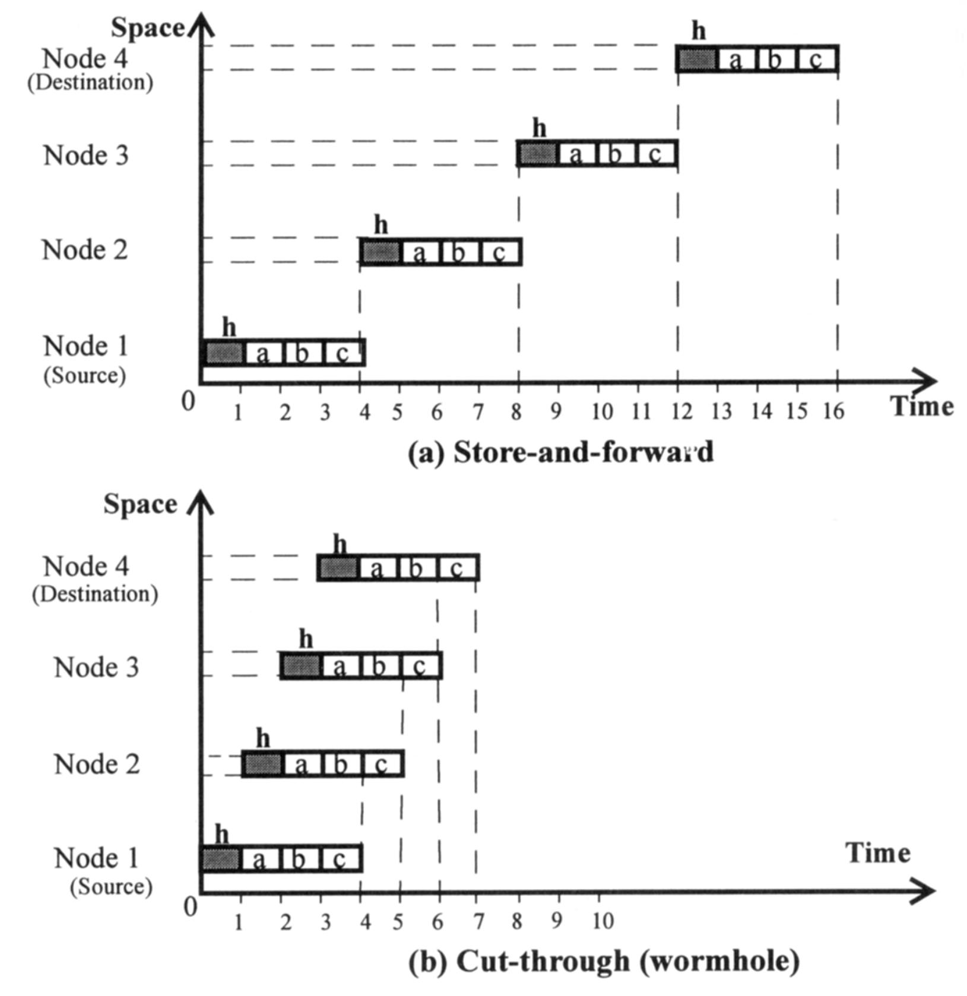

Slide 18
Switching Schemes
Using the cut-through it takes only 7 time units for node 4 to receive the entire message
The same message took 16 time units in the store-and-forward scheme

Slide 19
Network Performance Metrics
Communication latency
software overhead: overhead associated with sending and receiving messages at end stations
channel delay: caused by the channel occupancy
routing delay: time spent in the successive switches in making a sequence of routing decisions along the routing path
contention delay: caused by traffic contentions in the network

Slide 20
Network Performance Metrics
Per-port bandwidth: maximum number of bits that can be transmitted per second from any port to any other port
For symmetric network, per-port bandwidth is independent of port location
For asymmetric network, depends on port location
Aggregate bandwidth: defined as the maximum number of bits that can be transmitted from one half of the nodes to another half of the nodes per second

Slide 21
Network Performance Metrics
For example, for 512-port HPS with 40MB/s per-port bandwidth, the
aggregate bandwidth = (40x512)/2 = 10.24GB/s

Slide 22
Routing on Static Networks
Meshes and Rings:
Simplest connection topology is the one-dimensional mesh, or linear array
In a linear array, the interior nodes have two connections and boundary nodes have one
If we connect the two boundaries, we get a ring with all nodes of degree 2
A higher dimensional mesh is constructed similarly with k dimensions, interior nodes have degree 2k

Slide 23
Routing on Static Networks…
Common mesh topology is the 2-D mesh
Some 2-D meshes have wrap-around connections along the edges
Routing:
Assume interior nodes – routing performed over one dimension at a time
On a 3-D mesh, minimal path from a node (a, b, c) to (x, y, z) is constructed by moving along 1st dimension to (x, b, c) then to (x, y, c) and finally to (x, y, z)
This is known as the XY-routing

Slide 24
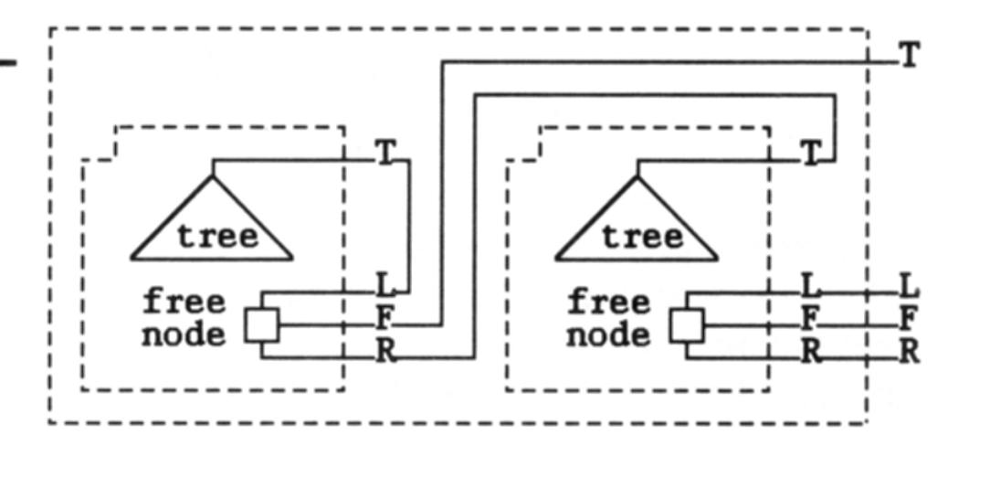
Routing on Static Networks …
Trees:
Common tree topology is the binary-tree
Binary trees are well matched for VLSI and other planar layouts

Slide 25
Routing on Static Networks…
Routing in trees
Idea: travel up the tree from A until you reach an ancestor of B and then travel down
To implement number the root as 1 and left and right children as of x as 2x and 2x+1, respectively
If the root is at level 1
Then the nodes at level i have a label that is i bits long and the left and right children of a node have 0 or 1 appended to their parent’s number, respectively

Slide 26
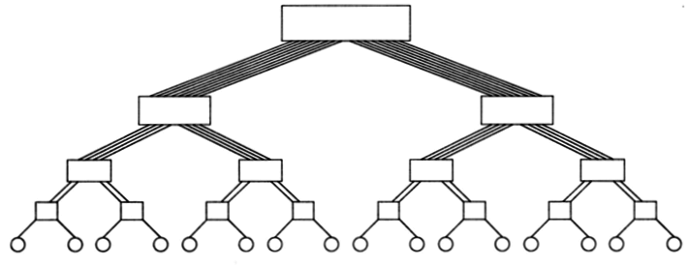
Routing on Static Networks…
Lowest common ancestor of A (source) and B (destination) is the node numbered P, the longest common prefix of A and B
From this it is easy to see how many levels we should go up to reach B from A
What is this tree called?

Slide 27
Routing in Trees
0001
0010
0011
0100
0101
0111
0110
1010
1011
1100
1101
1110
1111
1000
1001
Src 1010
Dst 1110 ➔ 1 (longest common prefix) & 110 remainder on dst
Node 0001 is the common ancestor; use 110 to route down from ancestor
110 ➔ right, right, left from 0001 (common ancestor)

Slide 28
Routing on Static Network…
Hybercubes:
Multidimensional mesh of processors with exactly two processors in each dimension
D-dimensional hypercube has p = 2^{D}
Recursively constructed as follows:
a single processor is 0-dim hypercube
1-dim hypercube is constructed by connecting two 0-dim hypercubes
(d+1)-dim hypercube is constructed by connecting corresponding processors of two d-dim hypercubes

Slide 29
Routing on Static Network…
Properties of hypercube network
two processors are connected by a direct link if and only if the binary representation of their labels differ at exactly one bit position
in a d-dimensional hypercube, each processor is directly connected to d other processors
a d-dimensional hypercube can be partitioned into two (d-1)-dimensional sub-hypercubes
total number of bit positions at which these two labels differ is called the hamming distance

Slide 30
Routing on Static Network…
Routing: E-Cube routing
Let s and d be the labels of the source and destination nodes respectively
Minimum distance between the processors is given by x = (s XOR d)
Processor s sends the message along dim k, where k is the position of the least significant non-zero bit in (s XOR d)

Slide 31
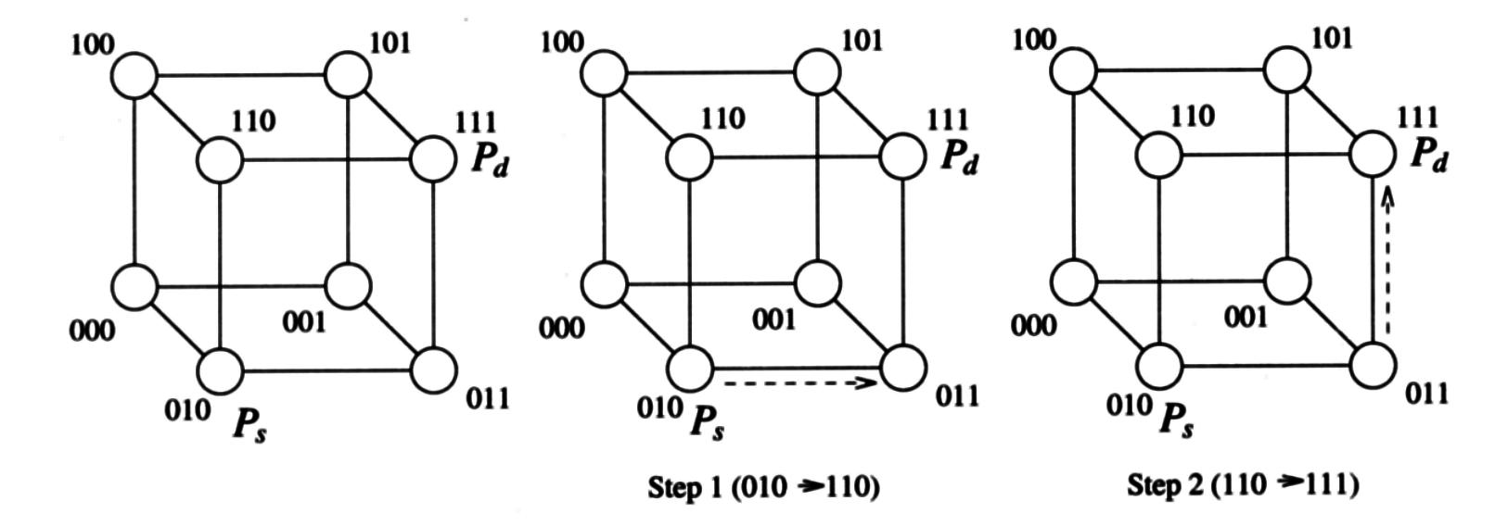
Routing on Static Network…
Processor i computes (i XOR d) and forwards the message along the dimension corresponding to the least significant nonzero bit

Slide 32
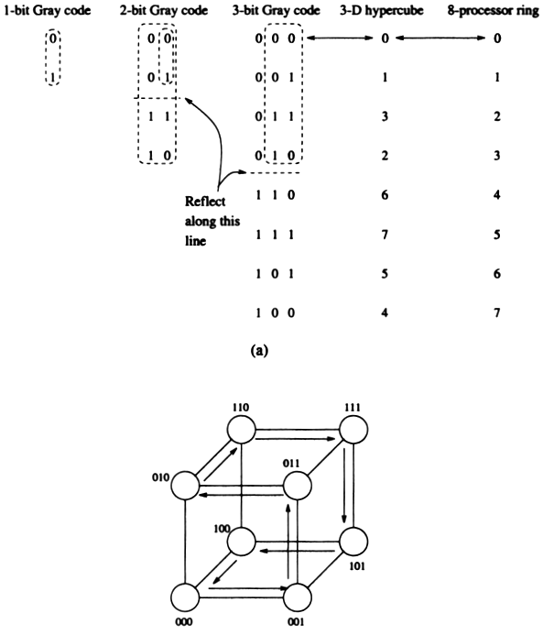

Slide 33
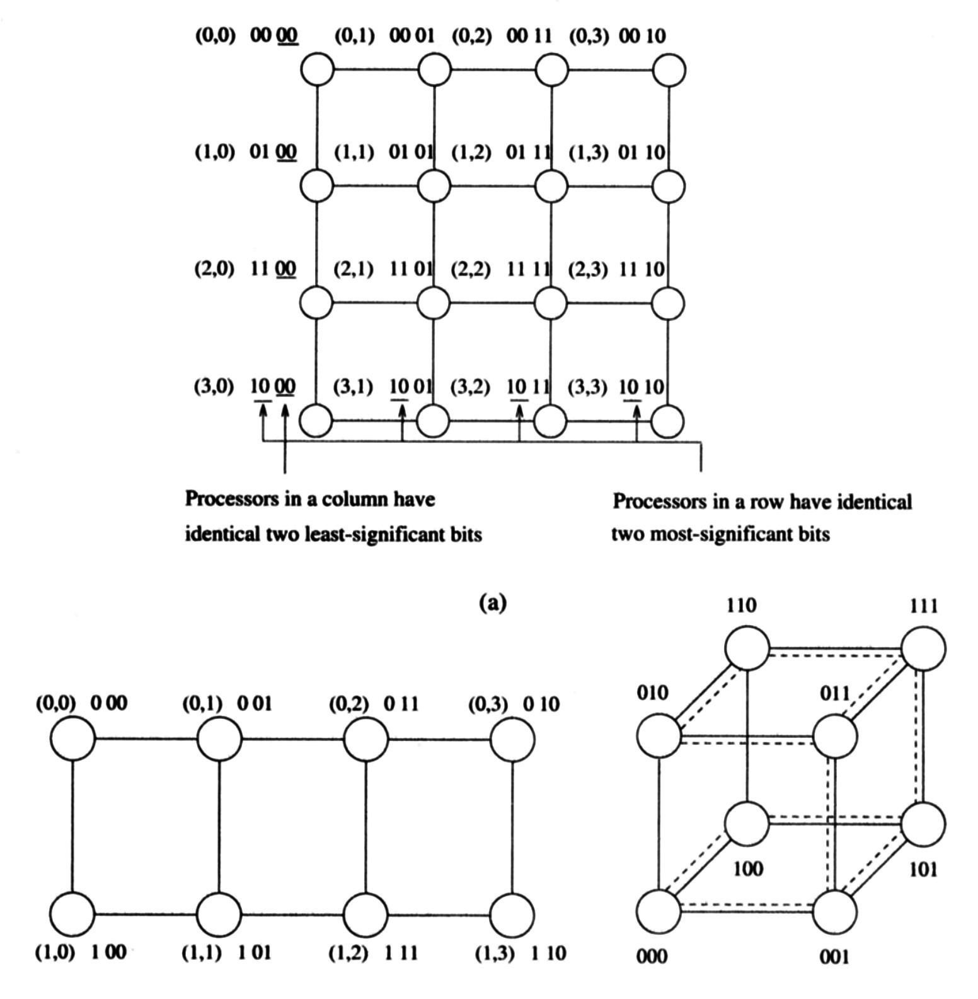

Slide 34
Dynamic Network Topologies
Examples:
Buses, Crossbars, and Multistage interconnection networks
Supercomputers, high performance IP routers, ATM switches use these networks (e.g., IBM DeepBlue)
Several aliases - omega, flip, butterfly, baseline, delta, generalized cube, multistage shuffle-exchange

Slide 35
Multistage Cube Network
Cross-bar has several advantages
Allows different types of connection patterns – unicast, broadcast, multicast
Has n² switch cost – not very scalable
Multistages switches – build cheaper and scalable switches that can provide “large” number of connection patterns
Reduce switch cost (n² ➔ n log n)

Slide 36
Multistage Cube Network
Cross Bar Switch
Cross Bar Switch
Cross Bar Switch
Cross Bar Switch
Cross Bar Switch
Cross Bar Switch
Cross Bar Switch
Cross Bar Switch
Cross Bar Switch
Cross Bar Switch

Slide 37
Multistage Cube Network
For a NxN network, we have m = log₂N stages
Each stage has N/2 two-input/two-output interchange boxes
The connection pattern among the boxes is different for the different multistage interconnection networks (MINs)
P
P
cube_{i}(P)
cube_{i}(P)

Slide 38
Multistage Cube Network
cube_{i}(P) is the cube interconnection function
Let P = p_{m-1}...p_{i}...p₁p₀
cube_{i}(P) = p_{m-1}...p_{i}...p₁p₀
Each box can be controlled by routing tags -- in one of the following four states

Slide 39
Multistage Cube Network
Routing in multistage cube networks:
Circuit-switching – all switches in a stage set the same way
Packet switching – each packet has routing tag in its header and the routing can be performed in a distributed fashion
Less overhead for circuit switching – almost like a direct wire connection

Slide 40
Multistage Cube Network
Unicast routing: routing between a sender and a receiver
XOR routing tags
Let source be S and destination be D
tag T = S XOR D
If circuit switching is used, stage i is set straight if bit i of T is 0 otherwise stage i is set exchange
If packet switching is used, each box is set independently by the header (tag is sent in the header) of the packet

Slide 41
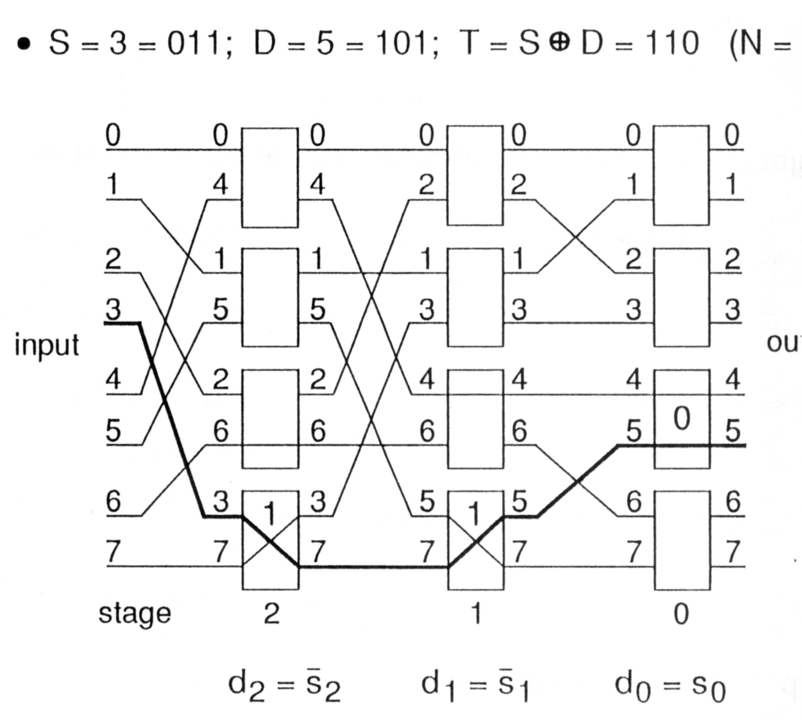
Multistage Cube Network

Slide 42
Multistage Cube Network
Destination Routing Tag
Let S be the source and D be the destination
Tag = D
This is used in distributed fashion -- each network input device determines its own action
Tag is sent in the header for the message
Stage i box examines d_{i}
d_{i} = 0 use upper box output
d_{i} = 1 use lower box output

Slide 43
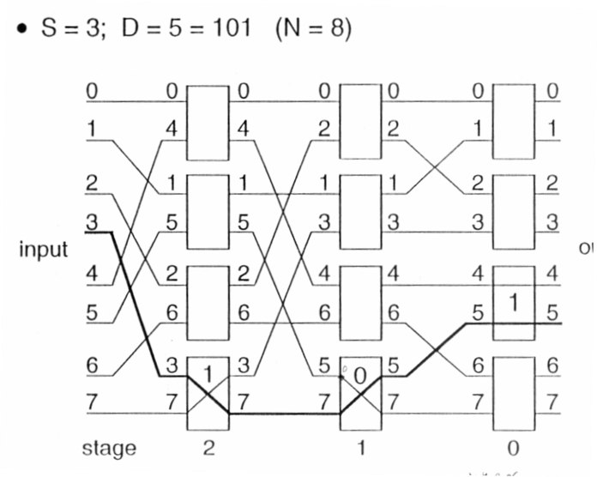
Multistage Cube Network

Slide 44
Multistage Cube Network
Trade-offs between the two routing schemes for MINs
XOR tag can be used for return message and source information
T = S XOR D = D XOR S; S = D XOR T
destination tag can be used to check the correct destination

Slide 45
Multistage Cube Network
Broadcast routing:
One port to 2^{j} ports -- note this is a restriction -- this is not a multicast where you can have an arbitrary set of receivers
The receivers can have at most j bits different between any pair of destination addresses
port S -> ports { D₁, D₂, ... _{D2}^{j}}
unicast routing tag R = S XOR D₁
broadcast tag B = D_{i} XOR D_{k} (must differ in at least j positions)

Slide 46
Multistage Cube Network
Stage i looks at the i-th bit of routing tag R (r_{i}) and broadcast tag B (b_{i})
If b_{i} = 0, use r_{i} 1 exchange, 0 straight
If b_{i} = 1, broadcast (ignore r_{i})

Slide 47
Multistage Cube Network
Example
Source S = 2 = 010
Destinations = {100, 101, 110, 111}
Vary at most 2 bits
R = S XOR 100 = 110
B = 100 XOR 111 = 011

Slide 48
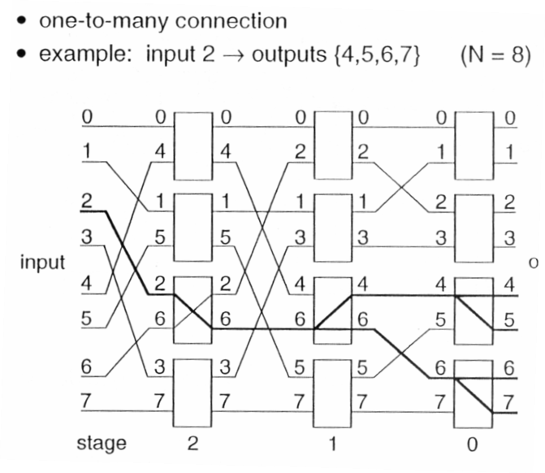
Multistage Cube Network

Slide 49
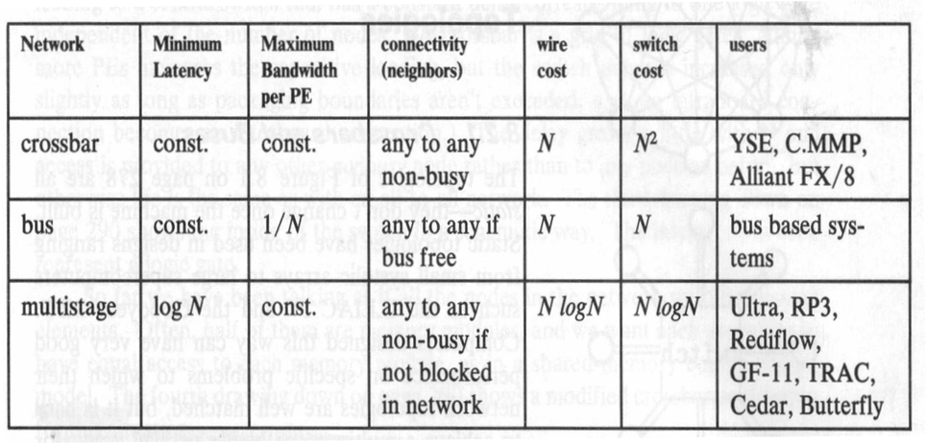
Summary of Dynamic Topologies

Slide 50
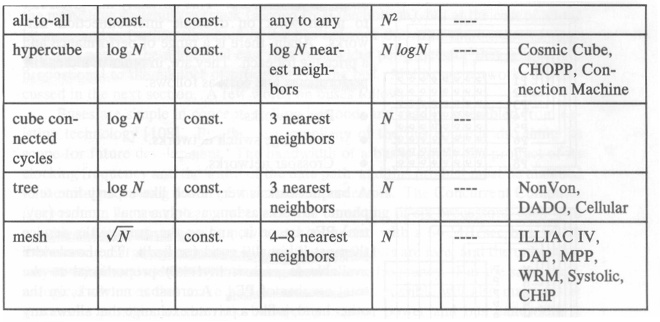
Summary of Static Topologies

