Slide 1
Denial of Service, Firewalls, and Intrusion Detection
Notes:
Lecture slides prepared by Dr Lawrie Brown (UNSW@ADFA) for “Computer Security: Principles and Practice”, 1/e, by William Stallings and Lawrie Brown, Chapter 8 “Denial of Service”.

Slide 2
Denial of Service
denial of service (DoS) an action that prevents or impairs the authorized use of networks, systems, or applications by exhausting resources such as central processing units (CPU), memory, bandwidth, and disk space
attacks
network bandwidth
system resources
application resources
have been an issue for some time
Notes:
This chapter explores denial of service attacks, their definition, the various forms they take, and defenses against them. Denial of service is a form of attack on the availability of some service. In the context of computer and communications security, the focus is generally on network services that are attacked over their network connection. From this definition you can see that there are several categories of resources that could be attacked:
• network bandwidth - relates to the capacity of the network links connecting a server to the wider Internet
• system resources - typically aims to overload or crash its network handling software
• application resources - aim to overload the capabilities of a server and limit its ability to respond to requests from other users
Denial of Service attacks have been a problem for many years. The 2006 CSI/FBI Computer Crime and Security Survey states that 25% of respondents experienced some form of denial of service attack in the previous 12 months. This value has varied between 25% and 40% over the previous 8 years of surveys.

Slide 3
Classic Denial of Service Attacks
can use simple flooding ping
from higher capacity link to lower
causing loss of traffic
source of flood traffic easily identified
Notes:
The simplest classical denial of service attack is a flooding attack on an organization. The aim of this attack is to overwhelm the capacity of the network connection to the target organization. If the attacker has access to a system with a higher capacity network connection, then this system can likely generate a higher volume of traffic than the lower capacity target connection can handle. The attack might be as simple as using a flooding ping command directed at the target network. This traffic can be handled by the higher capacity links on the path between them, until the final router in the Internet cloud is reached. At this point some packets must be discarded, with the remainder consuming most of the capacity on the link to the medium sized company. Other valid traffic will have little chance of surviving discard, as the router responds to the resulting congestion on this link.
In this classic ping flood attack, the source of the attack is clearly identified since its address is used as the source address in the ICMP echo request packets. This has two disadvantages from the attacker’s perspective. Firstly the source of the attack is explicitly identified, increasing the chance that the attacker can be identified, and legal action taken in response. Secondly, the targeted system will attempt to respond to the packets being sent.

Slide 4
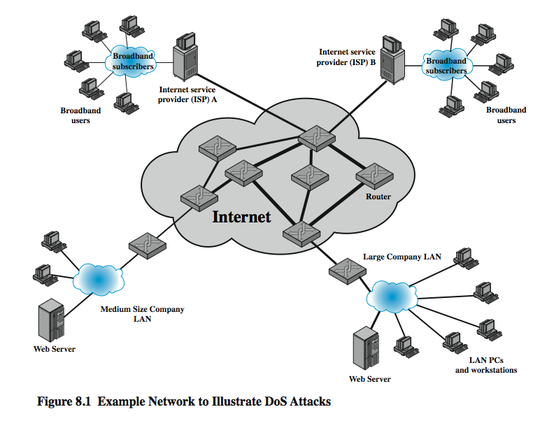
Classic Denial of Service Attacks
Notes:
For example, in the network shown in Figure 8.1, the attacker might use the large company’s web server to target the medium sized company with a lower capacity network connection.

Slide 5
Source Address Spoofing
use forged source addresses
given sufficient privilege to “raw sockets”
easy to create
generate large volumes of packets
directed at target
with different, random, source addresses
cause same congestion
responses are scattered across Internet
real source is much harder to identify
Notes:
A common characteristic of packets used in many types of denial of service attacks, is the use of forged source addresses. This is known as source address spoofing. Given sufficiently privileged access to the network handling code on a computer system, it is easy to create packets with a forged source address (and indeed any other attribute that is desired). Given raw access to the network interface, the attacker now generates large volumes of packets. These would all have the target system as the destination address, but use randomly selected, usually different, source addresses for each packet. These packets would flow over the same path from the source towards the target system. The same congestion would result in the router connected to the final, lower capacity link. However the response packets, generated in response to those packets reaching the target system, would no longer be reflected back to the source system. Rather they would be scattered across the Internet to all the various forged source addresses. Some of these addresses might correspond to real systems, others may not be used, or not reachable. As well, the use of packets with forged source addresses means the attacking system is much harder to identify. The attack packets seem to have originated at addresses scattered across the Internet. Hence just inspecting each packet’s header is not sufficient to identify its source. Rather the flow of packets of some specific form through the routers along the path from the source to the target system must be identified.

Slide 6
SYN Spoofing
other common attack
attacks ability of a server to respond to future connection requests
overflowing tables used to manage them
hence an attack on system resource
Notes:
Along with the basic flooding attack, the other common classic denial of service attack is the SYN spoofing attack. This attacks the ability of a network server to respond to TCP connection requests by overflowing the tables used to manage such connections. This means future connection requests from legitimate users fail, denying them access to the server. It is thus an attack on system resources, specifically the network handling code in the operating system.

Slide 7
TCP Connection Handshake
Notes:
To understand the operation of these attacks we need to review the 3-way handshake that TCP uses to establish a connection. This is illustrated in Figure 8.2. The client system initiates the request for a TCP connection by sending a SYN packet to the server. This identifies the client’s address and port number, and supplies an initial sequence number. The server records all the details about this request in a table of known TCP connections. It then responds to the client with a SYN-ACK packet. This includes a sequence number for the server, and increments the client’s sequence number to confirm receipt of the SYN packet. Once the client receives this it sends an ACK packet to the server with an incremented server sequence number, and marks the connection as established. Likewise, when the server receives this ACK packet it also marks the connection as established. Either party may then proceed with data transfer. In practice, this ideal exchange sometimes fails. These packets are transported using IP, which is an unreliable, though best-effort, network protocol. Any of the packets might be lost in transit, as a result of congestion for example. Hence both the client and server keep track of which packets they have sent, and if no response is received in a reasonable time, will resend those packets. As a result, TCP is a reliable transport protocol, and any applications using it need not concern themselves with problems of lost or reordered packets.

Slide 8
SYN Spoofing Attack
Notes:
A SYN spoofing attack exploits this behavior on the targeted server system. The attacker generates a number of SYN connection request packets with forged source addresses. For each of these the server records the details of the TCP connection request, and sends the SYN-ACK packet to the claimed source address, as shown in Figure 8.3. The server will resend the SYN-ACK packet a number of times before finally assuming the connection request has failed, and deleting the information saved concerning it. This table is typically sized on the assumption that most connection requests quickly succeed, and that a reasonable number of requests may be handled simultaneously. However in a SYN spoofing attack, the attacker directs a very large number of forged connection requests at the targeted server. These rapidly fill the table of known TCP connections on the server. Once this table is full, any future requests, including legitimate requests from other users, are rejected. The table entries will time out and be removed, which in normal network usage, corrects temporary overflow problems. However, if the attacker keeps a sufficient volume of forged requests flowing, this table will be constantly full and the server will be effectively cutoff from the Internet, unable to respond to most legitimate connection requests.

Slide 9
SYN Spoofing Attack
attacker often uses either
random source addresses
or that of an overloaded server
to block return of (most) reset packets
has much lower traffic volume
attacker can be on a much lower capacity link
Notes:
In order to increase the usage of the known TCP connections table, the attacker ideally wishes to use addresses that will not respond to the SYN-ACK with a RST. This can be done by overloading the host that owns the chosen spoofed source address, or by simply using a wide range of random addresses. In this case, the attacker relies on the fact that there are many unused addresses on the Internet. Consequently a reasonable proportion of randomly generated addresses will not correspond to a real host.
There is a significant difference in the volume of network traffic between a SYN spoof attack, and the basic flooding attack we discussed. The actual volume of SYN traffic can be comparatively low, nowhere near the maximum capacity of the link to the server. It simply has to be high enough to keep the known TCP connections table filled. Unlike the flooding attack, this means the attacker does not need access to a high volume network connection. In the network shown in Figure 8.1, the medium sized organization, or even a broadband home user, could successfully attack the large company server using a SYN spoofing attack.

Slide 10
Types of Flooding Attacks
classified based on network protocol used
ICMP Flood
uses ICMP packets, eg echo request
typically allowed through, some required
UDP Flood
alternative uses UDP packets to some port
TCP SYN Flood
use TCP SYN (connection request) packets
but for volume attack
Notes:
Flooding attacks take a variety of forms, based on which network protocol is being used to implement the attack. Common flooding attacks use any of the ICMP, UDP or TCP SYN packet types.
An ICMP flooding attack uses an ICMP packet, such as ICMP echo request packets in a ping flood. This type of ICMP packet was chosen since traditionally network administrators allowed such packets into their networks. More recently, many organizations have restricted the ability of these packets to pass through their firewalls. In response, attackers have started using other ICMP packet types. Since some of these should be handled to allow the correct operation of TCP/IP, they are much more likely to be allowed through an organization’s firewall.
An alternative to using ICMP packets is to use UDP packets directed to some port number, and hence potential service, on the target system. Spoofed source addresses are normally used if the attack is generated using a single source system, for the same reasons as with ICMP attacks.
Another alternative is to send TCP packets to the target system. Most likely these would be normal TCP connection requests, with either real or spoofed source addresses. In this case, it is the total volume of packets that is the aim of the attack, rather than specifically targeting the system code. This is the difference between a SYN spoofing attack and a SYN flooding attack.

Slide 11
Distributed Denial of Service Attacks
have limited volume if single source used
multiple systems allow much higher traffic volumes to form a Distributed Denial of Service (DDoS) Attack
often compromised PC’s / workstations
zombies with backdoor programs installed
forming a botnet
e.g. Tribe Flood Network (TFN), TFN2K
Notes:
All of these flooding attack variants are limited in the total volume of traffic that can be generated if just a single system is used to launch the attack. By using multiple systems, the attacker can significantly scale up the volume of traffic that can be generated. Each of these systems need not be particularly powerful, or on a high capacity link. But what they don’t have individually, they more than compensate for in large numbers. These systems were typically compromised user workstations or PC’s. The attacker used some well-known flaw in the operating system or in some common application, to gain access to these systems, and to install their own programs on it. Such systems are known as “zombies”. Once suitable “backdoor” programs were installed on these systems, they were entirely under the attacker’s control. Large collections of such systems under the control of one attacker can be created, collectively forming a “botnet”. One of the earliest and best known DDoS tools is Tribe Flood Network (TFN), written by the hacker known as Mixter. The original variant from the 1990’s exploited Sun Solaris systems. It was later rewritten as Tribe Flood Network 2000 (TFN2K), and could run on UNIX, Solaris, and Windows NT systems. The agent was a Trojan program that was copied to, and run on compromised, zombie systems. It was capable of implementing ICMP flood, SYN flood, UDP flood, and ICMP amplification forms of denial of service attacks.

Slide 12
DDoS Control Hierarchy
Notes:
Whilst the attacker could command each zombie individually, more generally a control hierarchy is used. A small number of systems act as handlers controlling a much larger number of agent systems, as shown in Figure 8.4. There are a number of advantages to this arrangement. The attacker can send a single command to a handler, which then automatically forwards it to all the agents under its control. Automated infection tools can also be used to scan for and compromise suitable zombie systems. Once the agent software is uploaded to a newly compromised system, it can contact one or more handlers to automatically notify them of its availability. By this means, the attacker can automatically grow suitable “botnets”. TFN and TFN2K use a version of this two-layer command hierarchy.
The best defense against being an unwitting participant in a DDoS attack is to prevent your systems from being compromised. For the target of a DDoS attack, the response is the same as for any flooding attack, but with greater volume and complexity.

Slide 13
Reflection Attacks
use normal behavior of network
attacker sends packet with spoofed source address being that of target to a server
server response is directed at target
if send many requests to multiple servers, response can flood target
various protocols e.g. UDP or TCP/SYN
ideally want response larger than request
prevent if block source spoofed packets
Notes:
Reflection and amplification attacks use network systems functioning normally. The attacker sends a network packet with a spoofed source address to a service running on some network server, which responds to this packet, sending it to the spoofed source address that belongs to the actual attack target. If the attacker sends a number of requests to a number of servers, all with the same spoofed source address, the resulting flood of responses can overwhelm the target’s network link. The fact that normal server systems are being used as intermediaries, and that their handling of the packets is entirely conventional, means these attacks can be easier to deploy, and harder to trace back to the actual attacker. Ideally the attacker would like to use a service that created a larger response packet than the original request. This allows the attacker to convert a lower volume stream of packets from the originating system into a higher volume of packets from the intermediary directed at the target. Common UDP services are often used for this purpose. Another variant of reflection attack uses TCP SYN packets, and exploits the normal 3-way handshake used to establish a TCP connection. Fundamental to the success of reflection attacks is the ability to create source spoofed packets. If filters are in place which block source spoofed packets, then these attacks are simply not possible.

Slide 14
Amplification Attacks
Notes:
Amplification attacks are a variant of reflector attacks, that differ in generating multiple response packets for each original packet sent. This can be achieved by directing the original request to the broadcast address for some network. As a result, all hosts on that network can potentially respond to the request, generating a flood of responses as shown in Figure 8.6. It is only necessary to use a service handled by large numbers of hosts on the intermediate network. A ping flood using ICMP echo request packets was a common choice, used by the “smurf” DoS program. Another possibility is to use a suitable UDP service, such as the echo service, which the “fraggle” DoS program used. The best additional defense against this form of attack is to not allow “directed broadcasts” to be routed into a network from outside.

Slide 15
DNS Amplification Attacks
use DNS requests with spoofed source address being the target
exploit DNS behavior to convert a small request to a much larger response
60 byte request to 512 - 4000 byte response
attacker sends requests to multiple well connected servers, which flood target
need only moderate flow of request packets
DNS servers will also be loaded
Notes:
A further variant of a reflection or amplification attack uses packets directed at a legitimate DNS server as the intermediary system. They gain attack amplification by exploiting the behavior of the DNS protocol to convert a small request into a much larger response. Using the classic DNS protocol, a 60 byte UDP request packet can easily result in a 512 byte UDP response, the maximum traditionally allowed. More recently, the DNS protocol has been extended to allow much larger responses of over 4000 bytes, to support extended DNS features such as IPv6, security, and others. By targeting servers that support the extended DNS protocol, significantly greater amplification can be achieved than with the classic DNS protocol.
In this attack, a selection of suitable DNS servers with good network connections, are chosen. The attacker creates a series of DNS requests containing the spoofed source address of the target system. These are directed at a number of the selected name servers. They respond to these requests, sending the replies to the spoofed source, which appears to them to be the legitimate requesting system. The target is then flooded with their responses. Because of the amplification achieved, the attacker need only generate a moderate flow of packets to cause a larger, amplified flow to flood and overflow the link to the target system. Whilst the intermediate systems will also experience significant loads, by using a number of high capacity, well connected systems, the attacker can ensure they are not overloaded, allowing the attack to proceed.

Slide 16
DoS Attack Defenses
high traffic volumes may be legitimate
result of high publicity, e.g. “slash-dotted”
or to a very popular site, e.g. Olympics etc
or legitimate traffic created by an attacker
three lines of defense against (D)DoS:
attack prevention and preemption
attack detection and filtering
attack source traceback and identification
Notes:
There are a number of steps that can be taken to both limit the consequences of being the target of a denial of service attack, and also to limit the chance of your systems being compromised and then used to launch denial of service attacks. It is important to recognize that these attacks cannot be prevented entirely, as high traffic volumes may sometimes occurs by accident as a result of high publicity about a specific site, or due to extreme popularity of a site, e.g. a posting to the well-known “Slashdot” news aggregation site often results in overload of the referenced server system. Similarly, when popular sporting events like the Olympics or Soccer World Cup matches occur, sites reporting on them experience very high traffic levels. Also if an attacker can direct a large enough volume of legitimate traffic to your system, then there is a high chance this will overwhelm its network connection, and thus limit legitimate traffic requests from other users. There is very little that can be done to prevent this type of either accidental or deliberate overload, without also compromising network performance. The provision of significant excess network bandwidth and replicated distributed servers is the usual response, particularly when the overload is anticipated.
In general, there are three lines of defense against DDoS attacks:
Attack prevention and preemption (before the attack): These mechanisms enable the victim to endure attack attempts without denying service to legitimate clients.
Attack detection and filtering (during the attack): These mechanisms attempt to detect the attack as it begins and respond immediately.
Attack source traceback and identification (during and after the attack): This is an attempt to identify the source of the attack as a first step in preventing future attacks.

Slide 17
Attack Prevention
block spoofed source addresses
on routers as close to source as possible
still far too rarely implemented
rate controls in upstream distribution nets
on specific packets types
e.g. some ICMP, some UDP, TCP/SYN
use modified TCP connection handling
or selective or random drop when table full
Notes:
A critical component of many denial of service attacks, is the use of spoofed source addresses. One of the fundamental, and longest standing, recommendations for defense against these attacks is to limit the ability of systems to send packets with spoofed source addresses, cf. RFC 2827. This filtering needs to be done as close to the source as possible, by routers or gateways knowing the valid address ranges of incoming packets. Typically this is the ISP providing the network connection for an organization or home user. Regrettably, despite this being a well-known recommendation, many ISPs still do not perform this type of filtering.
Any defenses against flooding attacks need to be located back in the Internet cloud, not at a target organization’s boundary router, since this is usually located after the resource being attacked. The filters must be applied to traffic before it leaves the ISP’s network, or even at the point of entry to their network. Some attacks using particular packet types, such as ICMP floods, or UDP floods to diagnostic services, can be throttled by imposing limits on the rate at which these packets will be accepted.
It is possible to specifically defend against the SYN spoofing attack by using a modified version of the TCP connection handling code. Instead of saving the connection details on the server, critical information about the requested connection is cryptographically encoded in a “cookie” that is sent as the server’s initial sequence number. Typically this technique is only used when the table overflows. Alternatively, the system’s TCP/IP network code can be modified to “selective drop” or “random drop” an entry for an incomplete connection from the TCP connections table when it overflows, allowing a new connection attempt to proceed.

Slide 18
Attack Prevention
block IP directed broadcasts
block suspicious services & combinations
manage application attacks with “puzzles” to distinguish legitimate human requests
good general system security practices
use mirrored and replicated servers when high-performance and reliability required
Notes:
The best defense against broadcast amplification attacks is to block the use of IP directed broadcasts. This can be done either by the ISP, or by any organization whose systems could potentially be used as an intermediary. As we noted earlier in this chapter, this along with anti-spoofing filters are long standing security recommendations that all organization’s ought to implement. More generally, limiting or blocking traffic to suspicious services, or combinations of source and destination ports, can restrict the types of reflection attacks that can be used against an organization.
Defending against attacks on application resources generally requires modification to the applications targeted, such as web servers. Defenses may involve attempts to identify legitimate, generally human initiated, interactions from automated DoS attacks. These often take the form of a “graphical puzzle”, which is easy for most humans to solve, but difficult to automate.
Beyond these direct defenses against denial of service attack mechanisms, overall good system security practices should be maintained. The aim is to ensure that your systems are not compromised and used as zombie systems. Suitable configuration and monitoring of high performance, well-connected servers, is also needed to help ensure they don’t contribute to the problem as potential intermediary servers.
If an organization is dependent on network services, they should consider mirroring and replicated these servers over multiple sites with multiple network connections. This is good general practice for high performance servers, providing greater levels of reliability and fault tolerance in general, not just as a response to these types of attack.

Slide 19
Responding to Attacks
need good incident response plan
with contacts for ISP
needed to impose traffic filtering upstream
details of response process
have standard filters
ideally have network monitors and IDS
to detect and notify abnormal traffic patterns
Notes:
In order to successfully respond to a denial of service attack, a good incident response plan is needed, including details of how to contact technical personal for your Internet Service Provider(s). Denial of service attacks, particularly flooding attacks, can only be filtered upstream of your network connection. The plan should also contain details of how to respond to the attack. The division of responsibilities between organizational personnel and the ISP will depend on the resources available, and technical capabilities of the organization.
Within an organization you should have implemented the standard anti-spoofing, directed broadcast, and rate limiting filters we discuss earlier in this chapter. Ideally, you should also have some form of automated network monitoring and intrusion detection system (IDS) running, so personnel will be notified should abnormal traffic be detected.

Slide 20
Responding to Attacks
identify type of attack
capture and analyze packets
design filters to block attack traffic upstream
or identify and correct system/application bug
have ISP trace packet flow back to source
may be difficult and time consuming
necessary if legal action desired
implement contingency plan
update incident response plan
Notes:
When a denial of service attack is detected, the first step is to identify the type of attack and hence the best approach to defend against it. Typically this involves capturing packets flowing into the organization, and analyzing them looking for common attack packet types. This may be done by organizational personnel or ISP, depending on relevant expertise. From this analysis the type of attack is identified, and suitable filters designed to block the flow of attack packets. These have to be installed by the ISP on their routers. If the attack targets a bug on a system or application, rather than high traffic volumes, then this must be identified, and steps taken to correct it to prevent future attacks.
The organization may also wish to ask their ISP to trace the flow of packets back in an attempt to identify their source. However if spoofed sources addresses are used, this can be difficult and time-consuming. Whether this is attempted may well depend on whether the organization intends to report the attack to the relevant law enforcement agencies. In such a case, additional evidence must be collected and actions documented to support any subsequent legal action.
In the case of an extended, concerted, attack, it may not be possible to successfully filter enough of the attack packets to restore network connectivity. In such cases the organization needs a contingency strategy to switch to alternate backup servers, or to rapidly commission new servers at a new site with new addresses, in order to restore service. Without forward planning to achieve this, the consequence of such an attack will be extended loss of network connectivity.
Following the immediate response, the organization’s incident response policy may specify further steps that are taken to respond to contingencies like this.

Slide 21
Summary
introduced denial of service (DoS) attacks
classic flooding and SYN spoofing attacks
ICMP, UDP, TCP SYN floods
distributed denial of service (DDoS) attacks
reflection and amplification attacks
defenses against DoS attacks
responding to DoS attacks
Notes:
Chapter 8 summary.

Slide 22
Firewalls and Intrusion Prevention Systems
effective means of protecting LANs
internet connectivity essential
for organization and individuals
but creates a threat
could secure workstations and servers
also use firewall as perimeter defence
single choke point to impose security
Notes:
Firewalls can be an effective means of protecting a local system or network of systems from network-based security threats while at the same time affording access to the outside world via wide area networks and the Internet. Internet connectivity is no longer optional for organizations. The information and services available are essential to the organization. Moreover, individual users within the organization want and need Internet access, and if this is not provided via their LAN, they will use dial-up capability from their PC to an Internet service provider (ISP). However, while Internet access provides benefits to the organization, it enables the outside world to reach and interact with local network assets. This creates a threat to the organization. While it is possible to equip each workstation and server on the premises network with strong security features, such as intrusion protection, this is not a practical approach. The alternative, increasingly accepted, is the firewall, inserted between the premises network and the Internet to establish a controlled link and to erect an outer security wall or perimeter. The aim of this perimeter is to protect the premises network from Internet-based attacks and to provide a single choke point where security and audit can be imposed.

Slide 23
Firewall Capabilities & Limits
capabilities:
defines a single choke point
provides a location for monitoring security events
convenient platform for some Internet functions such as NAT, usage monitoring, IPSEC VPNs
limitations:
cannot protect against attacks bypassing firewall
may not protect fully against internal threats
improperly secure wireless LAN
laptop, PDA, portable storage device infected outside then used inside
Notes:
The following capabilities are within the scope of a firewall:
1. A firewall defines a single choke point that keeps unauthorized users out of the protected network, prohibits potentially vulnerable services from entering or leaving the network, and provides protection from various kinds of IP spoofing and routing attacks. The use of a single choke point simplifies security management.
2. A firewall provides a location for monitoring security-related events.
3. A firewall is a convenient platform for several Internet functions that are not security related. These include a network address translator (NAT),, and a network management function that audits or logs Internet usage.
4. A firewall can act as the platform for IPSec to implement virtual private networks.
Firewalls have their limitations, including the following:
1. The firewall cannot protect against attacks that bypass the firewall, e.g. from dial-out, or a modem pool dial-in capability for traveling employees and telecommuters.
2. The firewall may not protect fully against internal threats, such as a disgruntled employee or an employee who unwittingly cooperates with an external attacker.
3. An improperly secured wireless LAN may be accessed from outside the org
4. A laptop, PDA, or portable storage device may be used and infected outside the corporate network and then attached and used internally.

Slide 24
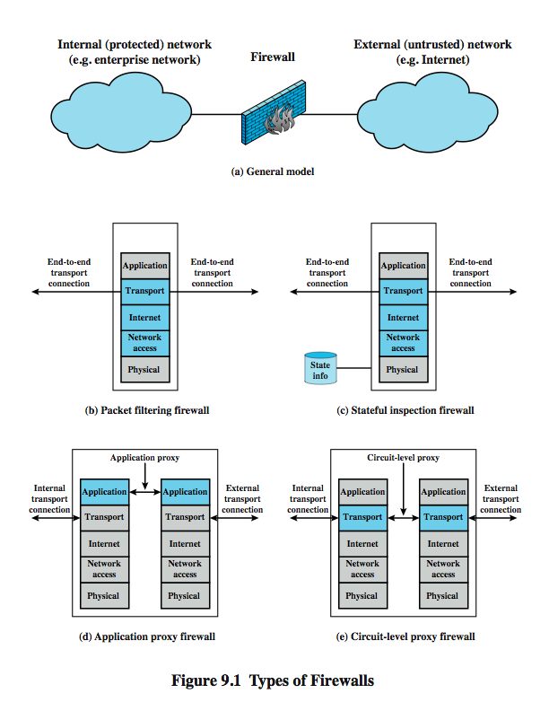
Types of Firewalls
Notes:
A firewall may act as a packet filter. It can operate as a positive filter, allowing to pass only packets that meet specific criteria, or as a negative filter,rejecting any packet that meets certain criteria. Depending on the type of firewall, it may examine one or more protocol headers in each packet, the payload of each packet, or the pattern generated by a sequence of packets. In this section, we look at the principal types of firewalls, which include:
Packet Filtering Firewall: applies a set of rules to each incoming and outgoing IP packet and then forwards or discards the packet (Figure 9.1b).
Stateful Inspection Firewalls: reviews the same packet information as a packet filtering firewall, but also records information about TCP connections (Figure 9.1c). May also keep track of TCP sequence numbers to prevent attacks that depend in some fashion on the sequence number, such as session hijacking.
Application-Level Gateway: acts as a relay of application-level traffic (Figure 9.1d). The user contacts the gateway with the name of the remote host to be accessed. When the user responds and provides a valid user ID and authentication information, the gateway contacts the application on the remote host and relays TCP segments containing the application data between the two endpoints.
Circuit-Level Gateway: or circuit-level proxy (Figure 9.1e) determining which connections will be allowed, and if so, sets up two TCP connections, one between itself and a TCP user on an inner host and one between itself and a TCP user on an outside host. Once the two connections are established, the gateway typically relays TCP segments from one connection to the other without examining the contents.

Slide 25
Packet Filtering Firewall
applies rules to packets in/out of firewall
based on information in packet header
src/dest IP addr & port, IP protocol, interface
typically a list of rules of matches on fields
if match rule says if forward or discard packet
two default policies:
discard - prohibit unless expressly permitted
more conservative, controlled, visible to users
forward - permit unless expressly prohibited
easier to manage/use but less secure
Notes:
A packet filtering firewall applies a set of rules to each incoming and outgoing IP packet and then forwards or discards the packet. The firewall is typically configured to filter packets going in both directions (from and to the internal network). Filtering rules are based on information contained in a network packet: source IP address, destination IP address, source and destination transport-level address (port number), IP protocol field, interface (on firewall packet came from or is destined for). One advantage of a packet filtering firewall is its simplicity. Also, packet filters typically are transparent to users and are very fast.
The packet filter is typically set up as a list of rules based on matches to fields in the IP or TCP header. If there is a match to one of the rules, that rule is invoked to determine whether to forward or discard the packet. If there is no match to any rule, then a default action is taken. Two default policies are possible:
• Default = discard: That which is not expressly permitted is prohibited.
• Default = forward: That which is not expressly prohibited is permitted.
The default discard policy is more conservative. Initially, everything is blocked, and services must be added on a case-by-case basis. This policy is more visible to users, who are more likely to see the firewall as a hindrance. The default forward policy increases ease of use for end users but provides reduced security; the security administrator must, in essence, react to each new security threat as it becomes known.

Slide 26
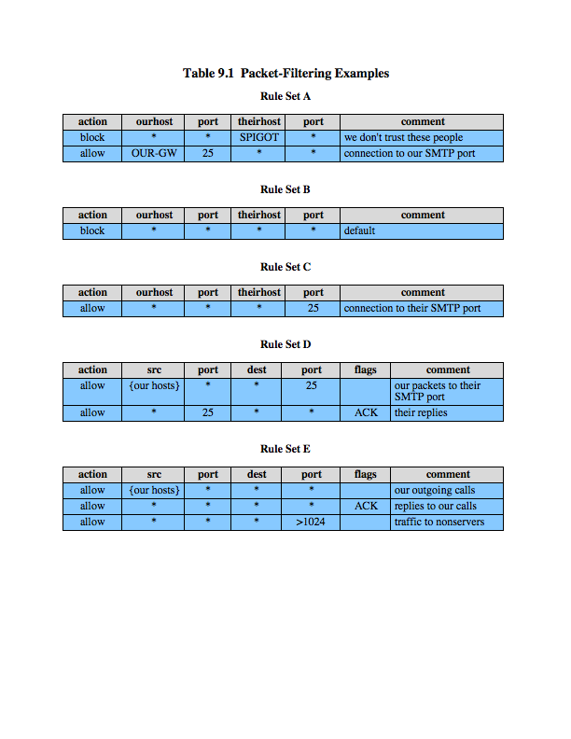
Packet Filter Rules
Notes:
Table 9.1, from the text gives some examples of packet filtering rule sets. In each set, the rules are applied top to bottom. The "*" in a field is a wildcard designator that matches everything. We assume that the default = discard policy is in force.
A. Inbound mail is allowed (port 25 is for SMTP incoming), but only to a gateway host. However, packets from a particular external host, SPIGOT, are blocked.
B. This is an explicit statement of the default policy, usually implicitly the last rule.
C. This rule set is intended to specify that any inside host can send mail to the outside. A TCP packet with a destination port of 25 is routed to the SMTP server on the destination machine. Problem is that 25 as SMTP is only a default; an outside machine could be configured to have some other application linked to port 25.
D. This rule set achieves the intended result that was not achieved in C. This rule set allows IP packets where the source IP address is one of a list of designated internal hosts and the destination TCP port number is 25. It also allows incoming packets with a source port number of 25 that include the ACK flag. This takes advantage of a feature of TCP connections that once set up, the ACK flag of a TCP segment is set to acknowledge segments sent from the other side.
E. This rule set is one approach to handling FTP which uses two TCP connections: a control connection and a data connection for the actual file transfer. The data connection uses a different dynamically assigned port number for the transfer. Most servers, and hence most attack targets, live on low-numbered ports; most outgoing calls tend to use a higher-numbered port, typically above 1023. Rule set E points out the difficulty in dealing with applications at the packet filtering level.

Slide 27
Packet Filter Weaknesses
weaknesses
cannot prevent attack on application bugs
limited logging functionality
do no support advanced user authentication
vulnerable to attacks on TCP/IP protocol bugs
improper configuration can lead to breaches
attacks
IP address spoofing, source route attacks, tiny fragment attacks
Notes:
Some weaknesses of packet filter firewalls:
• Because packet filter firewalls do not examine upper-layer data, they cannot prevent attacks that employ application-specific vulnerabilities or functions.
• Because of the limited info available to the firewall, the logging functionality present in packet filter firewalls the same as used to make access control decisions
• Most packet filter firewalls do not support advanced user authentication schemes.
• They are generally vulnerable to attacks and exploits that take advantage of problems within the TCP/IP specification and protocol stack, such as network layer address spoofing.
• Finally, due to the small number of variables used in access control decisions, packet filter firewalls are susceptible to security breaches caused by improper configurations.
Some of the attacks/countermeasures on packet filtering firewalls are:
• IP address spoofing: The intruder transmits packets from the outside with a source IP address field containing an address of an internal(assumed trusted) host. The countermeasure is to discard external packets with an inside source address
• Source routing attacks: specifies the route that a packet should take as it crosses the Internet. The countermeasure is to discard all packets that use this option.
• Tiny fragment attacks: intruder uses the IP fragmentation option to create extremely small fragments and force the TCP header information into a separate packet fragment, to circumvent filtering rule. It can be defeated by requiring that the first fragment contain most of the transport header.

Slide 28
Stateful Inspection Firewall
reviews packet header information but also keeps info on TCP connections
typically have low, “known” port no for server
and high, dynamically assigned client port no
simple packet filter must allow all return high port numbered packets back in
stateful inspection packet firewall tightens rules for TCP traffic using a directory of TCP connections
only allow incoming traffic to high-numbered ports for packets matching an entry in this directory
may also track TCP seq numbers as well
Notes:
A traditional packet filter makes filtering decisions on an individual packet basis and does not take into consideration any higher layer context. A Stateful Inspection Firewalls reviews the same packet information but also records information about TCP connections. In general, when an application that uses TCP creates a session with a remote host, it creates a TCP connection in which the TCP port number for the remote (server) application is a number less than 1024 and the TCP port number for the local (client) application is a number between 1024 and 65535. The numbers less than 1024 are the "well-known" port numbers and are assigned permanently to particular applications (e.g., 25 for server SMTP). The numbers between 1024 and 65535 are generated dynamically and have temporary significance only for the lifetime of a TCP connection. A simple packet filtering firewall must permit inbound network traffic on all these high-numbered ports for TCP-based traffic to occur. This creates a vulnerability that can be exploited by unauthorized users. A stateful inspection packet firewall tightens up the rules for TCP traffic by creating a directory of outbound TCP connections, as shown in Table 9.2 in the text. There is an entry for each currently established connection. The packet filter will now allow incoming traffic to high-numbered ports only for those packets that fit the profile of one of the entries in this directory. A stateful packet inspection firewall reviews the same packet information as a packet filtering firewall, but also records information about TCP connections. Some stateful firewalls also keep track of TCP sequence numbers to prevent attacks that depend in some fashion on the sequence number, such as session hijacking.

Slide 29
Application-Level Gateway
acts as a relay of application-level traffic
user contacts gateway with remote host name
authenticates themselves
gateway contacts application on remote host and relays TCP segments between server and user
must have proxy code for each application
may restrict application features supported
more secure than packet filters
but have higher overheads
Notes:
An application-level gateway, also called an application proxy, acts as a relay of application-level traffic. The user contacts the gateway using a TCP/IP application, such as Telnet or FTP, and the gateway asks the user for the name of the remote host to be accessed. When the user responds and provides a valid user ID and authentication information, the gateway contacts the application on the remote host and relays TCP segments containing the application data between the two endpoints. If the gateway does not implement the proxy code for a specific application, the service is not supported and cannot be forwarded across the firewall. Further, the gateway can be configured to support only specific features of an application that the network administrator considers acceptable while denying all other features.
Application-level gateways tend to be more secure than packet filters. Rather than trying to deal with the numerous possible combinations that are to be allowed and forbidden at the TCP and IP level, the application-level gateway need only scrutinize a few allowable applications. In addition, it is easy to log and audit all incoming traffic at the application level.
A prime disadvantage of this type of gateway is the additional processing overhead on each connection. In effect, there are two spliced connections between the end users, with the gateway at the splice point, and the gateway must examine and forward all traffic in both directions.

Slide 30
Circuit-Level Gateway
sets up two TCP connections, to an inside user and to an outside host
relays TCP segments from one connection to the other without examining contents
hence independent of application logic
just determines whether relay is permitted
typically used when inside users trusted
may use application-level gateway inbound and circuit-level gateway outbound
hence lower overheads
Notes:
A fourth type of firewall is the circuit-level gateway or circuit-level proxy (Figure 9.1e). This can be a stand-alone system or it can be a specialized function performed by an application-level gateway for certain applications. As with an application gateway, a circuit-level gateway does not permit an end-to-end TCP connection; rather, the gateway sets up two TCP connections, one between itself and a TCP user on an inner host and one between itself and a TCP user on an outside host. Once the two connections are established, the gateway typically relays TCP segments from one connection to the other without examining the contents. The security function consists of determining which connections will be allowed.
A typical use of circuit-level gateways is a situation in which the system administrator trusts the internal users. The gateway can be configured to support application-level or proxy service on inbound connections and circuit-level functions for outbound connections. In this configuration, the gateway can incur the processing overhead of examining incoming application data for forbidden functions but does not incur that overhead on outgoing data.

Slide 31
SOCKS Circuit-Level Gateway
SOCKS v5 defined as RFC1928 to allow TCP/UDP applications to use firewall
components:
SOCKS server on firewall
SOCKS client library on all internal hosts
SOCKS-ified client applications
client app contacts SOCKS server, authenticates, sends relay request
server evaluates & establishes relay connection
UDP handled with parallel TCP control channel
Notes:
An example of a circuit-level gateway implementation is the SOCKS package; version 5 of SOCKS is defined in RFC 1928. The RFC defines SOCKS in the following fashion: “The protocol described here is designed to provide a framework for client-server applications in both the TCP and UDP domains to conveniently and securely use the services of a network firewall. The protocol is conceptually a "shim-layer" between the application layer and the transport layer, and as such does not provide network-layer gateway services, such as forwarding of ICMP messages.” SOCKS consists of the following components:
• SOCKS server, which runs on a UNIX-based firewall.
• SOCKS client library, which runs on internal hosts protected by the firewall.
• SOCKS-ified versions of several standard client programs such as FTP and TELNET. The implementation of the SOCKS protocol typically involves the recompilation or relinking of TCP-based client applications to use the appropriate encapsulation routines in the SOCKS library.
When a TCP-based client wishes to establish a connection to an object that is reachable only via a firewall it must open a TCP connection to SOCKS port 1080 on the SOCKS server system. The client authenticates, and then sends a relay request. The SOCKS server evaluates the request and either establishes the appropriate connection or denies it. UDP exchanges are handled in a similar fashion. In essence, a TCP connection is opened to authenticate a user to send and receive UDP segments, and the UDP segments are forwarded as long as the TCP connection is open.

Slide 32
Firewall Basing
several options for locating firewall:
bastion host
individual host-based firewall
personal firewall
Notes:
It is common to base a firewall on a standalone machine running a common operating system, such as UNIX or Linux. Firewall functionality can also be implemented as a software module in a router or LAN switch. In this section, we look at some additional firewall basing considerations, including on a bastion host, individual host, personal firewall.

Slide 33
Bastion Hosts
critical strongpoint in network
hosts application/circuit-level gateways
common characteristics:
runs secure O/S, only essential services
may require user auth to access proxy or host
each proxy can restrict features, hosts accessed
each proxy small, simple, checked for security
each proxy is independent, non-privileged
limited disk use, hence read-only code
Notes:
A bastion host is a system identified by the firewall administrator as a critical strong point in the network's security. Typically, the bastion host serves as a platform for an application-level or circuit-level gateway. Common characteristics of a bastion host:
• executes a secure version of its operating system, making it a trusted system.
• only essential services are installed on the bastion host. These include proxy applications such as Telnet, DNS, FTP, SMTP, and user authentication.
• may require additional authentication before a user is allowed access to the proxy services, and may require its own authentication before granting user access.
• each proxy is configured to support only a subset of the application’s command set.
• each proxy is configured to allow access only to specific host systems.
• each proxy maintains detailed audit information by logging all traffic, each connection, and the duration of each connection.
• each proxy module is a very small software package specifically designed for network security, hence is easier to check such modules for security flaws.
• each proxy is independent of other proxies on the bastion host, and can be uninstalled without affecting the operation of the other proxy applications.
• generally performs no disk access other than to read its initial configuration file.
• each proxy runs as a nonprivileged user in a private and secured directory on host.

Slide 34
Host-Based Firewalls
used to secure individual host
available in/add-on for many O/S
filter packet flows
often used on servers
advantages:
taylored filter rules for specific host needs
protection from both internal / external attacks
additional layer of protection to org firewall
Notes:
A host-based firewall is a software module used to secure an individual host. Such modules are available in many operating systems or can be provided as an add-on package. Like conventional standalone firewalls, host-resident firewalls filter and restrict the flow of packets. A common location for such firewalls is a server. There are several advantages to the use of a server-based or workstation-based firewall:
• Filtering rules can be tailored to the host environment. Specific corporate security policies for servers can be implemented, with different filters for servers used for different application.
• Protection is provided independent of topology. Thus both internal and external attacks must pass through the firewall.
• Used in conjunction with standalone firewalls, the host-based firewall provides an additional layer of protection. A new type of server can be added to the network, with its own firewall, without the necessity of altering the network firewall configuration.

Slide 35
Personal Firewall
controls traffic flow to/from PC/workstation
for both home or corporate use
may be software module on PC
or in home cable/DSL router/gateway
typically much less complex
primary role to deny unauthorized access
may also monitor outgoing traffic to detect/block worm/malware activity
Notes:
A personal firewall controls the traffic between a personal computer or workstation on one side, and the Internet or enterprise network on the other side. Personal firewall functionality can be used in the home environment and on corporate intranets. Typically, the personal firewall is a software module on the personal computer. In a home environment with multiple computers connected to the Internet, firewall functionality can also be housed in a router that connects all of the home computers to a DSL, cable modem, or other Internet interface. Personal firewalls are typically much less complex than either server-based firewalls or standalone firewalls. The primary role of the personal firewall is to deny unauthorized remote access to the computer. The firewall can also monitor outgoing activity in an attempt to detect and block worms and other malware.
An example of a personal firewall is the capability built in to the Mac OS X. When the user enables the personal firewall in Mac OS X, all inbound connections are denied except for those the user explicitly permits. For increased protection, advanced firewall features may be available, such as: Stealth mode hides the Mac on the Internet by dropping unsolicited communication packets, making it appear as though no Mac is present. UDP packets can be blocked, restricting network traffic to TCP packets only for open ports. The firewall may also supports logging, an important tool for checking on unwanted activity.

Slide 36
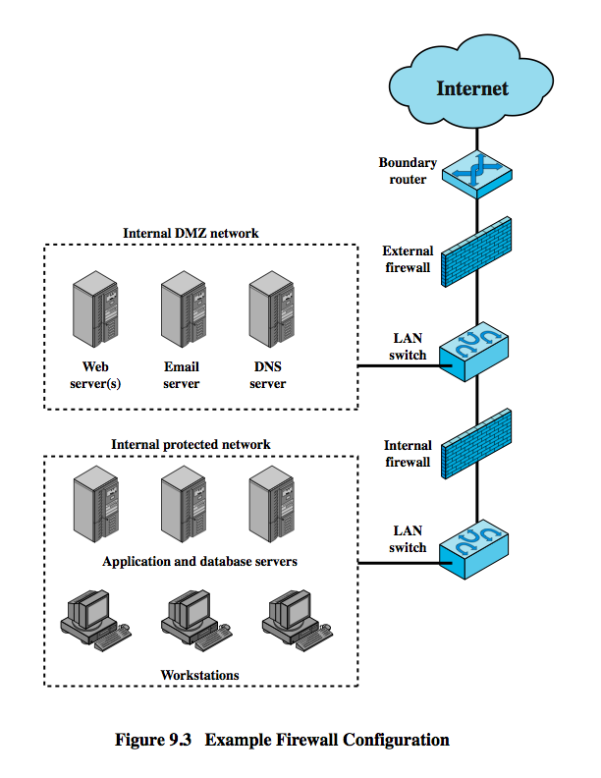
Firewall Locations
Notes:
A firewall is positioned to provide a protective barrier between an external, potentially untrusted source of traffic and an internal network. With that general principal in mind, a security administrator must decide on the location and on the number of firewalls needed. In this section, we look at some common options. Figure 9.3 suggests the most common distinction, that between an internal and an external firewall. An external firewall is placed at the edge of a local or enterprise network. One or more internal firewalls protect the bulk of the enterprise network. Between these two types of firewalls are one or more networked devices in a region referred to as a DMZ (demilitarized zone) network. Systems that are externally accessible but need some protections are usually located on DMZ networks.
The external firewall provides a measure of access control and protection for the DMZ systems consistent with their need for external connectivity. The external firewall also provides a basic level of protection for the remainder of the enterprise network.
In this type of configuration, internal firewalls server three purposes:
1. it adds more stringent filtering capability, compared to the external firewall, in order to protect enterprise servers and workstations from external attack.
2. it provides two-way protection with respect to the DMZ, protecting the remainder of the network from attacks launched from DMZ and protecting DMZ systems from attack from the internal protected network.
3. Multiple internal firewalls can be used to protect portions of the internal network from each other. Figure 6.5 in the text shows a configuration in which the internal servers are protected from internal workstations and vice versa.

Slide 37
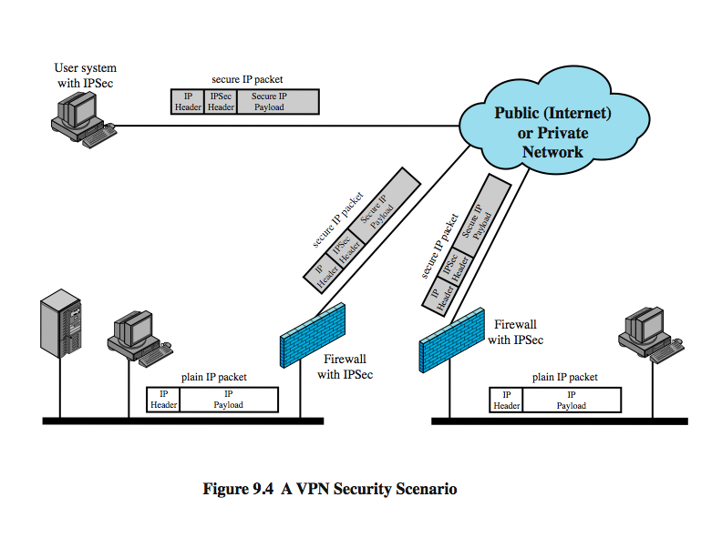
Virtual Private Networks
Notes:
In today's distributed computing environment, the virtual private network (VPN) offers an attractive solution to network managers. In essence, a VPN consists of a set of computers that interconnect by means of a relatively unsecure network. Use of a public network exposes corporate traffic to eavesdropping and provides an entry point for unauthorized users. To counter this problem, a VPN is needed. In essence, a VPN uses encryption and authentication in the lower protocol layers to provide a secure connection through an otherwise insecure network, typically the Internet. VPNs are generally cheaper than real private networks using private lines but rely on having the same encryption and authentication system at both ends. The encryption may be performed by firewall software or possibly by routers. The most common protocol mechanism used for this purpose is at the IP level and is known as IPSec.
Figure 9.4 from the text shows a typical scenario of IPSec usage. An organization maintains LANs at dispersed locations. Nonsecure IP traffic is conducted on each LAN. For traffic offsite, through some sort of private or public WAN, IPSec protocols are used to encrypt and compress all traffic going into the WAN, and decrypt and decompress traffic coming from the WAN; authentication may also be provided. These operations are transparent to workstations and servers on the LAN. A logical means of implementing an IPSec is in a firewall, as shown in Figure 9.4. If IPSec is implemented in a separate box behind (internal to) the firewall, then VPN traffic passing through the firewall in both directions is encrypted. In this case, the firewall is unable to perform its filtering function or other security. IPSec could be implemented in the boundary router, outside the firewall. However, this device is likely to be less secure than the firewall and thus less desirable as an IPSec platform.

Slide 38
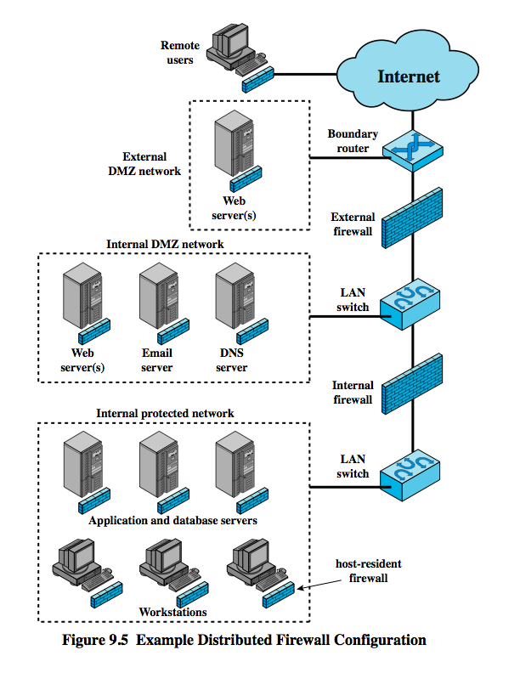
Distributed Firewalls
Notes:
A distributed firewall configuration involves standalone firewall devices plus host-based firewalls working together under a central administrative control. Figure 9.5from the text suggests a distributed firewall configuration. Administrators can configure host-resident firewalls on hundreds of servers and workstation as well as configuring personal firewalls on local and remote user systems. Tools let the network administrator set policies and monitor security across the entire network. These firewalls protect against internal attacks and provide protection tailored to specific machines and applications. Standalone firewalls provide global protection, including internal firewalls and an external firewall, as discussed previously.
With distributed firewalls, it may make sense to establish both an internal and an external DMZ. Web servers that need less protection because they have less critical information on them could be placed in an external DMZ, outside the external firewall. What protection is needed is provided by host-based firewalls on these servers.
An important aspect of a distributed firewall configuration is security monitoring. Such monitoring typically includes log aggregation and analysis, firewall statistics, and fine-grained remote monitoring of individual hosts if needed.

Slide 39
Firewall Topologies
host-resident firewall
screening router
single bastion inline
single bastion T
double bastion inline
double bastion T
distributed firewall configuration
Notes:
We can now summarize the discussion from Sections 9.4 and 9.5 to define a spectrum of firewall locations and topologies. The following alternatives can be identified:
• Host-resident firewall: This category includes personal firewall software and firewall software on servers, used alone or as part of an in-depth firewall deployment.
• Screening router: single router between internal and external networks with stateless or full packet filtering. Typical for small office/home office (SOHO) applications.
• Single bastion inline: single firewall device between an internal and external router (Fig 9.1a) .The firewall may implement stateful filters and/or application proxies. This is the typical firewall appliance configuration for small to medium-sized organizations.
• Single bastion T: Similar to single bastion inline but has a third network interface on bastion to a DMZ where externally visible servers are placed. Again, this is a common appliance configuration for medium to large organizations.
• Double bastion inline: Fig 9.3 illustrates this configuration, where the DMZ is sandwiched between bastion firewalls. This configuration is common for large businesses and government organizations.
• Double bastion T: Fig 6.5 illustrates this configuration. The DMZ is on a separate network interface on the bastion firewall. This configuration is also common for large businesses and government organizations and may be legally required in some cases.
• Distributed firewall configuration: Illustrated in Fig 9.5. This configuration is used by some large businesses and government organizations.

Slide 40
Intrusion Prevention Systems (IPS)
recent addition to security products which
inline net/host-based IDS that can block traffic
functional addition to firewall that adds IDS capabilities
can block traffic like a firewall
using IDS algorithms
may be network or host based
Notes:
A relatively recent addition to the terminology of security products is the intrusion prevention system (IPS). There are two complementary ways of looking at an IPS:
1. An IPS is an inline network-based IDS (NIDS) that has the capability to block traffic by discarding packets as well as simply detect suspicious traffic. For host-based systems, an IPS is a host-based IDS that can discard incoming traffic.
2. An IPS is a functional addition to a firewall that adds IDS types of algorithms to the repertoire of the firewall.
Thus, an IPS blocks traffic, as a firewall does, but makes use of the types of algorithms developed for IDSs. It is a matter of terminology whether an IPS is considered a separate, new type of product or simply another form of firewall. As with an IDS, an IPS can be either host-based or network based.

Slide 41
Host-Based IPS
identifies attacks using both:
signature techniques
malicious application packets
anomaly detection techniques
behavior patterns that indicate malware
can be tailored to the specific platform
e.g. general purpose, web/database server specific
can also sandbox applets to monitor behavior
may give desktop file, registry, I/O protection
Notes:
A host-based IPS (HIPS) makes use of both signature and anomaly detection techniques to identify attacks. In the former case, the focus is on the specific content of application payloads in packets, looking for patterns that have been identified as malicious. In the case of anomaly detection, the IPS is looking for behavior patterns that indicate malware. Examples of the types of malicious behavior addressed by a HIPS include: Modification of system resources; Privilege-escalation exploits; Buffer-overflow exploits; Access to email contact list; Directory traversal. Attacks such as these result in behaviors that can be analyzed by a HIPS. The HIPS capability can be tailored to the specific platform. A set of general-purpose tools may be used for a desktop or server system. Some HIPS packages are designed to protect specific types of servers, such as Web servers and database servers. In this case, the HIPS looks for particular application attacks.
In addition to signature and anomaly-detection techniques, a HIPS can use a sandbox approach. Sandboxes are especially suited to mobile code, such as Java applets and scripting languages. The HIPS quarantines such code in an isolated system area, then runs the code and monitors its behavior. If the code violates predefined policies or matches predefined behavior signatures, it is halted and prevented from executing in the normal system environment.
The following as areas for which a HIPS typically offers desktop protection: System calls; File system access; System registry; Host input/output.

Slide 42
Network-Based IPS
inline NIDS that can discard packets or terminate TCP connections
uses signature and anomaly detection
may provide flow data protection
monitoring full application flow content
can identify malicious packets using:
pattern matching, stateful matching, protocol anomaly, traffic anomaly, statistical anomaly
cf. SNORT inline can drop/modify packets
Notes:
A network-based IPS (NIPS) is in essence an inline NIDS with the authority to discard packets and tear down TCP connections. As with a NIDS, a NIPS makes use of techniques such as signature detection and anomaly detection. Among the techniques used in a NIPS but not commonly found in a firewall is flow data protection. This requires that the application payload in a sequence of packets be reassembled. The IPS device applies filters to the full content of the flow every time a new packet for the flow arrives. When a flow is determined to be malicious, the latest and all subsequent packets belonging to the suspect flow are dropped. In terms of the general methods used by a NIPS device to identify malicious packets, the following are typical:
• Pattern matching: Scans incoming packets for specific byte sequences (the signature) stored in a database of known attacks.
• Stateful matching: Scans for attack signatures in the context of a traffic stream rather than individual packets.
• Protocol anomaly: Looks for deviation from standards set forth in RFCs.
• Traffic anomaly: Watches for unusual traffic activities, such as a flood of UDP packets or a new service appearing on the network.
• Statistical anomaly: Develops baselines of normal traffic activity and throughput, and alerts on deviations from those baselines.
A modified version of Snort (Snort Inline) gives Snort an intrusion prevention capability. Snort Inline includes a replace option, which allows Snort user modify packets rather than drop them. This feature is useful in a honeypot implementation.

Slide 43
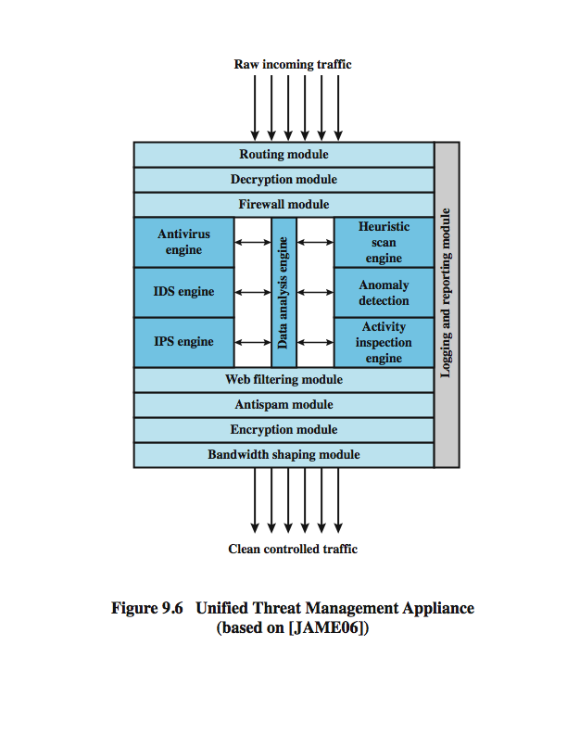
Unified Threat Management Products
Notes:
One approach to reducing the administrative and performance burden is to replace all inline network products (firewall, IPS, IDS, VPN, antispam, antisypware, and so on) with a single device, a unified threat management (UTM) system, that integrates a variety of approaches to dealing with network-based attacks. A significant issue with a UTM device is performance, both throughput and latency, e.g. typical throughput losses for current commercial devices is 50%.
Figure 9.6 is a typical UTM appliance architecture, in it note:
1. inbound traffic is decrypted if necessary before its initial inspection. If the device functions as a VPN boundary node, then IPSec decryption would take place here.
2. an initial firewall module filters traffic, discarding packets that violate rules and/or passing packets that conform to rules set in the firewall policy.
3. then, a number of modules analyze individual packets and flows of packets at various protocols levels. A data analysis engine is responsible for keeping track of packet flows and coordinating the work of antivirus, IDS, and IPS engines.
4. the data analysis engine also reassembles multipacket payloads for content analysis by the antivirus engine and the Web filtering and antispam modules.
5. some incoming traffic may need to be re-encrypted to maintain internal security
6. all detected threats are reported to the logging and reporting module, which is used to issue alerts for specified conditions and for forensic analysis.
7. the bandwidth-shaping module can use various priority and quality of service (QoS) algorithms to optimize performance.

Slide 44
Summary
introduced need for & purpose of firewalls
types of firewalls
packet filter, stateful inspection, application and circuit gateways
firewall hosting, locations, topologies
intrusion prevention systems

