Slide 1
Brute Force Cryptic Attack on DES encrypted Data
Group 01
Foucher, S
Thontat, Y
Shaduka, S

Slide 2
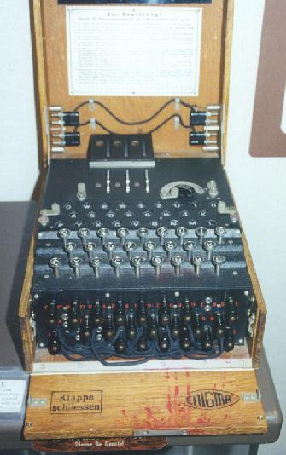
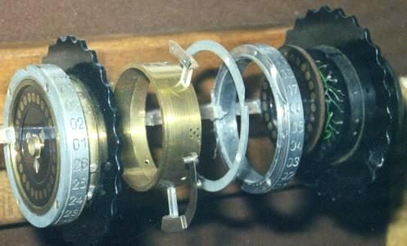
Encryption History
WWII and breaking the Enigma code
10 000 people full time

Slide 3
DES and Brute Force Attacks
56 bit keys to stop Birthday Attacks
7.2 x 10^16 possibility
64 bits of Data
Weakness (advantage):
easily implemented in HDW

Slide 4
Cryptanalysis
Partial knowledge about encoded message
“Drea Gro”… (64 bits)
Exploit Human weaknesses
“aaaaaaa” to “9999999”
20 500 Reduction in Explored key space

Slide 7
Probabilities
56 bit key space: 2^56 = 7.2 * 10^16
Collisions Expected every:
2^(OutputSz/2) = 2^32 = 4.3 * 10^9
p(collision) = 2.33 * 10^-10
p(2 simultaneous collisions) =
8.14 * 10^-19 (Every 779 years)
E(collisions) = 50,794

Slide 8
How to deal with 50,000 Keys

Slide 9
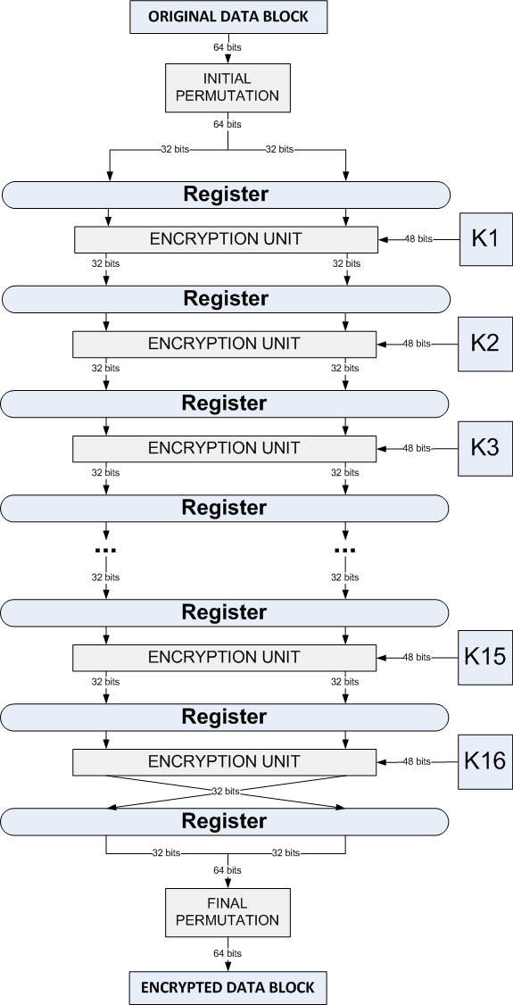
Structure of the Encrypter
18 pipelined stages
The first and final stages are key independent permutations
Encryption is performed in the 16 middle stages
Subkeys are applied to the middle stages in order, from K1 to K16
Notes:
Pipelining
In order to speed-up our brute force search, we pipelined the decrypter such that each pipeline stage can crack one key at a time. But since pipelining only increases the throughput of the system when processing a stream of data, it doesn’t make sense to pipeline the encrypter. However, because we are using the same structure for the encrypter and decrypter, we decided to pipeline our encrypter.
Registers are inserted in-between each pipeline stage, for a total of 18 stages, and the registers are clocked synchronously. The time between each clock signal is set to be greater than the longest delay between all stages, so that when the registers are clocked, the data that is written to them is the final result of the previous stage. In this end, we found the maximum pipeline stage latency in our system to be…
One key aspect of our pipeline design is balancing each pipeline stage. This is done by considering the structure and resources taken by the encrypter and key scheduler before pipelining.
Permutation
Once the key scheduling has been performed, the next step is to prepare the original data block for the actual encryption. This is done by passing the data block through a permutation called the Initial Permutation. This permutation also has an inverse, called the Final Permutation, and it is used in the final stage.
Encryption
Once the original data block preparation have been completed, the actual encryption is performed by the main DES algorithm. The 64-bit block of input data is first split into two halves. The core algorithm of the encrypter is then applied to those halves 16 times, making up the 16 rounds of standard DES.
Subkeys
Our final consideration was to ensure that the subkeys are applied to the middle stages in order, from K1 and K16. Also, because we pipelined the structure of the encrypter, it was imperative to pipeline the key scheduler such that each encrypter stage receives a subkey associated with its input data.

Slide 10
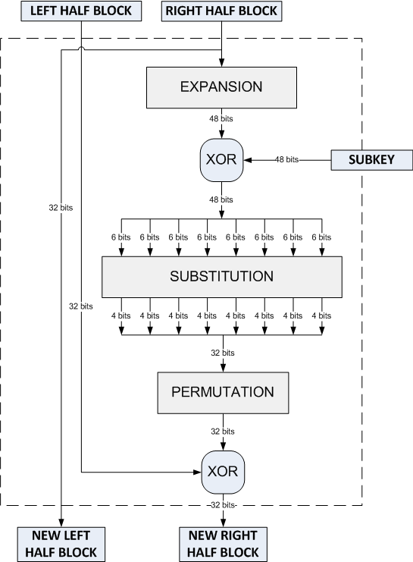
DES Core Algorithm
Feistel structure:
Encryption and Decryption are similar processes
The Feistel function operates on the right-half block and consists of four stages:
Expansion
Key mixing
Substitution
Permutation
Notes:
The Feistel function operates on the right-half block and consists of four stages:
Expansion: the 32-bit half-block is expanded to 48 bits using the expansion permutation, denoted E in the diagram, by duplicating some of the bits.
Key mixing: the result is combined with a subkey using an XOR operation. Sixteen 48-bit subkeys — one for each round — are derived from the main key using the key schedule (described below).
Substitution: after mixing in the subkey, the block is divided into eight 6-bit pieces before processing by the S-boxes, or substitution boxes. Each of the eight S-boxes replaces its six input bits with four output bits according to a non-linear transformation, provided in the form of a lookup table. The S-boxes provide the core of the security of DES — without them, the cipher would be linear, and trivially breakable.
Permutation: finally, the 32 outputs from the S-boxes are rearranged according to a fixed permutation, the P-box.

Slide 11
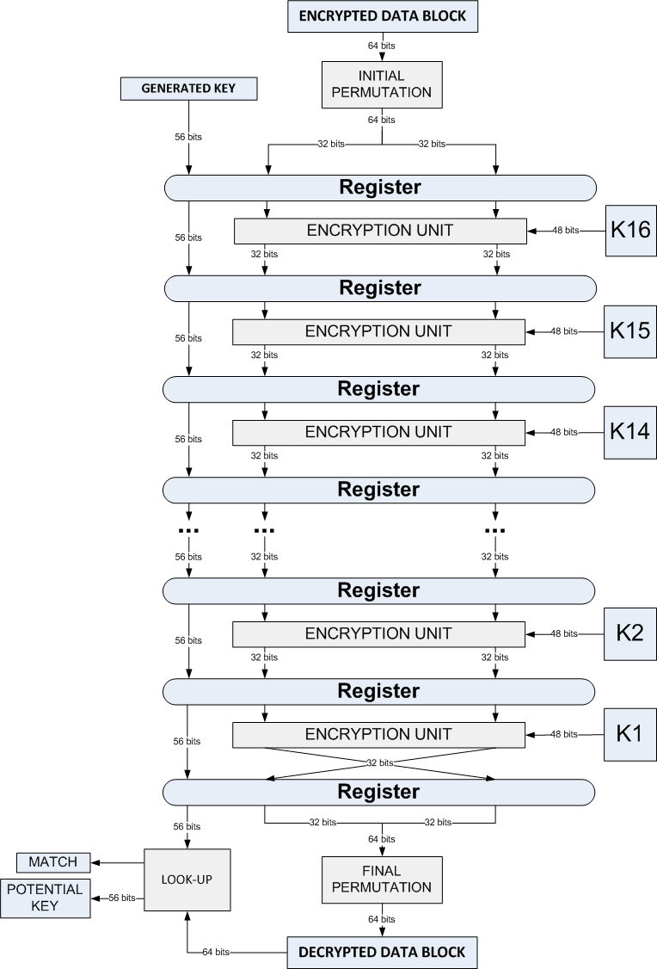
Structure of the Decrypter
Same algorithm used for encryption/decryption
Subkeys are applied in reverse order, from K16 to K1
Keys are aged
Decrypted data block is applied to a look-up

