Slide 1
GINI on a Cloud
Cloud computing for internet emulator

Slide 2
Team Members
Professor
Muthucumaru Maheswaran
David
El Achkar
Simon Foucher
Mia Hochar
Marc
Atie
David El Achkar, Simon Foucher, Mia Hochar, Marc Atie

Slide 3

Objectives
Professor
Muthucumaru Maheswaran
Evolution of GINI
Dispatcher
David
El Achkar
Simon Foucher
GINI Alterations
  Design Dilemma
Database
  Recomendations
Mia Hochar
Marc
Atie
Scheduler
Conclusion
David El Achkar, Simon Foucher, Mia Hochar, Marc Atie

Slide 4
Evolution of GINI
What is GINI?
GINI’s Features
Improvements Overview
David El Achkar, Simon Foucher, Mia Hochar, Marc Atie

Slide 5

GINI Defined
What is GINI?
  Toolkit for creating virtual micro Internets
  Create midsize networks
  Process creates virtual instances of network elements
Purpose:
  Teaching and learning tool
  Suitable to many levels of knowledge
  Future applications
David El Achkar, Simon Foucher, Mia Hochar, Marc Atie

Slide 6
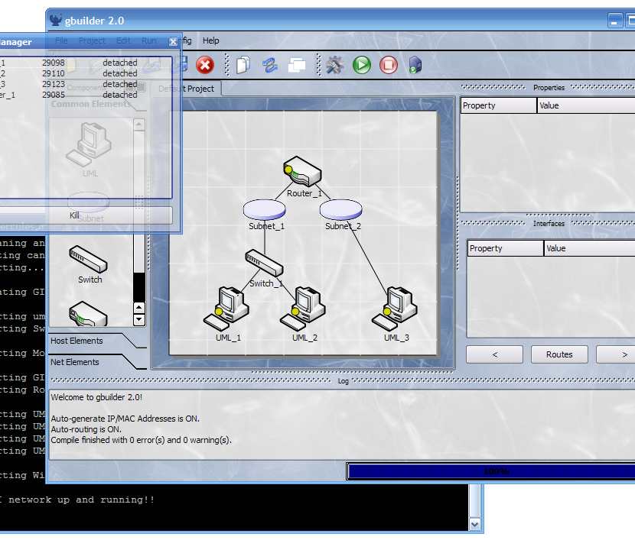
GINI Snapshot
David El Achkar, Simon Foucher, Mia Hochar, Marc Atie

Slide 7
Features
Simple to use GUI
Fully open-source system
Standard compliant router
Ability to implement additional protocols or new network elements
David El Achkar, Simon Foucher, Mia Hochar, Marc Atie

Slide 8
Improvements Overview
Client
Worker
Front End
Back End
David El Achkar, Simon Foucher, Mia Hochar, Marc Atie

Slide 9
Improvements Overview
Client
Worker
Front End
Back End
David El Achkar, Simon Foucher, Mia Hochar, Marc Atie

Slide 10
Improvements Overview
Client
Server
Workers
Front End
Dispatcher
Database
Back End
Back End
Back End
Scheduler
Back End
David El Achkar, Simon Foucher, Mia Hochar, Marc Atie

Slide 11
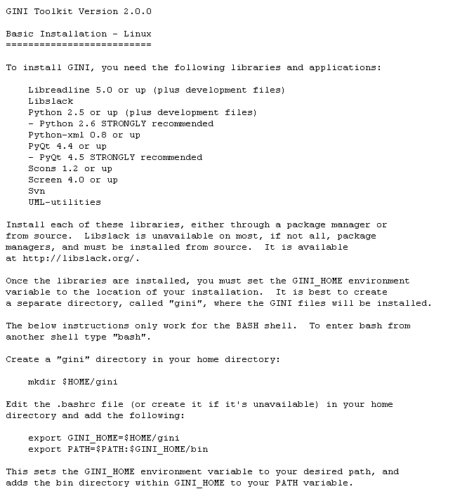
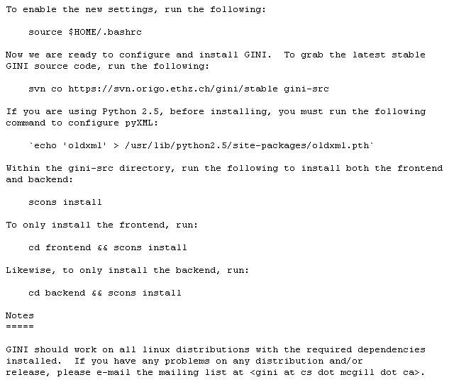
Drawbacks
Complicated Installation process
David El Achkar, Simon Foucher, Mia Hochar, Marc Atie

Slide 12



Drawbacks
OS Compatibility issues
David El Achkar, Simon Foucher, Mia Hochar, Marc Atie

Slide 13
GINI’s Components
GINI Components:
Basics
Improvements
gBuilder
gBuilder
GiniLinux
GiniLinux
Dispatcher
Dispatcher
gLoader
gLoader
uSwitch
uSwitch
Database
Database
gRouter
gRouter
WGINI
WGINI
Scheduler
Scheduler
David El Achkar, Simon Foucher, Mia Hochar, Marc Atie

Slide 14
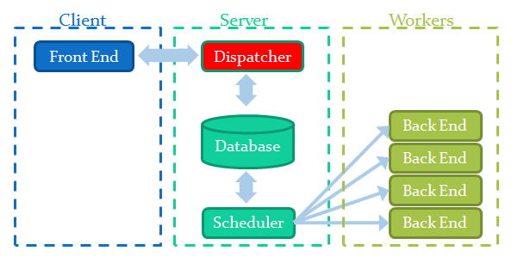
Dispatcher
Overview
Dispatcher Request
Connection Creation
Dispatcher Logging
David El Achkar, Simon Foucher, Mia Hochar, Marc Atie

Slide 15
Overview
Request/Reply
I need a worker
Front End
Dispatcher
Worker’s DNS
Lowest CPU Usage
Database
David El Achkar, Simon Foucher, Mia Hochar, Marc Atie

Slide 16
Dispatcher Request
Request/Reply
extractWorkerFromDB()
Dispatcher
Return worker DNS
DNS | IP | uptime
Lab2-17 | 134.204.2.56 | 0.112
Lab2-29 | 134.204.2.37 | 0.523
Lab2-20 | 134.204.2.112 | 0.938
… | … | …
David El Achkar, Simon Foucher, Mia Hochar, Marc Atie

Slide 17
Connection Creation
Connection Established
Front End
SSH Tunnel
Back End
David El Achkar, Simon Foucher, Mia Hochar, Marc Atie

Slide 18
Dispatcher Logging
Recording Connection
Dispatcher
Send:
  Client IP
  Worker DNS
Connection Recorded:
time stamp
Database
David El Achkar, Simon Foucher, Mia Hochar, Marc Atie

Slide 19
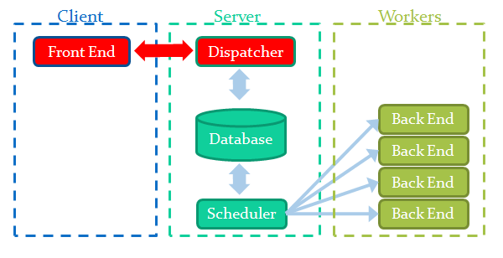
GINI Alterations
Design Paradigm
Connection to Server
Design Dilemma
David El Achkar, Simon Foucher, Mia Hochar, Marc Atie

Slide 20
Design Paradigm
Transparent to user
Component add-on rather than alteration
  GINI remains independent
  Only altered the Configuration file
David El Achkar, Simon Foucher, Mia Hochar, Marc Atie

Slide 21
Design Paradigm
Use of flexible communication library: twisted
  GINI already in Python
  Flexible
  Available source code
  Stable
  High-level functions
David El Achkar, Simon Foucher, Mia Hochar, Marc Atie

Slide 22
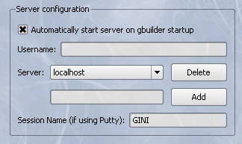
Current Access to Remote Server
David El Achkar, Simon Foucher, Mia Hochar, Marc Atie

Slide 23
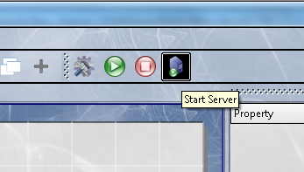
Connection to Server
David El Achkar, Simon Foucher, Mia Hochar, Marc Atie

Slide 24
Connection to server
Front End
SSH Tunnel
Back End
David El Achkar, Simon Foucher, Mia Hochar, Marc Atie

Slide 25
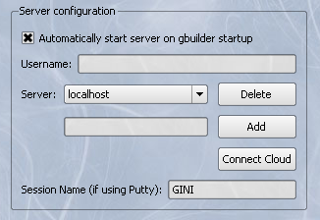
Addition to GINI
David El Achkar, Simon Foucher, Mia Hochar, Marc Atie

Slide 26
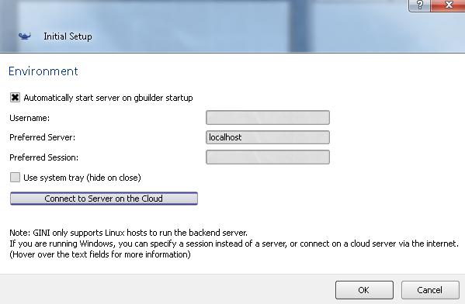
Addition to GINI
David El Achkar, Simon Foucher, Mia Hochar, Marc Atie

Slide 27
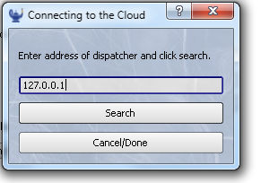
Gateway to the cloud
Notes:
Address can be DNS or IP address.
If static, can be hard coded; or at least hard code default address
When deployed, choose proper use

Slide 28
Sequence of Events
Send dummy variable
NoWorker
Front End
Dispatcher
Database
David El Achkar, Simon Foucher, Mia Hochar, Marc Atie

Slide 29
Sequence of Events
Send dummy variable
Dispatcher searches for a worker
Front End
Dispatcher
Best Worker?
Database
David El Achkar, Simon Foucher, Mia Hochar, Marc Atie

Slide 30
Sequence of Events
Send dummy variable
Dispatcher searches for a worker
Returns worker or dummy variable
Front End
Dispatcher
Worker’s DNS name
Database
David El Achkar, Simon Foucher, Mia Hochar, Marc Atie

Slide 31
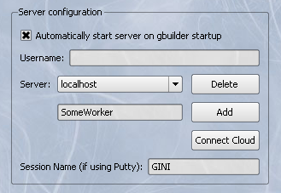
Result: Unaltered GINI
David El Achkar, Simon Foucher, Mia Hochar, Marc Atie

Slide 32
Connection to server
Connection remains unaltered
User needs no knowledge of Back End location
Front End
SSH Tunnel
Back End
David El Achkar, Simon Foucher, Mia Hochar, Marc Atie

Slide 33
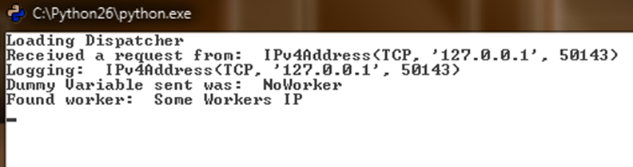
Purpose of Dummy Variable
Need to establish TCP communication
Recycled as an error flag
Could be used to convey info in future upgrade
David El Achkar, Simon Foucher, Mia Hochar, Marc Atie

Slide 34
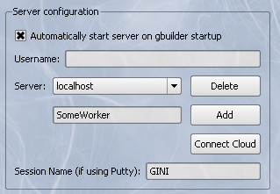
Flexibility
Non-fixed data types being passed
Currently a string: IP, DNS or anything else
David El Achkar, Simon Foucher, Mia Hochar, Marc Atie

Slide 35
Drawback
Temporary TCP connection: Port expiration at timeout
Most Clients don’t have DNS
David El Achkar, Simon Foucher, Mia Hochar, Marc Atie

Slide 36
Design Dilemma
Maintain permanent client-dispatcher connection
  Resources consuming
  Might not bring any tangible benefits
  Requires alterations to gServer and core Config
  Requires 3 communication events (instead of 1)
Drop the connection after delivering the goods
  Lightweight component
  No extra resources used
  Impossible (or difficult) to retrieve clients
David El Achkar, Simon Foucher, Mia Hochar, Marc Atie
Notes:
More elaboration on this by Mia and Dave; Second option implemented with DB support for first one if need arises

Slide 37
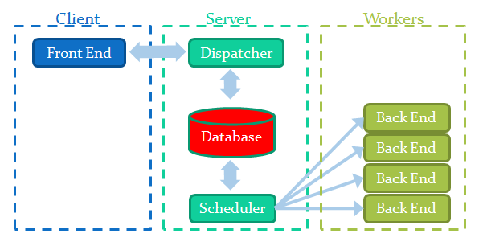
Database
Contents
Dispatcher Database Relationship
Design choices
Recommendations
David El Achkar, Simon Foucher, Mia Hochar, Marc Atie

Slide 38
Database Storage: workers Table
DB keeps history of 10 last CPU usages for every worker
Database
Initial Design
Workers | Usage | History
W1 | 34% | 12 | 15 | 80 | 45 | …
W2 | 49% | 70 | 33 | 10 | 28 | …
W3 | 57% | 2 | 88 | 78 | 65 | …
… | … | …
David El Achkar, Simon Foucher, Mia Hochar, Marc Atie

Slide 39
Database Storage: workers Table
Uptime is the average load on the system processor
Database
Implementation
workerID | dnsName | uptime
1 | lab2-42 | 0.23
2 | lab2-39 | 0.18
3 | lab2-37 | 0.56
… | … | …
David El Achkar, Simon Foucher, Mia Hochar, Marc Atie

Slide 40
Database Storage: clients Table
DB keeps track of all the connections and their start time
Database
Initial Design
Client | Connected to | Time Stamp
134.204.2.56 | 134.204.2.56 | 1:03
168.141.2.9 | 134.204.2.21 | 1:21
191.24.2.56 | 134.204.2.37 | 1:56
… | … | …
David El Achkar, Simon Foucher, Mia Hochar, Marc Atie

Slide 41
Database Storage: clients Table
Time stamp is calculated in minutes starting midnight
Database
Implementation
clientID | workerName | IP address | timeStamp
1 | Lab2-37 | 134.204.2.56 | 789
2 | Lab3-39 | 134.204.2.21 | 300
3 | Lab2-42 | 134.204.2.37 | 1056
… | … | … | …
David El Achkar, Simon Foucher, Mia Hochar, Marc Atie

Slide 42
Database - Dispatcher
1
getFreeWorker()
Database
Dispatcher
Lab2-39
3
2
Sort workers table by uptime
workerID | dnsName | uptime
1 | lab2-42 | 0.23
2 | lab2-39 | 0.18
3 | lab2-37 | 0.56
David El Achkar, Simon Foucher, Mia Hochar, Marc Atie

Slide 43
Database - Dispatcher
4
Connection between client and lab2-39
Database
Dispatcher
5
clientID | workerName | IP address | timeStamp
1 | lab2-37 | 134.204.2.56 | 789
2 | lab2-39 | 134.204.2.21 | 300
3 | lab2-42 | 134.204.2.37 | 1056
4 | lab2-39 | 123.45.6.78 | 840
David El Achkar, Simon Foucher, Mia Hochar, Marc Atie

Slide 44
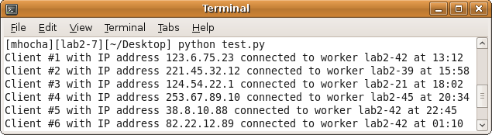
Client Log
Call to the function displayClientsLog()
David El Achkar, Simon Foucher, Mia Hochar, Marc Atie

Slide 45
Design Choices
Database implemented in SQL
  Used MySQLdb: wrapper around MySQL
  Compatible with Python API
Database stored on the SOCS MySQL server
  Free, available and provided by McGill
  Database Name: 2010GINIdb
  Machine Name: mysql.cs.mcgill.ca
Database can be reset at anytime
David El Achkar, Simon Foucher, Mia Hochar, Marc Atie

Slide 46
Managing Client Connections
Killing a connection
  Polling (time out):
    Dispatcher periodically polls client
    No response: dispatcher terminates connection
  Manual
    Client shuts down connection
    Sends message to dispatcher
Too complex to implement:
  Needs modification to the core GINI code
David El Achkar, Simon Foucher, Mia Hochar, Marc Atie

Slide 47
Managing Client Connections
Database functions provided:
  getTimedOutClients()
  updateClientTime()
  removeClientByID()
  removeClientByIP()
David El Achkar, Simon Foucher, Mia Hochar, Marc Atie

Slide 48
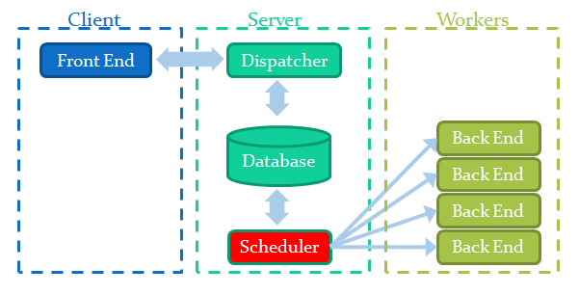
Scheduler
Purpose
Design Choices
Methodology
Sample Output
Recommendations
David El Achkar, Simon Foucher, Mia Hochar, Marc Atie

Slide 49
Purpose
Manage workers and their connections
Examine CPU usage
Ensure all workers are accessible
David El Achkar, Simon Foucher, Mia Hochar, Marc Atie

Slide 50

Design choices
Paramiko
  Module for Python
  Implements secure SSH protocol
Uptime
  Load average for past 1, 5, and 15 minutes
  No need to store each worker’s history
David El Achkar, Simon Foucher, Mia Hochar, Marc Atie

Slide 51

Methodology
Retrieve workers list from database
Get CPU usage of workers
  SSH connection to each worker
  Get “uptime” information
  Update database entry
Sleep for one minute, then start again
David El Achkar, Simon Foucher, Mia Hochar, Marc Atie

Slide 52
Database Update
1
Request Workers List
Database
Scheduler
lab2-42, lab2-39, …
2
3
4
lab2-42
New uptime 0.26
workerID | dnsName | uptime
1 | lab2-42 | 0.26
2 | lab2-39 | 0.12
… | … | …
lab2-39
New uptime 0.12
David El Achkar, Simon Foucher, Mia Hochar, Marc Atie

Slide 53
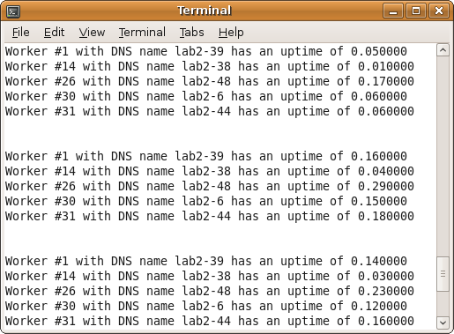
Sample Output
David El Achkar, Simon Foucher, Mia Hochar, Marc Atie

Slide 54
Dynamic Update
Worker
$ gAddWorker<>
$ gRemoveWorker<>
Worker
Scheduler
Worker
David El Achkar, Simon Foucher, Mia Hochar, Marc Atie

Slide 55
Dynamic Update
Two Bash scripts on server:
  addWorker.sh
  removeWorker.sh
Boot configuration and shut down sequence need to be updated.
  $ /removeworker.sh <dnsName>
  $ /addworker.sh <dnsName>
David El Achkar, Simon Foucher, Mia Hochar, Marc Atie

Slide 56
Workers
Computers in the Krieble lab
  All machines could be shut down simultaneously
  No available workers
Worker could be disconnected
  Workers Log could be used to find new worker
  Initiate new connection automatically
David El Achkar, Simon Foucher, Mia Hochar, Marc Atie

Slide 57
Configuration
Change passwords:
  SSH access to SOCS server
  Database access to SOCS MySql server
David El Achkar, Simon Foucher, Mia Hochar, Marc Atie

Slide 58
Conclusion
Summary
Advantages
David El Achkar, Simon Foucher, Mia Hochar, Marc Atie

Slide 59
Summary
Initiating a connection
  Client contacts dispatcher
  Dispatcher queries database for worker, updates database accordingly
  Dispatcher sends IP address of worker to the client
  Client connects to worker through SSH tunnel
Client
Dispatcher
Database
Worker
David El Achkar, Simon Foucher, Mia Hochar, Marc Atie

Slide 60


Advantages
No need to install back end
  Easier installation (less packages)
  Saves user trouble of software maintenance / update
Cross-platform compatibility
  Back end can only run on Linux
  Front end supported by Linux and Windows
David El Achkar, Simon Foucher, Mia Hochar, Marc Atie

Slide 61
Advantages
Mobility
  Back end runs on remote server
  Users can run GINI from wherever they are
Resource usage
  Managed, automated distribution of computing
  resources among users
  Easy to monitor and to add more workers
David El Achkar, Simon Foucher, Mia Hochar, Marc Atie

Slide 62
Thank you!
Questions?

