Slide 1
GINI on a Cloud
Cloud computing for internet emulator

Slide 2
Team Members
Professor
Muthucumaru Maheswaran
David
El Achkar
Simon Foucher
Mia Hochar
Marc
Atie
David El Achkar, Simon Foucher, Mia Hochar, Marc Atie

Slide 3

Objectives
Professor
Muthucumaru Maheswaran
Current State of GINI
Proposed Improvements
  Overview
  Dispatcher
David
El Achkar
Simon Foucher
  Resource Manager
Mia Hochar
Marc
Atie
Conclusion
  Summary and Advantages
  Recommendations
David El Achkar, Simon Foucher, Mia Hochar, Marc Atie

Slide 4
Current State of GINI
What is GINI?
GINI’s purpose, features, & components
Drawbacks
David El Achkar, Simon Foucher, Mia Hochar, Marc Atie

Slide 5

Current State of GINI
What is GINI?
  Toolkit for creating virtual micro Internets
  Create midsize networks
  Process creates virtual instances of network elements
David El Achkar, Simon Foucher, Mia Hochar, Marc Atie

Slide 6
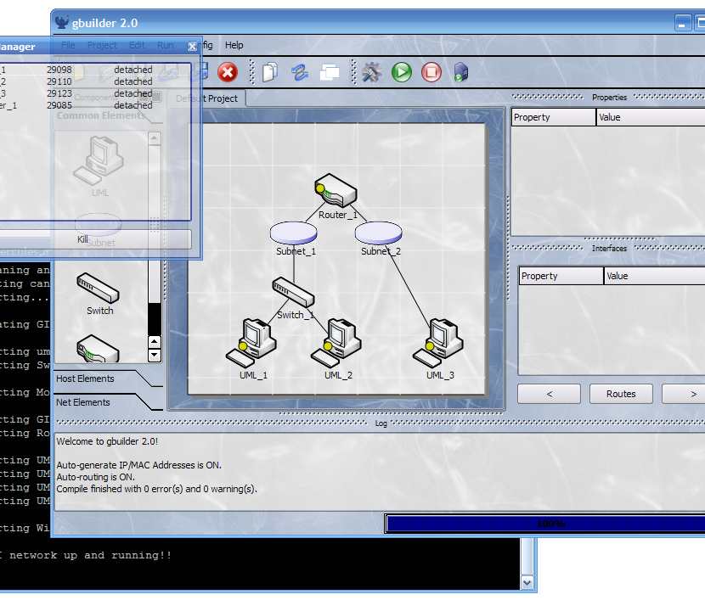
GINI Snapshot
David El Achkar, Simon Foucher, Mia Hochar, Marc Atie

Slide 7
Current State of GINI
GINI’s purpose:
  Teaching and learning tool
  Suitable to many levels of knowledge
  Future applications
David El Achkar, Simon Foucher, Mia Hochar, Marc Atie

Slide 8
Current State of GINI
GINI Features:
  Simple to use GUI
  Fully open-source system
  Standard compliant router
  Ability to implement additional protocols or new network elements
David El Achkar, Simon Foucher, Mia Hochar, Marc Atie

Slide 9
Current State of GINI
GINI Components:
gBuilder
gBuilder
GiniLinux
GiniLinux
gLoader
gLoader
uSwitch
uSwitch
gRouter
gRouter
WGINI
WGINI
David El Achkar, Simon Foucher, Mia Hochar, Marc Atie

Slide 10
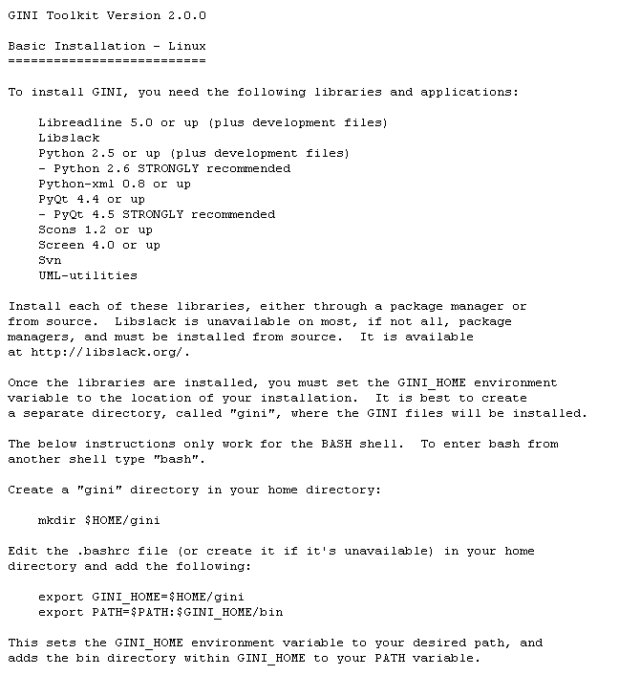
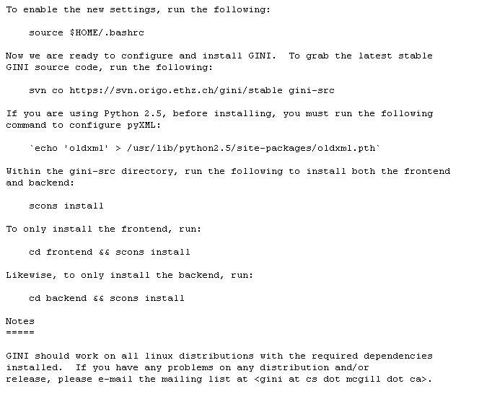
Drawbacks
Complicated Installation process
David El Achkar, Simon Foucher, Mia Hochar, Marc Atie

Slide 11




Drawbacks
OS Compatibility issues
Network protocol compatibility issues
David El Achkar, Simon Foucher, Mia Hochar, Marc Atie

Slide 12
Proposed Improvements – Dispatcher
Overview
Dispatcher Flow 1 – Request/Reply
Dispatcher Flow 2i – Connection Established
Dispatcher Flow 2ii – Connection Recorded
Why Twisted?
David El Achkar, Simon Foucher, Mia Hochar, Marc Atie

Slide 13
Improvements Overview
Client
Worker
Front End
Back End
David El Achkar, Simon Foucher, Mia Hochar, Marc Atie

Slide 14
Improvements Overview
Client
Worker
Front End
Back End
David El Achkar, Simon Foucher, Mia Hochar, Marc Atie

Slide 15
Improvements Overview
Client
Server
Workers
Front End
Dispatcher
Database
Back End
Back End
Back End
Scheduler
Back End
David El Achkar, Simon Foucher, Mia Hochar, Marc Atie

Slide 16
Dispatcher Flow 1
Request/Reply
I need a worker
Front End
Dispatcher
Worker’s IP
Lowest CPU Usage
Database
David El Achkar, Simon Foucher, Mia Hochar, Marc Atie

Slide 17
Dispatcher Flow 1
Request/Reply
Dispatcher
Query min()
Return IP or host name
DNS | IP | W_CPU%
Lab2_17@cs.mcgill.ca | 134.204.2.56 | 5
Lab2_18@cs.mcgill.ca | 134.204.2.21 | 8
Lab2_29@cs.mcgill.ca | 134.204.2.37 | 12
Lab2_20@cs.mcgill.ca | 134.204.2.112 | 18
… | … | …
David El Achkar, Simon Foucher, Mia Hochar, Marc Atie

Slide 18
Dispatcher Flow 2i
Connection Established
Front End
SSH Tunnel
Back End
David El Achkar, Simon Foucher, Mia Hochar, Marc Atie

Slide 19
Dispatcher Flow 2i
Connection Recorded
Dispatcher
Database
Create host IP entry
Time Stamp
David El Achkar, Simon Foucher, Mia Hochar, Marc Atie

Slide 20
Dispatcher Flow 2ii
Connection Recorded
Dispatcher
Client | Connected to | Time Stamp
14.89.2.44 | 134.204.2.56 | 1:03
168.141.71.9 | 134.204.2.21 | 1:21
191.24.2.56 | 134.204.2.37 | 1:56
134.13.22.121 | 134.204.2.112 | 12:12
… | … | …
David El Achkar, Simon Foucher, Mia Hochar, Marc Atie

Slide 21
Dispatcher
Network Programming models
  Handle connections in a separate OS process
  Handle connections in a separate thread
  Use non-blocking system calls to handle all connections in one thread.
David El Achkar, Simon Foucher, Mia Hochar, Marc Atie

Slide 22

Dispatcher- Why Twisted?
GINI already in Python
Available Win/Linux
Networking libraries
Flexibility
Available source code
Stability
High-level language
David El Achkar, Simon Foucher, Mia Hochar, Marc Atie

Slide 23
Scheduler
Purpose
Database
Time Out
User Interface
David El Achkar, Simon Foucher, Mia Hochar, Marc Atie

Slide 24
Purpose
Manage workers and their connections
Examine CPU usage
David El Achkar, Simon Foucher, Mia Hochar, Marc Atie

Slide 25
Database Storage
What will store all the information ?
  Database Links scheduler and dispatcher
Dispatcher
Database
Scheduler
David El Achkar, Simon Foucher, Mia Hochar, Marc Atie

Slide 26
Database Storage
DB keeps history of 10 last CPU usages for every worker
Database
Workers | Usage | History
W1 | 34% | 12 | 15 | 80 | 45 | …
W2 | 49% | 70 | 33 | 10 | 28 | …
W3 | 57% | 2 | 88 | 78 | 65 | …
… | … | …
David El Achkar, Simon Foucher, Mia Hochar, Marc Atie

Slide 27
Database Storage
How does the scheduler determine the usage?
  Pipe $PS data
  Extract CPU usage
Scheduler
Worker 1
CPU Usage 26%
Worker 2
Worker 3
…
David El Achkar, Simon Foucher, Mia Hochar, Marc Atie

Slide 28
Database Update
Query database for worker entry
Extract previous ten CPU usages
Compute new weighted average
Store new weighted average
David El Achkar, Simon Foucher, Mia Hochar, Marc Atie

Slide 29
Database Update
1
Request Worker 1 Entry
Database
Scheduler
12, 15, 80, 45, …
2
4
3
Worker 1
New Usage 26%
Workers | New Usage | History
W1 | 26% | …
W2 | 49% | …
… | … | …
David El Achkar, Simon Foucher, Mia Hochar, Marc Atie

Slide 30
Time Out
Timer value must be inserted by user
When time limit expires: user gets a popup message
Database
Scheduler
Are you still there?
Host | Time
15.141.123.4 | 43:27
122.131.4.10 | 60:01
192.168.2.125 | 07:13
… | …
Host
IP 122.131.4.10
David El Achkar, Simon Foucher, Mia Hochar, Marc Atie

Slide 31
User Interface
Scheduler process runs in background
Update $PATH file on server
Add few commands to communicate with scheduler
  $ gtimeout <timeInMinutes>
  $ gkill <ipAddress>
  $ gaddworker <ipAddress> <name>
  $ gremoveworker <ipAddress> <name>
  $ showWorkers
  $ showActiveSessions
David El Achkar, Simon Foucher, Mia Hochar, Marc Atie

Slide 32
Dynamic Update
Update worker boot/shutdown sequence
Worker
$ gAddWorker<>
$ gRemoveWorker<>
Worker
Scheduler
Worker
David El Achkar, Simon Foucher, Mia Hochar, Marc Atie

Slide 33
Conclusion
Summary
Advantages
Recommendations
David El Achkar, Simon Foucher, Mia Hochar, Marc Atie

Slide 34
Summary
Initiating a connection
  Client contacts dispatcher
  Dispatcher queries database for worker, updates database accordingly
  Dispatcher sends IP address of worker to the client
  Client connects to worker through SSH tunnel
Client
Dispatcher
Database
Worker
David El Achkar, Simon Foucher, Mia Hochar, Marc Atie

Slide 35
Summary
Killing a connection
  Manual
    Client shuts down connection
    Sends message to dispatcher
  Polling (time out):
    Scheduler periodically polls client
    No response: scheduler terminates connection
David El Achkar, Simon Foucher, Mia Hochar, Marc Atie

Slide 36
Advantages
No need to install back end
  Easier installation (less packages)
  Saves user trouble of software maintenance / update
Cross-platform compatibility
  Back end can only run on Linux
  Front end supported by Linux and Windows
David El Achkar, Simon Foucher, Mia Hochar, Marc Atie

Slide 37
Advantages
Mobility
  Back end runs on remote server
  Users can run GINI from wherever they are
Resource usage
  Managed, automated distribution of computing
  resources among users
  Easy to monitor and to add more workers
David El Achkar, Simon Foucher, Mia Hochar, Marc Atie

Slide 38


Recommendations
Support for additional platforms:
  Many different OS on market
  Support more platforms for expansion
Move to a public cloud:
  Make software more accessible
  Provide better educational platform
  for students
David El Achkar, Simon Foucher, Mia Hochar, Marc Atie

Slide 39
Thank you!
Questions?

