Slide 1




Barrick Gold in Tanzania
Simon Foucher
Weilun Chang
Archna Soni
Heba Muhey

Slide 2
Barrick’s Vision and Values:
“to continue finding, acquiring, developing and producing quality reserves in a safe, profitable and socially responsible manner”

Slide 3
Problem Statement
Maximize Profits
Minimize negative impacts on local communities
Justify Investment

Slide 4

External Analysis

Slide 5
Mature Industry
External Analysis
Industry Rivalry:
Med-High
Threats of New Entrants: Low
Buyer Power:
High
Threats of Substitutes: Low
Supplier Power:
Low-Med
Since gold is traded as a commodity;
Industry KSF is efficiency and low costs

Slide 6
Industry-wide Ethical Factors
External Analysis
Minerals in developing country with weak institutions
Corruption leading to lost revenues and inadequate redistribution of wealth
Minimalistic compliance / Externalities
Commodity price pressure can lead to
“Cutting Corners”

Slide 7
Stakeholder Analysis Framework
Best
Practices
External Analysis
Duties
Rights
Commitments
Best Practices
Stakeholders
Barrick Gold
Government
Communities
Multiple stakeholders with
diverging goals and motivations

Slide 8
Summary of External Analysis
Opportunities
Low wages
Unaddressed social issues
Threats
Vandalism and theft
Pollution
Scrutiny by activists and NGOs

Slide 9

Internal Analysis

Slide 10
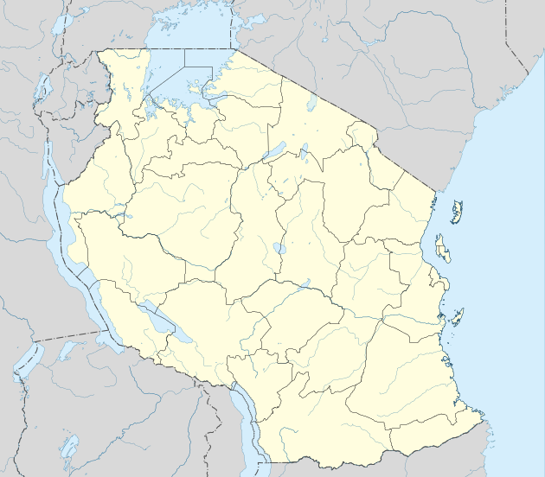


About Barrick Gold Corp.
Internal Analysis
Operates in 5 continents
Listed on multiple stock exchanges
1995 – exploration
1999 – excavation
2009 – spinoff TZ mines
North Mara
Tulawaka
Bulyanhulu
Buzwagi

Slide 11
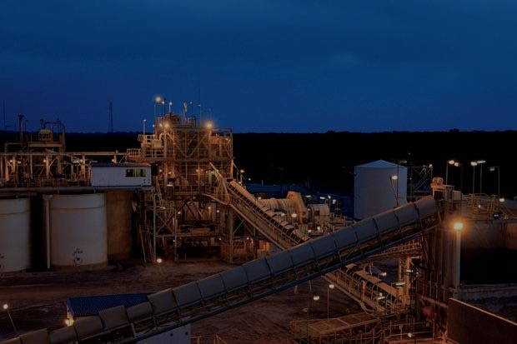
Operations Analysis
Internal Analysis
Advanced exploration and processing technologies
Reliance on TZ government and institutions
Operates more sustainably and responsibly than global competitors

Slide 12
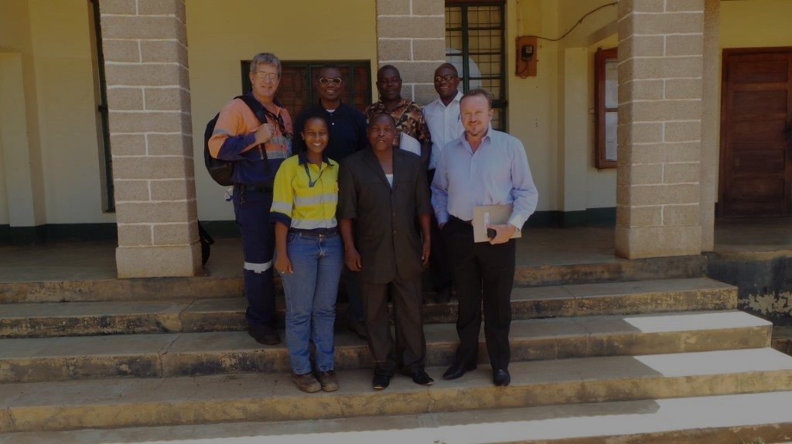
Social Processes
Internal Analysis
Global CSR standards
Established a “community department”
  entrepreneurship programs
  healthcare accessibility
  corporate ambassadors
Commitments inconsistent with
perceived behaviours by locals

Slide 13

Human Capital
Internal Analysis
Corporate culture of socialization in human resource management
Integrated Mining Technical Training program (IMTT)
Global Succession Planning Program (GSPP)

Slide 14
Summary of Internal Analysis
Strengths
strong corporate culture and HR management
Weaknesses
CSR efforts perceived negatively
reliance on government and institutions
poor cultural understanding and communication with stakeholders
advanced technology and global expertise

Slide 15
Problem Statement
Maximize Profits
Minimize negative impacts on local communities
Justify Investment

Slide 16

Alternatives

Slide 17
Leave TZ –refocus resources
Alternative 1
PROS | CONS
Eliminates ethical issues company might have in TZ Provides ability to reallocate resources more efficiently to existing projects (increase efficiency) Recoup investment by selling off assets | It might not be possible to find mineral deposits that would yield profitable operations in industrialized countries Competitors will take over mineral extraction rights in TZ and might be even less ethical than ABG Potential financial losses, investment losses if potential buyer not secured Leave sites in worse state (damage to environment, social programs)

Slide 18
Follow regulation & hire security to protect operations –if it was an emergent issue...can’t follow a compliance approach because
Alternative 2
PROS | CONS
Control the population and prevent destruction of the mining sites Less money invested into the community hence a more profitable bottom line | Potentially costly Socially unacceptable, promoting hostility Even with hired security, operations might still be vulnerable
Notes:
Follow regulation & hire security to protect operations –if it was an emergent issue then we could use this alternative and be minimilistically compliant...but at the moment we are in consolidating so we have to bemanagerial about i.

Slide 19
Enhance CSR activities to reduce Tensions
Alternative 3
PROS | CONS
Increases welfare of local residents Long-term sustainability Cooperative working environment, leading to higher productivity | Potentially costly Might not completely satisfy local communities whose livelihoods are affected by mining operations

Slide 20

Recommendation-Choose Alternative 3
Metrics
 | Alternative 1 | Alternative 2 | Alternative 3
Impact on Employees | - | o | +
Impact on Government | - | o | +
Impact on Company | o | + | O
Impact on Local Communities | - | x | +
Impact on Environment | + | o | O
Recommended Action |  |  | ✓
Notes:
Using the utilitarian approach we devised a metrics bla bla bla…

Slide 21

Implementation

Slide 22
Implementation
3 pillars strategy
Health
Environment
Social and Community

Slide 23
Health
Implementation
Short Term (<1yr)
Reduce noise pollution
Medium Term (1-2yr)
Continue investing in hospital
Reach out to the government to get the hospital subsidised
Long Term (2yr+)
Work with the Africa “The water project” to create drinkable water

Slide 24
Environment
Implementation
Short Term (<1yr)
Create industry associations
Medium Term (1-2yr)
Create a cultural training program expatriates
Long Term (2yr+)
Plan and eventually execute a clean exit strategy
Share best practices

Slide 25
Social and Community
Implementation
Short Term (<1yr)
Strengthen communication with community leaders & government
Medium Term (1-2yr)
Build framework where local communities can voice their concerns
Long Term (2yr+)
Bridge the gap between level of labor required and education
Habitat for humanity
Identify entrepreneurships and invest in them (Agriculture/fishing)
Invest in technology (R&D) to minimise the environmental impacts of operations
Reduce the amounts of ex-pats by using people from the community

Slide 26






  Make sure that with all the efforts invested, in the last 2 years, Barrick develops a “deep understanding, integration, and [builds] a trusting relationship”.

Slide 27
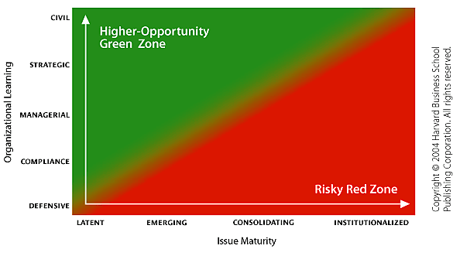
Positioning
Implementation
Notes:
So now we reached managerial how can we improve and get to startegic/instutionalised?

Slide 28
Implementation
Notes:
So now we reached managerial how can we improve and get to startegic/instutionalised?

Slide 29
Recuperate CSR investments selling a commodity
Implementation
Brand a commodity
Develop marketing plan for “Green Gold”
Create new traceable distribution channel
Target Jewelry industry
Charge premium to cover CSR costs
As the issue gains maturity,
take strategic approach

Slide 30
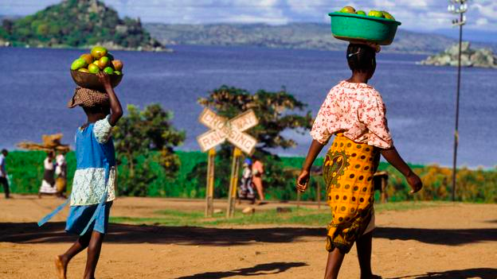
Q&A

