Slide 1
MBA 691 Business Ethics

Slide 2
Business this week
July 2012
Jamie Dimon, the boss of JPMorgan Chase, appeared before a Senate
committee to explain his bank's recent $2 billion trading loss on credit
derivatives.
Mr. Dimon gave little away but did say that the chief investment office had been told to reduce its risk exposure in December and “had done the opposite”. Things should have been scrutinized more closely by executives.
http://www.economist.com/node/21556990/print 7/18/2012

Slide 3
Fast Forward October 24, 2013
JPMorgan Chase (JPM) has tentatively agreed to pay the U.S. Department of Justice $13 billion, to settle civil investigations into mortgage-backed securities it sold in the run up to the 2008 financial crisis. It’s more than the combined salaries of every athlete in every major U.S. professional sport. The challenges facing Jamie Dimon and his company are far from over. With the $13 billion payout, JPMorgan is still the subject of a criminal probe into its mortgage-bond sales, which could end in charges against the bank or its executives. And other federal investigations - into suspected bribery in China, the bank’s role in the Bernie Madoff Ponzi scheme, and more - are ongoing. Jamie Dimon, the chief executive of the nation's largest bank is bracing for as much as a year of regulatory headaches, according to people who have spoken to him, marring what Dimon and his top lieutenants believe is the firm's exceptional financial performance.

Slide 4
Business this week
June 2012
There was another revolt against executive pay in Britain, this time at
WPP, a global advertising agency.
Around 60% of shareholders voted against the £6.8m ($10.6m) package awarded to Sir Martin Sorrell, the chief executive.
The vote is non-binding, but the government is considering legislation to give shareholders more say on pay.

Slide 5
WPP, a global advertising agency.
Fast Forward to June 9, 2015
WPP investors once again expressed their anger at the scale of chief executive Sir Martin Sorrell’s pay, with 22% refusing to endorse his £43m remuneration at the advertising giant’s annual meeting.
Sorrell, the highest-paid boss of a British public company by some distance, came under fire from investors who said that “enough is enough”.
The vote at WPP’s annual general meeting in London on Tuesday saw 77.7% of investors back his pay packet, while 22.3% of voters failed to back WPP’s remuneration report.
The shareholder revolt is lower than at last year’s annual meeting, when almost 30% of investors refused to back WPP the company pay plan.
Shareholder advisory firm Pirc has labelled Sorrell’s pay as “excessive”. Sorrell’s pay last year was 37 times his base salary of £1.15m.
This takes Sorrell’s earnings over the past 11 years to about £187m. His biggest payday was in 2004 when he received £53m.

Slide 6
How Unethical is American Business
8 Types of Unethical Activities
Fraud (accounting, securities and consumer)
Discrimination practices
Undisclosed executive pay (failure to fully disclose details of the compensation packages)
Antitrust activities (i.e. in Europe Coca Cola offered unfair incentives to retailers)
Patent infringement (i.e. iPhone/Samsung 40 patent lawsuits against each other was dropped)
Other violations of the law (i.e. secretly agreeing to hire into an executive position a government official who oversaw the allocation of specific contracts)

Slide 7
How Unethical is American Business
Three conditions that seemingly signal “unethical behavior”
a plea of guilty by a firm to charges of misconduct,
A ruling against a firm by a government agency or a court,
An agreement by a firm to settle charges, often by paying a fine

Slide 8
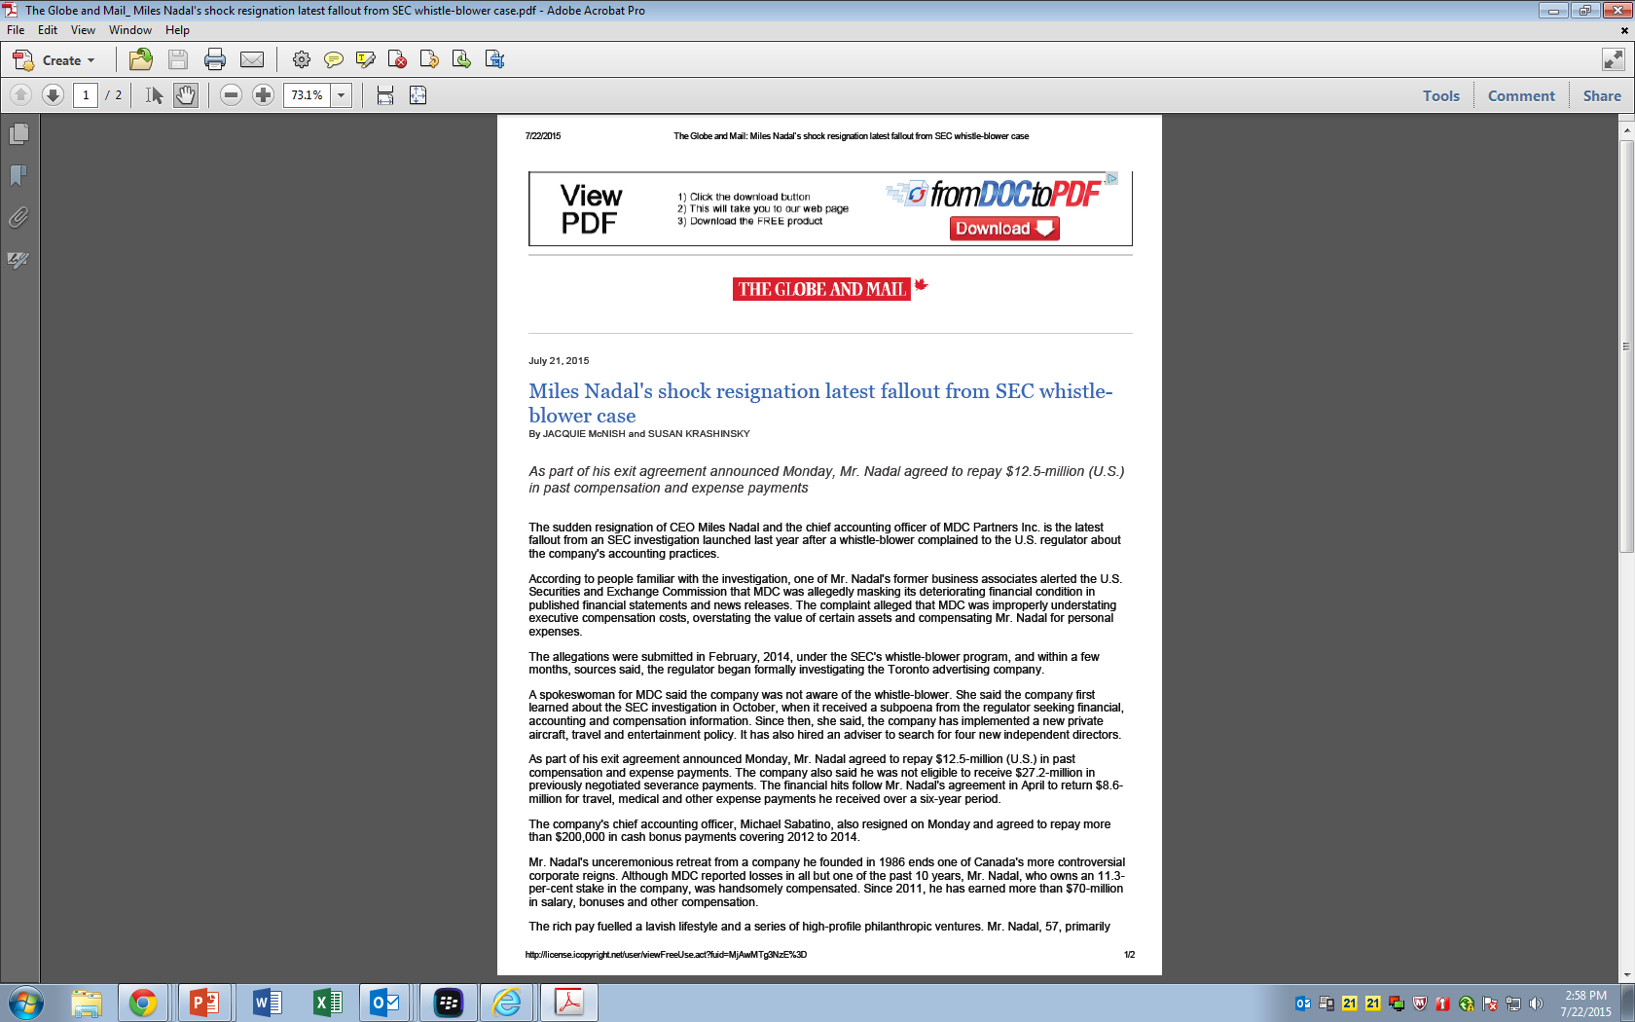
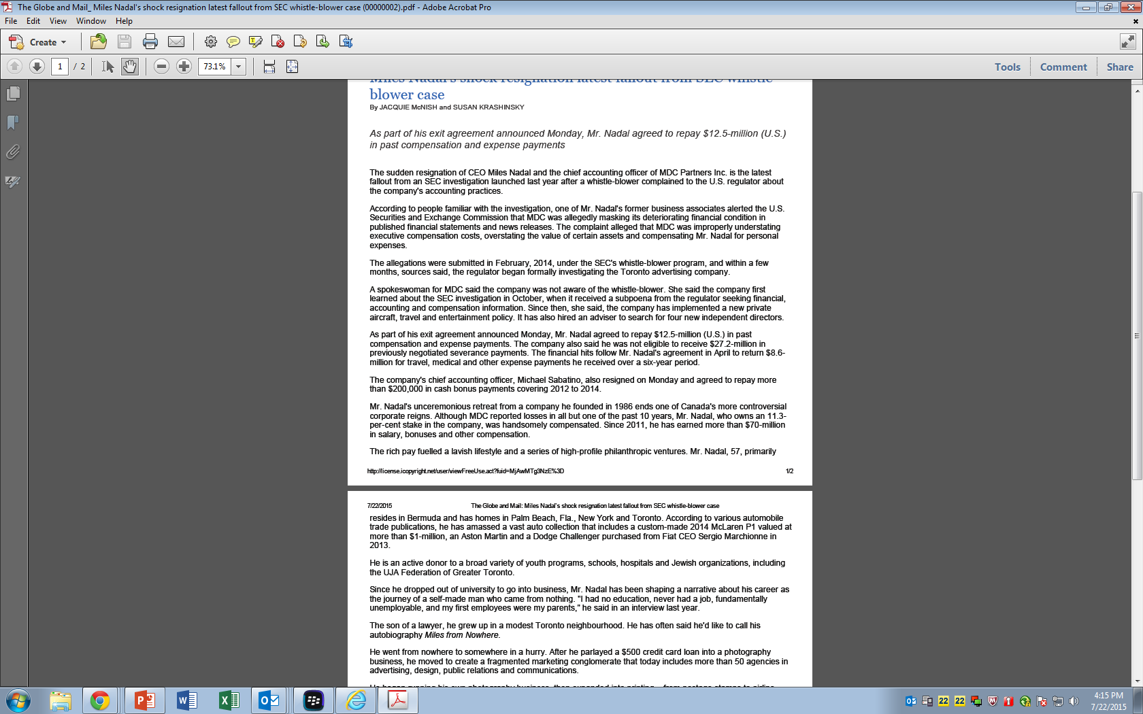
IN THE NEWS TODAY
Toshiba CEO Resigns After Accounting Scandal
Toshiba announces a sweeping reorganization of its leadership
Updated July 21, 2015 TOKYO—CEO responsible for an accounting scandal in which the Japanese industrial and electronics company overstated profit by more than $1.2 billion over seven years.

Slide 9
Acting Unethically has its Consequences
ENRON TIMELINE (1985-2002)
1985: Enron formed
Oct 2001: Enron reports $638m third quarter loss and $1.2bn fall in shareholder equity
Oct 2001: Securities and Exchange Commission begins inquiry into firm
Nov 2001: Enron shares sink to 10-year lows as buyout deal falls through and further losses are revealed at the firm
Dec 2001: Enron files for Chapter 11 bankruptcy
2002: Criminal investigation launched

Slide 10
Enron
Jeff Skilling (CEO) and Ken Lay (Chair) accused of:
improperly moving poorly performing assets off-balance sheet;
concealing Enron’s poor operating performance;
manufacturing earnings through sham transactions; and
improperly inflating the value of Enron’s investment portfolio by backdating documents

Slide 11
ENRON
Acting Unethically has its Consequences
ENRON TIMELINE (2004-2006)
2004: Jeff Skilling and Ken Lay charged over Enron collapse. Former finance chief Andrew Fastow pleads guilty to criminal charges and agrees a 10-year jail term
Jan 2006: Enron trial begins
May 2006: Enron trial ends with guilty verdicts for Skilling and Lay on 25 out of 34 charges
July 2006: Ken Lay dies of a heart attack
http://www.reuters.com/article/2013/06/21/us-enron-skilling-idUSBRE95K12520130621

Slide 12
Lord Black, who was born in Montreal
He once controlled Hollinger International
In 1990, he was awarded the Order of Canada, which recognizes a lifetime of achievement.
Lord Black renounced his Canadian citizenship when becoming a British peer in 2001 and becomes a member of the UK House of Lords.
In 2007, he was found guilty in the US of conspiring with other executives to siphon off millions of dollars from the sale of newspapers as they unwound Hollinger which published the London Daily Telegraph and the Chicago Sun-Times. http://www.telegraph.co.uk/news/uknews/1552970/Court-sees-Black-take-boxes-on-CCTV.html
Some of those convictions were later overturned, and his sentence shortened to 42 months.
He moved back to Canada following his release from a Florida prison in May 2012
Canada stripped the former media baron of his Order of Canada
Lord Black was later removed from the Queen's Privy Council for Canada.
He now lives in Toronto.
Lord Conrad Black – Unethical Behavior

Slide 13
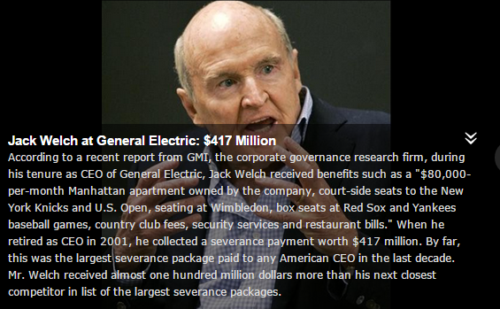
GE “failed” to disclose extent of CEO retirement package.
After this incident GE agreed to “cease and desist”
from violating future disclosure requirements

Slide 14
How Unethical is American Business Actions required to foster a culture of ethical behavior
You need top management’s commitment by:
  Promoting an ethical culture through the regular communication concerning ethics,
  Applying an appropriate reward system,
  Key executives must behave ethically themselves

Slide 15
TAX RATES

Slide 16
History of US Tax Rates
In 1913, the top tax rate was 7% on incomes above $500,000 ($10 million 2007 dollars) and a total of $28.3 million was collected.^{[50]}
During World War I, the top rate rose to 77% and the income threshold to be in this top bracket increased to $1,000,000 ($16 million 2007 dollars).
Under Treasury Secretary Andrew Mellon, top tax rates were reduced in 1921, 1924, 1926, and 1928. Mellon argued that lower rates would spur economic growth.^{[51]} By 1928, the top rate was scaled down to 24% and the income threshold for paying this rate fell to $100,000 ($1 million 2007 dollars).
During the Great Depression and World War II, the top income tax rate rose from pre-war levels. In 1939, the top rate was 75% applied to incomes above $5,000,000 ($75 million 2007 dollars). During 1944 and 1945, the top rate was its all-time high at 94% applied to income above $200,000.
The highest marginal tax rate for individuals for U.S. federal income tax purposes for tax years 1952 and 1953 was 92%.^{[52]}
Since 1964, the threshold for paying top income tax rate has generally been between $200,000 and $400,000. From 1981 until 1986 the top marginal rate was lowered to 50%. From 1988–1990, the threshold for paying the top rate was even lower, with incomes above $29,750 to $32,450 ($51,000 in 2007 dollars) paying the top rate of 28% in those years.^{[53]}
Top tax rates were increased in 1992 and 1994, culminating in a 39.6% top individual rate applicable to all classes of income.
Top individual tax rates were lowered in 2004 to 35% and tax rates on dividends and capital gains lowered to 15%, with the Bush administration claiming lower rates would spur economic growth.
Based on the summary of federal tax income data in 2009, with a tax rate of 35%, the top 1% covered 36.7% of the nation’s income taxes.^{[54]}
In 2012, President Obama has announced that he plans to raise the two top tax rates from 33% to 36% and from 35% to 39.6%.[

Slide 17
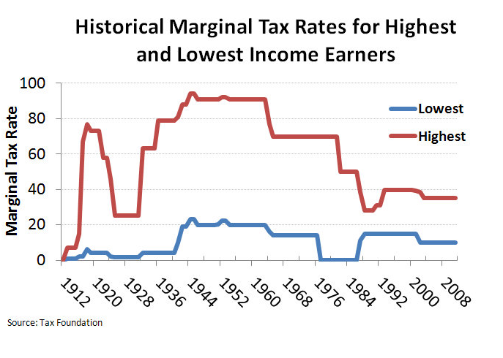
Why are Taxes trending lower for the Highest Income Earners

Slide 18
Henry Graves Industries:
Paul Lohnes Marine Hardware
The Story is?

Slide 19
Henry Graves Industries:
Paul Lohnes Marine Hardware
Creative Accounting

Slide 20
Henry Graves Industries: Paul Lohnes Marine Hardware
Actions | Acceptable | Unethical | Fraudulent
Maintaining large cash reserves
Division president instructs his employees to control sales and profits
Shipping moratorium
Ship now, bill later
Buildup of reserves
Prepaying next years marketing expense
Early order program

Slide 21
Actions | Acceptable | Unethical | Fraudulent
Maintaining large cash reserves | X | ? What is the Purpose
The Division president instructs his employees to control sales and profits |  | X
Shipping moratorium | X | ? But what about customers?
Ship now, bill later |  |  | X Manipulation
Buildup of reserves | X if justified by business reasons
Prepaying next years marketing expense (billed as services for the current year) |  |  | X
Early order program | X

Slide 22
Graves Industries: Lohnes Marine Hardware
How should a “President” define to middle management “what is the appropriate manner to conduct oneself when managing the profit and sales figures of the company”?
Pick one of the following and support your choice:
  Don’t compromise the long-term interests of the company?
  Don’t hurt customers?

Slide 23
Graves Industries: Lohnes Marine Hardware
Is a “Code of Ethics” required? If so,
  What do you feel the “Code of Ethics” document should cover? and
  How would you recommend enforcing it?

Slide 24
Graves Industries: Lohnes Marine Hardware
How do managers convince themselves their manipulative actions are acceptable?
  They don’t even think about it.
  They think about self-preservation.
  They feel they are doing what is best for the corporation (e.g., the chairman needs to keep the stock price up)
  They use the materiality argument: a little is OK, particularly where grey judgment areas are involved.

Slide 25
Remember
Being
ETHICAL
pays off
in the long run

