Slide 1
MBA 691
Business Ethics
BOD, Management & HR
http://www.ted.com/talks/lang/en/sheryl_sandberg_why_we_have_too_few_women_leaders.html

Slide 2
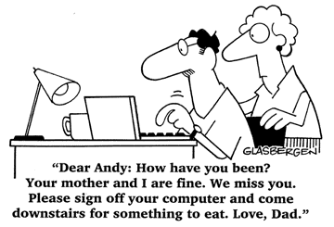
We Googled You!!!!!!!

Slide 3
We Googled You!!!!!
The Candidate (Mimi at 29, Ivey League MBA, Spoke Mandarin and a local Dialect, 4 years U.S. retail experience)
Bullish on a China Shop (Fred Westen betting on China’s luxury goods market, 70%g/yr.,)
The First Impression (Mimi “A store is more than just a look and feel of a brand” &“It’s a woman’s fashion fantasy”)
Page Nine News (Google pg.9 Mimi participated in mobilized campaigns against WTO. A Mimi photo protesting China’s treatment of a dissident journalist outside the Chinese consulate in S.F.)
Ex Post Facebook (“Google anyone and you’ll get some dirt”, 8 years ago, “Let’s get Mimi in here to hear her side”, Virginia Flanders VP HR– may want feedback from company lawyers, “Bit risky letting her know we’re considering not hiring her because we Googled her”)
The Decision Point (“Internet postings are like tattoos – they never go away and if wrong people get hold of this information, your China plans will be derailed”)

Slide 4
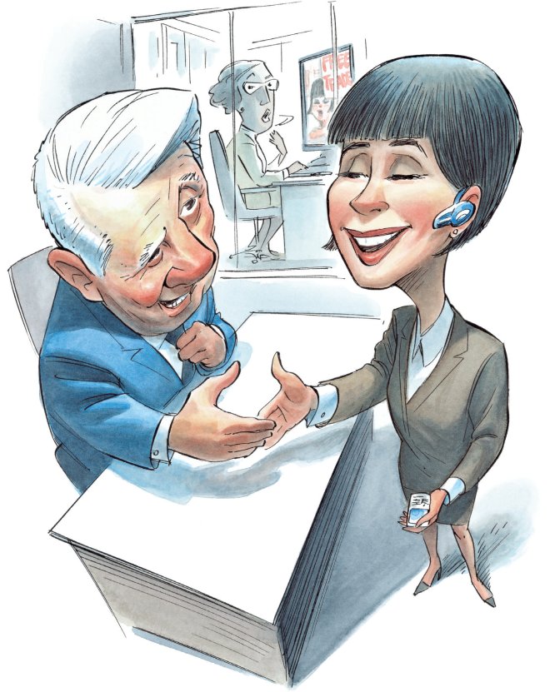
We Googled You!!!!!
Should Fred hire Mimi despite her
“online history”? Yes/No! Why?

Slide 5
Some Commonly Accepted Practices “Prior” to the Civil Rights Act
Stating desired gender of applicants in job ads
Creating a lower pay scale for women
Promoting only men on internal job ladders
Firing women when they became pregnant

Slide 6
U.S. Women in Business

Slide 7
U.S. Full-time Working Women earnings relative to Male Counterparts 1978-98
In 1978, full-time working women aged “25-34” earned 70 cents for every dollar earned by a full-time working man in that age group. This figure rose to 85 cents by 1998.
In 1978, full-time working women aged “45-54” earned 58 cents for every dollar earned by a full-time working man in that age group. This figure rose to 72 cents by 1998.

Slide 8
U.S. Full-time Working Women earnings relative to Male Counterparts 1960-2013

Slide 9
U.S. Full-time Worker earnings relative to White non-Hispanic Men 2013

Slide 10
U.S. Women in Business 2010 The Catalyst Pyramid: Women in Business Catalyst, Inc. was founded in 1962 and is the leading nonprofit organization expanding opportunities for women and business. Their focus has been on research. This research has shown there is a lot more parity between women and men at the beginning of their careers “but” at a certain point on the leadership level, things begin to change and the data supports it. The Catalyst Pyramid below shows the status of women in business in Fortune 500 companies as of 2010. It points out the decreasing presence of women as they move up the ladder. Women represent 46.7% of the US Labor Force but only 13.5% of the executive officers of Fortune 500 companies and only 2.8% are CEO’s.

Slide 11
US Women in Business 2010
Fortune 500 (only 14 CEOs)
Patricia A. Woertz, Archer Daniels Midland Company (ADM) (#27)
Angela F. Braly, WellPoint, Inc. (#31)
Indra K. Nooyi, PepsiCo, Inc. (#50)
Irene B. Rosenfeld, Kraft Foods Inc. (#53)
Lynn Laverty Elsenhans, Sunoco (#78)
Ellen J. Kullman, DuPont (#86)
Carol M. Meyrowitz, The TJX Companies, Inc. (#119)
Ursula M. Burns, Xerox Corporation (#152)
Brenda C. Barnes, Sara Lee Corporation (#180)
Andrea Jung, Avon Products, Inc. (#228)
Laura Sen, BJ's Wholesale Club (#232)
Susan M. Ivey, Reynolds American, Inc. (#272)
Carol Bartz, Yahoo! Inc. (#343)
Christina A. Gold, Western Union Holdings, Inc. (#413)
Fortune 501-1000 (only 14 CEOs)
Ilene Gordon, Corn Products International (#546)
Amy Miles, Regal Entertainment (#660)
Mindy F. Grossman, HSN (#685)
Linda A. Lang, Jack in the Box Inc. (#687)
Janet L. Robinson, The New York Times Company (#733)
Mary Berner, Reader's Digest Association (#738)
Constance H. Lau, Hawaiian Electric Industries, Inc. (#759)
Mary Agnes (Maggie) Wilderotter, Frontier Communications (#794)
Cindy B. Taylor, Oil States International, Inc. (#796)
Catherine Burzik, Kinetic Concepts (#833)
Tamara L. Lundgren, Schnitzer Steel Industries (#863)
Katherine (Kay) L. Krill, AnnTaylor Stores Corporation (#888)
Sara Mathew, Dun & Bradstreet, Inc. (#940)
Patricia Gallup, PC Connection, Inc. (#990)
Published: June 2010

Slide 12
U.S. Women in Business 2011

Slide 13
U.S. Women in Business 2015

Slide 14
Canadian Women in Business

Slide 15
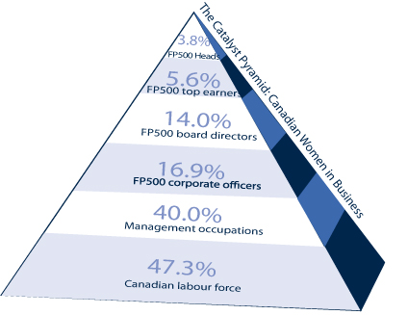
Canadian Women in Business 2010

Slide 16
Canadian Women in Business 2010
Financial Post 500 (only 19 Companies With Women Heads)
Karen Kinsley, Canada Mortgage and Housing Corporation (#40)
Monique F. Leroux, Mouvement des caisses Desjardins (#50) 1
Annette Verschuren, The Home Depot Canada (#64)
Laura Formusa, Hydro One Inc. (#87)
Nancy C. Southern, ATCO Ltd. (#113)
Linda Hasenfratz, Linamar Corporation (#147)
Kathy Bardswick, Co-operators General Insurance Company (#156) 2
Sophie Brochu, Gaz Métro, Inc. (#157)
Julie A. Dill, Union Gas Limited (#161)
Monique F. Leroux, Desjardins General Insurance Group (#215) 1
Linda Kuga Pikulin, The Pepsi Bottling Group (Canada), Co. (#237)
Michelle Carinci, Atlantic Lottery Corporation (#283)
Heather M. Reisman, Indigo Books & Music Inc. (#302)
Tamara Vrooman, Vancouver City Savings Credit Union (#307)
Marilyn McLaren, The Manitoba Public Insurance Corporation (#316)
Kathy Bardswick, Co-operators Life Insurance Company (#351) 2
Monique F. Leroux, Caisse centrale Desjardins (#362) 1
Rosemarie Leclair, Hydro Ottawa Holding Inc. (#375)
Ellen J. Moore, Chubb Insurance Company of Canada (#379)
This Catalyst publication includes women heads of organizations appearing on the most recent list of the largest Canadian corporations, published annually by the Financial Post. It was updated July 6, 2010.

Slide 17
Canadian Women in Business 2011

Slide 18
Canadian Women in Business 2011
Financial Post 500 (only 31 Companies With Women CEO/Heads)
Shelley Broader, Wal-Mart Canada Corp. (#11)
Louise Wendling, Costco Wholesale Canada Ltd. (SVP) (#28)
Monique F. Leroux, Mouvement des caisses Desjardins (Desjardins Group). (#29)
Jacynthe Côté, Rio Tinto Alcan Inc. (#32)
Karen Kinsley, Canada Mortgage and Housing Corporation (#34)
Dianne Craig, Ford Motor Co. of Canada (#45)
Laura Formusa, Hydro One Inc. (#77)
Marguerite J. Trussler, Alberta Gaming and Liquor Commission (#99)
Nancy C. Southern, ATCO Ltd. (#102)
Kathy Bardswick, Co-operators Financial Services Ltd. (#117)
Linda Hasanfratz, Linamar Corporation (#133)
Karen H. Sheriff, Bell Aliant Regional Communications Inc. (#138)
Dawn Farrell, TransAlta (#144)
Zoë A. Yujnovich, Iron Ore Co. of Canada (#154)
Sophie Brochu, Gaz Métro, Inc. (#182)
Karen Gavan, The Economical Insurance Group (#185)
Sylvie Paquette, Desjardins General Insurance Group (#189)
Elaine Campbell, AstraZeneca Canada Inc. (#218)
Debra Armstrong, BofA Canada Bank (President) (#227)
Violet A. M. Konkle, The Brick Ltd. (#236)
Mandy Shapansky, Xerox Canada, Inc. (#252)
Heather M. Reisman, Indigo Books & Music Inc. (#294)
Christine M. Day, Lululemon Athletica, Inc. (#303)
Marilyn McLaren, The Manitoba Public Insurance Corporation (#310)
Maria Codipietro, SAP Canada Inc. (#318)
Tamara Vrooman, Vancouver City Savings Credit Union (#371)
Ellen J. Moore, Chubb Insurance Company of Canada (#384)
Marie-Claude Houle, EBC Inc. (#392)
Monique F. Leroux, Caisse centrale Desjardins (#407)
Sue Stevenson, Electrolux Canada Corp. (#410)
Tracy Redies, Coast Capital Savings Credit Union (#455)
Note: Although there are 31 companies with women CEO/heads, there are only 30 women who head those companies. Monique F. Leroux heads two companies.
This list is based on the Financial Post 500 list of companies published by the Financial Post in June of each year. The number and rank of companies remains unchanged throughout the year until a new list is published. We update our list throughout the year whenever a woman becomes CEO/head or departs a CEO/head position at any of the listed companies. Women are counted in our list starting on the date they officially take over their positions. We strive to keep this list accurate and timely; if you have found that we have missed someone, or have any questions, please email us at icinfo@catalyst.org.
Current calculations for this women CEO/Heads list are based on the 492 companies which have CEO/Heads or for which the CEO or head could be determined by our Information Center.
This list was last updated June 29, 2012.

Slide 19
European Countries
Population
• Total population of the European Union in January 2010 was 501,259,840
• There were 105 women for every 100 men, equating to 51.0% women compared with 49.0% men
Education
• In 2008, 81% of females aged 20 to 24 completed at least upper secondary education compared with 76% of males
Government
• Of the 27 cabinet members that make up the current European Commission, 9 are women, or 33.3%
• At present, of the 736 Parliament seats, 258 are women, or 35%
• In 2010:
o 7 of the 36 members that make up the Court of Justice of the European Communities are women, or 19%
o 6 of the 28 members of the General Court are women, or 21%
o 3 of the 8 members of the Civil Service Tribunal are women, or 38%
• There are currently 7 major political parties within the EU Parliament with 9 leaders; 1 is a women,
or 11%.
Labour Force
• In 2008, the total labour force participation rate for persons aged 15 to 64 was 66%; 59% of females were employed compared with 73% of males.
• In 2005, the total gross annual earnings per capita was €29,114. Women earned €26,678, and men earned €34,536.
• Women earned 18.0% less than what men earned in 2009

Slide 20
Lesbian, Gay, Bi-Sexual, Transgender (LGBT) Workplace
The lesbian, gay, bisexual and transgender population in the United States is estimated at over 9 million
Workplace
There are 11 openly gay “presidents of colleges” in the U.S.
Benefits in the Workplace
57% of Fortune 500 companies offer domestic partner benefits.
At least 52 major employers reported to the HRC (Human Rights Campaign) that they offer transgender inclusive health benefits.
35% of Fortune 500 companies have protection policies based on gender identity; 61% of the Fortune 100 have protection policies based on gender identity.
85% of Fortune 500 companies have non-discrimination policies based on sexual orientation; 94% of the Fortune 100 have non-discrimination sexual orientation policies.
Discrimination
Almost two-fifths (39%) lesbian and gay adults in America's workplaces report facing some form of hostility or harassment on the job. 11% experience very frequent or frequent harassment or discrimination.
19% LGBT employees reported barriers in promotion due to their sexual orientation/gender identity.
Almost one in ten lesbian and gay adults state they were fired or dismissed unfairly from a previous job or pressured to quit a job because of their sexual orientation.
A small study of 155 transgender participants by the National Center for Lesbian Rights and the Transgender Law Center found that nearly 1 in 2 transgender people has experienced employment discrimination.
In the United States, twenty states and the District of Columbia prohibit discrimination based on one's sexual orientation. Of those states, thirteen have laws and the District of Columbia prohibiting discrimination based on gender identity/expression.
Buying Power
The buying power of the LGBT community in the U.S. in 2013 is estimated to be $830 billion.
58% of LGBT people would switch brands to companies that market directly to LGBT individuals.
25% of LGBT adults have changed brands to a competing company that is LGBT-friendly.

Slide 21
Questions re: State of Gender Equality
Is it even an issue?
What do you expect to face when you graduate?
Are companies becoming more aware of gender equality?

Slide 22
Break Out
Groups of 4
(2 Ladies and 2 Gentlemen)

Slide 23
MTN Cameroon
Land Area 475,000 sq. km (Canada 10 mln sq. km)
20 million people (50/50 urban/rural)
Life expectancy <54 (among the lowest in the world)
Literacy rate 70%
50% of children aged 5-14 are working children

Slide 24
MTN Cameroon “External Analysis”
Identify the “Mobile Telephone Industry’s” ‘Structure and Trends’ in Cameroon:
Highly regulated industry – with the extra challenge of political risk, high taxation, corruption and poor infrastructure
Cameroon is a diverse nation – with 10 provinces and a population that is spread out
Poverty a major issue in Cameroon (great divergence between rich and poor), 40% of population live on an avg. of 75₵/adult/day - also, ‘urban areas’ have high level of extreme poor (easiest to target but least able to afford cell phones)
Cameroon land lines are only really set up for business/government
Expansion really about targeting the large low income segment
Explosive growth in Africa – overall 100%/year – market size in 2005 has grown to approx. 2 million

Slide 25
MTN Cameroon “External Analysis” Re the previous slide: “In one sentence write down your synopsis of the mobile telephone industry in Cameroon”
Overall the mobile telephone business is an attractive market but highly regulated requiring a large investment and economies of scale coupled with the ability to offer payment schemes to the customer

Slide 26
MTN Cameroon From the: “External Analysis Point of View” In one sentence specify the main “Ethical Consideration” surrounding this case:
Although cell phones provide communication advantages, “pushing” the poor to consume is a key “Ethical Consideration” – and a key challenge given that the investment in Africa requires targeting this group.

Slide 27
MTN Cameroon From an “External Analysis” perspective Write down your answers concerning the following:
How do poor African people spend their income? What is their income level? Is there any discretionary income available to pay for cell phones?
Can cell phones provide opportunities to raise BOP income for those “in urban areas”? How? “in rural areas” How?
Can cell phones provide opportunities to encourage “Entrepreneurship”? How?
Can cell phones provide opportunities to help farmers in remote areas? How?
(commodity prices, weather conditions?)
Can cell phones help transfer money from relatives who live abroad to those living in remote African areas? How?
Gov’t responsibility is to its people but when corruption is running rampant is there anything one can do?
Is it possible for MNC to combine profits and social impact?

Slide 28
MTN Cameroon “Internal Analysis”
Identify the company’s financial ‘factors’:
Assets $6.2 billion, ROE 48.4%, Op profit 31.6%
54% market share and 1 mln active subscribers
Customer base up by 1118% in 4 years (WOW!), rev up 14%
Business model is based on usage fees (‘prepaid” model) that puts pressure on driving up volume and duration of calls – this creates the need to encourage usage.
From a Financial Perspective, identify the ethical issues :
The firm must balance the return to its shareholders while considering the responsibility to the African population as there are moral issues in targeting the lowest economic segment of this market.
Are the enticing marketing techniques “good business practice” and does it improve their standard of living “OR” is pushing this product detrimental to African society since they have limited financial resources

Slide 29
MTN Cameroon “Internal Analysis”
Identify MTN’s key marketing/competitive position strategy:
MTN is focused on selling airtime (not handsets) and has set up a volume based business. This matches the market’s KSFs and is the primary reason the firm has been successful (and in the number 1 position).
Overall, the payment schemes like the prepaid model are particularly ideal for the African market
Identify the “ethical issues” associated with this strategy:
MTN must balance the business need to grow airtime use and the affect on the customer – the firm must be aware of its obligation to the consumer >>> from the consumer perspective, one can argue that people will benefit from greater communication, however with such a low income level and the fact basic needs are often not met, does pushing this product make sense? Furthermore, marketing schemes designed to drive up usage also pose a problem from a moral perspective

Slide 30
MTN Cameroon
http://www.theguardian.com/technology/2011/jul/24/mobile-phones-africa-microfinance-farming

