Slide 1
MBA 691 Business Ethics
Ethics and Marketing
http://www.cbc.ca/news/canada/saskatoon/students-viral-video-challenges-depictions-of-women-in-ads-1.1381523

Slide 2
Doctor-Patient Drug Kick-backs
When a doctor recommends a certain heart medication or an antidepressant, chances are he has been paid a cash bonus and perks by the manufacturer, making it difficult to give objective advice. Some pharmaceutical firms have gone so far as to invent and promote a new syndrome in order to create a market for a new drug! Social Anxiety Disorder (the acronym SAD) was devised in 1998 and publicized by planting fifty press stories and quizzes such as: “Do you have social anxiety disorder?”. Soon after, Smithkline Beecham released Paxil - the 'cure' for SAD.

Slide 3
Is Marketing Fundamentally Deceptive
Why do Pharmaceutical companies advertise prescription drugs to the end consumer?
Is it not the responsibility of the Physician to determine the needs of the patient and prescribe the required mediation?
Is the marketing strategy of “brand development” the appropriate method for selling these types of drugs?
Do consumers possess sufficient information to make this decision?

Slide 4
SUBLIMINAL ADVERTISING Acceptable Business Practice or Not?

Slide 5
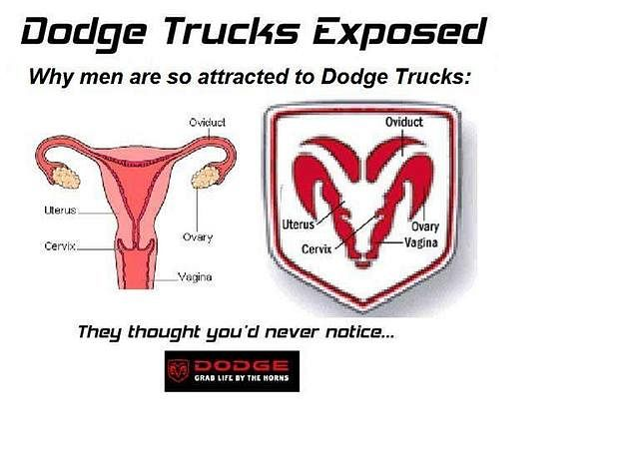
SUBLIMINAL ADVERTISING Acceptable Business Practice or Not?

Slide 6
SUBLIMINAL ADVERTISING Acceptable Business Practice or Not?

Slide 7
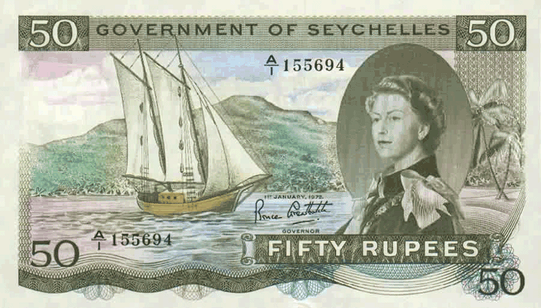
SUBLIMINAL ADVERTISING Acceptable Business Practice or Not?

Slide 8
SUBLIMINAL ADVERTISING Acceptable Business Practice or Not?

Slide 9
SUBLIMINAL ADVERTISING Acceptable Business Practice or Not?

Slide 10
SUBLIMINAL ADVERTISING Acceptable Business Practice or Not?

Slide 11
SUBLIMINAL ADVERTISING Acceptable Business Practice or Not?

Slide 12
SUBLIMINAL ADVERTISING Acceptable Business Practice or Not?

Slide 13
SUBLIMINAL ADVERTISING Acceptable Business Practice or Not?

Slide 14
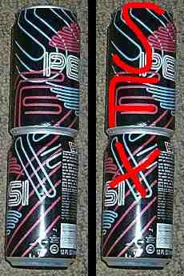
SUBLIMINAL ADVERTISING Acceptable Business Practice or Not?

Slide 15
SUBLIMINAL ADVERTISING Acceptable Business Practice or Not?

Slide 16
SUBLIMINAL ADVERTISING Acceptable Business Practice or Not?
Court Precedents
In 1990, Nevada Court Justice Jerry C. Whitehead ruled in "Vance vs. Judas Priest" that the First Amendment protections of freedom of speech don’t extend as far as subliminal messages. Upheld by later courts and the U.S. Supreme Court, this legal precedent established that “subliminal messages are aimed not at the person’s “conscious mind” but rather, seek to coerce individuals by speaking to the “subconscious brain” without the permission of the person subjected to the subliminal messages. Subliminal communication is therefore “not protected” and “may be prohibited or restricted”. Because the subconscious mind is the target, the precedent declares that neither the First Amendment’s protection of speech or the press applies.”
Read more: Laws Governing Subliminal Messages in Advertisements | eHow.com http://www.ehow.com/list_6730170_laws-governing-subliminal-messages-advertisements.html#ixzz1RRZjZnHS

Slide 17
And Now, a Word from Our Sponsor
Should Bryant Pharma approve VP of Marketing Laura’s idea (of having Jeanne Alyson TV’s testimonial) for “Product Placement re Seflex”? Are the boundaries of Business Ethics being exploited?
$1 million, Jeanne’s Age, Public Deception
What’s the difference re: “American Idol & Coca-Cola; Reese’s Pieces & E.T.; Austin Mini in the Italian Job; other infomercials with celebrities as spokespersons”?
http://www.bloomberg.com/news/articles/2015-01-28/super-bowl-advertisers-go-long
http://popwatch.ew.com/2015/01/28/adorable-puppy-horses-return-in-this-years-budweiser-super-bowl-ad/

Slide 18
Obesity in Children
Dr Tim Lobstein, of the International Obesity Task Force, who analyzed the worldwide trends in childhood obesity stated, "When we looked at the overweight situation it was astonishing to see that nearly “half” of children in both North and South America could be overweight in four years time."
Currently North America, Europe and part of the Western Pacific have the highest prevalence of overweight children at about 20-30%. This means that the number of obese children will nearly double in the next four years.
Children and Type 2 Diabetes
"One in three American Children born in the year 2000 will go on to develop Diabetes

Slide 19
Obesity in Children
Over a ten year period the proportion of people with diabetes has gone up almost 40% between 1990 and 1999," said Dr. Narayan chief of the Centre for Disease Control and Prevention’s diabetes epidemiology section, who spoke at the American Diabetes Association's annual meeting.
"And if trends continue, a girl born in 2000 has a 39% chance of developing diabetes in her lifetime and a boy born the same year has a 33% chance of developing the disease in his lifetime", according to Narayan.
"Diabetes is a very serious disease and our estimates also suggest that there is “a lot of life years lost” because of diabetes," added Narayan. A man diagnosed with diabetes at age 40 will lose approximately 12 years of life and a female about 15 years of life, he explained.

Slide 20
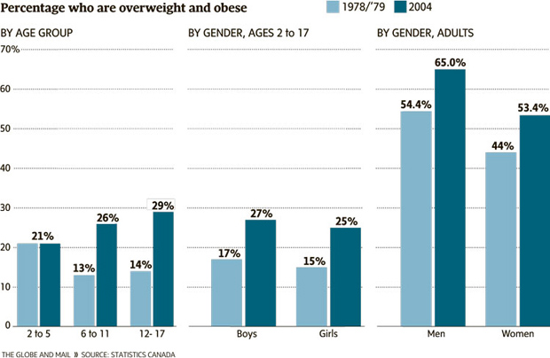
Obesity in Children & Adults

Slide 21
Kraft Foods Fight Against Obesity
What is Overweight? Body mass index, or BMI, is a measurement that “calculates weight in relationship to height “and is considered an indicator of body fat. For adults, BMI breakdowns are as follows:
Normal – 24.9 or less
Overweight – 25 to 29.9
Obese – 30 to 39.9
Extreme (or morbid) obesity – 40 or higher

Slide 22
Kraft Foods Fight Against Obesity
America is the fattest country on the planet with more than one third of the people being overweight. Because of this, it also has one of the highest heart disease rates in the world. Even though one in four women are on a diet, and one in five men, America keeps getting fatter.
There were more obese people in 2004, then in 2003. In the 1990’s every state saw a big jump in obesity, and then by 2000, twenty-two (22) of the fifty (50) states had a obesity rate of over 20%. Obesity is affecting everyone: women, men and children of all ages. Men are more likely to be overweight then women, but women are more likely to be obese.

Slide 23
Kraft Foods Fight Against Obesity
Obesity in Canada is almost as big as a problem as it is in the United States. More than half of Canadians are overweight or obese. This statistic is a little better than the 60% of Americans who are either overweight or obese.
The cause of obesity in Canada and the United States is very similar. People live a very fast-paced lifestyle. They would rather drive their cars to work or eat fast food because “there is no time to prepare food at home”. In Canada, the number of obese people has been growing. In 1985, less than 15% of the country was overweight or obese. Now, more than half of Canadians are overweight or obese. Even though Canada keeps getting fatter, they are actually doing things about it. Last year they spent over $1.8 billion on medical cost such as different diets and liposuction.

Slide 24
Kraft Foods Fight Against Obesity “Consumers versus Business”
“Consumer Advocacy Group” Viewpoint: “It is” the responsibility of “your food company” to promote healthy eating habits.
“Kraft’s Advocacy Group” Viewpoint: “It is not” the responsibility of “our food company” to promote healthy eating habits since it is up to you the consumer to choose what you consume.

Slide 25
Kraft Foods Fight Against Obesity
How should Kraft grow its business in light of growing health issues?
What is the long-term impact to the economy of “growing health concerns” given the high fat and caloric content of a majority of Kraft products?
What is the responsibility of Kraft to safeguard the health of their consumers and encourage health eating habits?
Whom do you blame for the growing obesity levels in people: food companies, the government, or the consumers themselves? Why?
Do you agree that junk food companies encourage unhealthy eating habits that could cause obesity and other health problems? Why?
To what extent do you think food companies are justified in targeting children through their advertisements? Why?
Do you think the practice of junk food companies setting up vending machines carrying junk food in schools is good for children? Why?
Do you think a special tax (like tax on tobacco companies) should be levied on companies offering junk food? Why?

Slide 26
Kraft Food Inc.
Building Strategic Alliances
Kraft Foods is a founding member of the Healthy Weight Commitment Foundation, a coalition of 160 retailers, food and beverage manufacturers, restaurants, sporting goods and insurance companies, professional sports organizations, non-governmental organizations, trade associations and the U.S. Army, committed to reducing obesity in the U.S.
Launched in 2009, the foundation began a multi-year effort to encourage behavioral change and provide tools to help consumers achieve energy balance in three critical areas: marketplace, workplace and schools.
In 2010, member food and beverage companies, including Kraft Foods, pledged to collectively reduce 1.5 trillion calories from their products by 2015.
More recently, the Foundation launched Together Counts™, a nationwide campaign and social media movement to inspire families to engage in healthy activities together with the goal of balancing calories consumed with calories expended. The campaign includes both online and smart phone tools for families to join the movement and track progress compared with results in their own communities and across the U.S.

Slide 27
Taking the Cake
Remember Southland is the third largest independent cookie company in the United States (mellobar, chizzlewits etc….)
Should Peter tell CEO Ed Malanga that Southland needs to recast its product lines? Yes group! No group! Why???
Trans fats issue and obesity!!!!
FYI other real issues: sodium as well as fructose???

