Slide 1
Organization Design and Structure
Northlands Ledger

Slide 2
Today’s class
Info about next class
Case analysis
BREAK
Reading about organizational structure
If we have time – video about radical changes to industry?

Slide 3
Next week’s class
For the Trans world Auto case
  Focus on the questions provided in the outline
For the Levendry café case
  Don’t get overwhelmed by the reading
  Don’t worry about the methods section.
  Look at the table
  Try to get at the big idea of MNC-subsidiary relationships

Slide 4
Case Analysis
Central problem?
What are the core issues for analysis
Central recommendation?
Implementation plan?

Slide 5
Is the print dead or not?
https://www.youtube.com/watch?v=J1teOodfZrM&list=PLS8YLn_6PU1koamawHw_ynTLD109dpdZ7&index=17
(up to 15 minutes)

Slide 6
Break!

Slide 7
Organizational Structure
Pattern of organizational roles, relationships and procedures
Enables organizations to undertake activities according to specialization, standardization and departmentalization
Has integrating mechanisms such as hierarchical supervision, formal rules and procedures, training and socialization
Defines the boundaries of the organization and its interfaces with the environment or other organizations and institutions

Slide 8
Central concepts in O.S.
Division of labour:
  Defining the range of activities
  Depth of activities
  Grouping of activities (based on products/services/markets)
Coordination mechanisms: bring together the activities of the members of a firm.
  Depends on the extent of integration required; routine vs. exceptional
  Effective integration is as important as careful differentiation

Slide 9
Central concepts in O.S.
Distribution of decision rights: who should make what decision
  Organizing information flows
    Take care of initiation, approval, implementation and control of products, services and resources.
Organizational boundaries: what to do inside and what outside the firm’s boundaries
  Where are the client interfaces
  Make vs buy decisions

Slide 10
Central concepts of O.S.
Informal structure: the relationships beyond roles
  Contributes to the image and identity of the organization
  Socialization initiatives
Political structure: the competing agendas and maneuvering because of different coalitions
Legitimate basis of authority: formal position, rank and title indicate who has authority in the organization.

Slide 11
Strengths and weakness of structures
Resource efficiency: ability to perform its task with quality, reliable and with economy of effort and resources
Time efficiency: speed and timeliness with which the organization is able to execute its tasks
Responsiveness: satisfy the demands of the various domains of the environment
Adaptability: ability of the organization to innovate and change
Accountability: ability to hold individuals responsible for performance/result oriented metrics

Slide 12
Classic organization structures with known strengths and weaknesses
Functional structure
Product or divisional structure
Matrix organization
Hybrid structures

Slide 13
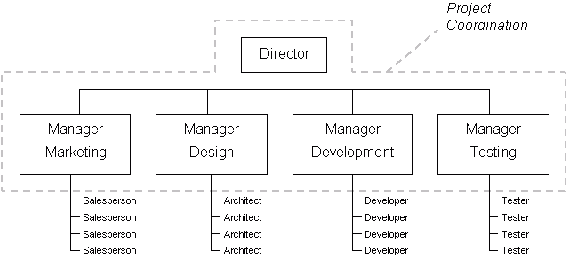
Example of functional structure

Slide 14
Key Characteristics
When an organization grows beyond a certain size, it organically differentiates according to functions.
  Activities are grouped together according to function
  Activities are coordinated vertically within the function by supervision, rules and plans
  Grouping of the ‘similars’- similar values, goals, orientation.
  Cross functional coordination done by the generalists

Slide 15
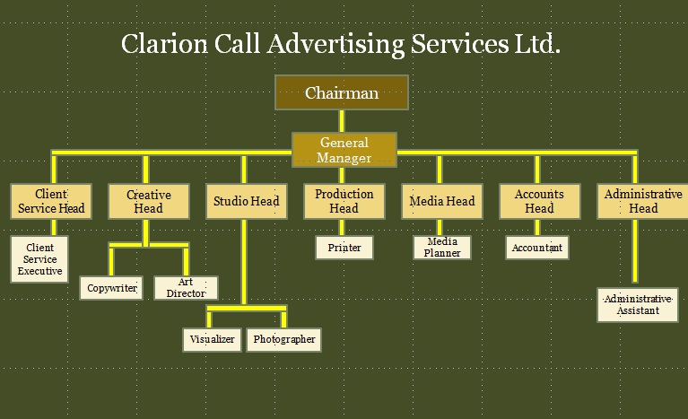
Functional structure

Slide 16
What are the advantages and disadvantages of a functional structure?

Slide 17
Pros and cons of functional structure
Economies of scale within functional units
Enables in-depth knowledge and skill development
Enables pursuit of functional goals
Works best with limited product range
Works best when the dominant goals stress expertise, efficiency and quality.
Slow response to environmental change
Potential for hierarchical overload
Poor horizontal coordination
Reduced innovation
Managers have restricted view of organizational purpose

Slide 18
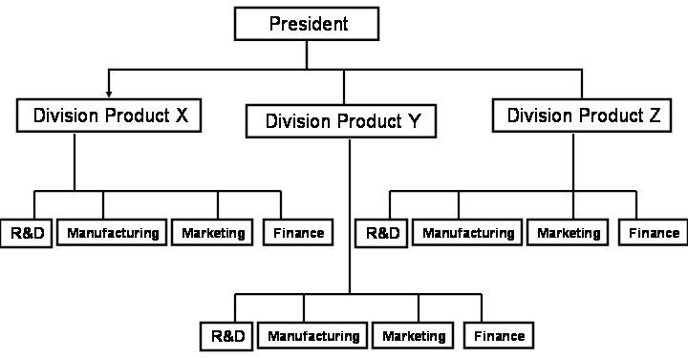
Divisional organizational structure

Slide 19
Divisional Form
Functions grouped into divisions
All the necessary functions are contained within each division
Divisional structure organized according to products/geographical markets/clients.
Cross functional coordination is optimised
Optimum when degree of uncertainty in the environment is moderate to high.
Works best in heterogeneous organization

Slide 20
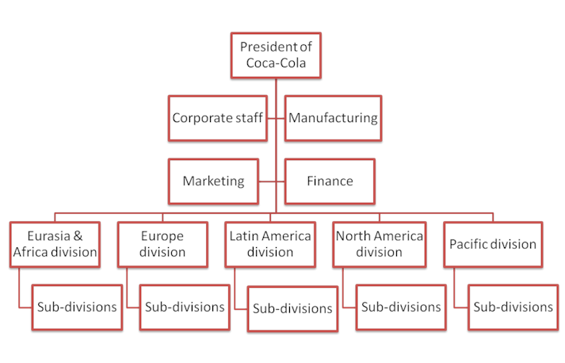
Org Structure of Coca- Cola

Slide 21
What are the advantages and disadvantages of a divisional form?

Slide 22
Pros and cons of divisional structure
Responsive to environmental change
Client satisfaction and product responsibility contact points are clear
Better coordination among functions
Decentralized decision-making profit and loss accountability
Best in organizations with multiple products
Loss of economies of scale
Loss of in-depth functional competence and technical specialization
Poor coordination across product lines, weak knowledge transfer
Competition for central resources, reduces cooperation
Integration and standardization across product lines difficult

Slide 23
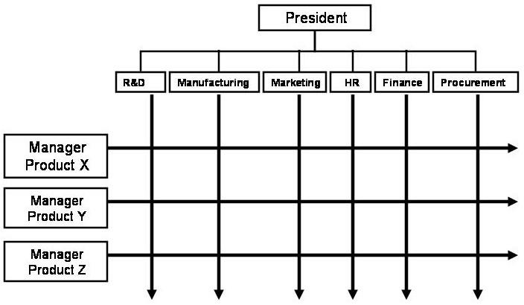
Example matrix organization

Slide 24
Matrix form
Organizations need both technological expertise within functions and horizontal coordination across functions.
Both divisional and functional structures are implemented simultaneously.
Most firm employees have dual assignments and have dual reporting responsibilities
Enables organizations to meet multiple demands from the environment

Slide 25
What are the advantages and disadvantages of a matrix form?

Slide 26
Pros and cons matrix organization
Enables coordination to meet dual customer demands
Flexible sharing of human resources across products
Enables both functional & product skilled development
Suited to complex decisions and frequent changes in the environment
Best in medium organization sized with multiple products, projects
Frustration of dual authority
Demands high interpersonal skills, extensive training
Time-consuming, frequent meetings, conflict resolutions
Participants must adopt collegial not vertical type relationships
Prone to tipping over, effort required to maintain balance of the matrix

Slide 27
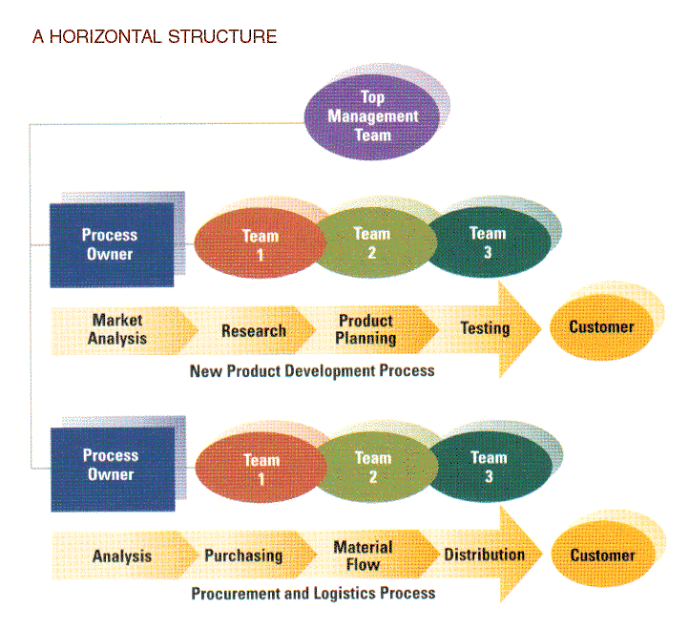

Slide 28
Horizontal organizations
Operate with few levels between managers and staff
Employees filter new information at the team level. possess a cross-functional understanding responsibilities.
The horizontal structure focuses on the external environment, the customers.
Employees combine skills to perform a task, customers drive horizontal cooperation, value assessed on customer centric measures

Slide 29
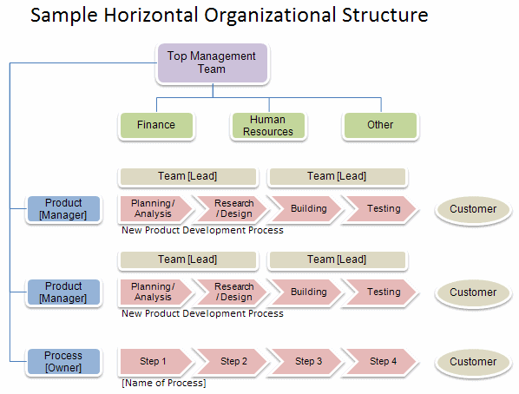

Slide 30
Pros and cons of horizontal structure
Enables flexibility and fast response and attention to consumer needs
Focuses attention towards production and valued customers
Employees have a broad view of organizational purpose
Focus on teamwork and collaboration
Empowerment and control offers better quality of work life
Determining core processes often difficult
Costly changes in culture, Job design, management philosophy, information, reward systems
Traditional hierarchical managers have difficulty
Costly employee training
Multi-skilling limits development of portable functional skills

Slide 31
Recent trends in org designs
Hollow organization
  Outsourcing supportive functions of the organization
  Critical factor: determining the non-core processes
    What is a core function
    When can organizations get it wrong?
  Focus: design and marketing
  Used when competition is based mostly on price and there is a market outside the firm to perform these processes
Notes:
Core functions: they are critical to business performance, they create current or potential business advantage and they are likely to drive future growth and rejuvenation

Slide 32
Hollow Organizations

Slide 33
Pros and cons of Hollow organizations
Cost savings
Tapping into wider sources of specialization and technology
Bringing competition and innovation to supply chain
Flexibility in balance of cost/quality
Loss of in-house skills
Loss of innovation capacity (why?)
Costs of monitoring increases
Reduced control over the supply chain
Competitive threat by suppliers.

Slide 34
Modular organizations
Collection of Lego bricks that can be snapped together or can be hived off as necessary.
  Assembling product chunks provided by internal and external subcontractors.
Outsourcing is for pieces of the product rather than processes
Design interfaces that allow different chunks to work together
Organization focuses on assembling and distributing chunks
Nature of the product is specific and amenable to chunking.

Slide 35
Modular organizations

Slide 36
Pros and cons of modular organizations
Products broken into manageable moulds
Outsourced parts more efficiently produced by others
Bringing competition to the value chain
Possibility of innovating through recombination of modules
Products may not be amenable to chunking
Interfaces not precise enough
Innovations have to percolate down the chain.

Slide 37
Virtual Organizations
Creating a company outside the organization to respond to an exceptional and likely temporary opportunity.
Organization created using external partners and uses technology to link, people assets and ideas.
Once the opportunity is over the virtual company is disbanded or absorbed into the larger organization.

Slide 38
Virtual organizations

Slide 39
Pros and cons of virtual organizations
Provides nimbleness to exploit a market opportunity
Allows for product extensions that leverage competencies of partnering firms
Can be disbanded /absorbed once the opportunity is over.
Incredible investment in communication and understanding to avoid duplication and redundancy
Lack of trust or misalignment of incentives
Organizational identification is weak/confused.

Slide 40
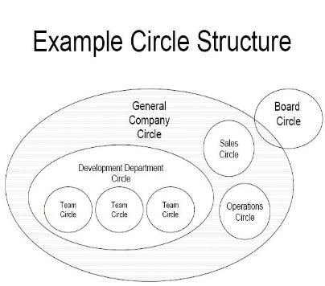
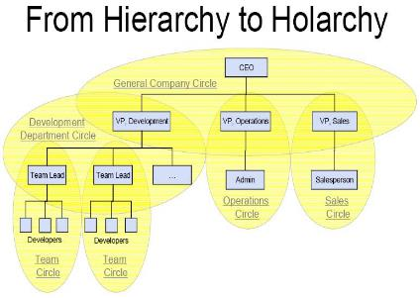
Holacracy

Slide 41
Holacracy
Management structure based on the tasks a company needs to accomplish, rather than a standard reporting structure
Essentials
  Energizing roles
  Circle structure
  Integrative decision making around governance issues
  Processes aligned around teams’ operational requirements.
  http://www.youtube.com/watch?v=RnQkP691a_s
  Risks?

Slide 42
Risks of holacracy
Designed for happy growing times, when empowerment makes sense
  What happens in the case of downturns, when layoffs and closures have to occur?
Supports a certain kind of organizational structure that may seem ‘cultish’ to many
Can holacracy scale?
What about MNCs operating in many different cultures?
What are the career paths in holacratic companies?

Slide 43
Final take home points
Structural choices are the building blocks of the firm’s strategic architecture
Structural design choices employ trade-offs between desirable strategic attributes
Excessive hybridization brings structural complexity ( bureaucracy), misalignment with strategy
Structure constrains strategy!

