Slide 1
Balanced Score Card and Transworld Auto Parts (A)
Balanced scorecard

Slide 2
Class Structure for today
Quick lecture
Break
Case questions
Transworld Auto Parts (B)

Slide 3
Balanced scorecard and strategy maps
Transworld Auto Parts Case analysis

Slide 4
The triumvirate of financial reporting
P&L Statements: reports over a specified timeframe how much money you have earned (revenue), how much you have spent (expenses) and the difference between the two (profit/loss)
Cash flow statements: whether the business has enough cash at a certain date to pay its current liabilities (the bills it needs to pay now or very shortly)
Balance sheet: overall status of your finances at a certain date; totals all your assets and subtracts your liabilities to compute your overall net worth.
Why isn’t this enough to guide organizations?

Slide 5
What is a Balanced Score Card
A set of measures that gives top managers a fast but comprehensive view of the business.
Includes financial measures that tell the results of actions already taken.
Complements the financial measures with operational measures on customer satisfaction, internal processes, and the organization’s innovation and improvement activities
It should be able to ‘tell the story’ of the business unit’s strategy.

Slide 6
Focus of the BSC
It provides answers to four basic interrelated questions:
  How do customers see us? (customer perspective)
  What must we excel at? (internal business perspective)
  Can we continue to improve and create value? (innovation and learning perspective)
  How do we look to shareholders? (financial perspective)

Slide 8
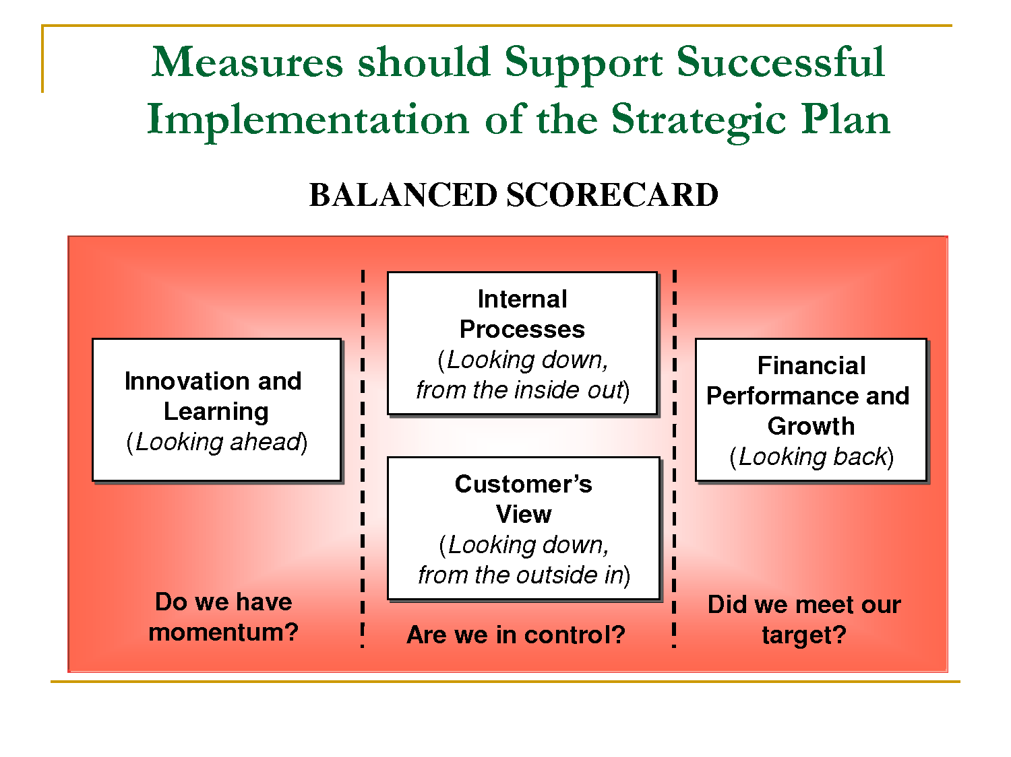
How should measures be developed?

Slide 9
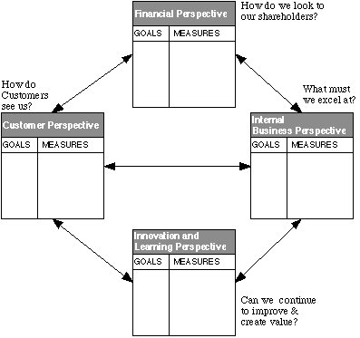
BSC links goals with performance measures

Slide 10
Advantages of the BSC
Forces managers to focus on the handful of measures that are most critical.
Forces senior managers to consider all the important operational measures together, to see whether improvement in one area may have been achieved at the expense of another.
Forces managers to translate general mission statements on customer service into specific measures that reflect time, quality, performance, service and cost.

Slide 11
Constraints of BSC
BSC has its greatest impact when used to drive a change process.
The relationship between process and output could become strained if one is emphasized
The BSC should be the core of the management system and not the management system

Slide 12
Strategy Map
The strategy map is a visual framework for integrating a firm’s objectives.
Provides the cause-and-effect relationship that link intangible capabilities with process, financial and customer outputs.
In some ways it is an answer for ‘where we want to go’; combined with the BSC which taps into ‘how we will get there’ – the combination provides organizations a tool for strategy execution.

Slide 13
Strategy Map
Mostly organized on the following four parameters:
  Learning growth and innovation
  Process improvement
  Customer satisfaction and loyalty
  Revenue growth and cost management

Slide 14
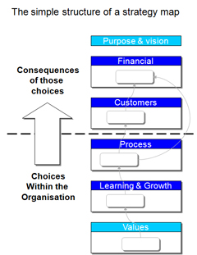
A simple template for a strategy map

Slide 15
Building the strategy map
Detailed enough yet clear
Strategy maps show cause-and-effect links between specific improvements and desired outcomes
Cascading goals and objectives.
Difficult part of process: state objective, measurement, target, specific action & initiative
http://www.thepalladiumgroup.com/KnowledgeObjectRepository/Sample%20Strategy%20Maps.pdf

Slide 16
How do BSC and strategy map relate?

Slide 17
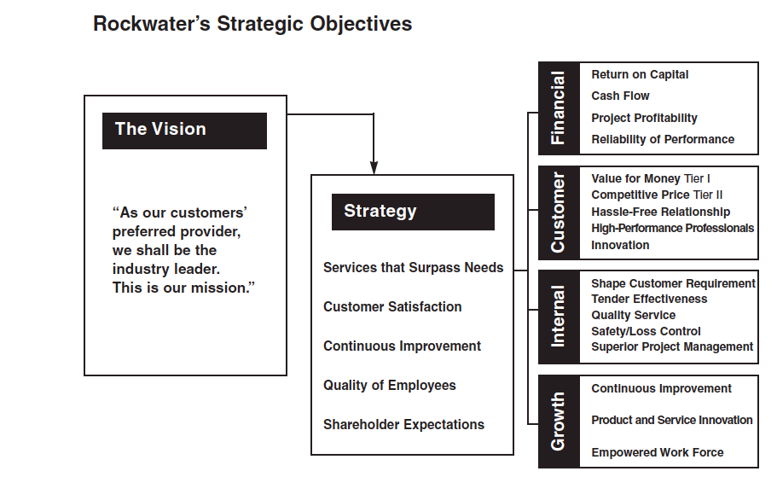

Slide 18
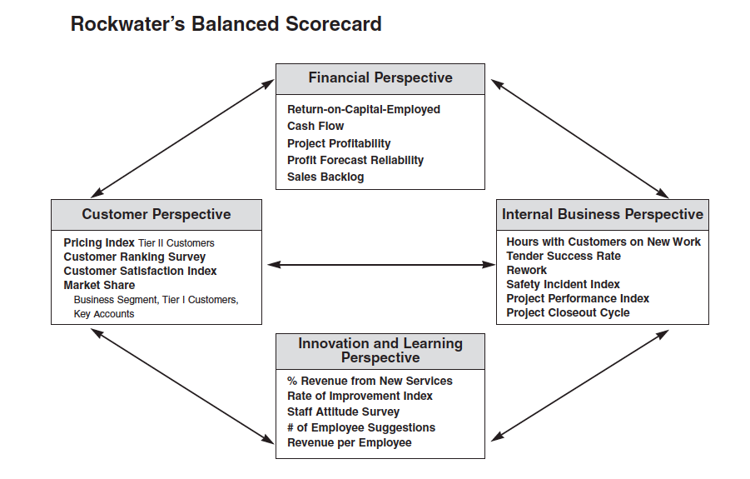

Slide 19
BSC , org. designs, org.types
Is the BSC suitable for the major types of organizational structures that we are familiar with?
Are there certain types of organizations that BSC would work better for?

Slide 20
Disadvantages/critique of the BSC

Slide 21
Critique of Balanced scorecard
Few empirical studies linking the use of Balanced Scorecards to better decision making or improved financial performance of companies
A common use of Balanced Scorecard is to link to individual incentives but not designed for this purpose nor is particularly suited to it!
The balanced scorecard is not a template that can be applied to businesses in general or even industrywide.

Slide 22
More Critiques of the BSC
It is most suitable for firms which have a long lead time between management action and financial benefit.
It will be less suitable for firms with a short-term focus.
Many companies use metrics that are not applicable to their own situation
The scorecard does not translate easily to the investment community. A scorecard makes sense primarily for business units and divisions with a well-defined strategy.

Slide 23
Other Metrics and Fit
KPI- Key Performance Indicators: these are quantifiable measurements, agreed to beforehand, that reflect the critical success factors of an organization. They will differ depending on the organization.
Benchmarking: it is the process of comparing one's business processes and performance metrics to industry bests or best practices from other industries.
Service-profit chain: establishes relationships between profitability, customer loyalty, and employee satisfaction, loyalty, and productivity.
  Profit and growth are stimulated primarily by customer loyalty.
  Loyalty is a direct result of customer satisfaction.
  Satisfaction is largely influenced by the value of services provided to customers.
  Value is created by satisfied, loyal, and productive employees.
  Employee satisfaction, in turn, results primarily from high-quality support services and policies that enable employees to deliver results to customers.

Slide 24
Central idea behind performance metrics
The importance of measuring the right stuff
  Understanding the core objectives of the organization/B.U.
  Understanding the strategic orientation and what needs to be done to get there.
  The right metrics would differ by organizational size, strategy, stage of development and industry.

Slide 25
Break!
Back in 15….

Slide 26
Transworld Autoparts
What are the respective business strategies of Transworld Auto Part’s economy and luxury divisions? What must each division do well to execute its strategy?
Which division performed better? Kwon(Economy) or Eckhardt (Luxury)?
Which division manager developed a better strategy map and balanced scorecard?
Transworld Auto Parts B
  Evaluate Eckhard’s performance using the strategy map and BSC in the B case (Class)

