Slide 1
MBA 625 Strategy in Action
Dr. Rajshree Prakash
Notes:
.

Slide 2
In today’s class
We talk about:
What this course is about
The key concepts of this course
The organization of the course
Course mechanics
Assessment criteria for assignments
Group presentations
Mid term and final exams
BREAK
The first reading

Slide 3
To start with…
What do you think this course is about?

Slide 4
Connecting Strat 1 with Strat 2
You’ve looked at the big picture within which an organization is situated
Done the PEST
Down to the Porter’s
And even a SWOT
Arrived at the immediate context of the firm
Figured out which strategy will work in terms of this firm in its immediate context
What next?

Slide 5
In Strat 2
We focus on how the organization achieves its strategic goals
How organization specific variables impact strategy and strategic implementation

Slide 6
What is Strat 2 about?
Focus on which key factors impact implementation
Systems
Processes
Structure
Culture
Implementation requires continuous attention
Is operations driven rather than market driven

Slide 7
What is Strat 2 about?
The biggest change from Strat 1 is :
Models used for analysis
The attention to implementation plans
(shift in mind set)

Slide 8
Differences in case analysis
Strat 1
Problem statement
External analysis
Internal analysis
Strategic alternatives
Central recommendation
Strat 2
Central Problem (bigger than the problem statement)
Analysis of issues (which firm specific factors are impeding goal achievement?)
Central recommendation and alternatives
Implementation plan

Slide 9
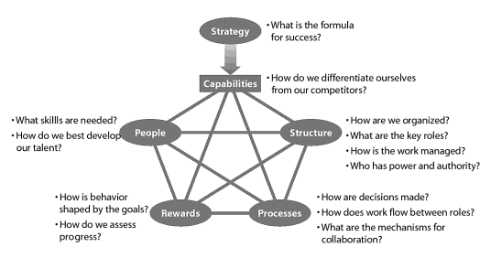
Models used for analysis in Strat 2- the star model

Slide 10
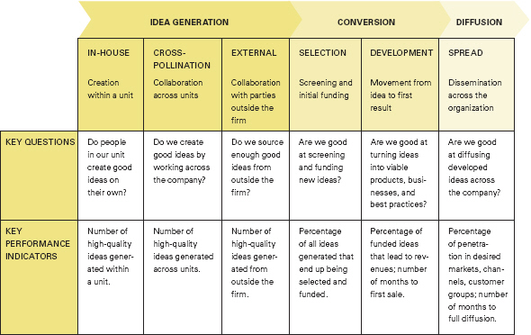
Models used for analysis in Strat 2- the ‘Innovation Value Chain’ model

Slide 11
Thinking about change and implementation
Use two different kind of change models
Lewin’s change model
Kotter’s 8 step change model

Slide 12
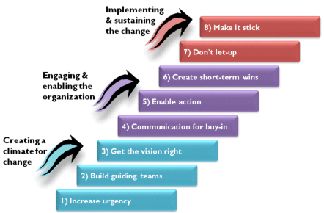
Thinking about change and implementation (Kotter’s 8 step model)

Slide 13
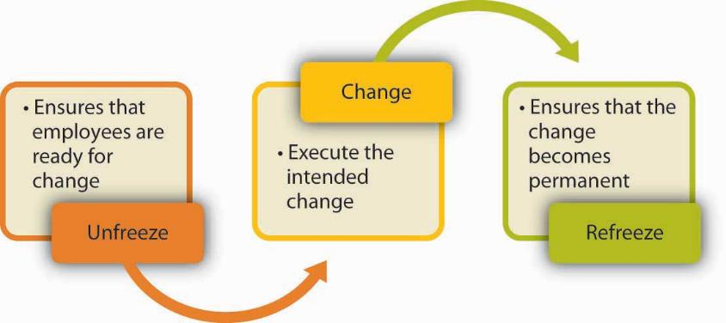
Thinking about change and implementation (Lewin’s change model)

Slide 14
Implementation Plan
A good implementation plan is sensitive to:
Time frames
Priority and trade-offs
Metrics

Slide 15
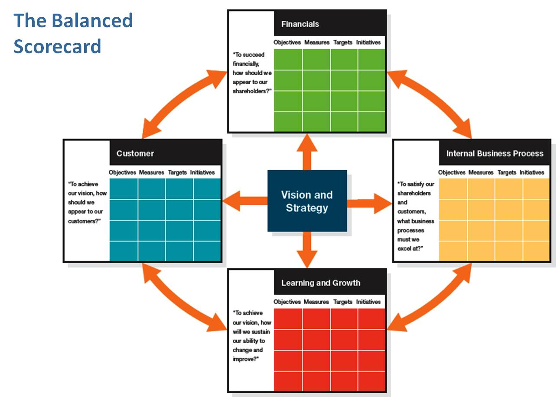
Implementation using BSC

Slide 16
The central idea behind Strat 2- Alignment
The core concept that drives strategy implementation is the idea of strategic alignment
Strategic alignment
What is it?
Fit between structure, processes, people and strategy

Slide 17
Strat 2
Organizations achieve their goals only when they are in a state of ‘strategic alignment’
Strategic alignment: strategy, org design work together to implement strategic goals
The two take aways from this course:
The idea of strategic alignment
Alignment can gained through implementation

Slide 18
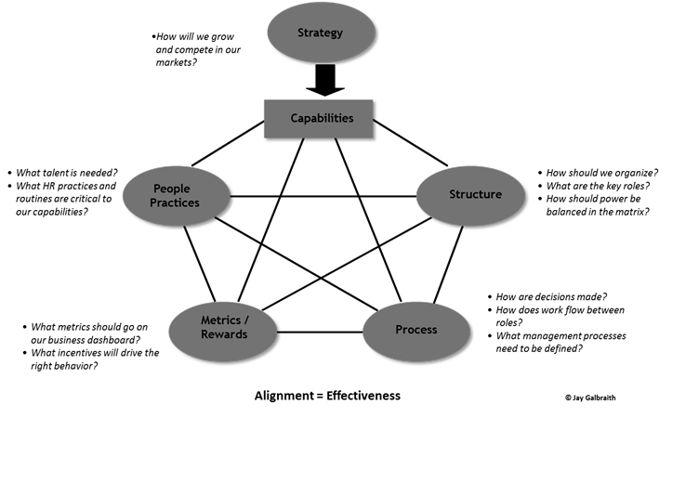
Strategy alignment diagram

Slide 19
Central concepts in alignment
Organization structure
What is it?
Why do we need to understand its core concepts?

Slide 20
Understanding organizational structure
Structure is the architecture for
People
Incentives and controls
Supporting organizational processes
Leadership & governance
Culture
Alignment taps into the relationship between strategy and structure

Slide 21
Organization Structure

Slide 25
The Cases in the Course
Cases create the context for misalignment
Northland Ledger’s case – change of leadership/structure in a misaligned organization.
How do you get it back on track?
Transworld Autoparts case: firm undergoing fundamental changes.
How do processes and metric contribute to bringing the firm back into alignment
Rakuten case: radical change brought on by the leadership that requires a cultural shift for the organization
How do they realign
Lululemon case: how is a quick growth strategy implemented in organization? Is it right for the organization?

Slide 26
Doing case analysis
Here’s the structure we follow
Central problem
Analysis of issues
Strategic alternatives and central recommendation
Implementation plan
The questions that are provided for every case are guiding questions- they should help you focus on key issues.
If they don’t seem to help, ignore them.

Slide 27
The ‘don’t –like-it’ part of this course
Deal with large bureaucratic organization for the most part.
BUT
Concepts we use can be applied to most organizations
There isn’t a text book
No gradual learning curve
The cases require in depth understanding of organizational structure and design and the idea of alignment

Slide 28
Strategy in Action (Course mechanics)
Grading: out of 100
Class contribution – 15
Major individual case assignment – 30
Group project – 35
Final Exam -30
Get organized:
Nobody starts at a certain grade- we work for grades
Get into groups asap
Discuss your strengths and weaknesses
Be familiar with assessment criteria
Understand tradeoffs

Slide 29
Individual Assessment -15%
Participation Evaluation Form
Attendance
Always …………….....................Mostly………………………………………Never
Amount of contribution in class
Outstanding……………………………….Fair share………………………………….Little or none
Cognitive Element (knowledge, logic, creativity and question asking)
Logical………………………………………..Orderly ……………………………………..Disjointed
Thorough…………………………………….Fairly Thorough…………………………..Cursory
Imaginative………………………………….Competent……………………………..Unimaginative

Slide 30
Mid term Exam
The case is in the course pack
Follow the framework (central problem, analysis of issues, strategic alternatives and central recommendation, and implementation plan)
Report not more than 8 pages in length, typed double spaced, excluding title and exhibit pages
Stapled in the top left corner
Due: beginning of class 7: Feb 18th
No late reports accepted

Slide 31
MARKING RUBRICS | Excellent 25+ | Proficient 21-24 | Average 20-16 | Poor (Oh dear!)
Understanding and application of the theory | Showed a thorough understanding of the theory; able to concisely assess the case to apply the theoretical concept at a deep level | Showed a working understanding of the theory; applied the theoretical concept at a surface level | Showed basic understanding of the theory; attempted to assess the case and apply the theoretical concept in a very limited level | Showed little understanding of the theory; poorly assessed the case and applied the theoretical concept
Problem solving skills | Able to suggest and bring out appropriate solutions to the case; logical approach to seek solutions was observed | Able to bring out some solutions; logical flow was still observed but there was a lack of relevance of the flow | Still able to bring out a few solutions on time; logical flow was hardly observed | Failed to bring out any solution to the case; logical flow was not observed
Creative opinions and solutions | Able to come up with some innovative solutions | Attempted to look for a few innovative solutions. | Marginal attempts to look for any innovative solutions | Failed to show or didn’t attempt to give any innovative solutions.

Slide 32
Group case presentations- 25%
Groups should get formed by the third class
Cases will be assigned to groups on the third class(January 21st).
On presentation days, some groups will be asked to evaluate the presentations.
Groups have 30 minutes excluding questions and answers.
Please provide a printed copy of your slides, including backup slides on the day of the presentation

Slide 33
Group Presentation Assessment Criteria
Grade (Total out of 25) | Problem Identification | Analysis of Issues | Alternative Strategies & Recommendation | Implementation Plan | Creative Insight
 | Clear, specific, concise and accurate | Comprehensive, no omission of core issues | Provides a clear resolution/s for the problem with a clear understanding of alternatives | Excellent plan – keeps in mind time pressures, trade-offs and feasibility of chosen alternatives | Original with unusual insight
 | Generally accurate but not concise and specific | Includes most core issues | Solves the problem in a general sense only with some attention to alternatives | Overall a feasible plan with good attention to objectives, time and pace and feasability | Generally good solid reasoning
 | Part of the problem not identified | Overlooks some issues | Solves only a part of the problem with limited attention to alternatives | Basic plan with little attention to time, goals tradeoffs and feasibility | OK- but suggests only the obvious
 | Vague problem definition | Omits some of the core issues | Doesn’t solve the problem or consider viable alternatives | Cursory plan with little attention to goals and time factor | Difficult to follow
 | Inaccurate assessment of the problem | Omits all of the important issues | Problem remains unsolved | Where is the implementation plan? | Misses the point completely
Comments

Slide 34
Doing Well on Case Presentations
Average grades for this class: B- to B
Being in the blue zone
The group addresses the all four criteria meeting minimum requirements
Being in the ‘peachy’ zone:
Group meets minimum criteria and then some by integrating insights from theory and class discussions
Being in the ‘rosy’ zone
Impeccable analysis that interacts strongly with theory and shows strong innovative and creative streak.

Slide 35
Final Exam
Case is not in the course pack
It will be posted on Moodle April 7th 15:30 p.m.
Report not more than 8 pages in length, typed double spaced, excluding title and exhibit pages
Stapled in the top left corner
Due: April 14th at 15:30 p.m.
Send me an electronic copy.
Assessment will be similar to that of the mid term

Slide 36
The Reading
From Strategy to Implementation

Slide 37
The disconnect between strategy and its implementation

Slide 38
Strategic Implementation
Concrete measures that translate intent into action that produce results.
Strategy can be commoditized, implementation is the key to a successful strategy
Successful implementation happens with alignment

Slide 39
Strategy Creation vs. Implementation
Strategy Creation
Analysis and planning
Thinking
Initiate
Top tier management
Entrepreneurial
Goal setting
Strategy Implementation
Execution
Doing
Follow through
Top-to- bottom
Operational
Goal achieving

Slide 40
Implementation of Generic Business Strategies
Differentiation
Cost leadership
Learning orientation, flexible, horizontal coordination,
Capabilities in research, marketing
Close to the customer
Reward employee creativity and risk-taking innovation
Efficiency orientation, strong central authority tight cost control, frequent detailed cost controls
Standard operating procedures
Tight supervision, routine task definition, limited employee empowerment

Slide 41
Basic implementation framework

Slide 42
People and Incentives
Hiring and training people with the right skills to make the strategy successful
People with attitudes that support the strategy
Providing the resources people need to do their jobs well.
Avoiding the ‘say-do’ problem

Slide 43
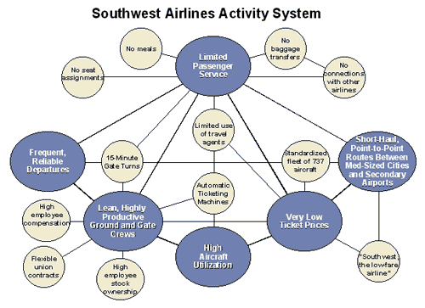
Supportive Activities
Strategy has to be a system of interdependent parts, with each element reinforcing the other.

Slide 44
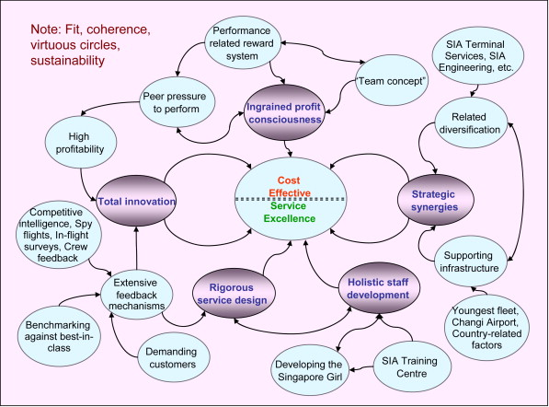
Supportive Activities (Singapore Airlines
Competitive advantage comes from the way activities fit and reinforce each- other

Slide 45
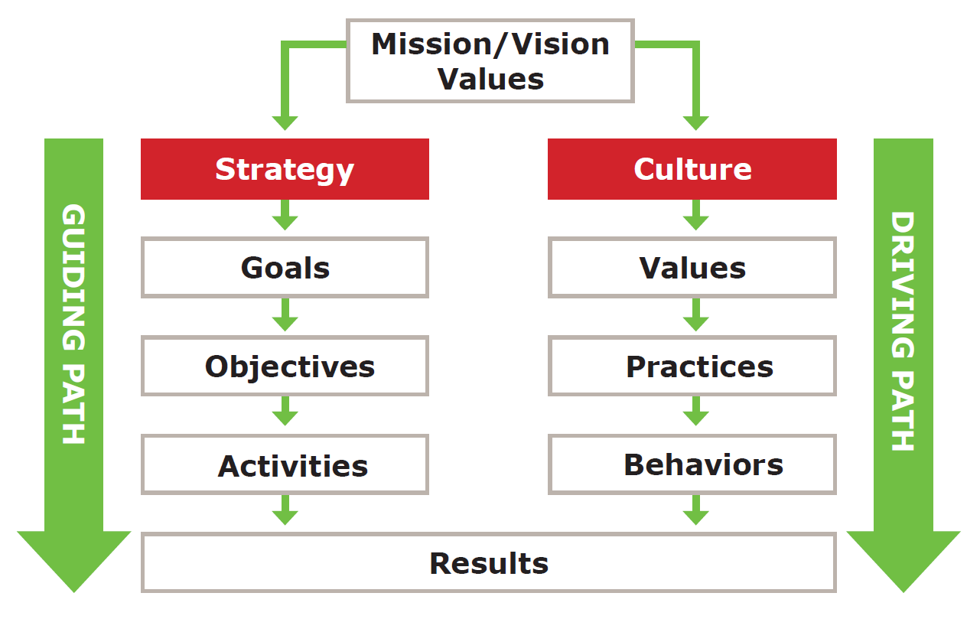
Culture and Leadership
Culture: values, traditions and operating style which sets the tone for managerial and employee behaviour.

Slide 46
Of Heroes and Heroics….
Who are your heroes?
What stories do you know of them?
Culture they set
Skills they valued in people
The kind of organization they worked/created (structure)
Rewards and incentives systems
Supportive activities that made the organization unique

