Slide 1
Business Models

Slide 2
Case Analysis
From the case data – what are the CVP, resources and capabilities and economic logic/profit formula for the GAA (Group 1)
  Discuss the same for the IRFU (Group 2)
Given the strategic challenges and opportunities that the GAA and the IRFU face what components of the business model are not aligned to achieve success in the current environment
  Discuss for GAA (Group 3)
  Discuss for IRFU (Group 4)
Craft a business model for each of the organizations. What is the source of differentiation and competitive advantage in these models. Remember that you are designing for the likelihood of these organizations surviving and growing into the next generation.
  For GAA (Groups 5 &6)
  For IRFU (Groups 7&8)

Slide 3
Business Model
The story that explains how the enterprise works…
  Who is the customer?
  What does the customer value?
  How do we make money in this business?
  What is the underlying logic that explains how we can deliver value to customers at an appropriate cost?

Slide 5
A successful business model has the following traits
Customer value proposition
  Study what customers do with the products
  Look at the alternatives to the offering
  Watch for compensating behavior
  Search for explanations
Profit formula
  Revenue model: price x volume
  Cost structure: direct costs, indirect costs and economies of scale
  Margin model:
  Resource velocity:
Key resources and processes
  People, technologies, assets, channels, operational and managerial processes

Slide 6
Designing a Business Model

Slide 7
Enduring Business Models
Is it aligned with firm goals?
  Xerox and Xerox PARC
Is it self reinforcing?
  Supporting mechanisms set up to strengthen key aspects
Is it robust?
  Fend off threats
    Imitation
    Hold up
    Slack
    Substitution

Slide 8
Identify when a new model may be needed
  The opportunity to
    Address the needs of large groups who find existing solutions too complicated or expensive
      E.g. Tata Nano
    Capitalize on a new technology by wrapping a new business model around it or use existing technology in a new market
      Mp3/apple ipod and transferring military/space tech to commercial space
    Bring a job-to-done focus where one doesn’t exist
      FedEx

Slide 9
Identify when a new model may be needed
  The need to
    Fend off low end disruptors
      Success of the Nano will force changes in other business models
    Respond to shifts in competition
      As core aspects of business models keep getting copied, it is important to keep the model agile

Slide 10
Business models and business environment
Successful business models emerge through interaction with their environment.
Emerging economies
  Start in the middle
  Offer unique benefits for less
    Affordability
    Access

Slide 11

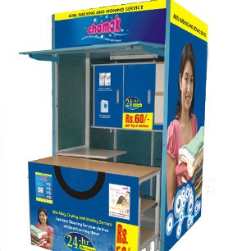
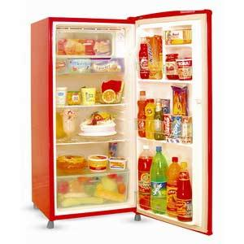
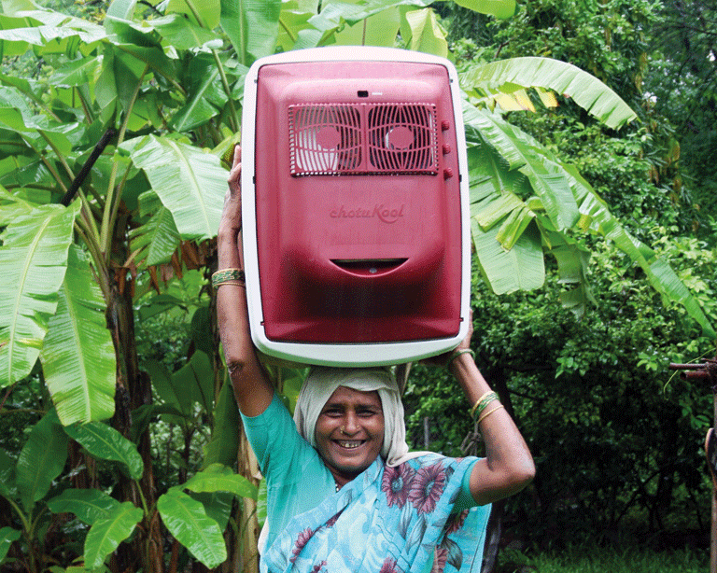
Business Models in Emerging Economies
Traditional Laundry service
http://www.villagelaundryservices.com/
Traditional refrigeration
https://www.chotukool.com/

Slide 12
Business Models and strategy
Business models lay out which value chain activities a firm would do; strategy guides which consumers/competitive landscape to target
  Dell
  Walmart
  Unilever
  Netflix

Slide 13
Innovating Business models
All business models are variations of the generic value chain
  Part one: all activities associated with making something
  Part two: all activities associated with selling something
A new business model may focus on designing a product for an unmet need or focus on process innovation for something already available.
Business models falter in two critical areas
  Narrative test (story doesn’t make sense) e.g. online grocery
  P& L test- the numbers don’t make sense

Slide 14
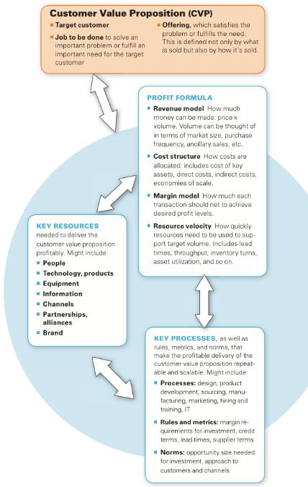

Slide 15
Take away
Business models are not theoretical constructs
  Stories of enterprise – both the narrative and the numbers need to make sense
    And then there is …patience
Successful business models are not those that are designed in vitro but the ones that compete in a business environment with other alternatives
Business models form the architecture of the firm’s offering but strategy guides what needs to be done with it.

