Slide 1
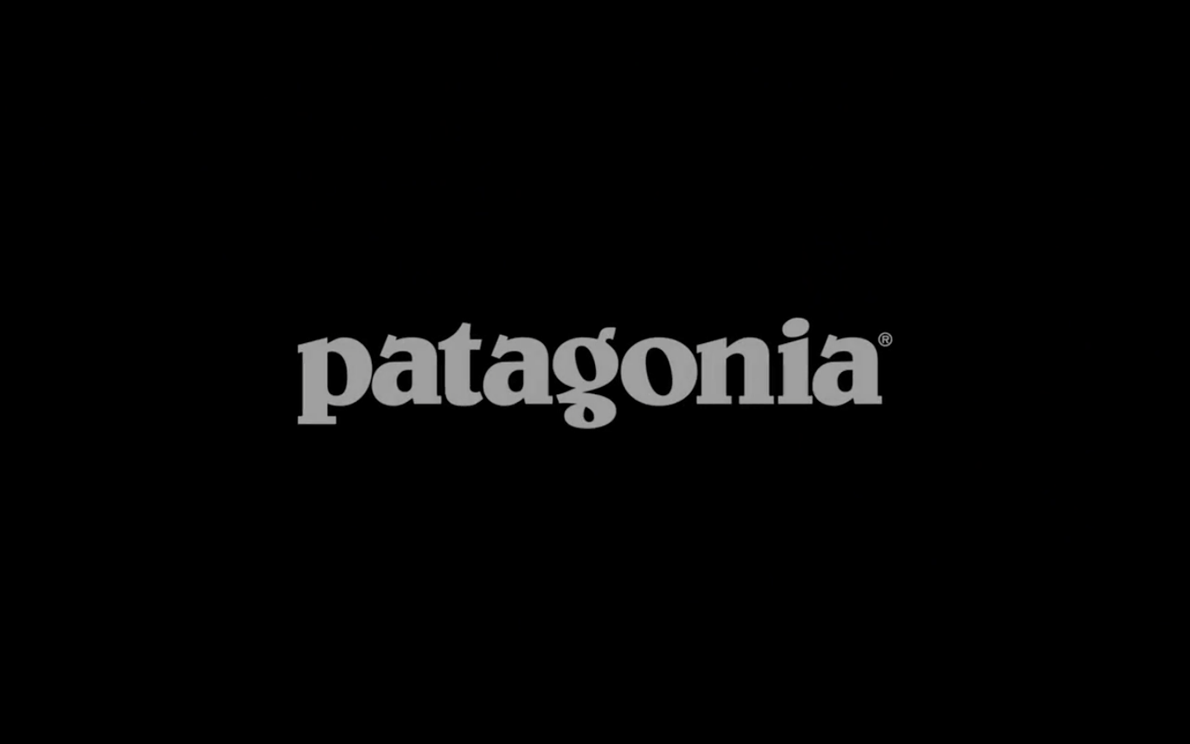

Slide 2
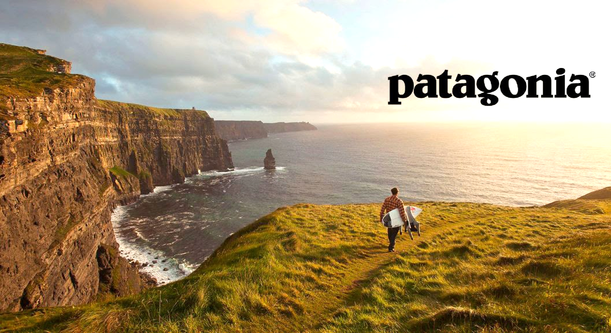
“Build the best product, cause no unnecessary harm, use business to inspire and implement solutions to the environmental crisis.”
Simon Foucher Neha Tally
Jonathan Suprovici Christina Paylan
Weilun Chang Nadia Cho

Slide 3
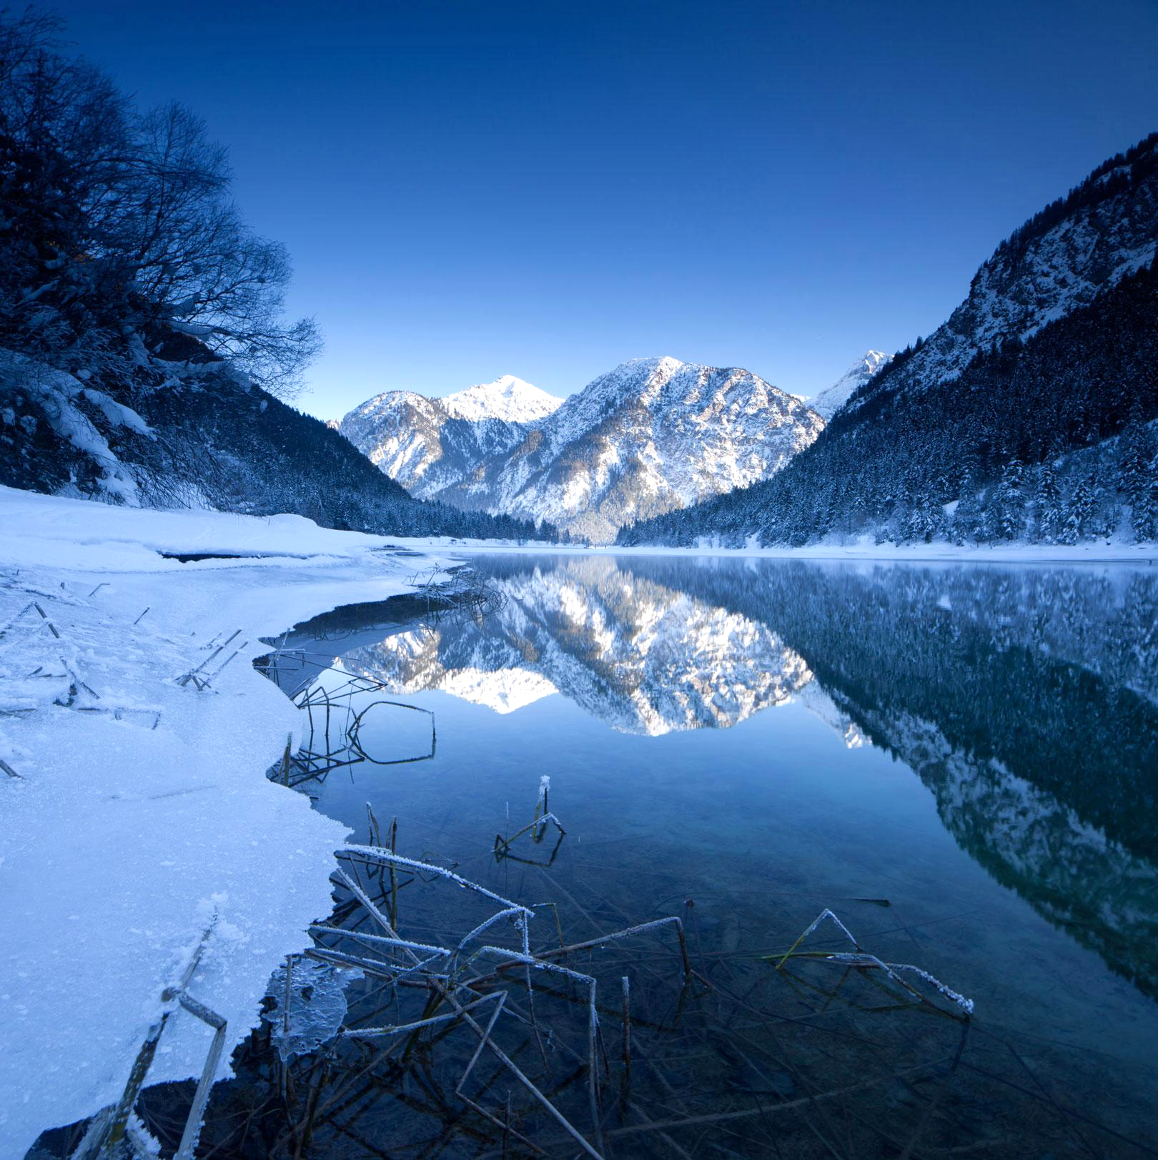
AGENDA
Company Overview
External and Internal Analysis
Alternative Solutions
Recommendation
Implementation

Slide 4
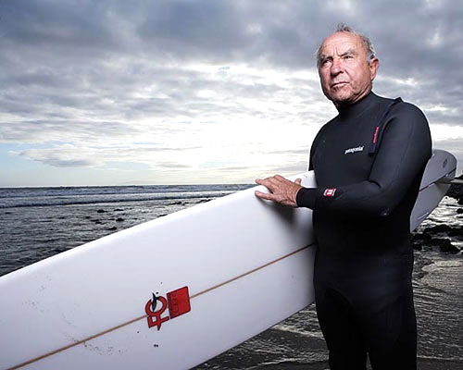
COMPANY OVERVIEW
History- Founded by Yvon Chouinard
Governance- Private Company
Philosophy- Dirtbag Lifestyle
Segment- Luxury Outdoor Products:
Sportswear, Technical Outerwear,
Technical Knits, Hard Goods, Misc
Goal- Achieving Growth aligned with Philosophy

Slide 5
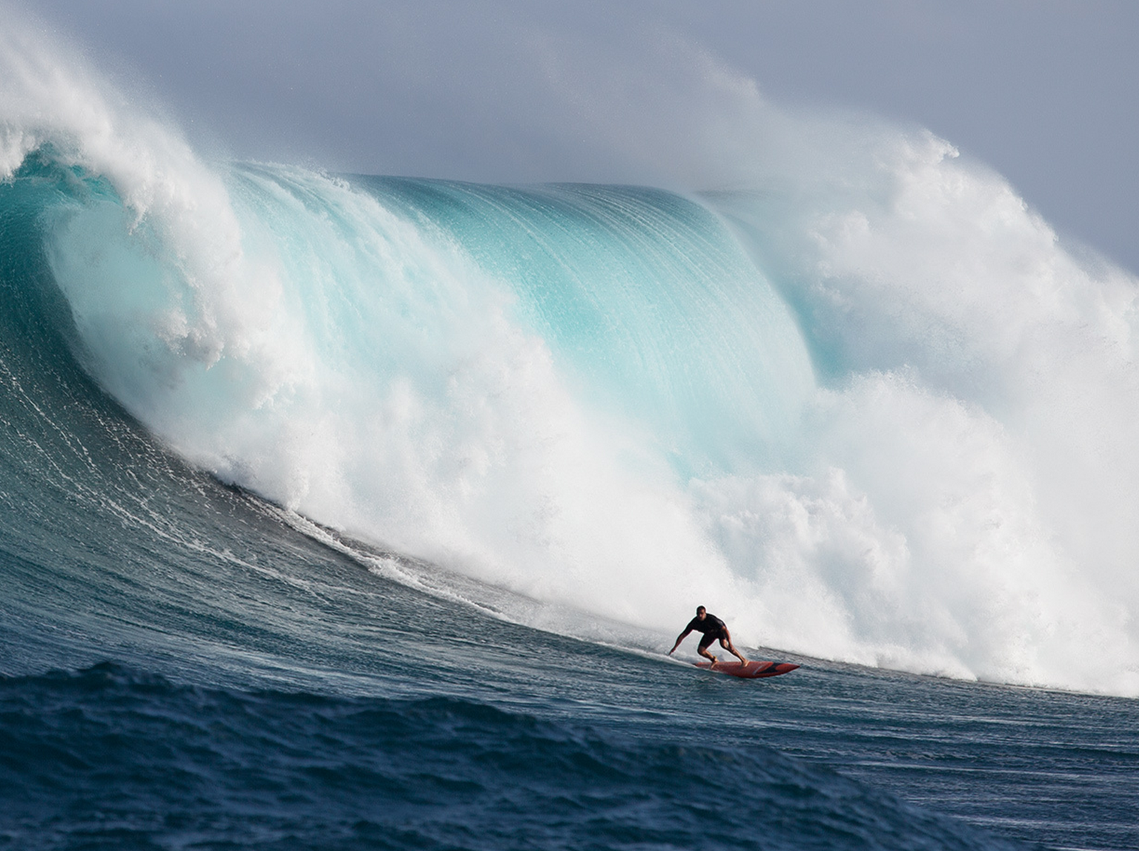
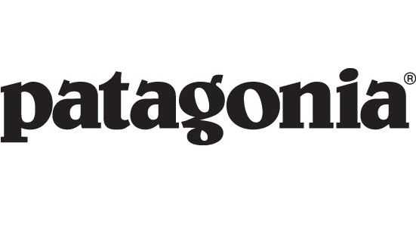
EXTERNAL ANALYSIS

Slide 6
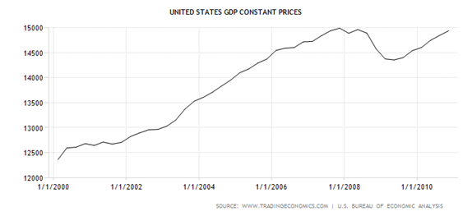
GENERAL ECONOMY
Focus on US Economy
Spring 2010- Indication of Slow recovery in GDP after 2009 recessionary trough

Slide 7
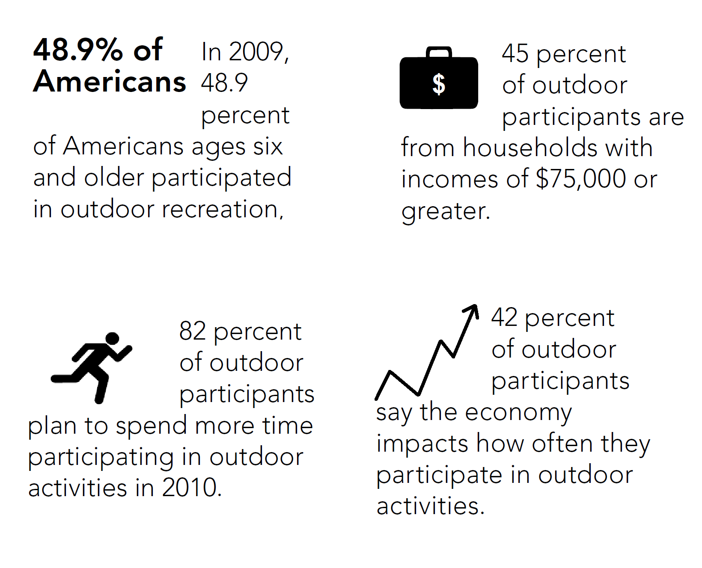
US OUTDOOR RECREATION ECONOMY
US$646 billion in direct consumer spending annually
5% growth annually from 2005-2011 despite recession
Notes:
Focus on US Market- currently the largest
Survey goal- The Outdoor Foundation's annual Outdoor Recreation Participation Report helps the outdoor industry, public agencies and community organizations better understand the trends in outdoor recreation participation, enabling groups to address America's inactivity crisis and the disconnect between children and the outdoors.
Note: A participant in outdoor recreation is defined as an individual who took part in one or more of 40 outdoor activities at least once during 2009.(From backpacking in a National Park to snowboarding at a mountain resort)

Slide 8
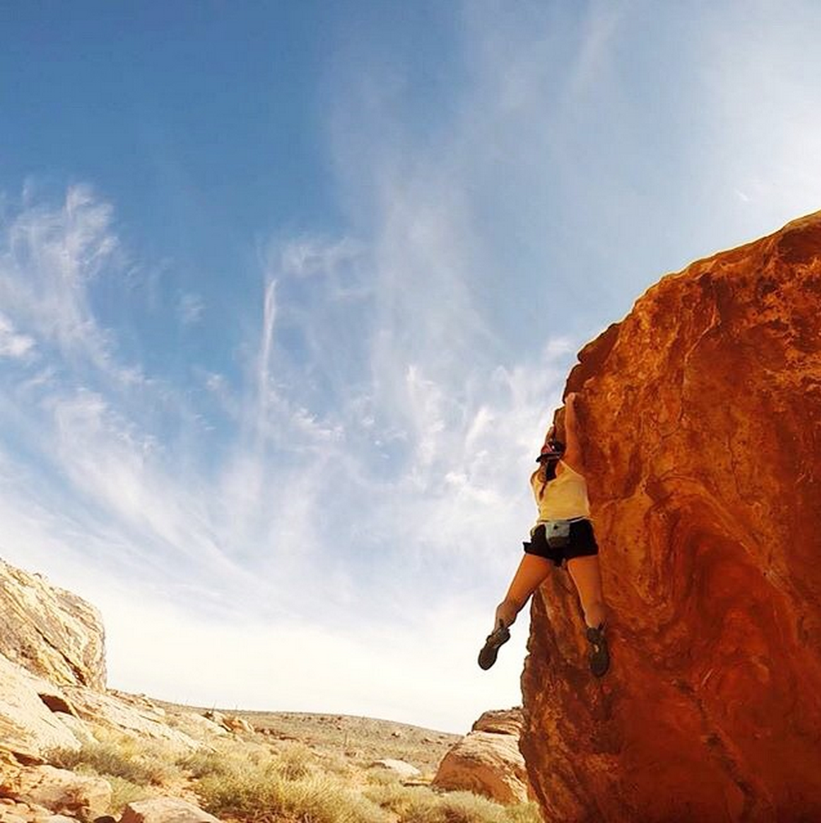
DEMOGRAPHICS
Correlation between Outdoor Participation and Attitude;
89% - of participants believe in preserving undeveloped land for outdoor recreation
AND
38% of participants have donated/volunteered to support environmental and conservation efforts

Slide 9
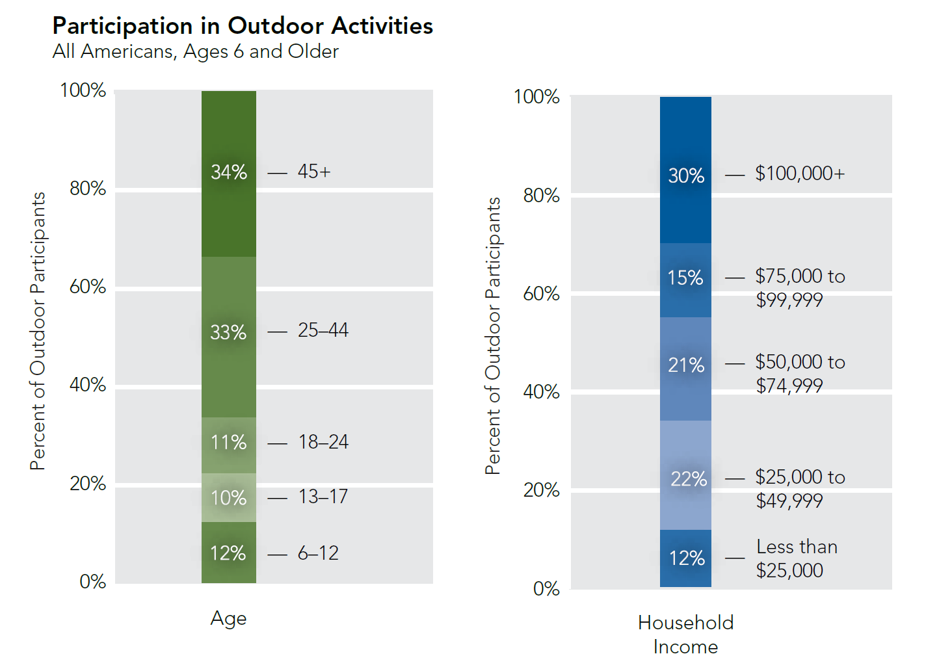

Slide 10
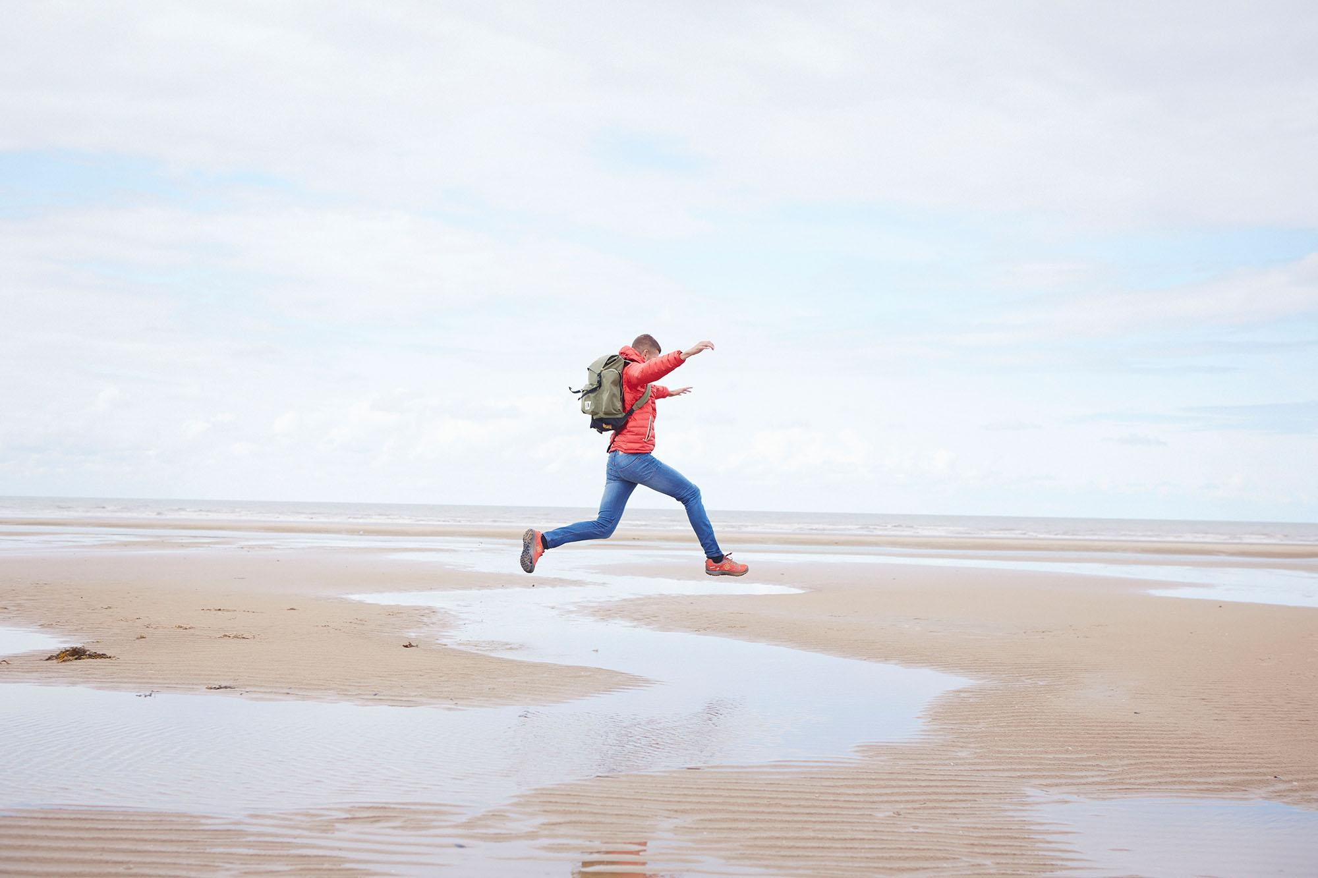
GLOBALIZATION
People from Mature Economies seek more extreme sports and experiences
World Tourism Organization (2006): Nature tourism expands at 6 times rate of tourism overall
People engaging in ecotourism want to be part of activities that benefit local and global environment
Environmental and Community Awareness increasing; Global Warming, Pollution and Deforestation
Notes:
As economies mature and people already possess most of the tangible consumer products that they want they start to desire intangible products such as experiences

Slide 11
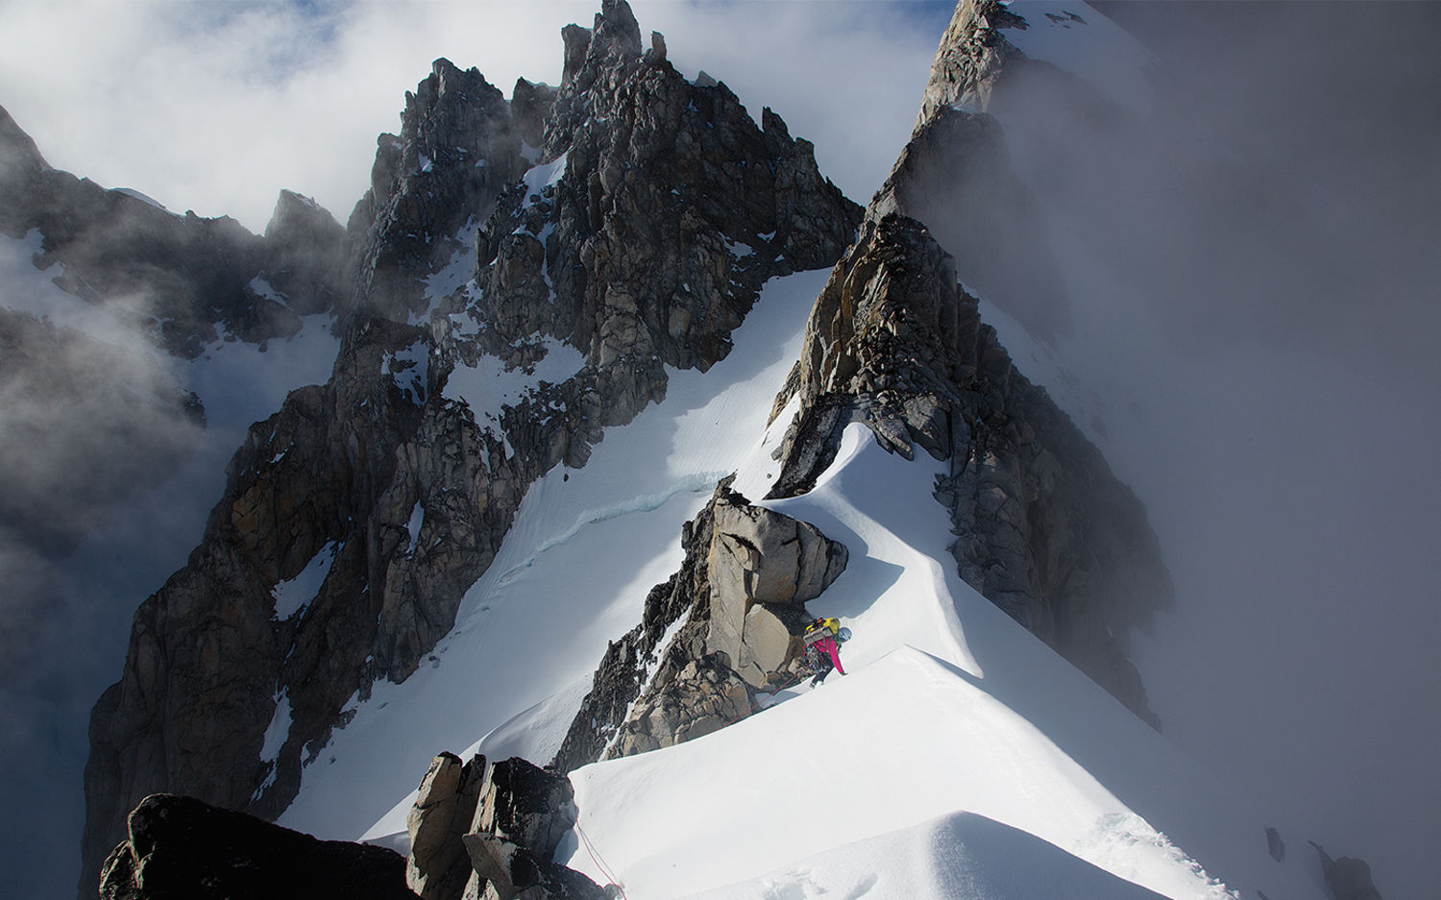
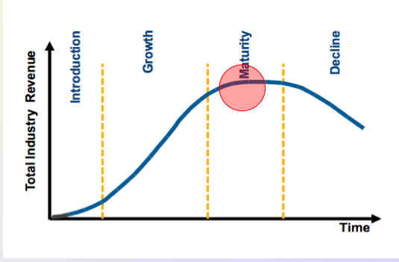
INDUSTRY ANALYSIS
INDUSTRY ANALYSIS
High-end outdoor apparel
Maturity Stage in Life Cycle
Product segments are well defined and experience only slight changes annually
Industry growth expected to follow increase in population and purchasing power of emerging markets

Slide 12
INDUSTRY ATTRACTIVENESS
INDUSTRY
Threat of New Entrants
LOW to MED
Economic barriers to entry
Brand establishment
Power of Suppliers
MED to HIGH
Eco-materials (cotton) and high-tech material dependencies
Internal technologies
Textile industry commoditized
Rivalry
MED to HIGH
Competition for market shares
Not-price sensitive
Differentiation
Power of Buyers
MED
Niche market
Not price-sensitive
Easy brand switch
Brand loyalty
Threat of Substitutes
LOW
Few to no substitutes of high-end apparel
Attractiveness: LOW to MED
Especially not attractive for new entrants

Slide 13
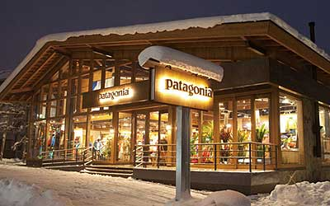
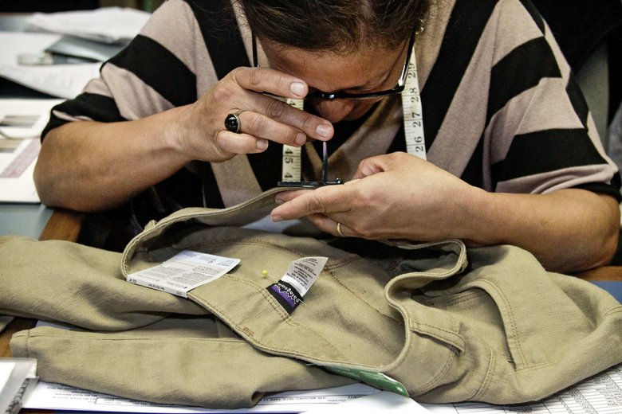
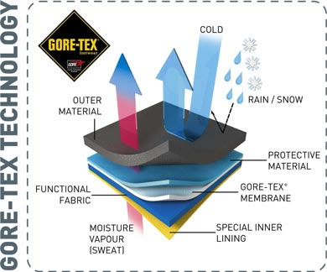
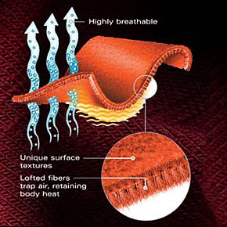
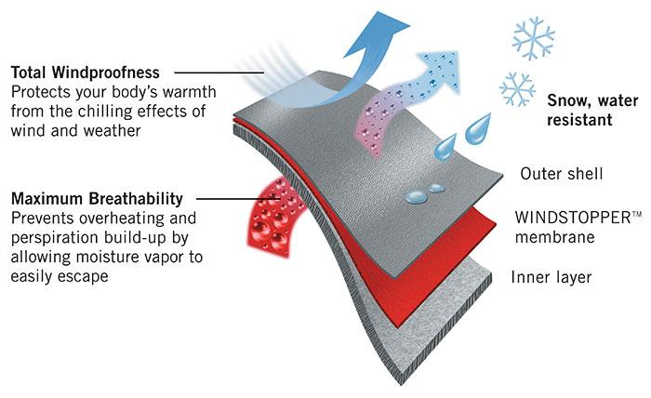
KEY SUCCESS FACTORS
Value chain optimization
Establishment of brand
Marketing of technical materials and designs

Slide 14
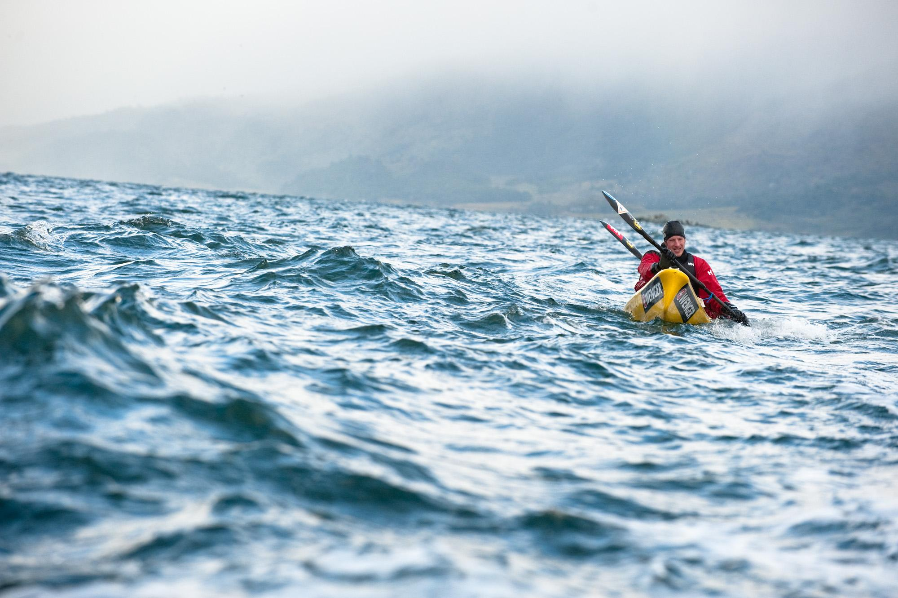
INDUSTRY TRENDS
Layering and integrated systems
Streetwear and youth culture influence
Environmental and sustainability initiatives, e.g. using organic cotton
Consolidating retailers and fast-growing competitors in outdoor apparel industry
Increased use of e-commerce channels as consumers increasingly shop online

Slide 15
COMPETITION
HIGH
MOUNTAIN
HARDWEAR
PATAGONIA
ARC’TERYX
MARMOT
THE NORTH FACE
PRICE
QUALITY
COLUMBIA
SPORTSWEAR
TIMBERLAND
NIKE
LOW
LOW
HIGH
ENVIRONMENTAL APPEAL

Slide 16
COMPETITION
PATAGONIA
SPECIALIZED
MOUNTAIN
HARDWEAR
ARC’TERYX
MARMOT
THE NORTH FACE
PRODUCT RANGE
COLUMBIA
SPORTSWEAR
TIMBERLAND
NIKE
GENERAL
LOW-TECH
TECHNOLOGY
HIGH-TECH

Slide 17
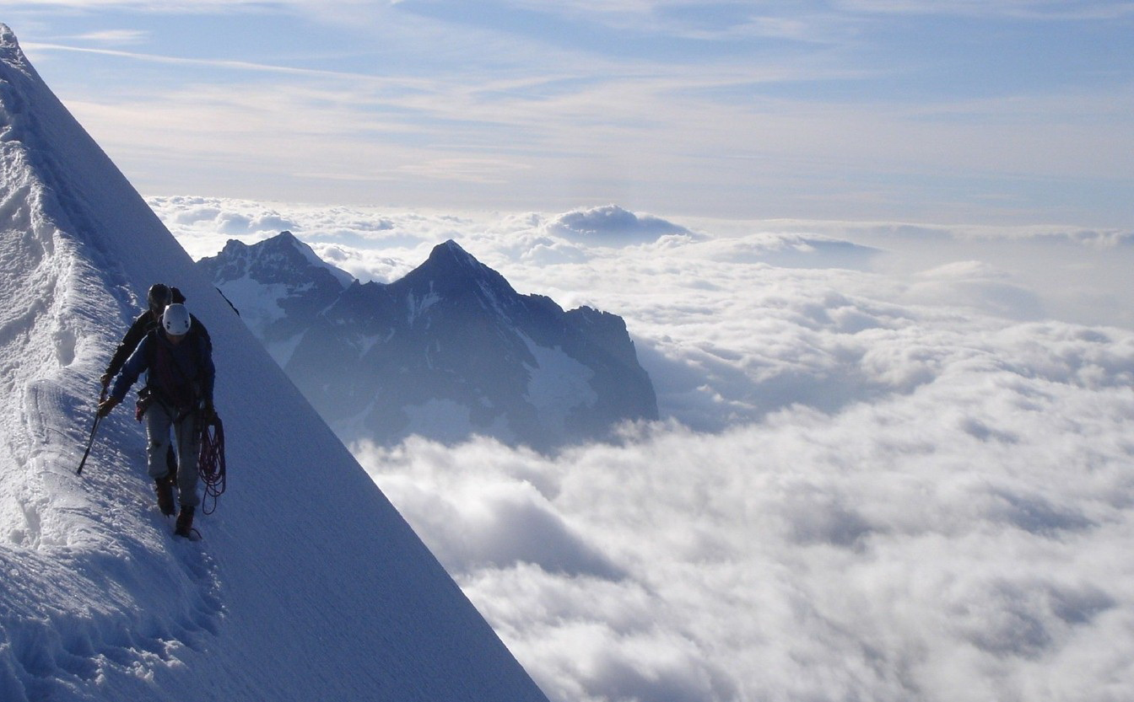
SUMMARY OF
OPPORTUNITIES AND THREATS
Opportunities
Mainstream market demand for eco-products and high-tech products
Potential for growth in international markets
Increase in interest for outdoor activities
Threats
High-end products in recovering economy
Dependency on suppliers for specialized materials
Imitation from competitors
Big budget competitors
Radical views can alienate certain customers

Slide 18
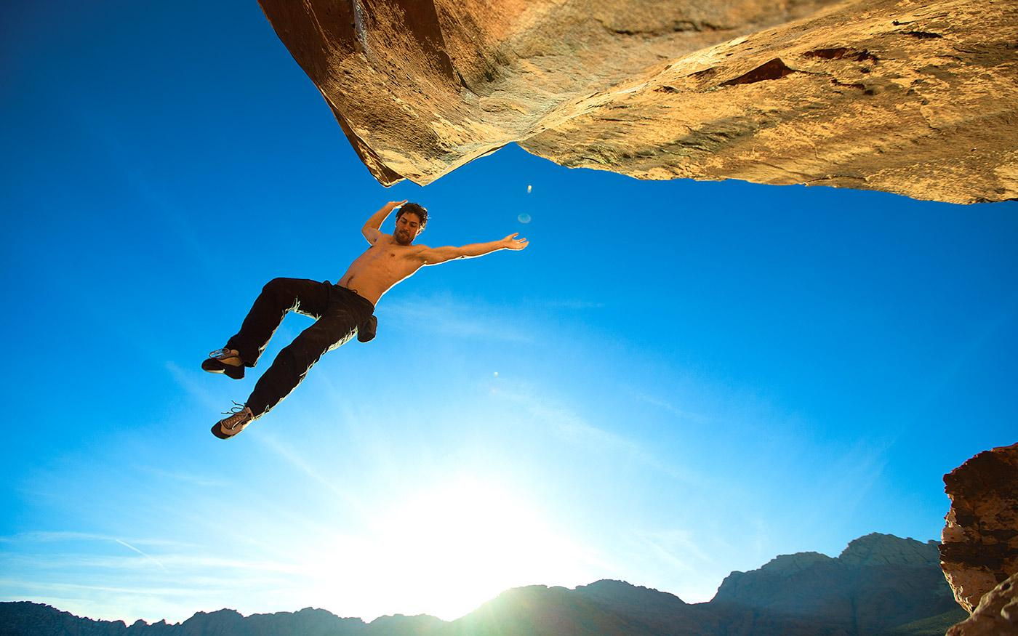
INTERNAL ANALYSIS

Slide 19
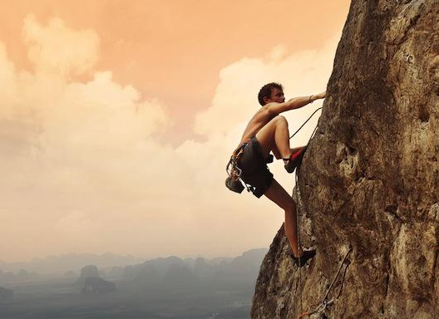
INNOVATION
1% of revenues for R&D
  More durable fabric and 100% recyclable zippers
  Industry leader in tech innovation
Patents for Synchilla, Capilene, and chlorine free wool

Slide 20
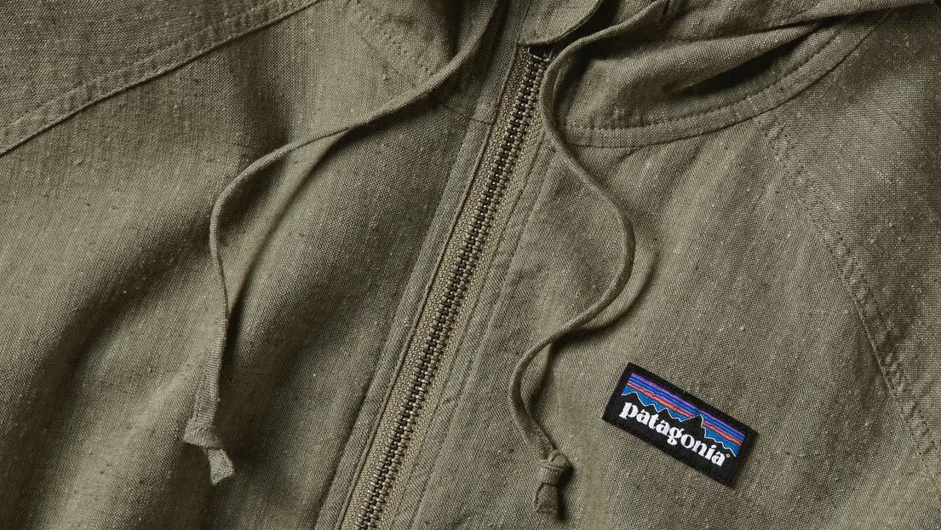
CUSTOMER ANALYSIS
TARGET MARKET
38 year old “dirtbag” with household income of $160,000
CUSTOMER ACQUISITION
Great PR for their efforts
Challenging based on marketing strategy

Slide 21
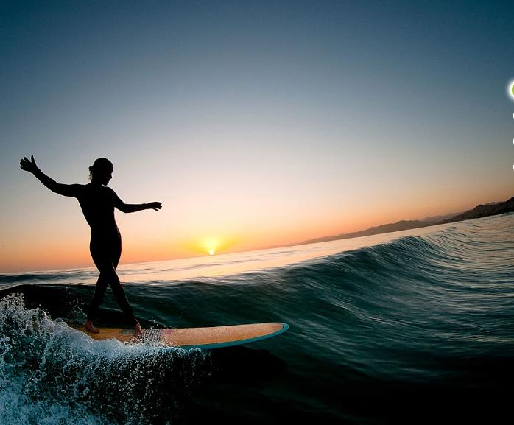
MARKETING
Celebrity ambassadors
Social media
Less than 1% of revenue for marketing
Lots of free PR
Marketing eco-concerns more than products

Slide 22
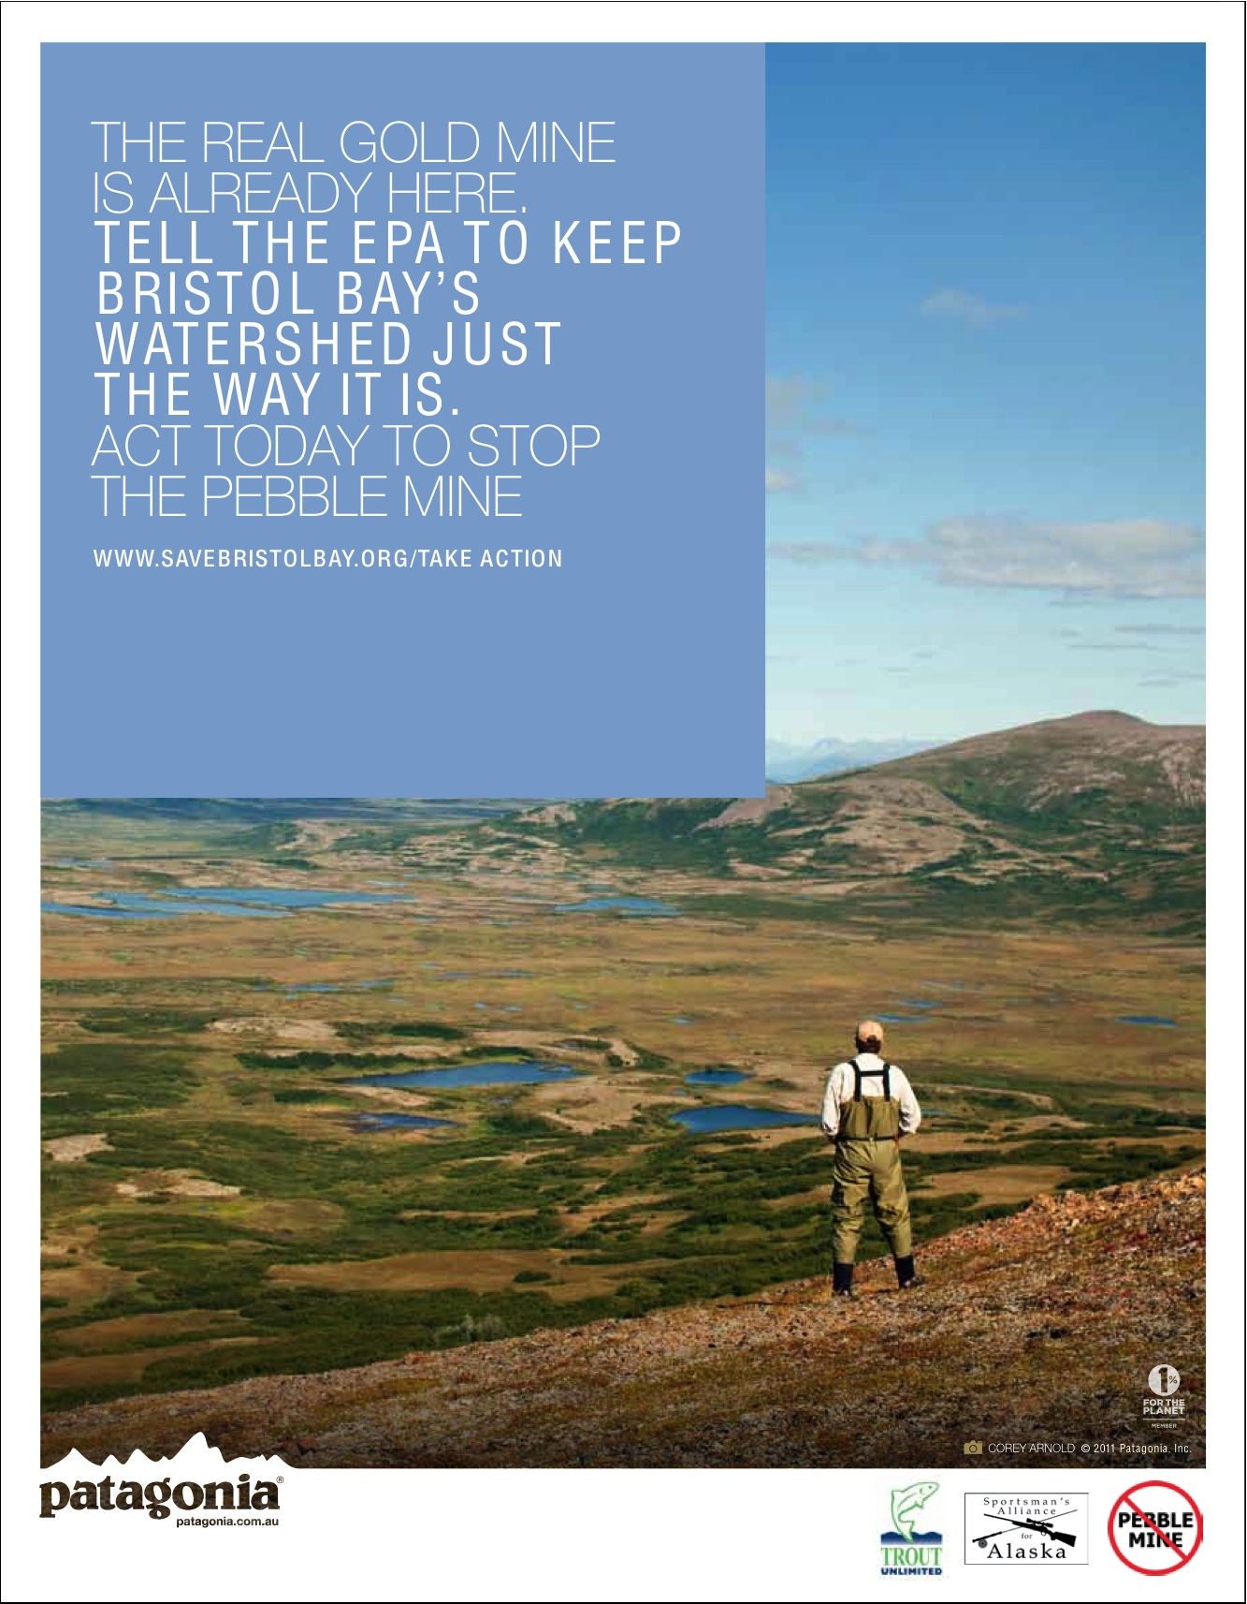
PATAGONIA
ADVERTISING

Slide 23
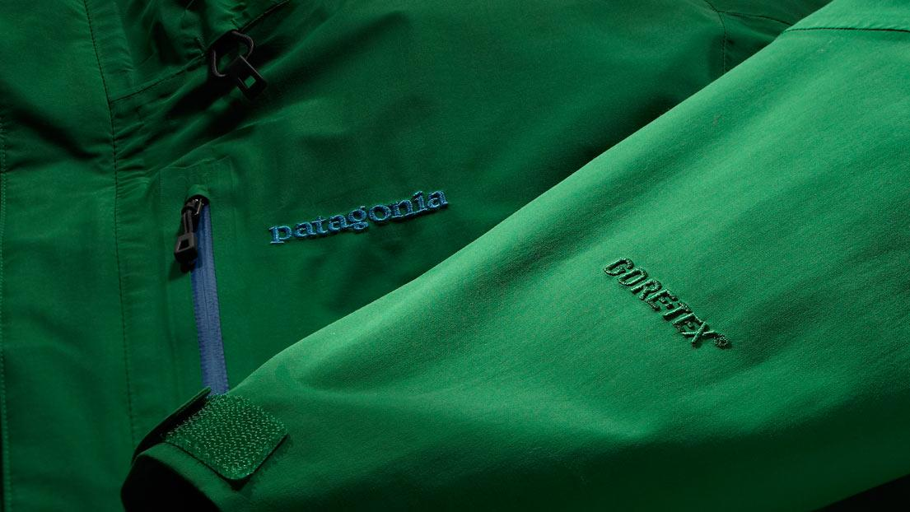
CORPORATE CULTURE
Employees take time off work if tide is up
2 months paid leave to work on environmental causes of their choice
$2000 subsidy for buying a hybrid car
Bail money for those arrested in nonviolent activism for enviro causes
Travelling to Patagonia, Chile, to help create a national park

Slide 24
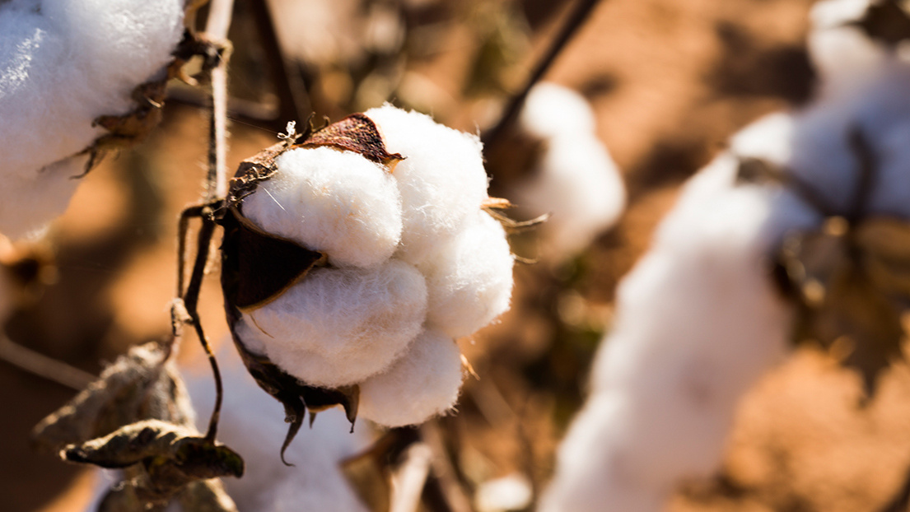

CORPORATE SOCIAL RESPONSIBILITY
Donations to external organizations
One Percent for the Planet
$200,000 in-kind donations annually
Donation of AmEx ad proceeds to 4 environmental groups
Internal operations
Eco-friendly production
Eco-friendly suppliers/dealers
Eco-friendly buildings
Corporate Culture
The Footprint Chronicles
Common Threads Initiative
  recycle
  repair
Notes:
Add a couple more CSR initiatives

Slide 25
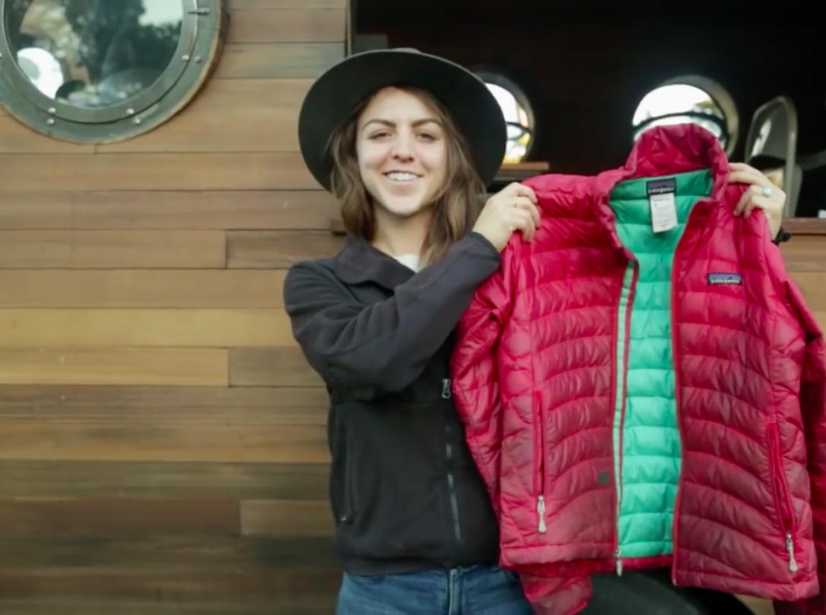
COMPETITIVE ADVANTAGE
Most eco-friendly
Only company to repair
  They own the largest repair facility in North America
Leaders of tech innovation
Patents for creations
Free media exposure

Slide 26
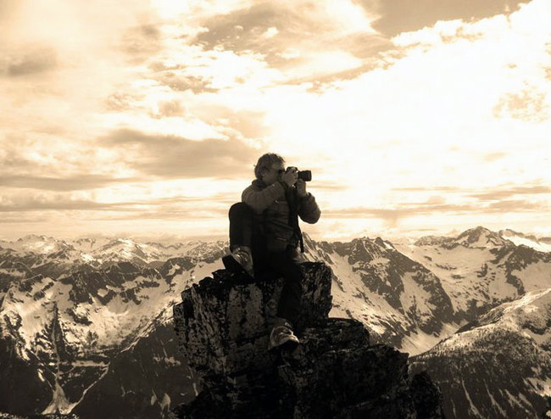
OPERATIONS MANAGEMENT

Slide 27
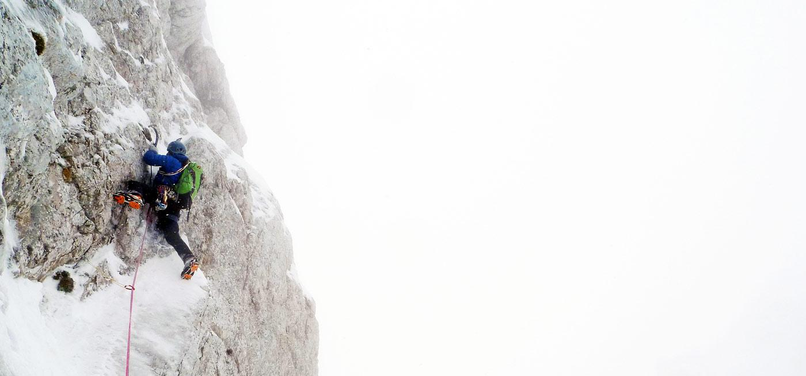
SUPPLIERS
Chosen based on environmental + social responsibility
Down to 41 from 200
Inventory management issues: shortages
PRODUCTION
Focus on reducing footprint
  packaging, dye, anti-odor chemicals, organic cotton
DISTRIBUTION
Distribution/ service center in Reno, Nevada
About 1000 dealers, mostly small single-store retailers and national chains
Suppliers
Chosen based on environmental efforts
Down to 41 from 200
Production
High CSR: focused on reducing footprint of production process
85% outsourced outside North America for cheaper labour
Lower rates of product return than industry standards
Order 2000-5000 units per order
Distribution
Distribution/ service center in Reno, Nevada
About 1000 dealers, mostly small single-store retailers and national chains

Slide 28
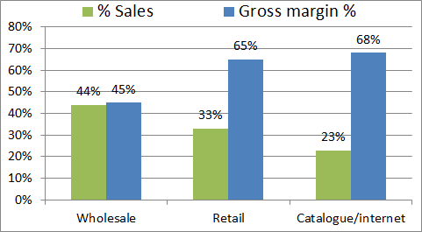
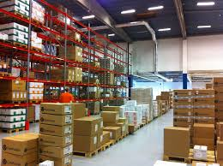
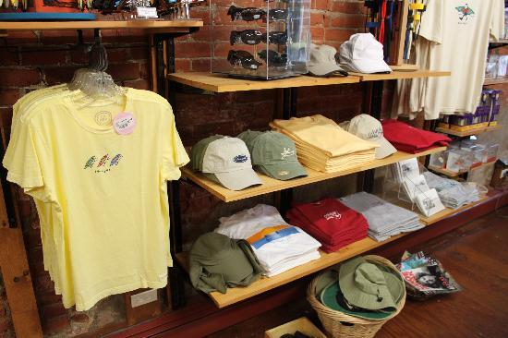
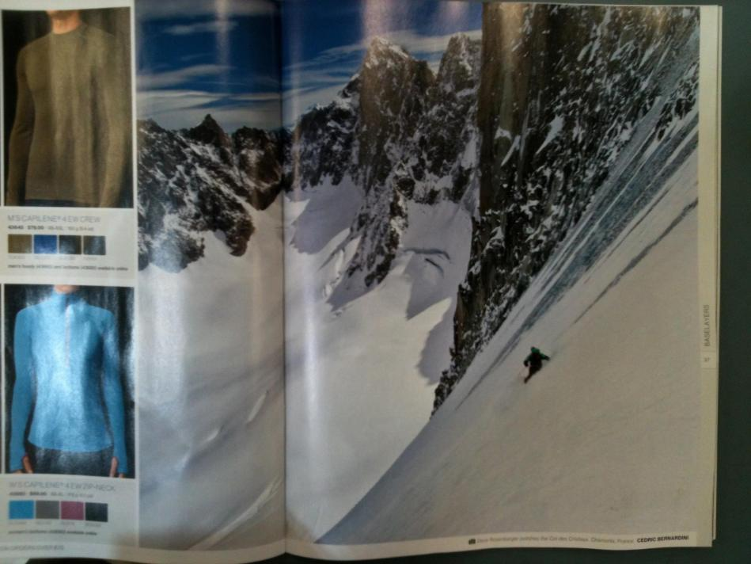
HIGHEST SALES FROM LOWEST MARGINS CHANNEL
OPPORTUNITY TO OPTIMIZE DISTRIBUTION CHANNELS

Slide 29
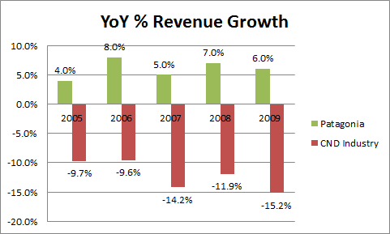
OUTPERFORMING THE INDUSTRY
HISTORICALLY NEVER ACHAIVED 10% GROWTH

Slide 30
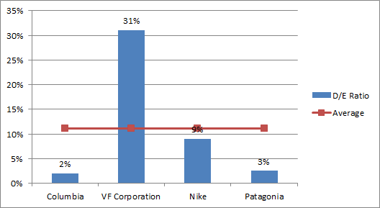
4 TIME BELOW AVERAGE D/E RATIO
INCREASING DEBT TO AVERAGE COULD YIELD $15M IN CAPITAL

Slide 31
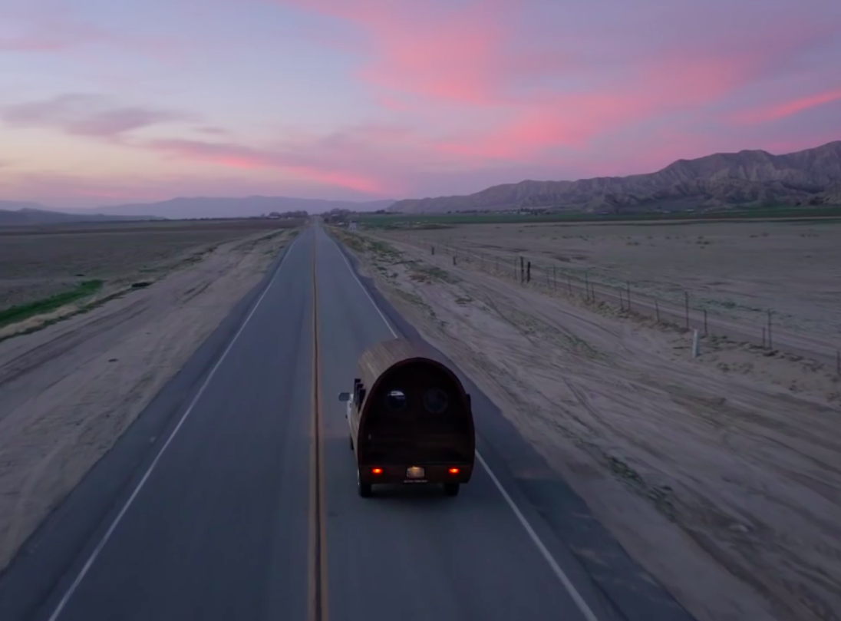
STRENGTHS
Reputation
Free publicity
Innovation
Corporate culture
Private company
Little debt
WEAKNESSES
Brand awareness
Governance
Size
Inventory
Niche target market
Most sales come from lowest margin channel

Slide 32
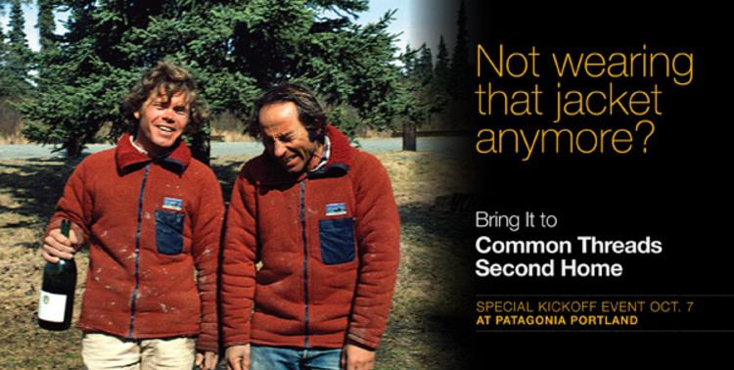
PRODUCT LIFECYCLE INITIATIVE (PLI)
2005 - Pioneered Fabric Recycling
Launched recycling program for technical fabrics
2010 - Enhance to “Product Lifecycle Initiative” (PLI)
Tell customers not to buy new products
Extend life & Repair

Slide 33
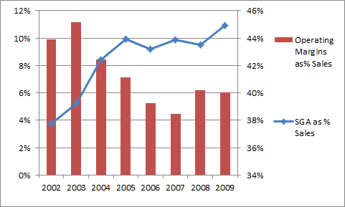
CONFLICT BETWEEN SUSTAINABILITY AND PROFITS
NEED TO FOCUS ON KEEPING COSTS UNDER CONTROL

Slide 34
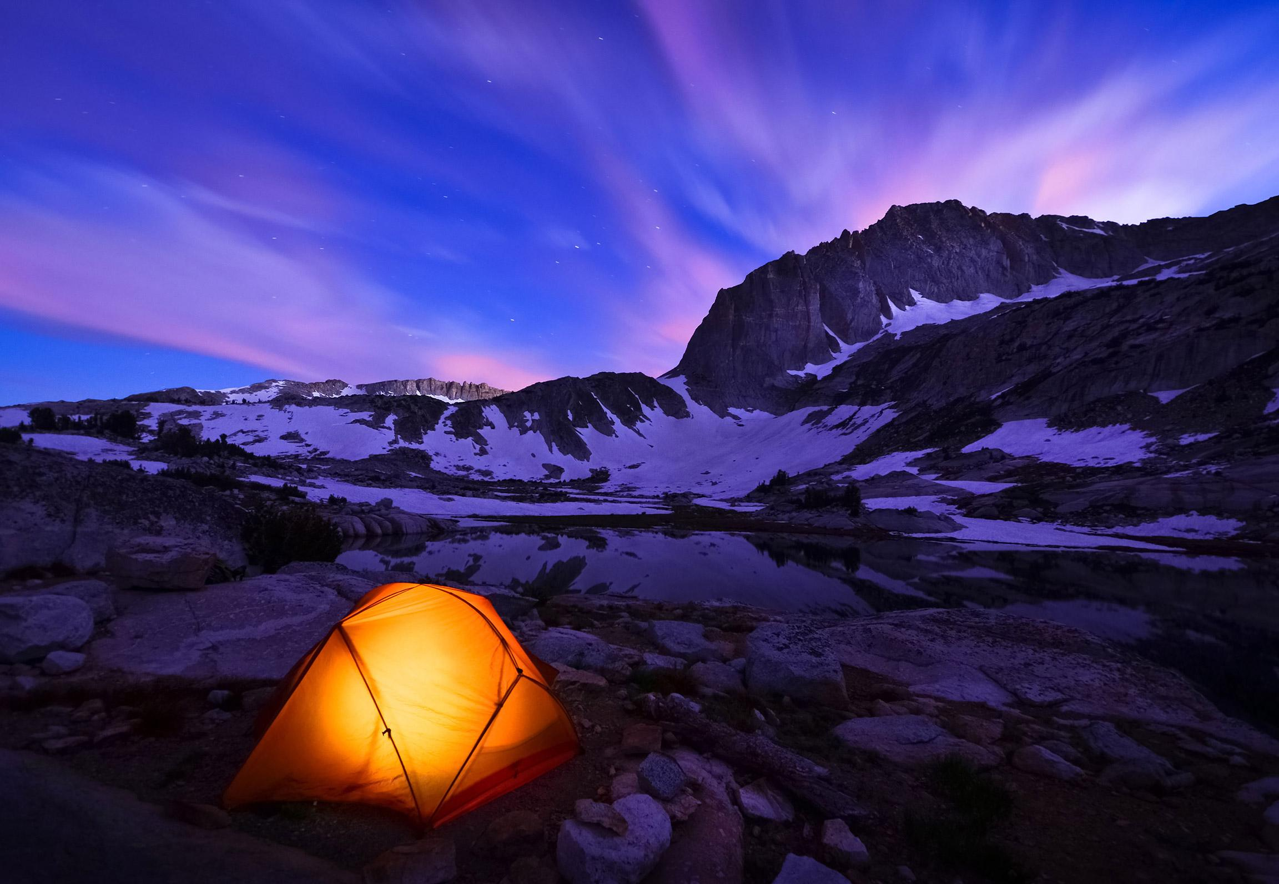
PROBLEM IDENTIFICATION
AND ALTERNATIVE OPTIONS

Slide 35
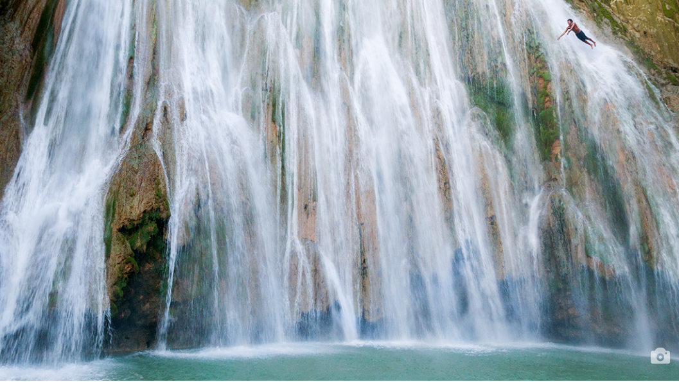
  * Growing 10% while maintaining environmental culture
  * Growth limited due to low brand awareness and inventory management
PROBLEM IDENTIFICATION

Slide 36
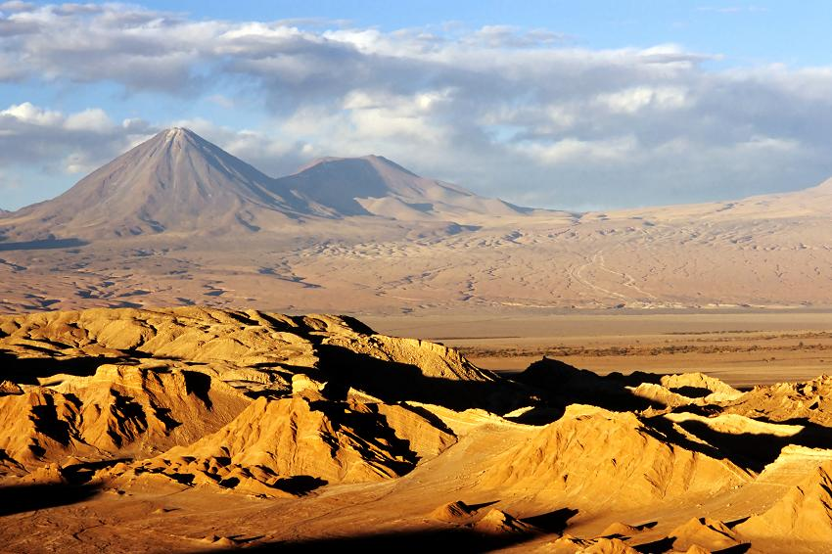
OPTION 1
Do NOT move forward with PLI and Pursue Global Expansion to Asia and South America
PROS
Increase global presence and brand awareness
Revenue focused strategy
CONS
High cost of implementation
Long time for market penetration
  Lack of experience in those markets
Take focus away from Environmental Initiatives

Slide 37
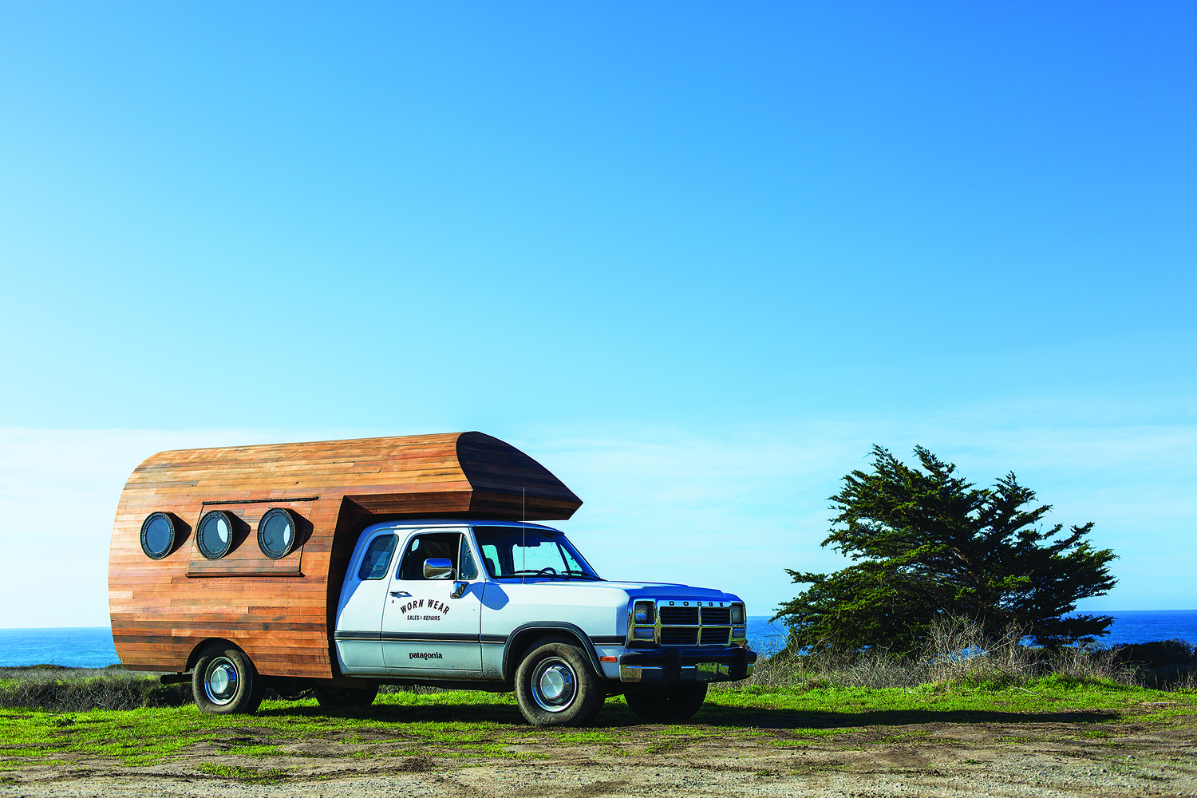
OPTION 2
Move forward with PLI and Target new customer segment with 2nd hand swap market
PROS
New market segmentation- Increase in sales
In line with company’s vision
  Reducing footprints
  Reaching the mass market
Ease of implementation
CONS
Possible decrease in sales of the existing products
Hesitant to purchase 2nd hand products

Slide 38
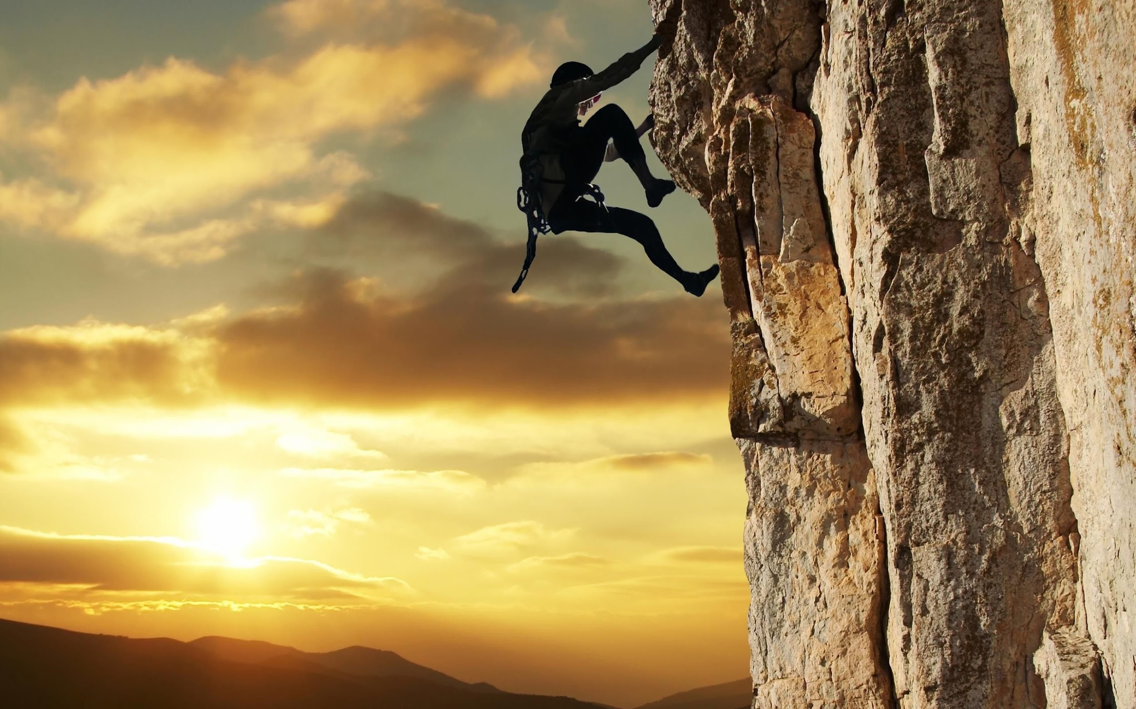
OPTION 3
Move forward with PLI and Create new, less expensive sub-brand
PROS
New target market- High potential of growth in sales
In line with company’s vision
  Higher awareness for environmental initiatives
CONS
High Implementation cost and time consuming
  Distribution channel & Inventory Management
  Marketing
High competition in the segment

Slide 39
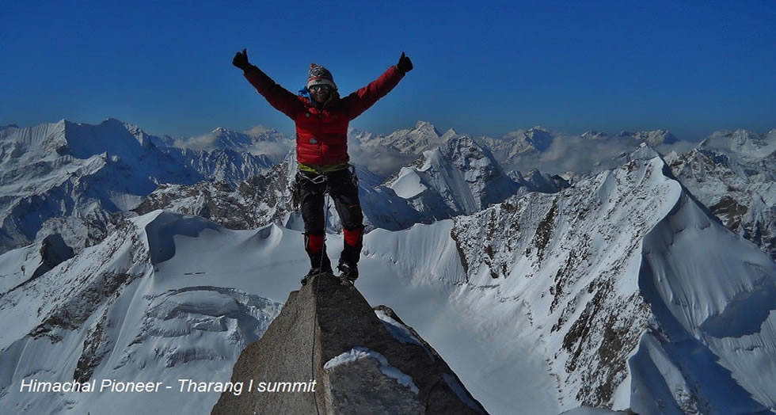
OPTION 4
Decrease Environmental focus to concentrate on growth through expanded supply chain
PROS
Increase in sales
Decrease cost structure
Ease of implementation
Meeting the consumer demand
  Inventory management + distribution channel
CONS
Against Corporate social responsibility values

Slide 40
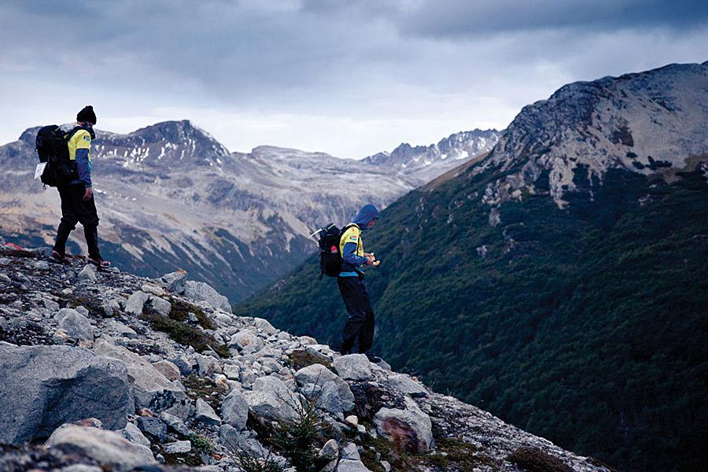
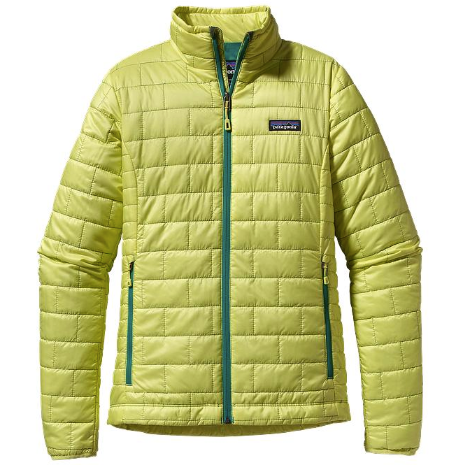
DECISION CRITERIA
 | Global expansion | 2nd Hand | Sub-Brand | Growth Focus
ALIGNMENT WITH VISION
GROWTH
BALANCE
EASE OF IMPLEMENTATION
Total | 9 | 17 | 14 | 12
Notes:
sub brand- time consuming,
Ease of implementation

Slide 41
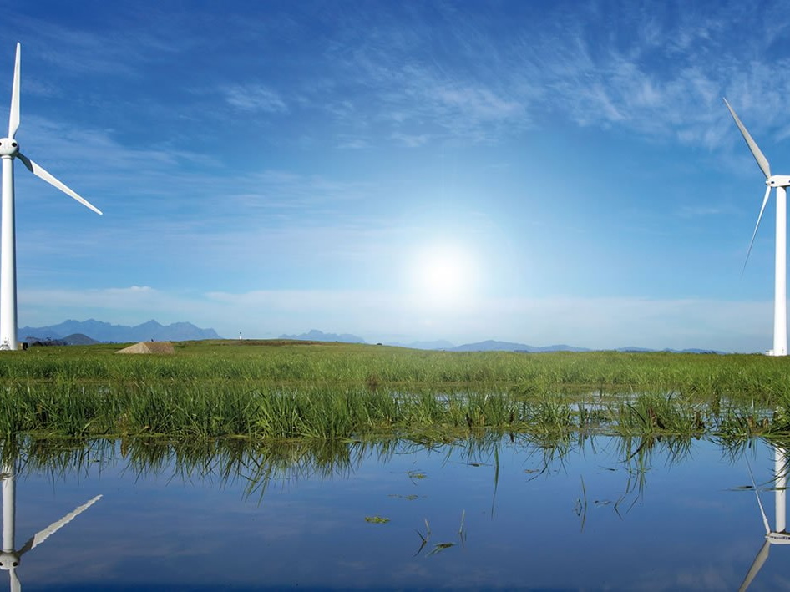
RECOMMENDATION
Target new segment with 2nd hand swap market
  Grow brand awareness
  Create entry level market
  Create a community
Move forward with PLI
  Enhance environmental and sustainability image
  Blue ocean strategy

Slide 42
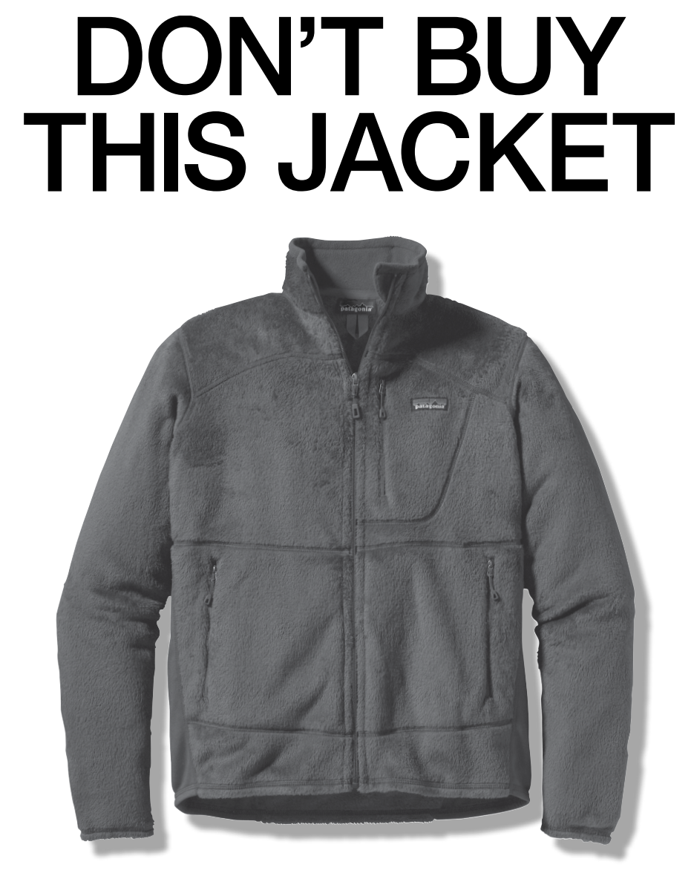
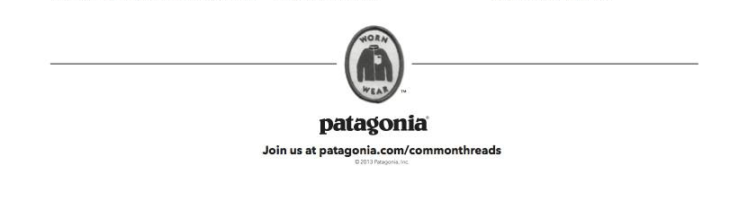

Slide 43

PRODUCT LIFECYCLE INITIATIVES
Program Mandates
  REDUCE - limit consumption to essentials, multifunctional
  REPAIR - highest quality, repairable, repair for other brands
  REUSE - online swap market, 2nd hand store, swap events, donation
  RECYCLE - return to Patagonia

Slide 44




IMPLEMENTATION
Strategic Partnerships
  Marketing: NGOs to help inform and educate customers
  Distribution: Sierra club
  Repairs: Retail outlets to pickup/dropoff
Build 2nd Hand E-store
  Revenue share partnership with eBay
  Online swap market
  Appraisal and refurbishment service

Slide 45

IMPLEMENTATION
PLI Integrated Marketing Communications
  Objectives:
    To build awareness and community
    To disseminate Information
    To educate consumers
  Advertising and public relations
  Direct: repair workshops/van tour, send DIY repair kits
  Internet: social media, youtube videos, online forums, blogs
Improve Inventory Management
Governance
  Integrate independant board members to keep vision in check

Slide 46
2010 | 2011 | 2012
eBay (online platform)
Partnerships
Sierra club (distribution, donations, marketing)
Regional outlets, retail channels (repairs, second hand)
Build online platform
Development
Improve Inventory Management
Expand repair facility
IMC Planning
2nd Hand Store Social Media Campaign
Marketing/Events
Launch Mobile Repair Workshops
Hold swap/donation events

Slide 47

Costs / Benefits
One time cost: $1.2M
Capital investment (debt to inventory): $4.6M
Ongoing costs: $1.1M
Additional increase in sales: $12.9M (10%)

Slide 48

Questions?
“I’m kind of like a Samurai. They say if you want to be a Samurai, you can’t be afraid of dying, and as soon as you flinch, you get your head cut off”
- Yvon Chouinard, Founder, Patagonia

Slide 49
APPENDIX

Slide 50

MANAGEMENT
Privately owned by Lost Arrow Corporation
High CEO turnover
HUMAN RESOURCES
Dirtbag employees
Eco-friendly staff
Less than 5% turnover
Voted best company to work for

Slide 51







COMPETITION
COMPANY | STRENGTH | WEAKNESS | STRATEGY
 | Brand power Distribution Network Large corporate resources | No product specialization Low-tech No environmental appeal | Full Market Coverage Large distribution network Cost leadership Brand recognition
 | Distribution network Wide market coverage | Low differentiation No product specialization Low-tech | Wide market coverage Cost leadership
 | Specialized products Parent company support | Low brand power Weak environmental appeal | Product specialization High price/quality
 | Brand power Large corporate resources Market leader | Not focused on specialization Weaker environmental appeal | Broad product range Large distribution network Brand awareness
 | Specialized products Environmental appeal | Low brand power | Product specialization High price/quality
 | Multi-product offering Wide market coverage | Caters to mainstream, casual consumers No environmental appeal | Mainstream casual appeal Develop a few key apparel lines
 | Specialized products High-quality | Weak environmental appeal Brand awareness | Product specialization High price/quality

Slide 52
Increase in Capital (All in M$)
Long term debt @ 2.5% D/E | 4.6
LTD w/ 11.1% D/E Ratio | 20.5
Additional Capital | 15.9

Slide 53
COSTS - Details

Slide 54
Revenues - Details

Slide 55
Cost/ Expenses
$3.8 million for eco-friendly commitment in 2009
$100k annually on field testing
$350k to repair 12k garments/yr = $29 per garment
Less than 1% revenues on marketing
1% revenues on environmental causes
$200k in kind donations to eco-causes

Slide 56

INTRODUCTION OF RECYCLING PROGRAM DID HAVE A POSITIVE IMPACT ON SALES
PROGRAM ENHANCEMENT HAS THE POTENTIAL TO FUEL TOP LINE GROWTH

Slide 57

PATAGONIA HAS BEEN OUTPERFORMING ITS INDUSTRY
ABLE TO PROTECT PROFITS EVEN DURING RECESSIONARY TIMES

Slide 58

VAST MAJORITY OF REVENUES COMES FROM 3 MAJOR PRODUCT LINES
POTENTIAL TO RATIONALIZE PRODUCTS IN ORDER TO ENHANCE INVENTORY MANAGEMENT

Slide 59

Heaviest returns from direct sales channel

Slide 60

Patagonia has some of the lowest sales per employees in its industry

Slide 61
Recommendation
 | Costs | Benefits
Reduce | short-term sales and profitability | high environmental impact enhance brand image blue ocean marketing
Repair | cost for free shipping educating consumers about repair expand repair department capacity | high environmental impact high-quality image reduced costs in returns (currently replace rather than repair)
Reuse | administration of swap and donation events establish online swap market marketing communications | targeting a different market segment increased brand awareness creating a brand community
Recycle | increase staff and storage capacity cost for free shipping | reduce landfill waste

Slide 62
Cost Mitigation Strategies
 | Costs | Cost Mitigation
Reduce | short-term sales and profitability | long-term gains in market growth and market share
Repair | cost for free shipping educating consumers about repair expand repair department capacity | establish regional partnerships for logistics (e.g. MEC) limit repairs for other brands
Reuse | administration of swap and donation events establish online swap market marketing communications | partnering with eBay for online market allow other brands for swapping take a small % of sales partner with Sierra Club
Recycle | increase staff and storage capacity cost for free shipping | establish regional partnerships for logistics (e.g. MEC)

Slide 63
Product Lifecycle Initiative
“The company’s history showed that making decisions in favor of environmental reasons always proved to be a good business in subsequent year”.

