Slide 1
What Investors Look For!

Slide 2
Key Characteristics That Appeal to Investors
Investors look for companies that exhibit certain criteria that they believe
increase the chances that an investment will pay off
It makes sense, therefore , that firms attempt to incorporate these criteria
in their strategies and operations, if at all possible
Some of these key characteristics include:
Operations in Attractive Industries and Markets
Leaders in Their Respective Fields
A Focused Business Strategy
Sustainable Competitive Advantages
Ability to Renew and Adapt to Change
Consistent Generation of Free Cash Flow Throughout Cycles
Quality Management

Slide 3
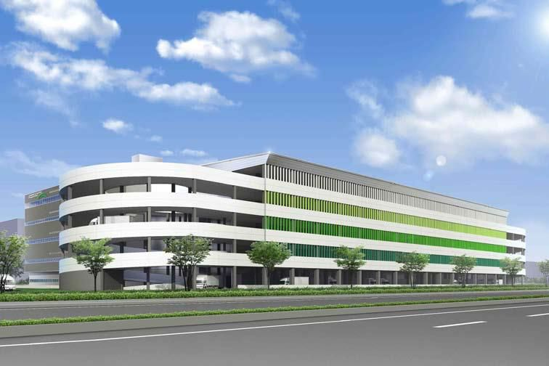
Operations in Attractive Industries & Markets
e.g. Global Logistic Properties
#1 provider of modern logistic facilities
in high growth markets of China, Japan & Brazil
their market-leading customers exhibit strong momentum, driven by
robust domestic consumption and a significant shortage of modern
logistic facilities
a leader in the highest growth market segments such as e-commerce
suppliers

Slide 4
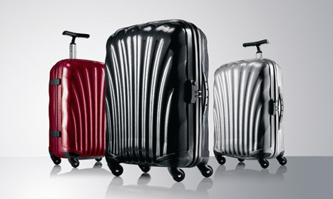
Leaders in Their Respective Fields
e.g. Samsonite
world’s largest travel luggage company
leverages on its global expertise to expand into complementary fields
uses its well-established global distribution network and retail presence
to significantly expand new brands

Slide 5
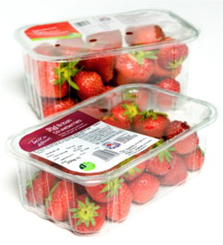
A Focused Business Strategy
e.g. Amcor
management has executed a clear strategy focused on delivering
solid growth in sales, margins and ROI
has a dual goal of improving efficiencies & diversifying operations into
fast-growing markets
it has become the world’s leading packaging company

Slide 6
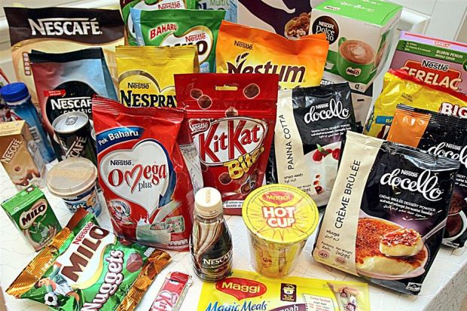
Sustainable Competitive Advantages
e.g. Nestlé
world’s leading food manufacturer
key ingredient of its success is its unrivalled portfolio of globally
recognizable brands, such as Kit Kat and Nescafé
the link between product, premier R&D, and unequalled geographic
presence and an entrepreneurial spirit have enables Nestlé to remain
dominant

Slide 7
Ability to Renew & Adapt to Change
e.g. Toto
world’s largest bathroom fixtures & accessories manufacturers
a pioneer in the areas of water & energy conservation
it continues to evolve its manufacturing practices and technologies
in advance of government regulations

Slide 8
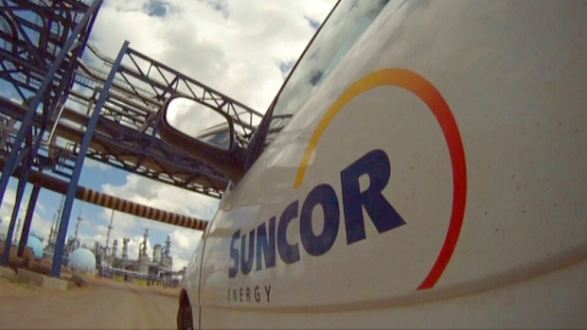
Consistent Generation of Free Cash Flow
e.g. Suncor
one of Canada’s largest integrated energy companies
has the ability to capture strong margins through the integration of its
dominant oil sands feedstock to its inland refineries reduces the impact
of volatile crude oil prices
this has allowed the firm to consistently generate between $2.0 and $2.7
billion in cash flow per quarter

Slide 9
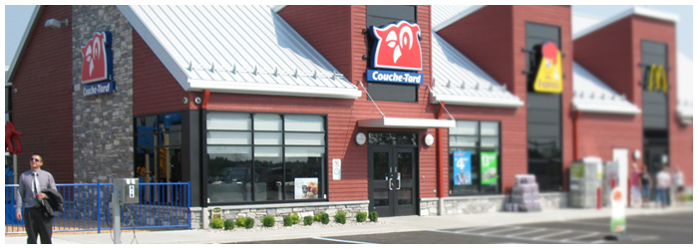
Quality Management
e.g. Couche-Tard
their management team has developed an expertise in identifying,
acquiring and integrating convenience store networks.
this translates into superior sales and operating performance

