Slide 1
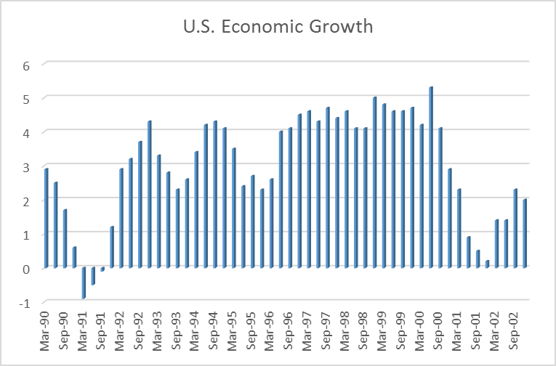
Gillette (Duracell)
Setting the Stage
Gillette – Beauty Products
- Global market (Biggest player by far)
Duracell – Batteries (Non rechargeable mostly Alkaline)
- Mostly U.S. (Biggest player; really an oligopoly – 3 large players)
Economics
Year over Year GDP Change

Slide 2
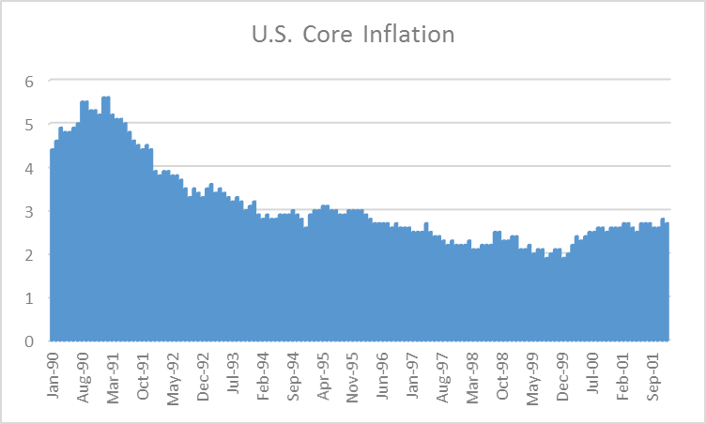
Gillette (Duracell)
Economics
Core Inflation
Interest Rates Fed Rate Mtg. Rate
Dec ’92 3.0 8.1
Dec ’93 3.0 7.3
Dec ’94 5.5 9.0
Dec ’95 5.8 7.8
Dec ’96 5.3 7.8
Dec ’97 5.5 7.3
Dec ’98 4.8 6.4
Dec ’99 5.5 8.0
Dec ’00 6.5 7.0
Dec ’01 2.0 7.3
Dec ’02 1.8 5.8

Slide 3
Gillette (Duracell)
Demographics
???
Social/Cultural Trends
Concerns about the environment
no real movements yet
no recycling
throw batteries away
no big movement towards rechargeable
most of the world is still using zinc carbon
Shifts in preferences
lot more products that need batteries
impulse buying
consumer has no clue how long batteries last
no brand preference
research shows no difference in brands - suggest buy on price
Globalization
the world is split between alkaline & zinc carbon
too expensive to build production facilities in emerging markets

Slide 4
Gillette (Duracell)
Technological Trends
acceleration of battery model introductions by major players
Government Interventions
???
Legal Battles
major battery players suing each other regularly
Business Trends
Gillette buys Duracell
Energizer is spun off by Ralston Purina
Rayovac goes from private to public

Slide 5
Gillette (Duracell)
Key Success Factors for Non-rechargeable Batteries
good relationships with key distributors
access to key shelf space
Business Cycle
from 1996 to 2000, primary battery industry has grown by 7% (2%p.a.)
the economy has grown by 4% p.a. in that same time period
late growth stage going into maturity stage
Attractiveness
Getting in
Substitutes
Power of Suppliers
Power of Buyers
3 main distributors, groceries, drug stores & discounters
rationalization in all 3 industries – fewer, bigger, more powerful
Rivalry
only way to make money in an oligopoly is peace & cooperation
Gillette started a way – paid 18Xs earnings, aggressive, sped up cycle

Slide 6
Gillette (Duracell)
Competitors
Energizer - Introduce new generation at same price
Rayovac – products 20% below Duracell & Energizer
- money back guarantee
Private Labels
Sony, Kodak, Panasonic

Slide 7
Gillette (Duracell)
Duracell Internal
Supply Side
no info
Operations
together with Gillette – one of the most recognizable brands worldwide
Gillette diversified business
personal grooming
small appliances (Braun)
oral care (Oral B)
portable power (Duracell)
has 77.2% of razorblade refill market
has 52.4% of disposable razorblade market
estimated they would reduce costs at Duracell by $80 – 120mm
Distribution
worldwide distribution network
great long-term relationships
but they are still big players – calling the shots
Risk Management
Duracell’s sales up, profits down
pre Duracell purchase, Gillette’s earnings were growing 17%p.a.

Slide 8
Gillette (Duracell)
Duracell Internal
Risk Management cont’d.
loans payable have gone from $500mm to $2.2 billion from 1997 to 2000
LT debt Current gone from $9mm to $631 mm
accounts payable from $1.8 billion to $2.4 billion
all this when interest rates are 7 – 8%
sales growth has flattened out after 17%p.a. growth pre Duracell
interest wet up 137% in 3 years
EBTA went from $1.7 billion to $1.3 billion from 1998 to 2000
Gillette’s price fell 45% from $49 to $34 from Jan. ‘99 to Jan. ‘01
U.S. stock market rose 6.5% in the same period

Slide 9
Gillette (Duracell)
Duracell Internal
Customer Selection
no info
Customer Attraction
spending money on advertising
customers can’t tell the difference
customers buy on impulse
Customer Retention
product not one that works on brand
just because you bought Duracell this time, does not mean you will buy
it next time – depends what’s on sale
Getting Customers to buy More
only if batteries are sold in large packages & cheap
only really works for AA

Slide 10
Gillette (Duracell)
Duracell Internal
Future Product Research
always working on the next generation
probably introduce new products too fast for the needs of the market
R & D
no info
New Product Prototyping
no info
Bringing New Products to Market
all seems coordinated
each generation results in massive advertising
each generation results in a price increase
Energizer is following suit but has a base product (Eveready)
Rayovac not really in the innovation race – competes on price & winning
Social Processes
Compliance with regulations
no info to the contrary
a lot of time in court
Social Reputation
no info

Slide 11
Gillette (Duracell)
Duracell Internal
Leadership
3 CEO’s in 4 years
in-your-face aggressive vis-a-vis competitors
no leaders have been able to get the Duracell investment going
new leader brought in to turn things around
Strategic Approach
Gillette is used to having the best, proving it and marketing it
Batteries are totally different
Duracell does not fit the pattern
Results
Stock price has fallen 45% from 1999 to 2001
Stock Market has gained
Staff
being cut – can’t be happy
no results – no bonuses probably

