Slide 1
HADOOP
Bleeding edge technology to transform Data into Knowledge
In pioneer days they used oxen for heavy pulling, and when one ox couldn’t budge a log, they didn’t try to grow a larger ox.
- Grace Hoppe

Slide 2
Current Situation
In 2012, an estimated 2.8 Zettabytes (2.8 Trillion GBs) was created in the world.
This is enough to fill 80 Billion 32GB iPads
Facebook hosts approximately 10 billion photos - taking up 1 petabyte of storage
NYSE generates ~1 TB of new trade data per day

Slide 3
Data - Moving Forward
Popular Saying: “More data usually beats better algorithms”
Big Data is here, but companies are unable to properly store and analyze it
Organizations IS departments can either:
- Give up: Succumb to information-overload paralysis, or
- Monetize big data: Attempt to harness new technologies

Slide 5
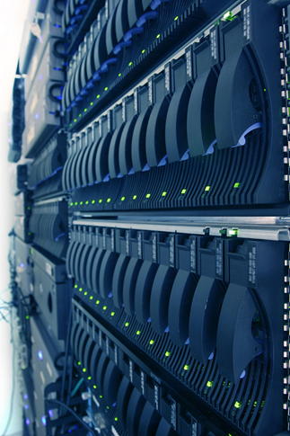
Early Adopters - Tech
Yahoo
Store in internet Index
43,000 nodes
Servers racked with Velcro (MTBF 1000 days)
FaceBook
Analysis for target adds
Over 100 Petabytes
Growing at ½ PB/day

Slide 6
Hadoop Architecture
Storage distributed across multiple nodes
Nodes are composed of commodity servers
Nodes orchestrated to process requests in parallel.
Process any kind of data

Slide 7
Hadoop Infrastructure
Hardware
Commodity servers
Software
Unix OS, Hadoop
Network
Data
Fiber network backend, IP LAN for users
Any format (structured or not)

Slide 8
Map Reduce

Slide 9
Limitations
Framework is not suited for transactional environments
Long load time; difficulty to edit partial dataset

