Slide 1
HADOOP
Bleeding edge technology to transform Data into Knowledge
In pioneer days they used oxen for heavy pulling, and when one ox couldn’t budge a log, they didn’t try to grow a larger ox.
- Grace Hoppe

Slide 2
Current Situation
In 2012, an estimated 2.8 Zettabytes (2.8 Trillion GBs) was created in the world.
This is enough to fill 80 Billion 32GB iPads
  Facebook hosts approximately 10 billion photos - taking up 1 petabyte of storage
  NYSE generates ~1 TB of new trade data per day

Slide 3
Data - Moving Forward
Popular Saying: “More data usually beats better algorithms”
Big Data is here, but companies are unable to properly store and analyze it
Organizations IS departments can either:
- Give up: Succumb to information-overload paralysis, or
- Monetize big data: Attempt to harness new technologies

Slide 4



Slide 5
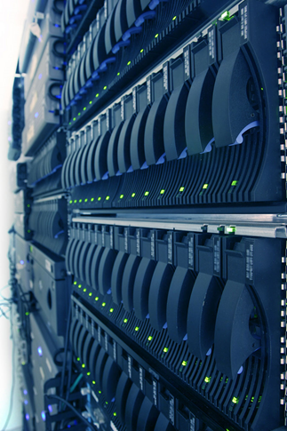


Early Adopters - Tech
Yahoo
Store in internet Index
43,000 nodes
Servers racked with Velcro (MTBF 1000 days)
FaceBook
Analysis for target adds
Over 100 Petabytes
Growing at ½ PB/day

Slide 6
Hadoop Architecture
Storage distributed across multiple nodes
Nodes are composed of commodity servers
Nodes orchestrated to process requests in parallel.
Process any kind of data

Slide 7
Hadoop Infrastructure
Hardware
Commodity servers
Software
Unix OS, Hadoop
Network
Data
Fiber network backend, IP LAN for users
Any format (structured or not)

Slide 8
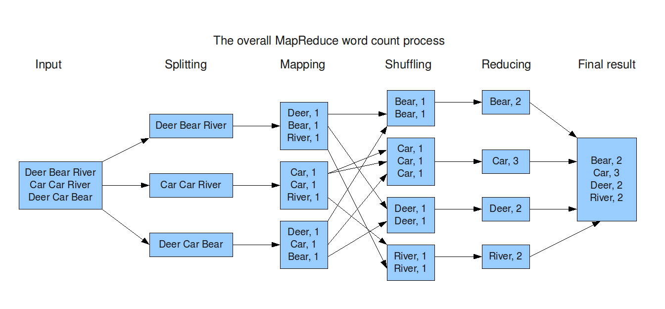
Map Reduce

Slide 9
Limitations
Framework is not suited for transactional environments
Long load time; difficulty to edit partial dataset

Slide 10
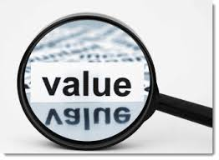
Business value
  Process Big Data at reasonable costs
  Provides fault tolerance (continue operating in the
  event of failure)
  Enables massive parallel processing (MPP)
  Runs on commodity infrastructure – Cheap to run
  Available under the GNU GPL (General Public License) – Free to use.

Slide 11
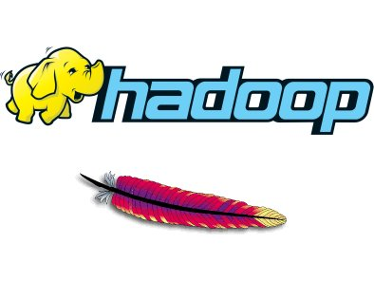
Challenges of adoption
  Fear of the unknown
  Lack of skillset
  Lack of understanding of ROI
  Open Source (potential security risk)

Slide 12
Data Governance
Exploratory Phase
Implementation Phase

Slide 13
Data Governance
Exploratory Phase
Hadoop integration into existing IT infrastructure.
Determining key issues and requirements around privacy.
Recognizing responsibilities associated with deploying Hadoop

Slide 14
Data Governance
Implementation Phase
Determining business needs
Organization Structure
Stewardship
Data Risk and Quality Management
Information Life Cycle Management
Security & Privacy
Data Architecture

Slide 15
Conclusions
The Hadoop platform was designed to solve problems where you have a lot of data.
Designed to run deep and computationally extensive analytics.
Hadoop applies to a bunch of markets and create competitive advantage
Knowledge is power

Slide 16
Thank you!

