Slide 1
Cash Flow Analysis
The bottom line,
below the bottom line

Slide 2
Practical Use of Cash Flow Analysis
Why are Cash Flows important?
Why bother?

Slide 3
Practical Use of Cash Flow Analysis
Why are Cash Flows important?
Why bother?
Year | Y1 | Y2 | Y3
NI | $ 703 M | $ 893 M | $ 979 M
NI % Grth |  | 27% | 10%

Slide 4
Practical Use of Cash Flow Analysis
Close Look at CF fro OPS (in Millions)
What questions are raised?
Year | Y1 | Y2 | Y3
NI | $ 703 | $ 893 | $ 979
NI % Grth |  | 27% | 10%
CF-OPS | $ 1,640 | $ 1,228 | $ 4,779
CRR | 2.3 | 1.4 | 4.9
 | Y1 Q1 | Y1 Q2 | Y1 Q3 | Y1 Q4
NI | $ 338 | $ 289 | $ 292 | $ 60
CF - Ops | $ (457) | $ (90) | $ 647 | $ 4,679
CRR | -1.4 | -0.3 | 2.2 | 78.0

Slide 5
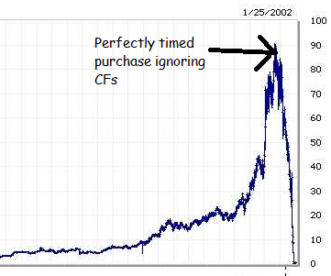

Slide 6
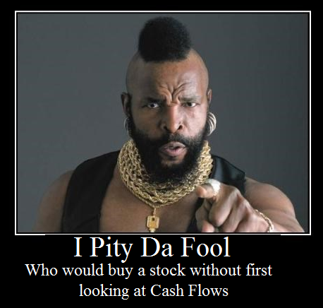

Slide 7
Cash Realization Ratio (Quality of Earnings)
How to calculate:
CRR = (Cash from Ops) / (N.I.)
What does it tell: ?

Slide 8
Cash Realization Ratio (Quality of Earnings)
How to calculate:
CRR = (Cash from Ops) / (N.I.)
What does it tell: Income dependency on non-cash sources Vs. Operations
(ex: mark-to-market accounting)
What a company wants: ?

Slide 9
Cash Realization Ratio (Quality of Earnings)
How to calculate:
CRR = (Cash from Ops) / (N.I.)
What does it tell: Income dependency on non-cash sources Vs. Ops
(ex: mark-to-market accounting)
What a company wants: CRR > 1
For AmerBran:
$574, 128 / $328,773 = 1.7 (Great)

Slide 10
Coverage Ratios Times Interest Earned
How to calculate:
TIE = EBIT / Interest Payable
CF based TIE = CF from Ops / Interest Payables
What does it tell: ?

Slide 11
Coverage Ratios Times Interest Earned
How to calculate:
TIE = EBIT / Interest Payable
CF based TIE = CF from Ops / Interest Payables
What does it tell: Ability to cover interest charges (Avoid bankruptcy)
Why use CF-Ops and not EBIT: ?

Slide 12
Coverage Ratios Times Interest Earned
How to calculate:
TIE = EBIT / Interest Payable
CF based TIE = CF from Ops / Interest Payables
What does it tell: Ability to cover interest charges (Avoid bankruptcy)
Why use CF-Ops and not EBIT: Focus on cash (Ignore depreciation/Accounting write-offs)
What a company wants: ?

Slide 13
Coverage Ratios Times Interest Earned
How to calculate:
TIE = EBIT / Interest Payable
CF based TIE = CF from Ops / Interest Payables
What does it tell: Ability to cover interest charges (avoid bankruptcy)
Why use CF-Ops and not EBIT: Focus on cash (Ignore depreciation/Accounting write-offs)
What a company wants: TIE >> 1
(TIE < 1 = Solvency issues)

Slide 14
Coverage Ratios Times Interest Earned
For AmerBran:
Estimation:
LTL + STD = $1,311,450
If 10% interest => Liability of $131,145
TIE = $603,331 / $ 131,145 = 4.6
CF-TIE = $574,128 / $ 131,145 = 4.3
Even if interest paid was 15%; still far from potential default

Slide 15
Coverage Ratios Fix Charges Ratio
Same principal as TIE Ratio
How to calculate:
FCR = EBIT / Fix Charges
CF based TIE = CF from Ops / Fix Charges
What does it tell: Ability to cover fix charges
Low FCR could lead to: ?

Slide 16
Coverage Ratios Fix Charges Ratio
Same principal as TIE Ratio
How to calculate:
FCR = EBIT / Fix Charges
CF based TIE = CF from Ops / Fix Charges
What does it tell: Ability to cover fix charges
Low FCR could lead to:
breaches of contract penalties / Lawsuits
loose capabilities (eviction, lease repossessions)
Asset deterioration (no $ to repair)
Why use CF-Ops and not EBIT: Focus on cash
What a company wants: TIE >> 1 ( < 1 = Solvency issues)

Slide 17
Free Cash Flow
How to calculate:
FCF = OPS CF – (KTLO + Service Debt + Dividends)
What does it tell: ?
What a company wants: ?

Slide 18
Free Cash Flow
How to calculate:
FCF = OPS CF – (KTLO + Service Debt + Dividends)
What does it tell: Capacity to maintain (or increase) dividends
What a company wants: FCF > 0

Slide 19
Free Cash Flow
For AmerBran:
Assume Annual Depreciation is typical Asset Replacement: $115,974
Assume 10% interest on LT/ST Debt: $131,145
Disclosed Dividend: $216,158
FCF = $574,128 – ($115,974 + $131,145 + $216,158) = $110,851
Conclusion ?

Slide 20
Free Cash Flow
For AmerBran:
Assume Annual Depreciation is typical Asset Replacement: $115,974
Assume 10% interest on LT/ST Debt: $131,145
Dividend: $216,158
FCF = $574,128 – ($115,974 + $131,145 + $216,158) = $110,851
Conclusion:
Dividends seems sustainable

Slide 21
Sources & Uses of Cash
Sources of Cash | Amount | %
Cash from Operations | $ 574,128 | 84%
Short Term Borrowing | $ 79,664 | 12%
Long Term Debt |  | 0%
Issuance of Stock |  | 0%
Asset disposals | $ 33,162 | 5%
Sales of Investments |  | 0%
TOTAL | $ 686,954 | 100%
Uses of Cash | Amount | %
Asset Acquisition | $ 260,075 | 38%
Purchase of Investments | $ 30,609 | 4%
Purchase of a company | $ 133,721 | 19%
Dividends Paid | $ 216,158 | 31%
Repayment of STD |  | 0%
Repayment of LTD | $ 34,606 | 5%
Misc. Activities | $ 6,825 | 1%
TOTAL | $ 681,994 | 99%
Net Increase in Cash | $ 4,960 | 1%

Slide 22
Sources of Cash
Sources of Cash | Amount | %
Cash from Operations | $ 574,128 | 84%
Short Term Borrowing | $ 79,664 | 12%
Long Term Debt |  | 0%
Issuance of Stock |  | 0%
Asset disposals | $ 33,162 | 5%
Sales of Investments |  | 0%
TOTAL | $ 686,954 | 100%
Conclusions on sources: ?

Slide 23
Sources of Cash
Sources of Cash | Amount | %
Cash from Operations | $ 574,128 | 84%
Short Term Borrowing | $ 79,664 | 12%
Long Term Debt |  | 0%
Issuance of Stock |  | 0%
Asset disposals | $ 33,162 | 5%
Sales of Investments |  | 0%
TOTAL | $ 686,954 | 100%
Conclusions on sources:
Borrowing comes with Liabilities
Stock issue dilutes ownership
Asset disposal impairs capabilities
Sales of investments in non-repeatable
Cash from Operations:
Fairly repeatable
No stings attached

Slide 24
Uses of Cash
Uses of Cash | Amount | %
Asset Acquisition | $ 260,075 | 38%
Purchase of Investments | $ 30,609 | 4%
Purchase of a company | $ 133,721 | 19%
Dividends Paid | $ 216,158 | 31%
Repayment of STD |  | 0%
Repayment of LTD | $ 34,606 | 5%
Misc. Activities | $ 6,825 | 1%
TOTAL SPENT | $ 681,994 | 99%
Net Increase in Cash | $ 4,960 | 1%
Cash Ratio:
$28,912 / $1,625,218 = 0.018
Quick Ratio:
$785,064 / $1,625,218 = 0.48
Questions raised: ?

Slide 25
Conclusion
Facts on AmerBrand:
Quality Earnings (Cash Realization Ratio = 1.7)
Not exposed to imminent bankruptcy (TIE = 4.3)
Questionable cash management (QR = 0.48 yet only 1% cash preserved)
Sustainable Divided (FCF = $110,851)
For Management Consultants:
Suggest revision of cash management/investment strategies
For Investors:
Solid operations and sustainable dividends
Buy as long as economy is doing well
Keep an eye on company’s cash levels

