Slide 1
Cash Flow Analysis
  “The bottom line, below the bottom line”

Slide 2
Cash Flow Analysis
Practical Use
Why are Cash Flows important?
Why bother?
Year | Y1 | Y2 | Y3
NI | $ 703 M | $ 893 M | $ 979 M
NI % Grth |  | 27% | 10%

Slide 3
Cash Flow Analysis
Practical Use
Close Look at CF fro OPS (in Millions)
What questions are raised?
Year | Y1 | Y2 | Y3
NI | $ 703 | $ 893 | $ 979
NI % Grth |  | 27% | 10%
CF-OPS | $ 1,640 | $ 1,228 | $ 4,779
 | Y3 Q1 | Y3 Q2 | Y3 Q3 | Y3 Q4
NI | $ 338 | $ 289 | $ 292 | $ 60
CF - Ops | $ (457) | $ (90) | $ 647 | $ 4,679

Slide 4

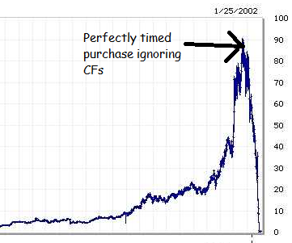

Perfect Timing!

Slide 5
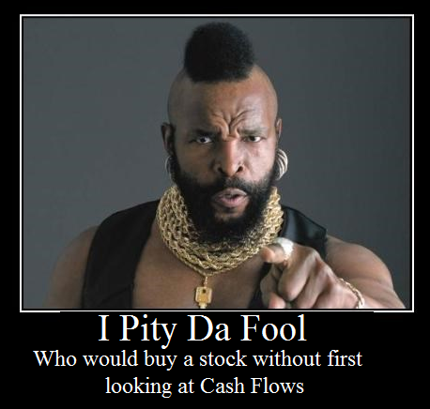

Slide 6

Cash Realization Ratio (CRR)
Quality of Earnings
How to calculate:
  CRR = (Cash from Ops) / (N.I.)
What does it tell?
  Income independence from non-cash sources or non-repeatable sources
  (ex: mark-to-market accounting, gain on asset sale, etc…)
What a company wants?
  CRR > 1
For AmerBran:
  $574, 128 / $328,773 = 1.7 (Great)

Slide 7
Coverage Ratios
Times Interest Earned (TIE)
How to calculate:
  TIE = EBIT / Interest Payable
  CF based TIE = CF from Ops / Interest Payables
What does it tell:
  Ability to cover interest charges (bankruptcy)
Why use CF-Ops and not EBIT:
Focus on cash (Ignore depreciation/Accounting write-offs)
What a company wants:
  TIE >> 1 ( < 1 = Solvency issues)

Slide 8
Coverage Ratios
Times Interest Earned (TIE)
For AmerBran:
  Estimation:
    LTL + STD = $1,311,450
    If 10% interest => Liability of $131,145
  TIE = $603,331 / $ 131,145 = 4.6
  CF-TIE = $574,128 / $ 131,145 = 4.3

Slide 9
Coverage Ratios
Fix Charges Ratio (FCR)
Same principal as TIE Ratio
How to calculate:
  FCR = EBIT / Fix Charges
  CF based TIE = CF from Ops / Fix Charges
What does it tell?
  Ability to cover fix charges
Low Fix Charges Ration could lead to:
  breaches of contract penalties / Lawsuits
  loose capabilities (eviction, lease repossessions)
  Asset Deterioration (no $ to repair)
Why use CF-Ops and not EBIT?
  Focus on cash
What a company wants?
  TIE >> 1 ( < 1 = Solvency issues)

Slide 10
Free Cash Flow (FCF)
How to calculate:
  FCF = OPS CF – (KTLO + Debt Service + Dividends)
What does it tell?
  Capacity to maintain (or increase) dividends
What a company wants?
  Free Cash Flow > 0

Slide 11
Free Cash Flow (FCF)
For AmerBran:
Assume Annual Depreciation is typical Asset Replacement:
$115,974
    Assume 10% interest on LT/ST Debt:
    $131,145
Disclosed Dividend: $216,158
FCF = $574,128 – ($115,974 + $131,145 + $216,158) = $110,851
Conclusion:
Dividends seems sustainable

Slide 12
Sources & Uses of Cash
Sources of Cash | Amount | %
Cash from Operations | $ 574,128 | 84%
Short Term Borrowing | $ 79,664 | 12%
Long Term Debt |  | 0%
Issuance of Stock |  | 0%
Asset disposals | $ 33,162 | 5%
Sales of Investments |  | 0%
TOTAL | $ 686,954 | 100%
Uses of Cash | Amount | %
Asset Acquisition | $ 260,075 | 38%
Purchase of Investments | $ 30,609 | 4%
Purchase of a company | $ 133,721 | 19%
Dividends Paid | $ 216,158 | 31%
Repayment of STD |  | 0%
Repayment of LTD | $ 34,606 | 5%
Misc. Activities | $ 6,825 | 1%
TOTAL | $ 681,994 | 99%
Net Increase in Cash | $ 4,960 | 1%

Slide 13
Sources of Cash
Sources of Cash | Amount | %
Cash from Operations | $ 574,128 | 84%
Short Term Borrowing | $ 79,664 | 12%
Long Term Debt |  | 0%
Issuance of Stock |  | 0%
Asset disposals | $ 33,162 | 5%
Sales of Investments |  | 0%
TOTAL | $ 686,954 | 100%
Conclusions on sources?
Borrowing comes with Liabilities
Stock issue dilutes ownership
Asset disposal impairs capabilities
Sales of investments in non-repeatable
Cash from Operations:
Fairly repeatable
No strings attached

Slide 14
Uses of Cash
Uses of Cash | Amount | %
Asset Acquisition | $ 260,075 | 38%
Purchase of Investments | $ 30,609 | 4%
Purchase of a company | $ 133,721 | 19%
Dividends Paid | $ 216,158 | 31%
Repayment of STD |  | 0%
Repayment of LTD | $ 34,606 | 5%
Misc. Activities | $ 6,825 | 1%
TOTAL SPENT | $ 681,994 | 99%
Net Increase in Cash | $ 4,960 | 1%
Cash Ratio:
- $28,912 / $1,625,218 = 0.018
Quick Ratio:
- $785,064 / $1,625,218 = 0.48
Questions Raised?

Slide 15
Conclusion
Facts on AmerBrand:
  Quality Earnings (Cash Realization Ratio = 1.7)
  Not exposed to imminent bankruptcy (TIE = 4.3)
Questionable cash management (QR = 0.48 yet only 1% cash preserved)
  Sustainable Divided (FCF = $110,851)
For Management:
  Suggest revision of cash management/investment strategies
For Investors:
  Solid operations and sustainable dividends
  Buy as long as economy is doing well
  Keep an eye on company’s cash levels

Slide 16
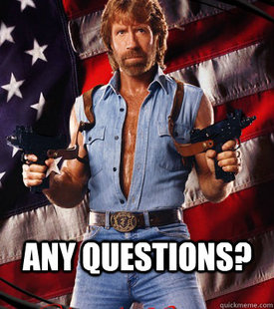

Slide 17


Slide 18


