Slide 1
AIR CANADA
Presented by
Simon Foucher
Geneviève Lavigueur

Slide 2
AIR CANADA OVERVIEW
Founded in 1936
Largest Airline in Canada
Four Hubs : Toronto, Vancouver, Montréal & Calgary
In 2013 : 1500 flights to over 326M passengers
Member of Star Alliance Network: 28 airlines affiliated with Aeroplan

Slide 3
Corporate Governance
Shareholders Relations
Auditors
Meetings downtown Montreal
Proxy voting by mail, fax or internet
Same Auditors since 1990 (PWC LLP)

Slide 4
Corporate Governance
Board
Number of director: 9 (8 independent)
Number of annual meetings: 10
Board tenure has an average of 4.6 years
Retirement policy (75 years old), but board has the right to overrule the guideline
Nomination committee with guidelines
In 2013, only 1 director missed 1 meeting, almost perfect attendance

Slide 5
Corporate Governance
Compensation
Industry benchmarking
Executive Compensation
Salaries frozen (pension solvency issue)
CEO offered a 5M$ bonus in 2012 (Sign up bonus)
Clear disclosure of accomplishments and targets

Slide 6
Corporate Social Responsibility
First corporate sustainability report in 2011
Four main sections: safety, environment, employees and community
Safety complies with minimum requirements
CO₂ reduction effort achieving efficiency and cutting cost
Unsatisfied employee :
Strikes and Lockouts
75 flights cancelled, pilots called in sick in 2012

Slide 7
Risk Management Strategy
Terrorist Act
The ability to reduce operation costs
Energy prices
Employee and labor relation
Liquidity
Pension
Impact on the business
War
Industry, market and competition
Economy and geo-political conditions
Epidemic Diseases
Currency exchange and interest rates
Interruption or disruption in service
Environmental Factors
Insurance issues and costs
Supply Issues
Changes in demand due to the seasonal nature of the business
Changes in laws and regulations
Customer cancelation, Overload happening, etc
Likelihood of occurrence

Slide 8
Risk Management Strategy
No systematic process to control/manage risk
No clear accountability (board / committees)
Risk related KPIs in compensation – no clear HR expertize
Audit and Risk Management Committee met 4/year

Slide 9
Ownership Structure
Dual Class Voting Shares
75% Class B (Canadian Owned)
Air Canada Public Participation Act
Canada Transportation Act (CTA)
25% Class A (International)

Slide 10
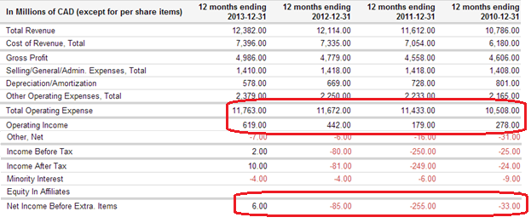
Financial Performance

Slide 11
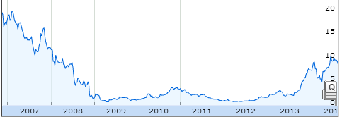
Share Performance

Slide 12
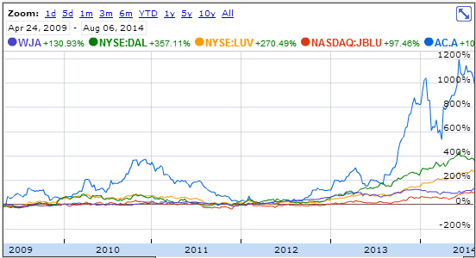
Share Performance

Slide 13
Recommendation – Don’t Buy
Cons
Unproven Success
Pension Liability
Pollution
Energy Costs
Pros
Canadian Control
Government Bailout
Starting to be Profitable
Labor Relations

