Slide 1
Risks
External
Energy Costs
Environment
Internal
Union Relations
Pension
Political Instability
Regulation
Financial Health
Corporate Culture

Slide 2
Ownership Structure
Dual Class Voting Shares
75% Class B (Canadian Owned)
Air Canada Public Participation Act
Canada Transportation Act (CTA)
25% Class A (International)

Slide 3
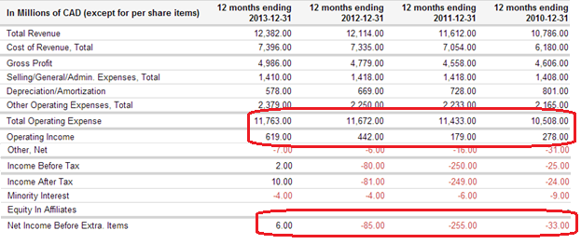
Financial Performance

Slide 4
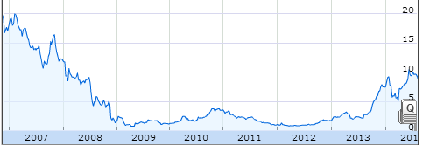
Share Performance

Slide 5
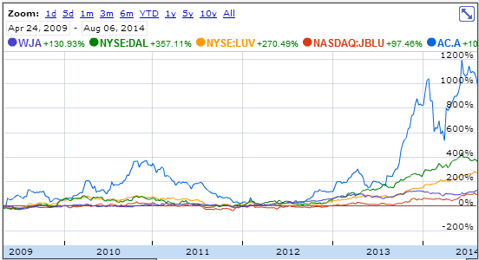
Share Performance

Slide 6
Recommendation – Don’t Buy
Cons
Unproven Success
Pension Liability
Pollution
Energy Costs
Pros
Canadian Control
Government Bailout
Starting to be Profitable
Labor Relations

