Slide 1
Applied Private Equity and Venture Capital
Course 4
Nicolas Renaud

Slide 2
Course Plan Today
  Forecasting Performance
  Top down
  Bottom up
  Course Points Outstanding
  Group projects

Slide 3
Forecasting is not a science
“ Those who have knowledge, don't predict. Those who predict, don't have knowledge. “
Lao Tzu, 6th Century BC
"It is far better to foresee even without certainty than not to foresee at all. "
Henri Poincare in The Foundations of Science

Slide 4
The Pillars of Performance Forecast
Historical performance
Company absolute performance
Performance vs. peers
Market forecasts
Forecast studies
Analyst reviews
Vision

Slide 5
The Pillars of performance forecast
Historical performance
Company absolute performance
Performance vs. peers
Market forecasts
Forecast studies
Analyst reviews
Vision

Slide 6
Historical Analysis
Company performance
Products – with a very good degree of accuracy
Understanding where the growth is coming from
Region
Perimeter (we are focused on ORGANIC growth)
TRY to understand what happened in the past to better forecast the future
Need to look at peers performance too

Slide 7
Importance of Perimeter
Although sales performance and rising COGS negatively impacted EBITDA, stringent cost control had a mitigated impact.

Slide 8
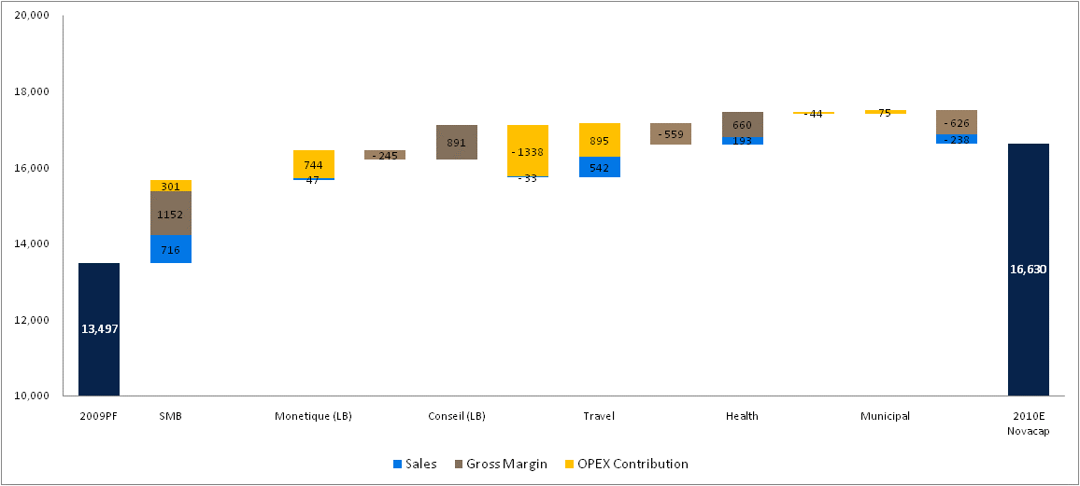
Historical Performance Analysis
EBITDA Detailed Performance Analysis
Only SMB and Travel performance where driven by sales performance
Strong performance of expense management

Slide 9
Example of Analysis
Potato Production
The chart opposite illustrates total annual US potato production as well as Idaho. While total production has been falling, Idaho has maintained its market share
The charts below illustrate pricing of potatoes over the last 10 years. Dehy pricing as a % of raw has varied greatly over the years, however, has been maintained at a higher level since 2006
All grade potatoes vs. Dehy prices
Process grade potatoes vs. Dehy prices

Slide 10
Historical Pricing
Hard to see a trend but
  Overall increase in Xconnect pricing due to switch toward T1
  Some decline in rev per cabinets in certain datacenters
Source: Quarterly by Site by Unit Revenue

Slide 11




Telecom and Fiber Comparables
(2)
(3)
Sources: Company filings, Bloomberg, Capital IQ, Scotia estimates and street research
(1) I.B.E.S. estimates calendarized a at December 31st (2) Pro forma acquisition of CTV Inc., two preferred share offerings, acquisition of MLSE and pension plan contribution (3) Pro forma two preferred share offerings and pension plan contribution (4) Pro forma acquisitin of Global Crossing Ltd closed October-4-11 (5) Pro forma L7 Solutions Pty Ltd acquisition closed Nov 12, 2011

Slide 12
The Pillars of Performance Forecast
Sales can be effectively forecasted using proper market analysis
Historical performance
Company absolute performance
Performance vs. peers
Market forecasts
Forecast studies
Analyst reviews
Vision

Slide 13
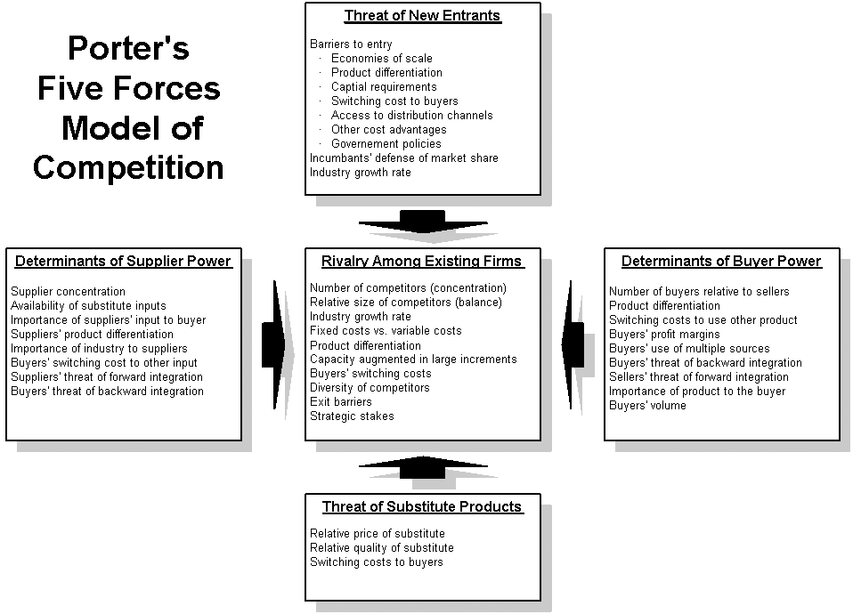
Good Old Porter
+ Government
& Regulation

Slide 14
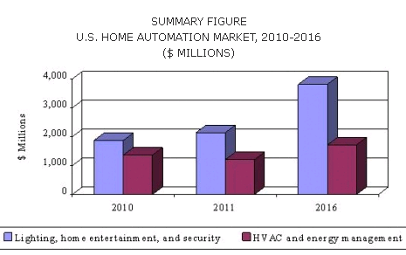
Home Automation
Home automation is a market that is underdeveloped, specifically on the ‘Security’ side of the industry.
The World is quickly beginning to automate; Offices and Cars no longer require the use of keys.
Home security has yet to reach this point, but it is projected to witness accelerated growth between now and 2016.
Rising home prices and income will be a driver behind the growth of this industry, as home owners will want to modernize and improve their overall quality of life.
The U.S. market for home automation systems and devices was worth approximately $3.2 billion in 2010. It is expected to grow to almost $3.4 billion in 2011. In the longer term (i.e., 2011 to 2016), the forecast is for strong renewed growth, which is expected to exceed $5.5 billion in 2016, a CAGR of 10.5% between 2011 and 2016.
Lighting, home entertainment, and security systems accounted for nearly 58% of the U.S. home automation market in 2010. It is estimated to be around $2.1 billion in the year and further to reach $3.8 billion by 2016 at a CAGR of 12.2 %.
Source: BCC Research

Slide 15
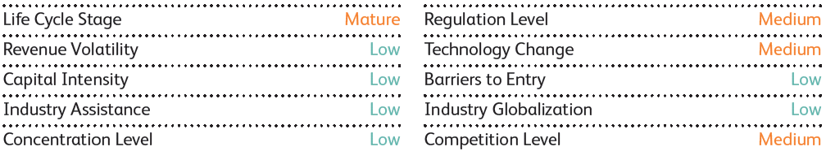
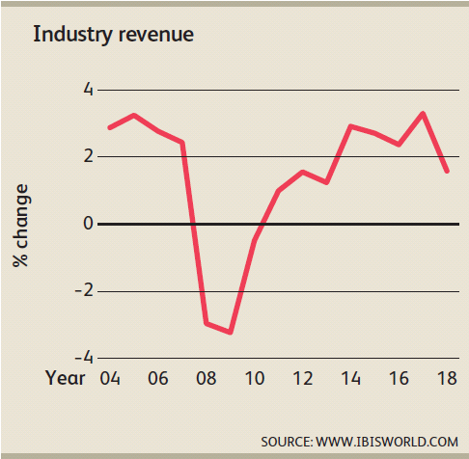
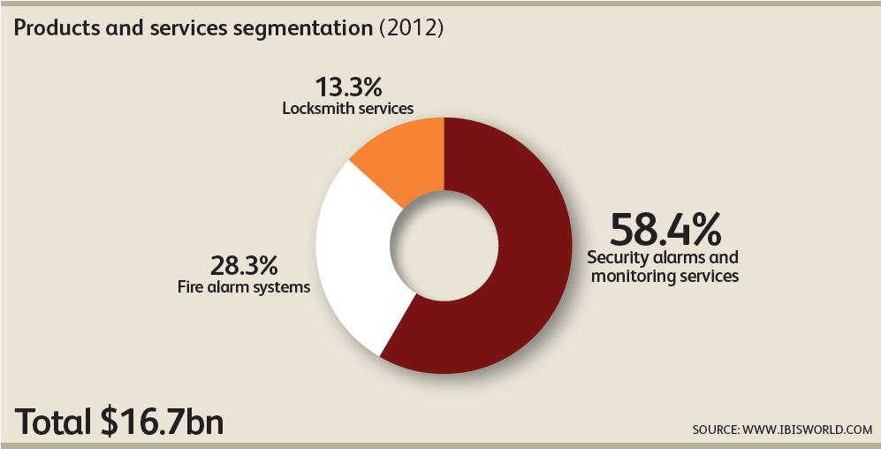
Security Industry Overview– United States
Alarm and Security industry in the United States is currently worth $16.7 Bn.
Revenue is expected to increase by at least 1% per annum through 2018 with an annualized rate of 2.6%
Generally a Capital Light industry.
Heavily impacted by external drivers such as: Crime rate, Per Capita Disposable Income, Spending on home improvements and finally value of residential and non-residential construction.
During the recession, industry only contracted by 3%, signaling some resilience.
Industry Structure
Source: IBIS World
Revenue Growth and Segmentation

Slide 16
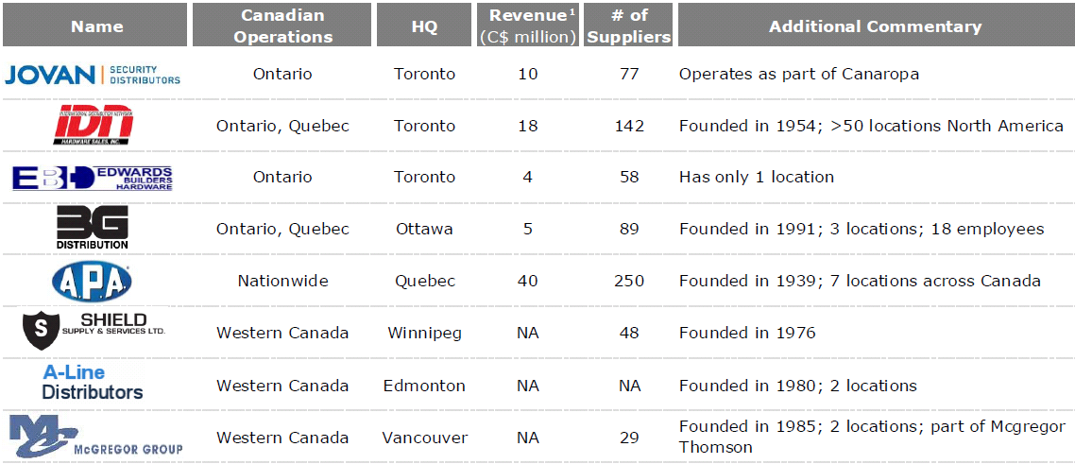
Industry Landscape

Slide 17
Chicago Competitive Landscape

Slide 18
The Pillars of Performance Forecast
Historical performance
Company absolute performance
Performance vs. peers
Market forecasts
Forecast studies
Analyst reviews
Vision
Explain market share gain or loss

Slide 19
Bottom Up
Bottom up Analysis
Recurring revenue
+
Backlog
-
Attrition
+
Pipeline

Slide 20
Revenue Breakdown – 2007 to 2010
  Revenue evolution has been pretty stable despite strong fluctuation in clients needs for recruiting
  Pure recurring portion of the business represent up to 72% of revenues

Slide 21
Bottom up
8.2
7.8

Slide 22
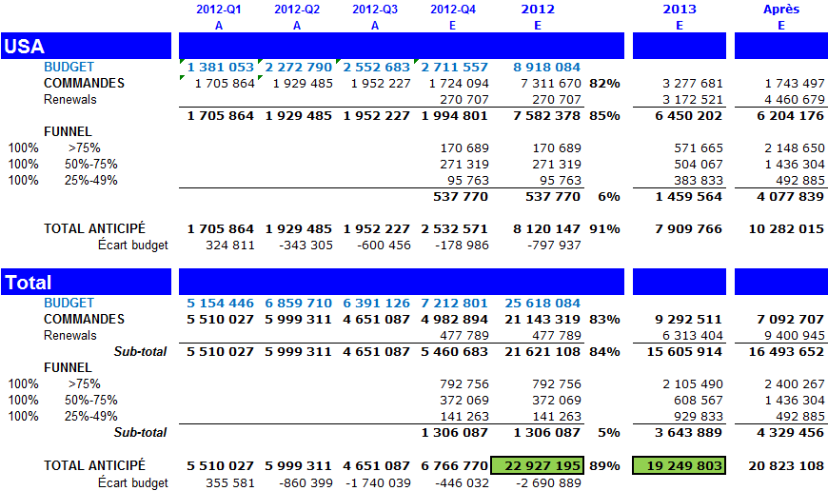
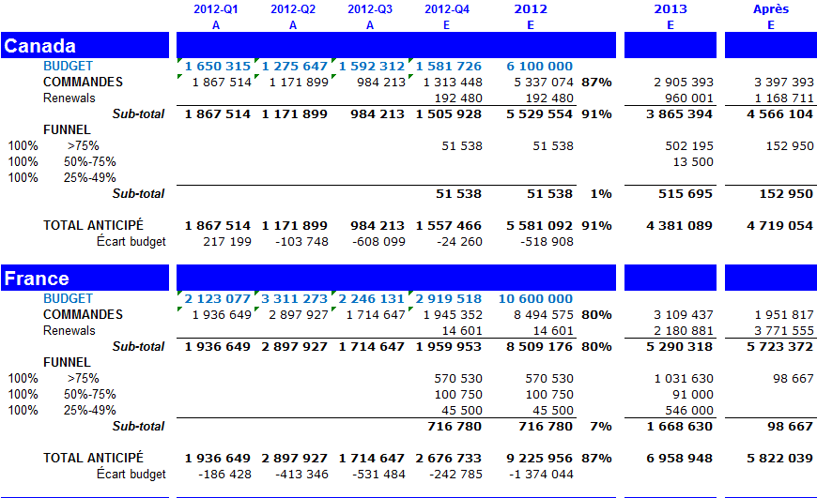

Forecasting Near Term Performance
In terms of visibility, Habs has already booked, or in its backlog, $21.1 M of revenues of the $22.6 M forecasted for 2012.
There is already $9.3 M of revenues in backlog for 2013
2012
Notes:
La différence de Hodes vient-elle du taux de change ?
Savio Pacifico:
the billing and backlog includes those items already billed and those items to be billed based on signed orders. i.e. they don’t include items up for renewal. I believe the original thinking behind including these billing + backlog slides was that we wanted to have some sort of visibility into our revenue if we were to only service existing clients.

Slide 23
Customer Churn
Customer churn varies substantially month-to-month but seem to have remained in check with positive (albeit small) net booking
Yearly churn in 2011 was 11.2%
Source: Gross Bookings Churn 4-30-2012 (17.2.9.2)

Slide 24
Customer Renewals
Source: Renewal Pricing (17.4.1) -

Slide 25
Customer Renewal Discussions
Approx 75 customers have > 50% of their total contract value in MTM at 5/31/2012
This is 21% of the MRR
We verified the renewal discussion status for 59 of these customers
MRR impact estimated at $242,199

Slide 26
Expected Customer Churn
Customer churn expected to occur within the quarter
Expected Churn – A sales rep views there is a high probability there will be a churn event associated to this account

Slide 27
Bookings Breakdown
Existing customers have the greatest impact on bookings
Price increases also plays an important part

Slide 28
Customer Analysis
Understanding each customer
Their past
+
Their prospects
+
Current situation

Slide 29
Top 10 Customers Overview
Among top 10 clients we see a little volatility of MRR revenues that is yet to be explained
No clear negative / positive trend appear customer seem fairly stable with the exception of Clearwire which is slightly growing

Slide 30
Company Analysis Check List
Overview of the business / geographical presence
Products overview / sales splits
Facilities
Management
Client concentration
Supplier relationships
Organization chart
Ownership structure
1
2
3
4
5
6
7
8

Slide 31
Sales Formula
Sales can be effectively forecasted using proper market analysis
Market
Measured in terms of units
Importance to define perimeter precisely
x
Market Share
Sometimes difficult to estimate
Management will ALWAYS be too optimistic
x
Price
Pricing power is sometimes difficult to ascertain
Remember that price variation will affect market share
Sales

Slide 32
Market Analysis Check List
Market Historical Growth
Market Perspectives
Competition
1
2
3
The missing element but most determining factor is the investment thesis

Slide 33
PM plan
  Forecasting Performance
  Normalizations
  Evaluation framework

Slide 34
The Pillars of Performance Forecast
He 3 pillar of performance forecast are historical performance, market forecasts and vision
They should be used to complement each other and special attention should be paid to cross checking
The astute analyst should remain aware of the limitations of each sources
Historical performance
Company absolute performance
Performance vs. peers
Market forecasts
Forecast studies
Analyst reviews
Vision

Slide 35
Sum Of The Parts
SoP valuation is the most common Valuation Method
Division 1
Valuation
Division 2
Valuation
Division 3
Valuation
Overhead Valuation
Usually Negative

Slide 36
Reminder: what we are going to forecast
P&L (up to EBITDA)
Sale & costs
Capex
Working Cap

Slide 37
Balance Sheet & Cash flow Statement
BS and CF can be summarized using:
P&L items
Debt items
WC items
Capex items
Note: under Canadian GAAP and IFRS, GW does not amortize

Slide 38
Company Analysis Check List
Overview of the business / geographical presence
Products overview
Facilities
Management
Client concentration
Supplier relationships
Organization chart (especially Sales Force, Collection Team)
Ownership structure
Inventory
Receivables / Payables
1
2
2
3
4
5
7
6
7
7
8
9
10

Slide 39
Sources Check List for Forecasting Performance
Company Historical Performance
Organic / In- Organic Growth
Peers
Market Studies
Brokers Estimates
Proxi Markets Performance
Top customer performance

Slide 40
Focus on Products
Different services, products and their contribution
  Services offered
  Margins
  Value created
Recurrence of revenue / stability
Capacity for new products / disruption in the market
New markets opportunities

Slide 41
Case Study: Step 1 Products and Service

Slide 42
Case Study: Step 2 Getting More Granular

Slide 43
Truly Understanding Historical Performance
Internet and Transit has shown adverse volatility in 2009-2010 especially on the wholesale side
Since August 2010 the revenues have been fairly stable with loops revenues growing steadily (with the exception of the sudden drop due to a single client)
Single Customer decline in MRR of $100 k
Question:
  what analysis would you have done if the decline had been steady ?
  What complementary analysis can you think of?

Slide 44
Customer 8
Description
Historical MRR
Only top 10 customers who is exclusively wholesale.
Over 16,000 employees
Key Stats
Start date | Oct. 2008
Total years as a customer | 4
Months remaining to contract | 12
Current MRR | $27,790
Number of cabs | 0
MRR / cab | NO CABS
Average MRR (since Mar-2011) | $64,888
Historical MRR Segmentation

Slide 45
Customer Renewals
We will need some clarity on the historic of certain clients renewals
Source: Renewal Pricing (17.4.1) -

Slide 46
Customer Renewal Discussions
Approx 75 customers have > 50% of their total contract value in MTM at 5/31/2012
This is 21% of the MRR
We verified the renewal discussion status for 59 of these customers
MRR impact estimated at $242,199

Slide 47
Understanding How Stickiness Evolves
While the Internet and Transit revenue remain fairly steady the stickiness of the revenue is consistently increasing
Customers renting Colo space represent 46% of internet and transit revenue

Slide 48
Understanding Where Performance

Slide 49
Cost Structure
2 Essential Parts
COGS
SG&A

Slide 50
What are we going to look for in COGS?
Question:
  Margin expansion in GM is fairly rare and only in certain very specific case
  It is important to document accurately any meaningful margin modification
COGS
Fixed vs. variable ?
Margin pressure
Change in product mix
Exposure in supply / inventory management

Slide 51
What are we going to look for in COGS?
Question:
  List the important factors for each items
SG&A
Employees expenses
Rents
Sales & Marketing
Maintenance
Other

Slide 52
Company Analysis Check List
Overview of the business / geographical presence
Products overview
Facilities
Management
Client concentration
Supplier relationships
Organization chart (especially Sales Force, Collection Team)
Ownership structure
Inventory
Receivables / Payables
1
2
2
3
4
5
7
6
7
7
8
9
10

Slide 53
Normalisation
Most valuation methods being based on growth or multiples it is paramount to determine your start point in a normalized manner with a good degree of accuracy
Exceptionals?
Undue expenses
Annualized cost reduction
Seasonality
Cycles
Abnormal margins
NOISE

