Slide 1
Applied Private Equity and Venture Capital
Course 2
Nicolas Renaud

Slide 2
Update on speakers
Course plan only indicative and highly likely to be modified as we progress (especially sessions orders)
Session | Activity
Sun 5/10
Sat 18/10 | Mid-Term + RHO venture + Tandem Expansion
Sat 1/11
Sat 15/11 | Arnaud Bellens PNSV
Sat 29/11 | iNovia (Chris arsenault)
Sat 6/12 | Final Exam
Working on it:
Rafal Wrzesien – Gowlings: M&A law, said yes need finalize date
David Lewin – Novacap said yes need finalize date
Pascal Drolet – GE capital - ABL
Real venture
Claridge
Invest PSP

Slide 3
Balance Sheet & Cash flow Statement
BS and CF can be summarized using:
P&L items
Debt items
WC items
Capex items
Note: under Canadian GAAP and IFRS, GW does not amortize
Notes:
Look at the 4 summary items.
3 schedule plus the P&L

Slide 4
Forecasting through Schedules
All important items can be adequately forecasted using simple schedules
Notes:
These r three blocks
Schedule for each line of debt: senior, revolving, long term
Investment schedule:

Slide 5
The Different Financing Sources Available
In Canada / Us true Mezzanine is not available due to absence of Mother – Daughter fiscal integration
The goal of the entrepreneur is to lower as best as he can his cost of capital
Main strategy involve delaying as much as possible capital raising to optimise leverage
Some variation include:
  PIK
  Revolver
  Convertible
  Mandatory convertible
  Hybrid
  Bullet
  Sukuk
1
Equity
  Most expensive type of capital
  The only one available at the beginning and the cushion for debt investors
Subordinated Debt
  13% - 18%+ fairly expensive type of capital
  Similar to equity but with a tax shield effect
  Used primarily for tax reasons, to increase leverage, to avoid diluting entrepreneur
Senior debt / bonds:
  Cheapest source of capital
  Bank financing, subject to strict covenants
  Usually amortizing term loan, can be a Bullet or very fashionable currently reducing revolving facility
  Typically require a minimum equity cushion of 40%
Subventions
2
3
4

Slide 6
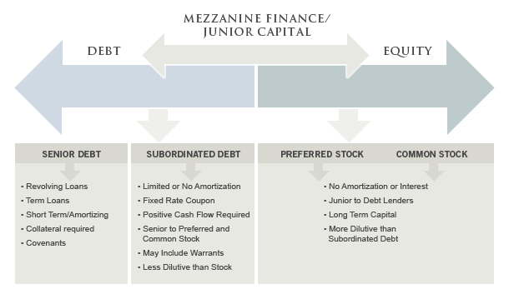
The different Financing Sources Available

Slide 7
What is Value
Value exclusively comes from economic profit
Value is not price
1
Companies create value by investing capital at rate of returns that exceed they cost of capital
  Spread between cost of capital and ROIC
  Invested capital is CAPEX + WC
Economic profit is the true measure of a company value:
  (ROIC-cost of capital) * capital deployed
  The goal is to maximize capital economic profit
Value of a company is the present value of economic profit:
  + invested capital of course
This is very different than price:
  Demand meets offer
  Sum of different expectations
  No equilibrium in markets + future based pricing
2
3
4
Notes:
Not in the test
Capital light if CAPEX is small, but not the same as risk light, could have a lot of inventories

Slide 8
Cash Flow vs. ROIC
If return on investment is constant, growth is essentially a factor of RONIC and investment rate
Initial Investment
$100
Return on Investment
20%
$20
Reinvest
50%
Additional Investment
$10
Return on NEW Investment
10%
$1
GROWTH = RONIC * Inv. Rate
Notes:
Not in the test
When do not reinvest in company, then ur taking money out of the company
Growth impact a lot the valuations

Slide 9
Free Cash Flow Formula
To measure the cash provided by the company it is important to remember that you want it free of the capital structure of the company
EBITDA
-
Reinvestment into the business
-
Tax

Slide 10
Free Cash Flow Formula
EBITDA
Closest measure to operational performance
least subject to manipulation
-
Reinvestment into the business
Capex
Working cap
-
Tax
Don t forget Depreciation tax shield
(1-τ) EBITDA + τ D&A – CAPEX - ΔWC
Notes:
This is def on test
Company is the sum of PV of cash flow: EBITDA – Reinvestment - Tax
Tax will be calculated on
T D&A: Tax on Depreciation and Amortization (used on assets) part is going to be deducted before tax, you add this back since tax on EBITDA should not include the tax on depreciation and amortization.
EX:
EBITDA 100
D&A 30
Profit 70
Tax (30%) -21
79

Slide 11
Main valuation Methods
Main Valuation Methods
Multiples
Transaction multiples
Easy to implement
DCF
Precise
LBO
More of an investment criteria than a valuation criteria
Easy to implement
Less room for manipulation
Imprecise / wrong
Sometimes difficult to find true comparables
Difficult to obtain data for non listed companies
Skewed by time
Theroretically corect
Difficult to implement
Lots of room for manipulation
Notes:
Multiples: compare two similar companies, ex: if one company has $10 million of sales and sells for $20 million then another company with sales of 5$ m sells for $10 m. Some type of business would use EBITDA. ex: mature company (Bell) would sell on Price/Equity multiple, . This is the most widely used method.
Transaction multiple: (most transation don’t see the EBITDA), skewed since markets move (P/E ratios could change a lot over time).
LBO: If I want 25% return on equity, check to see if you meet it

Slide 12
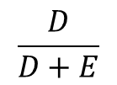
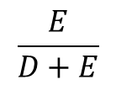
Discount Rate: WACC
The WACC is the best way to reflect for the structure of capital in the discount rate
Free Cashflow
DEBT
EQUITY
Discount rate
Return on capital to debt holders
Return on capital to Equity holders
WACC
=
$$\frac{D}{D+E}$$
(1-τ) k_{d}
+
$$\frac{E}{D+E}$$
k_{e}
Notes:
Cost of Debt is usaully the following in finance: (1 - T) Kd
But use WACC when finding the discount rate for the cashflow
But don’t keep updating WACC for a small change in interest rate. This is not what is normally done in real world.

Slide 13
Discount Rate - Risk
Risk is a measure of uncertainty
As private equity investors we are not concerned about systemic risk but only about company specific risk
In finance, risk is a measure of the probability and magnitude of a difference between actual returns and expected returns
There is 2 type of risk:
Systemic risk
Company specific risk

Slide 14
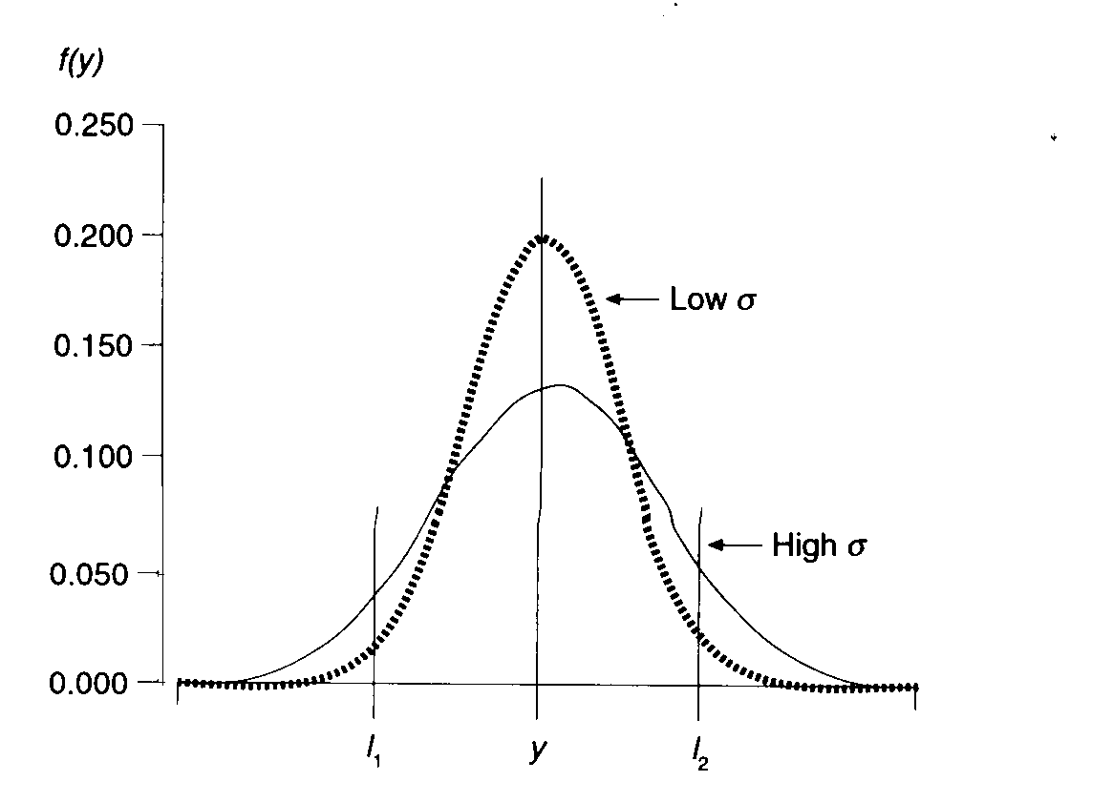
Variance
Note: risk is as much a question of perception as a question of actual risk
The measure of the actual risk of a company is unavailable to investors

Slide 15
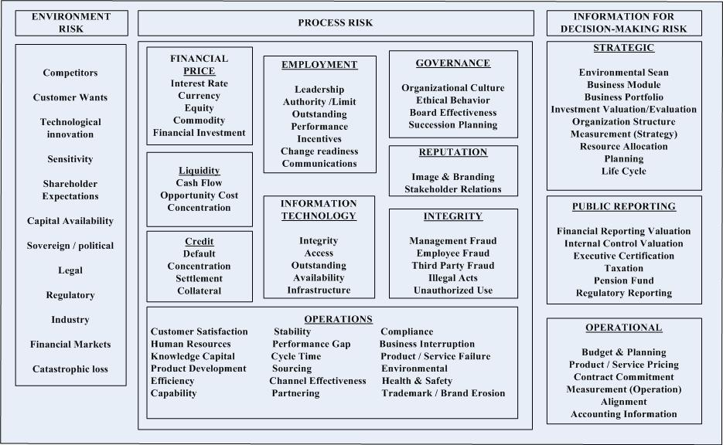
Types of risk

Slide 16
How to measure risk
Bank risk Kd:
Given to you by the bank who will measure ability of business to repay debt and add the specific risk (+ a margin) to systemic risk (LIBOR)
Ex: LIBOR +300bps
Equity risk Ke:
Most used model is CAPM : Ke = r_{f} + β (specific return)
Empirical evidence suggest specific return to be at 4% in equity markets
Not really relevant in practice and more arbitrary measures are used
  9% for equity markets
  15 – 25% for private equity
  More for VC

Slide 17
Continuing Value
Can represent most of the value of the DCF
Very sensitive to small changes in assumptions
1
Exit multiple
Simple
Can be misleading and should be adjusted if the entry multiple incorporate synergies or significantly different state than forecasted at exit (remaining capacity etc)
Perpertuity:
CF_{t+1} / (WACC-g)
effectively implies that RONIC = WACC
2

Slide 18
Publicly Traded Comparables
key market comparables that are engaged in network and application optimization activities for telecom and other (DC, enterprise, WAN). These were split into 3 categories for valuation metrics discussion
(in USD)
Notes:
More standard
Top three Comparables:
Sales (worst one, since do not know the margins, in tech may be only one if not profitable),
ex: EV/ Sales = 1.5x
EBITDA (),
ex: EV/EBITDA = 7.5x
NI:
ex: market cap/NI or Price/E.P.S (P/E)

Slide 19
Precedent Transaction Analysis
Precedent Transaction Analysis
(Figures in US$ millions)
Precedent transactions have typically occurred in the range of 1.2x to 2.8x TEV / LTM revenue or 6.7x to 16.0x TEV / LTM EBITDA
Note: Light grey figures excluded from calculation of average and median

Slide 20
Attractivity Band Concept
Sales Growth
Attractivity Band
Rapid improvement in EBITDA or mature EBITDA
Attractively is a balance between growth and EBITDA maturity
1
Notes:
Strong corelation b/w growth and EBITDA

Slide 21
Analysis of Valuation Categories
Market is Segmented in 3 clear categories
Hyper-Growth Unprofitable Companies
Growing Companies with Clear Path to Profitability
Low Growth but Highly Profitable Companies
1
Revenue Growth: ~30%
Long-term path to profitability
1
Revenue Growth: 15% - 25%
Clear path to profitability and significant operating leverage
1
Revenue Growth: ~8%
Currently profitable and mature EBITDA margins
2
2
2
Comments
Unforgiving reaction to deceleration
Comments
More stable market momentum
Comments
Less demanding valuations
Valuation
Valuation based on growth and sales multiples
Valuation
Valuation based on a mix of sales metric and forward EBITDA multiples
Valuation
Valuation based mostly on EBITDA multiples
Notes:
Put after comps.
This is very true for tech.

Slide 22
Preliminary Value Benchmarking
Company is likely to be valued in the moderate growth category but currently there is a significant disconnect between its EBITDA-based and Revenue-based implied valuations
Assuming current valuation environment continues, an IPO in Q2 2015 based on 2016E metrics would suggest a range of 220-240 based on Revenue multiples and 110-132 based on EBITDA multiples
Methodology
Implied Enterprise Value
(in US$ mm)
Hyper-Growth Companies
Moderate Growth Companies
Valuation Disconnect
Low Growth Mature Companies
2016E Metrics
Note: LTM calculated as the average of CY2013 and CY2014

Slide 23
Process Considerations

Slide 24
Process Objectives
Should a process subsequently and/or ultimately be undertaken, a successful process is typically expedient, minimizes disruption and realizes fair value for shareholders
In addition to achieving a high value for the assets, one may also desire a discrete and timely process
Critical to prioritize and find the proper balance between these objectives
Sale Process Alternatives
Maximize Value
Attractive Structure
Potential for
Value Maximization
Certainty of Outcome
Timely Completion
Minimize Disruption
Potential for a Disruptive Process
Discrete Process
Wide Auction

Slide 25
Process Considerations
Shorter Process Longer Process
Value Maximization
Greater access to a larger number of buyers requires significant investment in time and resources to schedule meetings, disseminate information and provide each buyer with sufficient management access to solicit each party's view on value; creates better chance that winning bidder ends up being the party willing to pay the most
Targeted Buyer Universe?
To the extent there is a limited buyer universe, a broad process may not be needed to maximize value, which would also minimize the risks associated with the market, potential leaks, employee distraction and customers/suppliers
Market Risk/Timing
Exposure to an extended time frame increases risk of adverse market events affecting the process; consideration to known holidays and reporting requirements should be factored into timeline
Priority/Concern?
Leaks
Leaks are a risk in any process and increases with the number of people and with the length of the process. Leaks can be disruptive to process - buyers walk, volatile share price, undue distractions
Employee Impact
Employees directly involved in the process will find that a majority of their time will be consumed with activities outside their day-to-day duties; a lengthy process may increase the risk of rumors and leaks and may adversely affect other employees and create uncertainty over future
Customer/Supplier Impacts
In addition to general business distraction, customers and suppliers may react with caution to any news or rumours of a change in control. Message and method of communication should be tightly controlled, and limited to a very limited number of potential transactions and ideally only immediately prior to singing a definitive agreement

Slide 26
Process Alternatives
The duration of a process depends on the overall objectives and ultimately the type of process undertaken
Sale Process Alternatives

Slide 27
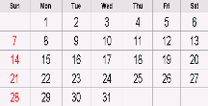
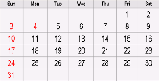
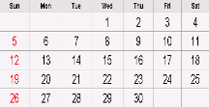
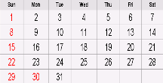
Overview of a 2-Stage Auction Process
Stage 1
Surface Initial Indications of Interest
Negotiation/Closing Stage
Due Diligence Stage
3 - 4 weeks
Approach Stage
3 - 4 weeks
Negotiate final proposals
Select winning partner
Finalize definitive agreements
Execute definitive agreements
Closing
Preparation Stage
3 - 4 weeks
Determine a short-list of partners
Short-list candidates
Reciprocal management presentations
Reciprocal due diligence
Pre-acquisition agreement
Solicit final proposals
3 - 4 weeks
Initial contact made to prospective purchasers
Signing of CAs/distribution of CIMs
Management presentation preparation
Data room preparation
Solicit non-binding expressions of interest
Organize process
Collect data
Develop potential purchasers list
Prepare Broadcast Letter/Teaser
Prepare CIM
Prepare form of CA
Stage 2
Finalize An Agreement With
A Selected Party

Slide 28
Appendix

Slide 29
Unsolicited Considerations
Early preparations for an unsolicited takeover bid can significantly enhance the effectiveness of a defence strategy
Front Door Approach First - Buyers prefer to go through the ‘front door’ in order to source the target’s co-operation, the board support on price, and the opportunity for due diligence
  However, unsolicited offers tend to occur in situations where the bidder may be perceived to be the ‘enemy’ or where front door overtures have been rebuffed
    Most initial unsolicited bids are unsuccessful, but ultimately cause a change of control
Best Defence - The best defence against any unsolicited proposal is to have the Company’s “full value” already reflected in the marketplace – thus avoiding opportunistic advances
Advance Preparation – When a Company finds itself in a vulnerable position, it would be prudent for the Board to prepare for a potential unsolicited bid
Proxy Contest – Activist shareholders may also see opportunities to push the Board into actions to augment value in short term
  Not necessarily aligned with all shareholders as their interests are short term in nature

Slide 30
Defence Preparation
Understanding Alternatives – An appropriate Board response will only be possible if the Board has a full understanding of all of the company’s alternatives as early in the defence contest as possible
  Ideally prepared in advance of receiving a hostile bid
  Time to respond to an unsolicited bid can be very limited
  True alternatives to an offer must be more favourable to shareholders
Preparation – An appropriate defensive strategy prior to receiving an unsolicited bid would include a preparation stage to establish key elements of the current environment:
  Clearly understand value proposition
  Communicate message to market
  Identify likely suitors and White Knight candidates
  Be prepared to review business in detail

Slide 31
Shareholder Value Team
Shareholder Value Team - Identify legal and financial advisors to work with senior management and the Company’s Board or independent committee (a “Shareholder Value Team”) to carry out the necessary analysis and planning functions
The Shareholder Value Team should undertake certain initial preparations, including:
  Review existing protection mechanisms (shareholder rights plan, key contracts, etc.);
  Consider structural initiatives and their role in any hostile take-over attempt;
  Identify and analyze potential strategic partners; and
  Initiate a “share watch” program to monitor trading of the Company’s shares
In addition, the Shareholder Value Team should participate in the Company’s business review and initiatives to maximize value
The Shareholder Value Team should have the confidence of the Board of Directors and the authority to respond quickly in the face of an unsolicited bid or proposal
In response to an unsolicited bid or proposal, the Shareholder Value Team should quickly assess the strategic objectives of the offeror, estimate its maximum price payable, and analyze all aspects of any proposals

Slide 32
Defense Preparation
Before any bid is received, the Shareholder Value Team can take considerable steps towards an unsolicited defence review, and save valuable time should an unsolicited bid surface
Identify Shareholder Value Team
Key management, legal, financial, and PR advisors
Consider potential candidates for a special committee
Establish Market Intelligence Program
Monitor share trading to detect unusual activity; may provide early warning
Identify key relationships: regulatory, political, customer, supply, lender notification/briefing requirements
  Relationships should be established in advance to be able to act immediately, if and when required
Review shareholders’ rights plan
  Buys time
Proactive Investor Relations Program
Receive and respond to calls, record source and nature of calls, monitor catalyst groups
Ensure shareholder sentiment is communicated to Shareholder Value Team
Update Business Plan
Update business plan and conduct detailed business and financial review
Due diligence will be done both by the Company and a White Knight to assess value
Effective data rooms take time to assemble, which should be spent pre-bid
Identify Potential White Knights
Refine list of potential White Knight candidates and determine the Company’s value proposition to each (ability to pay/synergies, financial capacity analysis, strategic value)
Focus on the most likely White Knight candidates to maintain credibility and efficiently manage time demands
Potentially maintain non-threatening dialogue with industry leaders (facilitates first call)

Slide 33
Planning Stage
The initial solicitation and screening will be structured to produce a sufficient range of qualified bidders so as to establish a competitive process
Tactical Objectives
  Once a group of prospective purchasers has been selected, the objectives become:
    Solicit expressions of interest
    Create urgency and tension by controlling buyers and maintaining a parallel process
    Develop negotiating strategies
    Pursue most serious buyer
    Verify candidates' financial capacity
    Engage in negotiations
Information
  Information is a tool used to motivate the buyer to bid with confidence
  The seller should produce high quality and accurate information
  It is materially more difficult to motivate a buyer to submit an aggressive offer when the quality and accuracy of the information cause the buyer to be less confident and less certain about the prospects of a business
Process
  Process should not impair the buyers' willingness to bid aggressively
  The sale process should be honest, fair and equal to all participants
  All qualified bidders should receive the same information, should have adequate time to evaluate the information and equal access to the key participants in the process. Otherwise, certain bidders may choose not to participate to the full extent, or not aggressively
  Management conflicts need to be addressed prior to launching the auction
Objectives
Info
Process
Initial Contact
Process Tools
Bid Tension
Bid Rounds

Slide 34
Approach Stage
The approach will be made once the planning stage is complete, and solicitation will be done in a manner to facilitate a process consistent with tactical objectives
Initial Contact – Canaccord Genuity will initiate
  Approach approved buyers at senior level, as appropriate
  Focus attention on opportunities presented by the Company
Process Tools
  If a prospective buyer's level of interest is sufficiently high, the initial call from Canaccord Genuity will be followed by a selling packet containing:
    Broadcast Letter/“Teaser”;
    Confidentiality Agreement; and
    Procedures Memo
Bid Tension
  Competition is a critical ingredient to developing full value for an asset
Bid Rounds
  A multi-phased process generates more aggressive bids
  A process which requires multiple indications of interest coupled with greater selectivity can generate incremental levels of aggressiveness with each phase (need to weigh against perception of a “never ending” auction)
  Clearly the appropriateness and extent of employing this approach is function of the level of interest
Objectives
Info
Process
Initial Contact
Process Tools
Bid Tension
Bid Rounds

Slide 35
Process Tools
Broadcast Letter/
Teaser
1
Confidential Information
Memorandum
3
Exclusivity
5
Shareholder Lock-up
7
A summary of the opportunity and key selling points sent immediately following initial contact with a potential purchaser
Entices potential interested parties into the auction process
Detailed document articulating and supporting key selling points, business plan, financial forecast to assist a purchaser in evaluating the opportunity and assessing value in light of public information available
Buyer may pre-empt process and ask for period of exclusivity to negotiate a transaction
May be provided at a late stage in the auction in return for an improved value or structure
Potential buyers will want a commitment from the key shareholders to sell at a specified price
2
Confidentiality
Agreement
6
Management
Presentation/Data Room
Definitive Agreement
4
Binds both parties to maintain confidentiality of the materials exchanged and nature of the process
Controls public disclosure and restricts discussions among competing purchasers
Access to confidential materials/ management and employees
Reduces transaction risk to buyer and allows better evaluation of synergies
Negotiations will ultimately result in finalizing terms in a Definitive Agreement
It is important for management to remain open and uncommitted to all opportunities in order to help maximize value
May help if there are regulatory issues
1
Broadcast Letter/
Teaser
2
Confidentiality Agreement
3
Confidential Information Memorandum
4
Management Presentation
5
Exclusivity
6
Definitive Agreement
7
Shareholder
Lock-up

