Slide 1
Applied Private Equity and Venture Capital
Course 1
Nicolas Renaud

Slide 2
Hello World!
No stupid questions only stupid answers…
Please focus on understanding not learning and even less grades
Be nice I am not a professional teacher, but at least you can be sure I apply what I teach
1
Nicolas Renaud:
  French (from France)
  Currently Vice President at Canaccord Genuity (M&A)
  Previously manager at Novacap (Private Equity)
  M&A at Morgan Stanley (London, UK)
Target for the course:
  Tools to analyze a company (financially)
  Introduction of what is important in a transaction
  Introduction to business plan analysis
What you won’t learn:
  Public company valuation
How we do that:
  Lectures
  Speakers
  Practical case
2
3
4

Slide 3
Admin
Course plan only indicative and highly likely to be modified as we progress (especially sessions orders)
Books are optional
Session | Activity
Sat 06/09 | Basic financial concepts, PE/VC market overview, source of financing, financing lifecycle, value vs price, WACC
Sat 20/09 | DCF, standalone model, LBO model, basic forecasting, valuation methods
Sun 5/10 | Modeling and Excel, the false god + Process Considerations
Sat 18/10 | Mid-Term
Sat 1/11 | Forecasting
Sat 15/11 | Advanced issues (WC adjustments, negotiation, financing terms, legal workshop, Governance)
Sat 29/11 | Advanced issues (WC adjustments, negotiation, financing terms, legal workshop, Governance)
Sat 6/12 | Final Exam
Textbook (suggested only):
Tim Koller – Valuation – Wiley Publishers 2010
Aswath Damodoran – Investment Valuation 3rd Edition
Venture Deals: Be Smarter Than Your Lawyer and Venture Capitalist – Brad Feld
The Dark Side of Valuation: Valuing Young, Distressed, and Complex Businesses -Aswath Damodaran
George Soros – Alchemy of Finance

Slide 4
Admin (cont’d)
Group work will be ranked instead of scored from A+ to B-
  This will then be translated to a grade based on the lowest number in the bracket
  i.e. A give grade of 85

Slide 5












Retail Banking
Products
Key skills
Wealth Management
Services
Wholesale Banking
Products
Loans/mortgages
Credit cards
Salary: $
Luck factor: 0
Hard to find: ---
Job security: ++++
Skills?
Tax planning
Asset allocation
Key skills
Relationship
Salary: $$ to $$$$$
Luck factor: +
Hard to find: - to +++
Job security: +++
Corporate financing
Project lending
Key skills
Strong analytics
Salary: $$$
Luck factor: ++
Hard to find: ++
Job security: ++
Investment Banking /
Private Equity
Markets / Funds
Services
IPOs
M&A advisory
Key skills
Exceptional analytics
Salary: $$$$
Luck factor: +
Hard to find: ++++
Job security: +
Products
Sales & trading
Equity research
Key skills
Market sense
Salary: $$$ to $$$$$$
Luck factor: +++
Hard to find: ++++
Job security: ---
Trust
Network
Good-Bad spread: --
Good-Bad spread: +++
Good-Bad spread: +
Good-Bad spread: ++
Good-Bad spread: +++++
Syndication
CDOs, CLOs
Risk assessment
Structuring
LBOs/MBOs
Hard work
Top of the crop
Hedge funds
Reactivity
Exceptional skills
The best job if you can’t kick or sing…

Slide 6
Financial Lifecycle of a Company
Company Development Phase
Seed
Start-up
Organic Growth
M&A
Market Dominance
Friends and Family
Venture Capital
Growth Funds
Buyout Funds
Public Markets
Focus of This course
Investor Base

Slide 7
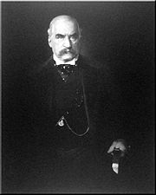
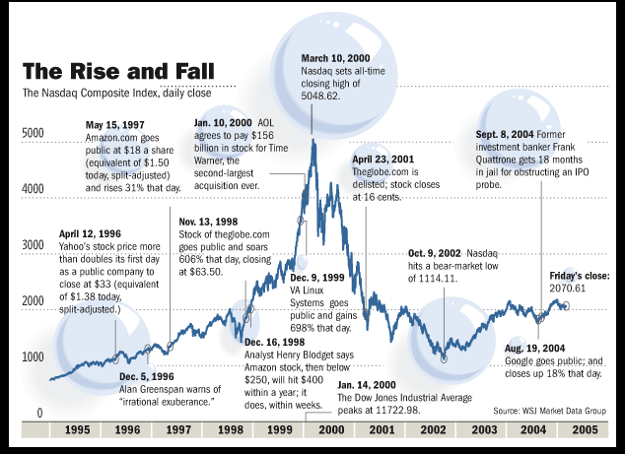
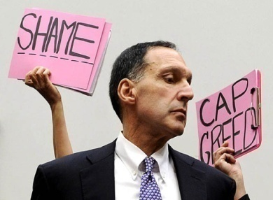
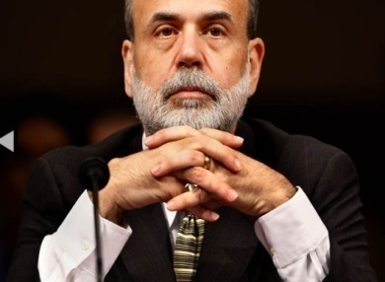






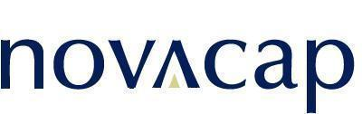

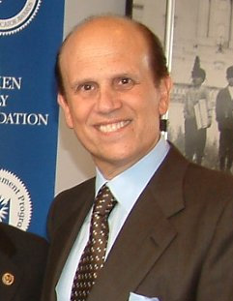








History of the Private Equity Industry
1901- J. Pierpont Morgan completes first buyout in history with the acquisition of Carnegie Steel
1955- Malcolm McLean completes first leveraged buyout by acquiring Pan-Atlantic Steamship Company
The Credit Crunch Financial crisis crushes PE firms that relied on heavy leverage and favored those that focus on adding operational value rather than solely through financial engineering
1989- Boom culminates with largest LBO in history at the time of RJR Nabisco by KKR due to its poor outcome
Venture capital boom and the Internet Bubble Private equity takes off and crashes again with the bursting of the internet bubble
1901-1945
1946-1954
1955-1981
1982-1989
1990-1994
1995-2003
2004-2007
2008-present
1946- First two private equity funds are founded: J.H Whitney & Company and American Research and Development Corporation
“Golden Age”
Low interest rates and increasing regulation brings golden age for private equity as 13 of the largest 15 LBOs in history are realized
1981- Foundation of Novacap
1990- Bankruptcy of Drexel Burnham Lambert leads to a collapse in the junk bond market
1982- Well-publicized and successful LBO of Gibson Greetings launches LBO boom

Slide 8
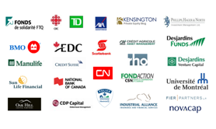
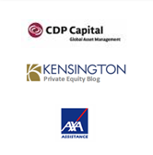


What is a Private Equity Fund?
Private equity is capital invested in the direct ownership of businesses that are not traded on public stock exchanges.
Co-invest
Limited Partnerships (LPs)
Fund of Funds
GPs
Universe of Potential Targets for Private Equity Funding
FUND
Direct
  Private equity investors are typically organized into a pool of funds as LPs.
  The pool is operated by a general partner (GP) who charges management fees to the LPs.
  The pool of funds has a finite life (10-12 years), during which the GP acquires businesses, increases their value, sells them at a profit and returns the capital to the LP of investors

Slide 9
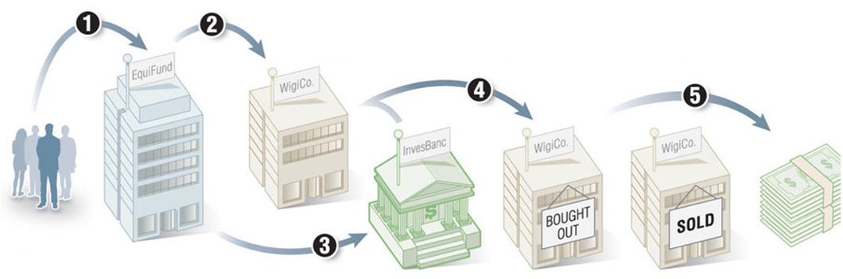
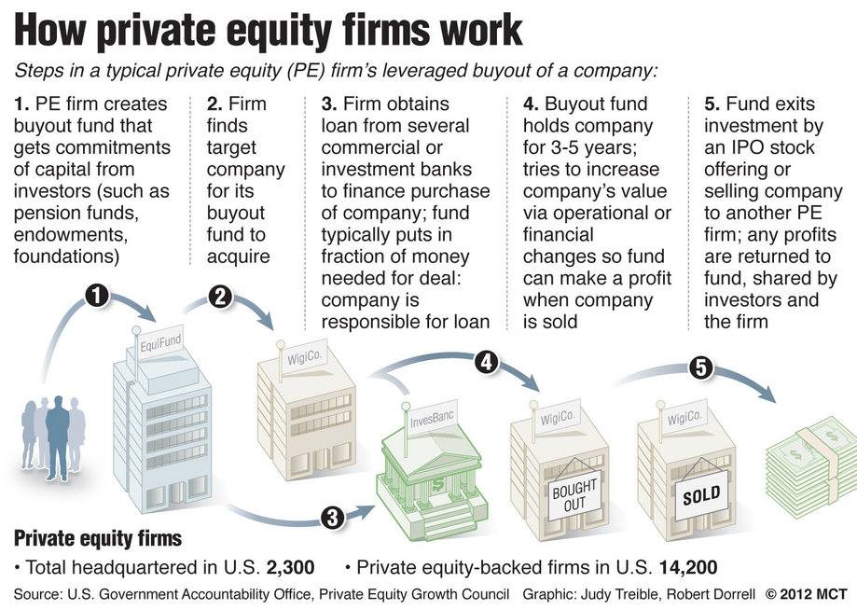
How Private Equity Firms Work
Steps in a Typical PE firm’s leverage buyout of a company:
Fundraising
Deal Sourcing
Deal Structuring
Company Management
Exit
1. PE firm creates buyout fund that gets commitments of capital from investors (such as pension funds, endowments, foundations, banks, high net worth individuals
2. Firm finds target company for its buyout fund to acquire
3. Firm obtains loan from several commercial or investment banks to finance purchase of company; fund typically puts in fraction of the money needed for deal (50% in Canada of equity and quasi-equity): company is responsible for loan.
4. Buyout fund holds company for 3-5 years (8-10 years for Novacap); tries to increase company’s value via operational or financial changes so fund can make a profit when company is sold
5. Fund exits investment by an IPO stock offering or selling the company to another PE firm or to a strategic player; any profits are returned to fund, shared by investors and the firm

Slide 10
Typical Transactions
Secure shareholders’ capital and grow the business:
Consolidation / Acquisition of competitors:
100% sale of the company:
The entrepreneur wants to secure part of his capital and pursue growth of the company
Novacap buys a stake in the equity and collaborates with the company to foster its growth
The company wants to become a leading player in its industry by consolidating its market
Novacap can provide the capital and play an important role in the industry consolidation strategy
Shareholders want to sell their company outright
Novacap buys the company in partnership with management

Slide 11
Typical Transactions
Turnaround:
Spin-off of a division:
Privatization of a public company:
The company has demonstrated its viability but requires capital to implement its restructuring plan
Novacap can actively assist in the turnaround and provide the required capital
The parent company seeks to sell one or more of its divisions
Novacap can move quickly and discreetly to facilitate the divestiture
A public company seeks to privatize
Novacap can work with management/shareholders to privatize the company and pursue its growth

Slide 12
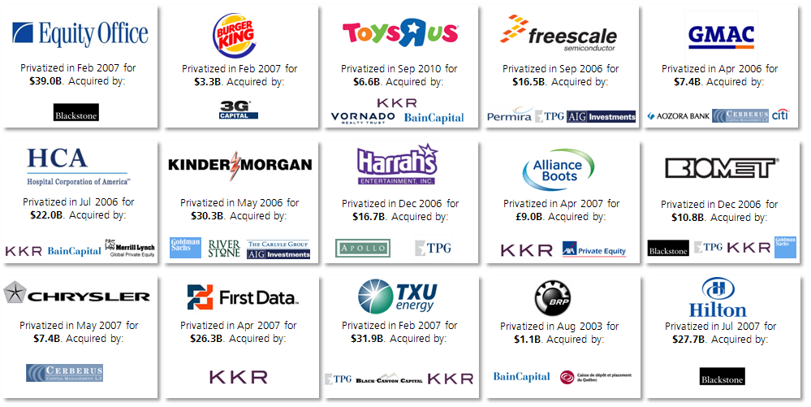
What is Private Equity?
Private equity firms have been in the headlines because of their fundraising prowess and because of the companies being purchased.
Having more capital, private equity funds have increased the size of their acquisitions. Many of their recent targets have been well-known public companies:

Slide 13
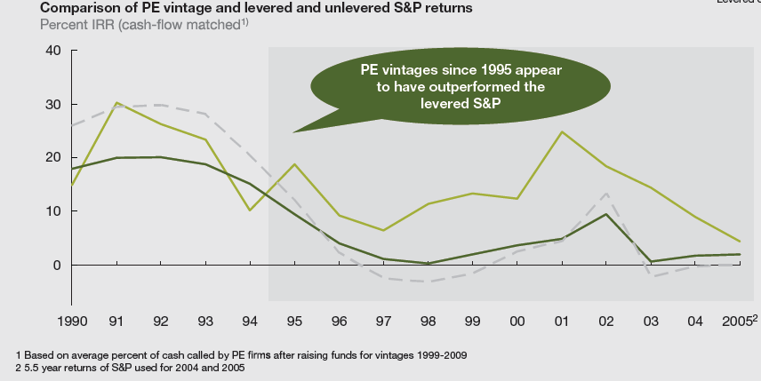

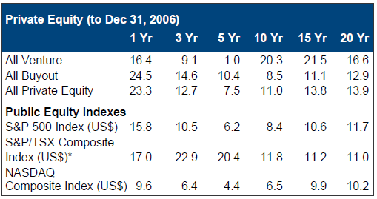
Why Invest in Private Equity?
The primary motivation to invest in private equity is to achieve returns above what the traditional asset classes of public equity (stocks) and debt (bonds) have provided.
Historical Returns
The longer-term data for private equity shows returns significantly higher than those of publicly traded stocks (S&P).
Over the twenty years to the end of 2006, private equity has provided excess returns of 3.7% (annualized) over public equity, as measured by the NASDAQ Composite Equity Index.
This is a substantial premium and is clearly a prime reason for the increasing interest from institutional investors.
Source: McKinsey & Co, PE Report 2010
Source: PH&N, Private equity returns are net of underlying fees and expenses. Total return shown for public market indices, except NASDAQ. Source: CVCA - Canada’s Venture Capital & Private Equity Association, “Why Canadian Institutional Investors Should Participate in Global Private Equity: ‘Finding the Key’ Report Implementation” (May 1, 2007). Accessed on November 14, 2007. http://www.cvca.ca/files/Downloads/CVCA_Institutional_Presentation_-_May_2007.

Slide 14
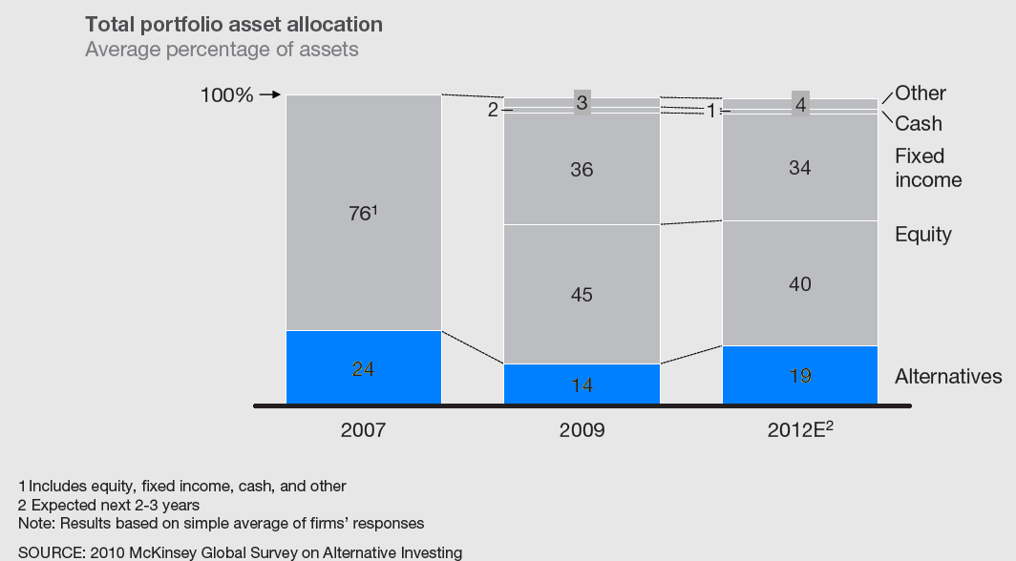
Investors’ Typical Allocation to Private Equity
Investors’ Expectations for Their Own Capital Allocation
Asset class where PE falls in

Slide 15
Buyout Principles
Structure
Strategic Partnership
  A buyout is a transaction where a controlling share of a company’s equity is sold from an entrepreneur to a private equity investor
  The transaction is based on issued and outstanding shares
  The entrepreneur sells between 50% to 100% of his equity stake
  The new shareholder becomes a business partner through same financial instrument as the entrepreneur.
  A buyout transaction has two main objectives:
  Provide liquidity to selling shareholders
  Create a partnership to foster growth
  Optimization of capital structure to support growth
  Increase of capital and resources
  Entrepreneur’s risk / return equilibrium
Entrepreneur
PE
<50%
>50%
Holdco
Operating Company

Slide 16
The LBO – Seller Point of View
Today
5 years later
Founder
$100
100%
Conservative business plan
5% growth
5 years = 28%
Founder
$128
100%
$128
Sell
$80
Reinvest
5 years = 28%
$102
40%
40%
$145
Founder
$20
Conservative business plan
5 years = 28%
Founder
$43
Debt
$50
Debt
$20
PE
$30
PE
$65
Investment
+ aggressive
$20
Growth surplus
$8
$153
+20%

Slide 17
Deal Life Cycle
Deal Alert | Preliminary Due Diligence | Confirmatory Due Diligence | Closing
1 week | 4-6 weeks | 4-6 weeks | 2-3 weeks
  Receive Confidential Information Memorandum CIM – or direct solicitation
  Prepare deal alert presentation
  Investment committee decides on pricing
  Preliminary due diligence – Dataroom (usually online)
  Process limited to selected parties
  Investment committee decides on pricing
  Full-blast due diligence
  Coordination with outside advisors (legal, operational, tax, etc.)
  Due diligence report
  Site visits, final negotiations
  Final closing documentation
  IOI (indication of Interest)
  LOI (Letter of Intent)
  Start legal drafting documentation
  (SPA or APA, Reps & Warranties, Schedules, Employment Agreement, Shareholders Agreement, etc.)

Slide 18

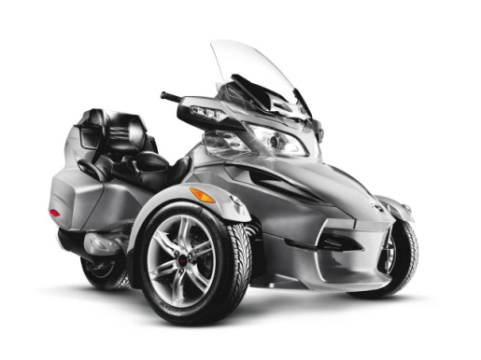

PE Investment Case Studies
Transaction | Acquired in December 2003 by Bain Capital, Beaudier and Caisse de Dépôt after Bombardier Inc. elected to sale non-core assets to focus on core competencies and restructure its balance sheet
Thesis | Brand restructuring, focus on innovation and product positioning to become the leader in each segment.
Value-add | Significant improvement of working capital, BRP brand creation, manufacturing & assembly cost reduction and model mix production approach.
2003
2011
Transition of new ownership and product repositioning
Market: | Global
Revenues: | $2.4B
Brands: | Limited
Profitability: | Low
Market Share: | Decreasing
2002
2003
…
2010
2011
Proliferation of products and SKUs, innovation leader
Market: | Global
Revenues: | Higher than $2.4B
Brands: | Strong Portfolio
Profitability: | Good
Market Share: | Increasing
BRP brand creation
Repositioning of the ATV line of products under new (old) Can-Am brand
Set manufacturing facilities in Mexico
True Should Cost approach (automotive costing approach)
Innovation center in Valcourt
Focus on innovation / « pleasure / sensation »
Launch of the Can-Am Spyder line of product
Refinancing (I-Q, recap, etc.)

Slide 19
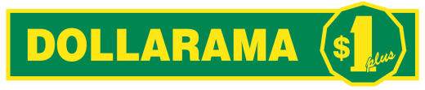
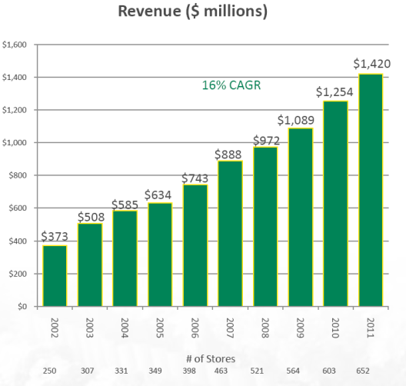
PE Investment Case Studies
Transaction | Acquired in November 2004 by Bain Capital. Rossy family and management retained approximately 20% of the equity post-transaction
Thesis | The company was founded in 1992 following a progressive conversion of former Rossy stores in Dollarama stores. A majority position was sold to Bain Capital in order to pursue an aggressive growth and development plan.
Value-add | Development of a focused business model, aggressive store openings, real estate optimization, improvement of IT management, $1+ concept/growth of in-store SKUs
2004
2011
High growth potential but limited resources
Market: | Eastern Canada
Revenues: | $500M
Concept: | Single price point ($1 SKUs)
Profitability: | Good
Market Share: | #1
2002
2003
…
2010
2011
5x the size of largest competitor, dominant position
Market: | National
Revenues: | $1.6B
Concept: | Multiple price points
Profitability: | High
Market Share: | Dominant
Store openings in Western Canada
Accelerated growth to 50 store openings/year
New distribution center in Montreal for all food products
Introduction of 3 new price points in order to offer a wider range of products and limit impact of price inflation
Success full IPO (IPO at $17.50 in Oct 2009, currently trading at $55.50) and full monetization

Slide 20



PE Investment Case Studies
ORGANIC GROWTH AND DEVELOPMENT STRATEGY
Transaction | Novacap acquired the company along with management in 2002.
Thesis | The business strategy is to become the largest contract manufacturer of personal products in North America through a combination of organic growth and acquisitions.
Novacap’s Value-add | The company is redefining the manufacturing of personal care products by offering turnkey solutions from formulation to product positioning.
2002
2003
…
2008
2009
2011
Initial Factory
Acquisitions
New Factory
2002
2011
Regional Manufacturer
Market:
Revenues: | $60M
Avg. Client: | Small
Profitability: | Medium
Production Runs: | Low
North American leader in formulation/fabrication
Market:
Revenues: | $400M
Avg. Client: | Important
Profitability: | High
Production Runs: | High
Business development with Fortune 500 customers;
Acquisition of Body Blue (ON) in May 2006 / Acquisition of Tri Tech Laboratories (VA) in December 2006;
Joint-venture with a European partner in order to penetrate the North American hair colour market; and
Creation of a dedicated group focused on new product and formulation development.

Slide 21
And Now for Something Completely Different…
Basic Financial Concepts

Slide 22
2 Axioms of finance
Every financial concepts revolve around only 2 principles:
  No free lunch
  Rationality of actors
Efficiency of market – “no free lunch”:
  No possible return without taking a risk
People are rationale:
  Maximization of utility
Time value of money
Entreprise Value
1
2

Slide 23
Rapid Reminders:
P&L
Balance Sheet
Cash Flow Statement
Consolidation
Acquisition accounting
Entreprise Value
Working Capital
IRR and VAN
1
2
3
4
5
6
7
8

Slide 24
P&L Overview

Slide 25
Summary Balance Sheet
Balance sheet is always divided between short and long term
Balance sheet present a Photography of the company
Note: under Canadian GAAP and IFRS, GW does not amortize

Slide 26
Cash Flow Statement

Slide 27
Consolidation
Please see any good accounting book
Holdco
Sales: 1100
EBITDA: 110
NI: 16.5
100%
Subsidiary
Associate
Investment
60%
30%
10%
Company 1
Company 2
Company 3
Company 4
Sales : 1,000
EBITDA : 100
NI : 10
Sales : 100
EBITDA : 10
NI : 10
Sales : 10
EBITDA : 1
NI : 1
Sales : 200
EBITDA : 20
NI : 2
Note: for all, assumes full amortization

Slide 28
Acquisition accounting
Please see any good accounting book
Assumes acquisition for EV of 250 financed by 100 of debt and 150 of equity
Company
Company
Company
Company
Cash: 10
Debt: 50
Equity: 100
Cash: -40
Debt: 0
Equity: 100
Cash: 210
Debt: 100
Equity: 250
Cash: 0
GW: 110
Debt: 100
Equity: 150
Repayment of Debt
-50
Issuance of Debt and Equity
+100 debt
+150 equity
Payment of purchase price
-210
Note: under Canadian GAAP, acquisition costs are no longer capitalised

Slide 29
Enterprise Value
  Entreprise Value
  - Net Debt
  (all debts – Operating cash & cash equivalents)
  - Off balance sheet items
  (unfunded pension liabilities, leasing obligations etc)
  - Minority interests
  + Investment in associate (at market value)
  = EQUITY

Slide 30
Exercise
  Exercise:
  Which bank loan is best :
  $1.0 M , capital payments of $200 k for 5 years and interest of 5% calculated on opening balance
  $1.0 M , no capital payments until term and interest of 5.3% calculated on opening balance

Slide 31
Exercise
  Which bank loan is best :
  $1.0 M , capital payments of $200 k for 5 years and interest of 5% calculated on opening balance
  $1.0 M , no capital payments until term and interest of 5.3% calculated on opening balance
  Quick Questions:
  Define WC
  Define GW
  If risk free rate go up how are valuation affected?

Slide 32
Exercise

Slide 33
The Different Financing Sources Available
In Canada / Us true Mezzanine is not available due to absence of Mother – Daughter fiscal integration
The goal of the entrepreneur is to lower as best as he can his cost of capital
Main strategy involve delaying as much as possible capital raising to optimise leverage
Some variation include:
  PIK
  Revolver
  Convertible
  Mandatory convertible
  Hybrid
  Bullet
  Sukuk
1
Equity
  Most expensive type of capital
  The only one available at the beginning and the cushion for debt investors
Subordinated Debt
  13% - 18%+ fairly expensive type of capital
  Similar to equity but with a tax shield effect
  Used primarily for tax reasons, to increase leverage, to avoid diluting entrepreneur
Senior debt / bonds:
  Cheapest source of capital
  Bank financing, subject to strict covenants
  Usually amortizing term loan, can be a Bullet or very fashionable currently reducing revolving facility
  Typically require a minimum equity cushion of 40%
Subventions
2
3
4

Slide 34
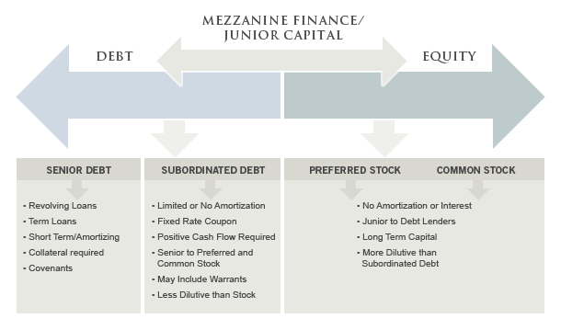
The different Financing Sources Available

Slide 35
What is Value
Value exclusively comes from economic profit
Value is not price
1
Companies create value by investing capital at rate of returns that exceed they cost of capital
  Spread between cost of capital and ROIC
  Invested capital is CAPEX + WC
Economic profit is the true measure of a company value:
  (ROIC-cost of capital) * capital deployed
  The goal is to maximize capital economic profit
Value of a company is the present value of economic profit:
  + invested capital of course
This is very different than price:
  Demand meets offer
  Sum of different expectations
  No equilibrium in markets + future based pricing
2
3
4

Slide 36
Cash Flow?
Income is not the primary goal per-se cash is the real factor

Slide 37
Cash Flow vs. ROIC
If return on investment is constant, growth is essentially a factor of RONIC and investment rate
Initial Investment
$100
Return on Investment
20%
$20
Reinvest
50%
Additional Investment
$10
Return on NEW Investment
10%
$1
GROWTH = RONIC * Inv. Rate

Slide 38
Cash Flow vs. ROIC (Cont’d)

Slide 39
Note: Returns favor higher reinvestment

Slide 40
Free Cash Flow Formula
To measure the cash provided by the company it is important to remember that you want it free of the capital structure of the company
EBITDA
-
Reinvestment into the business
-
Tax

Slide 41
Free Cash Flow Formula
EBITDA
Closest measure to operational performance
least subject to manipulation
-
Reinvestment into the business
Capex
Working cap
-
Tax
Don t forget Depreciation tax shield
(1-τ) EBITDA + τ D&A – CAPEX - ΔWC

Slide 42
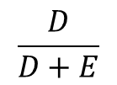
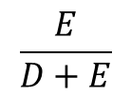
Discount Rate: WACC
The WACC is the best way to reflect for the structure of capital in the discount rate
Free Cashflow
DEBT
EQUITY
Discount rate
Return on capital to debt holders
Return on capital to Equity holders
WACC
=
$$\frac{D}{D+E}$$
(1-τ) k_{d}
+
$$\frac{E}{D+E}$$
k_{e}

Slide 43
Discount Rate - Risk
Risk is a measure of uncertainty
As private equity investors we are not concerned about systemic risk but only about company specific risk
In finance, risk is a measure of the probability and magnitude of a difference between actual returns and expected returns
There is 2 type of risk:
Systemic risk
Company specific risk

Slide 44
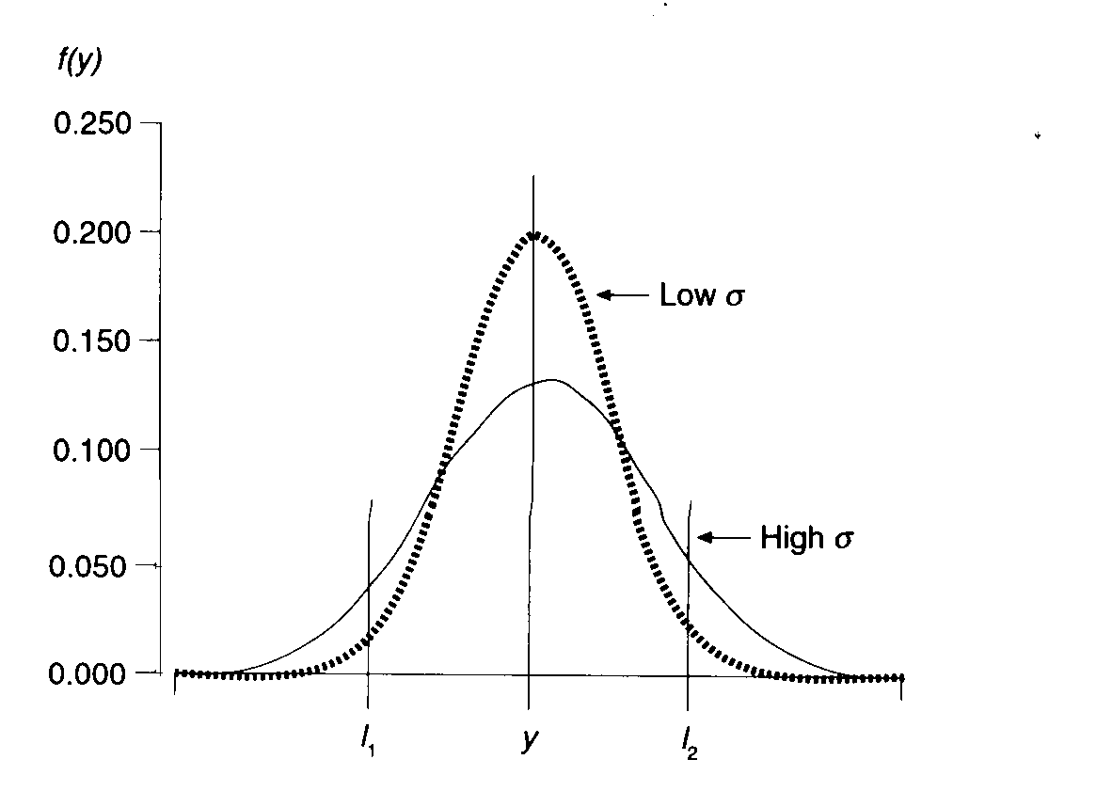
Variance
Note: risk is as much a question of perception as a question of actual risk
The measure of the actual risk of a company is unavailable to investors

Slide 45
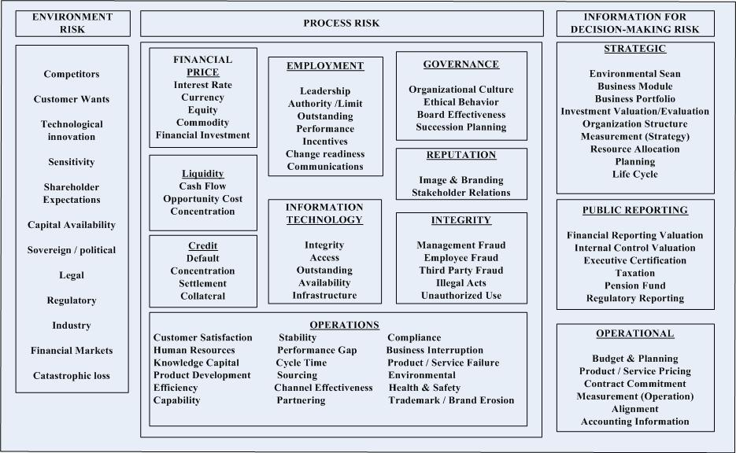
Types of risk

Slide 46
How to measure risk
Bank risk Kd:
Given to you by the bank who will measure ability of business to repay debt and add the specific risk (+ a margin) to systemic risk (LIBOR)
Ex: LIBOR +300bps
Equity risk Ke:
Most used model is CAPM : Ke = r_{f} + β (specific return)
Empirical evidence suggest specific return to be at 4% in equity markets
Not really relevant in practice and more arbitrary measures are used
  9% for equity markets
  15 – 25% for private equity
  More for VC

Slide 47
Continuing Value
Can represent most of the value of the DCF
Very sensitive to small changes in assumptions
1
Exit multiple
Simple
Can be misleading and should be adjusted if the entry multiple incorporate synergies or significantly different state than forecasted at exit (remaining capacity etc)
Perpertuity:
CF_{t+1} / (WACC-g)
effectively implies that RONIC = WACC
2

Slide 48
Exercises for next time
Can represent most of the value of the DCF
Very sensitive to small changes in assumptions
Demonstrate NPV formula given AoA
Demonstrate Perpetuity formula
Assuming a company worth $1.0 Bn has $500m of debt what is the value of the Equity. Demonstrate given AoA
Fin a public company with Investment in associates and minority interest

Slide 49
V. Process Considerations

Slide 50
Process Objectives
Should a process subsequently and/or ultimately be undertaken, a successful process is typically expedient, minimizes disruption and realizes fair value for shareholders
In addition to achieving a high value for the assets, one may also desire a discrete and timely process
Critical to prioritize and find the proper balance between these objectives
Sale Process Alternatives
Maximize Value
Attractive Structure
Potential for
Value Maximization
Certainty of Outcome
Timely Completion
Minimize Disruption
Potential for a Disruptive Process
Discrete Process
Wide Auction

Slide 51
Process Considerations
Shorter Process Longer Process
Value Maximization
Greater access to a larger number of buyers requires significant investment in time and resources to schedule meetings, disseminate information and provide each buyer with sufficient management access to solicit each party's view on value; creates better chance that winning bidder ends up being the party willing to pay the most
Targeted Buyer Universe?
To the extent there is a limited buyer universe, a broad process may not be needed to maximize value, which would also minimize the risks associated with the market, potential leaks, employee distraction and customers/suppliers
Market Risk/Timing
Exposure to an extended time frame increases risk of adverse market events affecting the process; consideration to known holidays and reporting requirements should be factored into timeline
Priority/Concern?
Leaks
Leaks are a risk in any process and increases with the number of people and with the length of the process. Leaks can be disruptive to process - buyers walk, volatile share price, undue distractions
Employee Impact
Employees directly involved in the process will find that a majority of their time will be consumed with activities outside their day-to-day duties; a lengthy process may increase the risk of rumors and leaks and may adversely affect other employees and create uncertainty over future
Customer/Supplier Impacts
In addition to general business distraction, customers and suppliers may react with caution to any news or rumours of a change in control. Message and method of communication should be tightly controlled, and limited to a very limited number of potential transactions and ideally only immediately prior to singing a definitive agreement

Slide 52
Process Alternatives
The duration of a process depends on the overall objectives and ultimately the type of process undertaken
Sale Process Alternatives

Slide 53
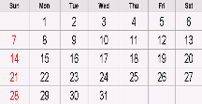
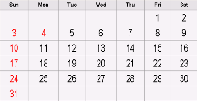
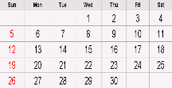
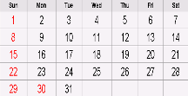
Overview of a 2-Stage Auction Process
Stage 1
Surface Initial Indications of Interest
Negotiation/Closing Stage
Due Diligence Stage
3 - 4 weeks
Approach Stage
3 - 4 weeks
Negotiate final proposals
Select winning partner
Finalize definitive agreements
Execute definitive agreements
Closing
Preparation Stage
3 - 4 weeks
Determine a short-list of partners
Short-list candidates
Reciprocal management presentations
Reciprocal due diligence
Pre-acquisition agreement
Solicit final proposals
3 - 4 weeks
Initial contact made to prospective purchasers
Signing of CAs/distribution of CIMs
Management presentation preparation
Data room preparation
Solicit non-binding expressions of interest
Organize process
Collect data
Develop potential purchasers list
Prepare Broadcast Letter/Teaser
Prepare CIM
Prepare form of CA
Stage 2
Finalize An Agreement With
A Selected Party

Slide 54
Appendix

Slide 55
Unsolicited Considerations
Early preparations for an unsolicited takeover bid can significantly enhance the effectiveness of a defence strategy
Front Door Approach First - Buyers prefer to go through the ‘front door’ in order to source the target’s co-operation, the board support on price, and the opportunity for due diligence
  However, unsolicited offers tend to occur in situations where the bidder may be perceived to be the ‘enemy’ or where front door overtures have been rebuffed
    Most initial unsolicited bids are unsuccessful, but ultimately cause a change of control
Best Defence - The best defence against any unsolicited proposal is to have the Company’s “full value” already reflected in the marketplace – thus avoiding opportunistic advances
Advance Preparation – When a Company finds itself in a vulnerable position, it would be prudent for the Board to prepare for a potential unsolicited bid
Proxy Contest – Activist shareholders may also see opportunities to push the Board into actions to augment value in short term
  Not necessarily aligned with all shareholders as their interests are short term in nature

Slide 56
Defence Preparation
Understanding Alternatives – An appropriate Board response will only be possible if the Board has a full understanding of all of the company’s alternatives as early in the defence contest as possible
  Ideally prepared in advance of receiving a hostile bid
  Time to respond to an unsolicited bid can be very limited
  True alternatives to an offer must be more favourable to shareholders
Preparation – An appropriate defensive strategy prior to receiving an unsolicited bid would include a preparation stage to establish key elements of the current environment:
  Clearly understand value proposition
  Communicate message to market
  Identify likely suitors and White Knight candidates
  Be prepared to review business in detail

Slide 57
Shareholder Value Team
Shareholder Value Team - Identify legal and financial advisors to work with senior management and the Company’s Board or independent committee (a “Shareholder Value Team”) to carry out the necessary analysis and planning functions
The Shareholder Value Team should undertake certain initial preparations, including:
  Review existing protection mechanisms (shareholder rights plan, key contracts, etc.);
  Consider structural initiatives and their role in any hostile take-over attempt;
  Identify and analyze potential strategic partners; and
  Initiate a “share watch” program to monitor trading of the Company’s shares
In addition, the Shareholder Value Team should participate in the Company’s business review and initiatives to maximize value
The Shareholder Value Team should have the confidence of the Board of Directors and the authority to respond quickly in the face of an unsolicited bid or proposal
In response to an unsolicited bid or proposal, the Shareholder Value Team should quickly assess the strategic objectives of the offeror, estimate its maximum price payable, and analyze all aspects of any proposals

Slide 58
Defense Preparation
Before any bid is received, the Shareholder Value Team can take considerable steps towards an unsolicited defence review, and save valuable time should an unsolicited bid surface
Identify Shareholder Value Team
Key management, legal, financial, and PR advisors
Consider potential candidates for a special committee
Establish Market Intelligence Program
Monitor share trading to detect unusual activity; may provide early warning
Identify key relationships: regulatory, political, customer, supply, lender notification/briefing requirements
  Relationships should be established in advance to be able to act immediately, if and when required
Review shareholders’ rights plan
  Buys time
Proactive Investor Relations Program
Receive and respond to calls, record source and nature of calls, monitor catalyst groups
Ensure shareholder sentiment is communicated to Shareholder Value Team
Update Business Plan
Update business plan and conduct detailed business and financial review
Due diligence will be done both by the Company and a White Knight to assess value
Effective data rooms take time to assemble, which should be spent pre-bid
Identify Potential White Knights
Refine list of potential White Knight candidates and determine the Company’s value proposition to each (ability to pay/synergies, financial capacity analysis, strategic value)
Focus on the most likely White Knight candidates to maintain credibility and efficiently manage time demands
Potentially maintain non-threatening dialogue with industry leaders (facilitates first call)

Slide 59
Planning Stage
The initial solicitation and screening will be structured to produce a sufficient range of qualified bidders so as to establish a competitive process
Tactical Objectives
  Once a group of prospective purchasers has been selected, the objectives become:
    Solicit expressions of interest
    Create urgency and tension by controlling buyers and maintaining a parallel process
    Develop negotiating strategies
    Pursue most serious buyer
    Verify candidates' financial capacity
    Engage in negotiations
Information
  Information is a tool used to motivate the buyer to bid with confidence
  The seller should produce high quality and accurate information
  It is materially more difficult to motivate a buyer to submit an aggressive offer when the quality and accuracy of the information cause the buyer to be less confident and less certain about the prospects of a business
Process
  Process should not impair the buyers' willingness to bid aggressively
  The sale process should be honest, fair and equal to all participants
  All qualified bidders should receive the same information, should have adequate time to evaluate the information and equal access to the key participants in the process. Otherwise, certain bidders may choose not to participate to the full extent, or not aggressively
  Management conflicts need to be addressed prior to launching the auction
Objectives
Info
Process
Initial Contact
Process Tools
Bid Tension
Bid Rounds

Slide 60
Approach Stage
The approach will be made once the planning stage is complete, and solicitation will be done in a manner to facilitate a process consistent with tactical objectives
Initial Contact – Canaccord Genuity will initiate
  Approach approved buyers at senior level, as appropriate
  Focus attention on opportunities presented by the Company
Process Tools
  If a prospective buyer's level of interest is sufficiently high, the initial call from Canaccord Genuity will be followed by a selling packet containing:
    Broadcast Letter/“Teaser”;
    Confidentiality Agreement; and
    Procedures Memo
Bid Tension
  Competition is a critical ingredient to developing full value for an asset
Bid Rounds
  A multi-phased process generates more aggressive bids
  A process which requires multiple indications of interest coupled with greater selectivity can generate incremental levels of aggressiveness with each phase (need to weigh against perception of a “never ending” auction)
  Clearly the appropriateness and extent of employing this approach is function of the level of interest
Objectives
Info
Process
Initial Contact
Process Tools
Bid Tension
Bid Rounds

Slide 61
Process Tools
Broadcast Letter/
Teaser
1
Confidential Information
Memorandum
3
Exclusivity
5
Shareholder Lock-up
7
A summary of the opportunity and key selling points sent immediately following initial contact with a potential purchaser
Entices potential interested parties into the auction process
Detailed document articulating and supporting key selling points, business plan, financial forecast to assist a purchaser in evaluating the opportunity and assessing value in light of public information available
Buyer may pre-empt process and ask for period of exclusivity to negotiate a transaction
May be provided at a late stage in the auction in return for an improved value or structure
Potential buyers will want a commitment from the key shareholders to sell at a specified price
2
Confidentiality
Agreement
6
Management
Presentation/Data Room
Definitive Agreement
4
Binds both parties to maintain confidentiality of the materials exchanged and nature of the process
Controls public disclosure and restricts discussions among competing purchasers
Access to confidential materials/ management and employees
Reduces transaction risk to buyer and allows better evaluation of synergies
Negotiations will ultimately result in finalizing terms in a Definitive Agreement
It is important for management to remain open and uncommitted to all opportunities in order to help maximize value
May help if there are regulatory issues
1
Broadcast Letter/
Teaser
2
Confidentiality Agreement
3
Confidential Information Memorandum
4
Management Presentation
5
Exclusivity
6
Definitive Agreement
7
Shareholder
Lock-up

