Slide 1
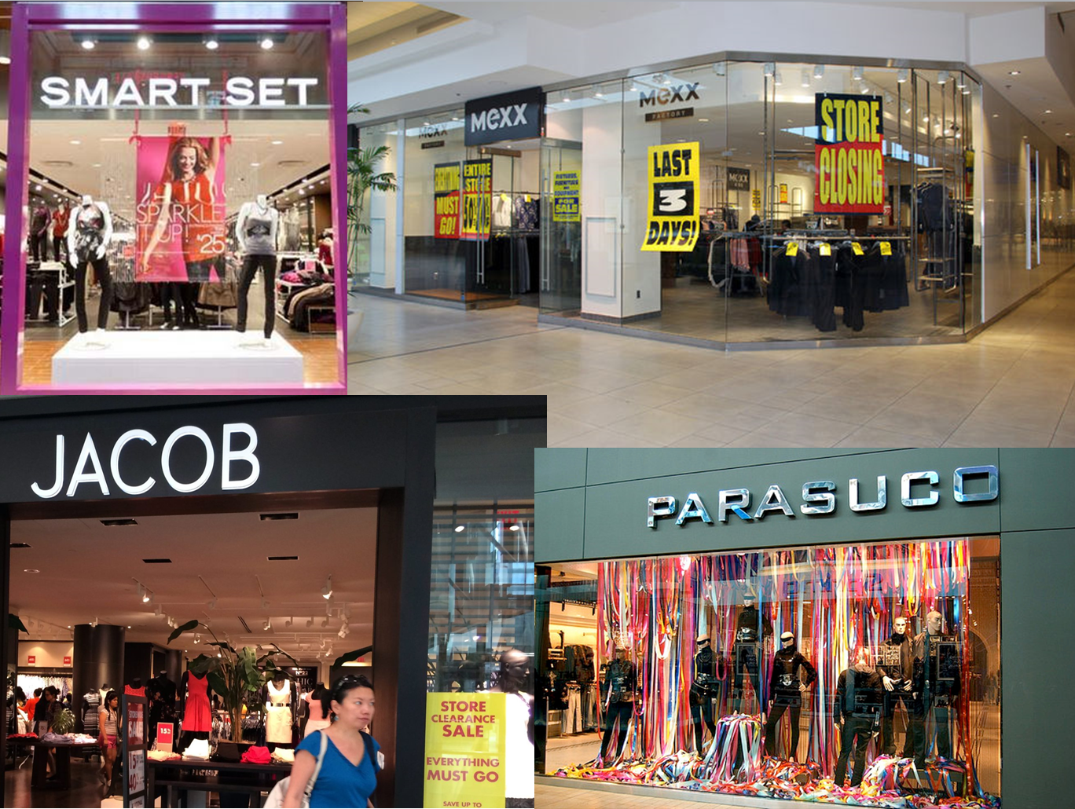
Introduction | Analysis | Valuation | Proposition
Competitive environment
Women Clothing Store Industry in Canada

Slide 2
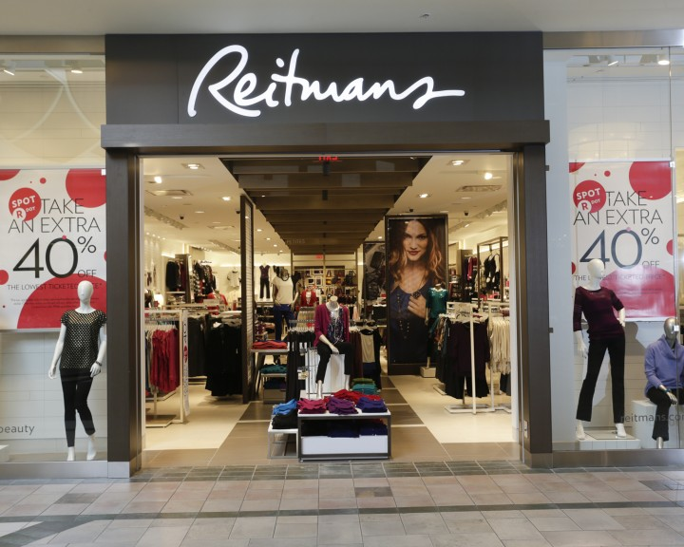
Introduction | Analysis | Valuation | Proposition
Key Statistics
Revenue: $5.6B
Profits: $253.2M
Margins: 4%
Annual Growth: 1.5%
Notes:
Source: IBIS

Slide 3

Introduction | Analysis | Valuation | Proposition
Economic Drivers
Per Capita Disposable Income
Slow growth in the past 5 years
Expected to grow during 2015, creating a potential for discretionary spending
External Competition
Increase in discount department stores & internet-based retailers
Number of adults aged 20 to 64
Expected to increase slowly
World price of cotton
Expected to decrease
Notes:
Source: IBIS

Slide 4
Introduction | Analysis | Valuation | Proposition
Value Chain
Raw Material Producers
Manufacturers
Wholesalers
Retails Stores
Consumers
Notes:
Source: IBIS

Slide 5
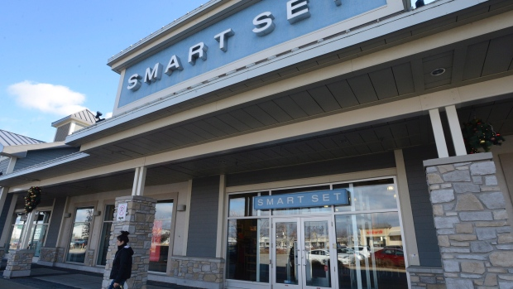
Introduction | Analysis | Valuation | Proposition
Extremely Fragmented Market
Reitman being the largest player
Notes:
Source: IBIS

Slide 6
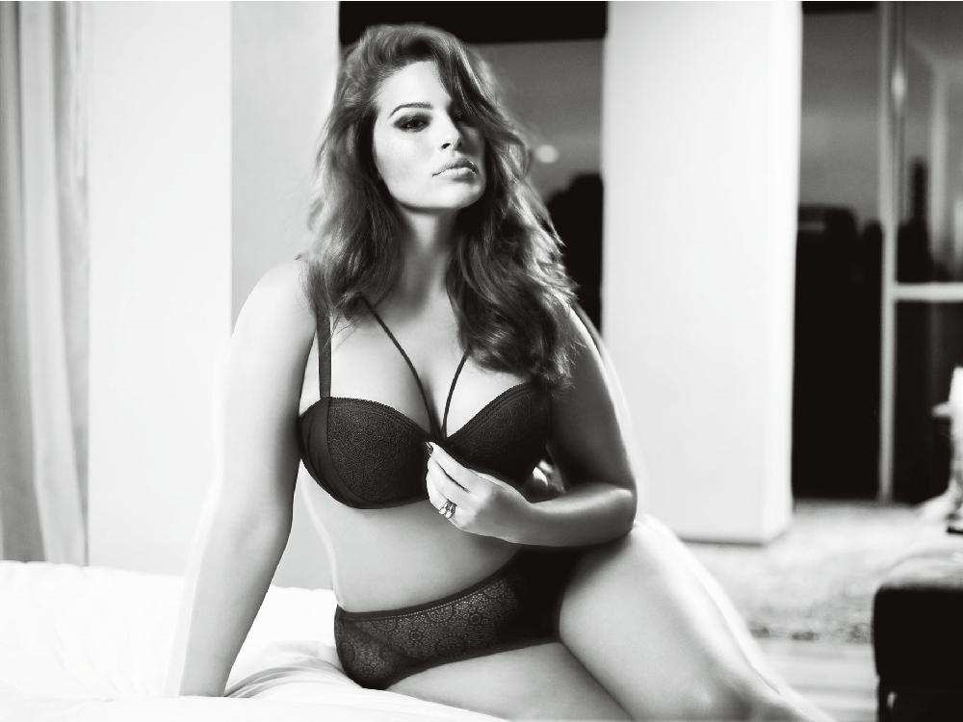
Introduction | Analysis | Valuation | Proposition
Market Segmentation
Notes:
Source: IBIS

Slide 7
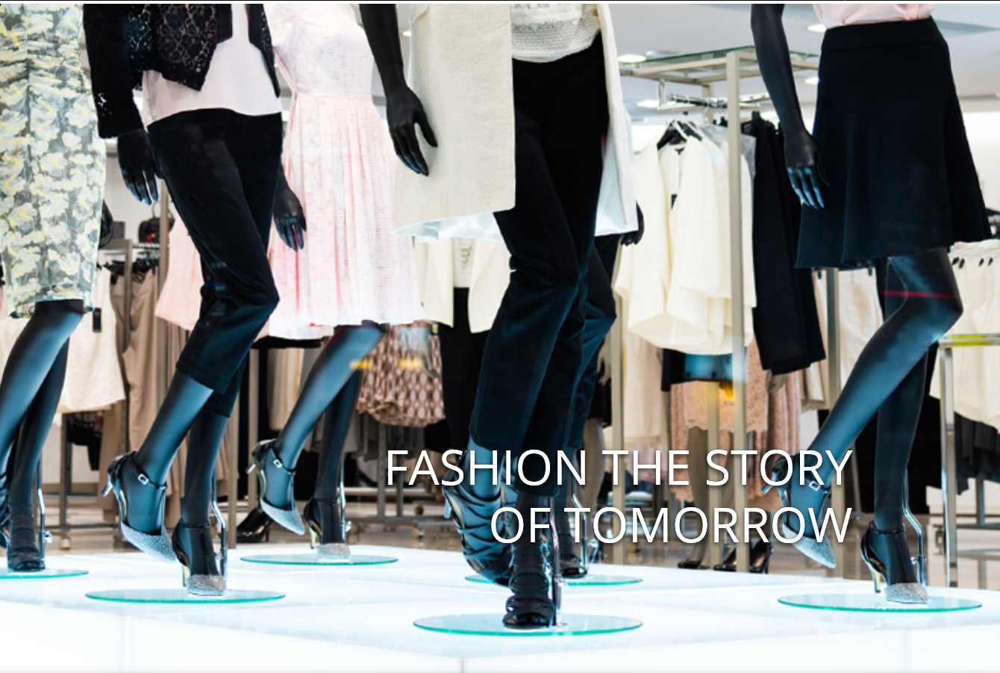
Key Success Factors
Introduction | Analysis | Valuation | Proposition
Attractive product presentation
Establishment of brand names
Areas for improvement
At Reitman’s
Ability to control stock on hand
Proximity to key markets
Up-to-date with fashion trends
Notes:
Source: IBIS

Slide 8
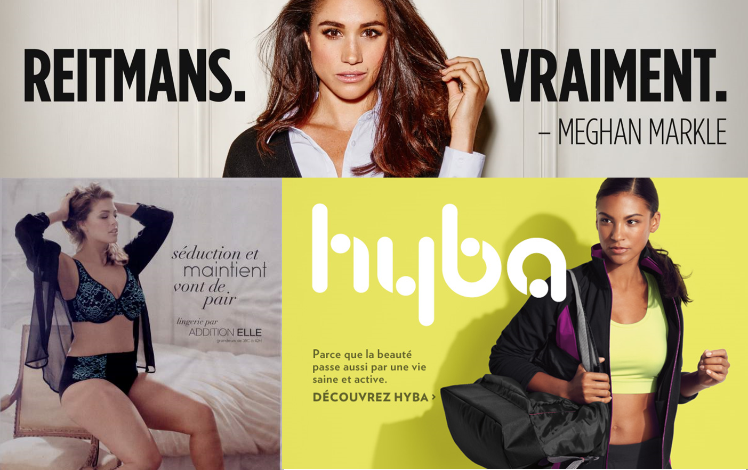
Industry Cost Structure Benchmark
Introduction | Analysis | Valuation | Proposition
Notes:
Source: IBIS

