Slide 1
Introduction | Analysis | Valuation | Proposition
Financial Performance Forecast
Scenario Considerations:
Better than expected 2016 4Q boosts sales in the year stub.
More Fashionable banners like Addition Elle, RW&Co and Pennington take the leadership in Organic growth at more than 1% Rapidly offsetting Smartset store Conversion/Closing.
Faster CAD stabilization and good performance of the Global Sourcing Initiative (Hong Kong office) produce COGS improvements.
Improvements in Opex begins only after fiscal 2017 when “SCORE” initiative is finished. No delays and total success is assumed.
Improvements in COGS come from “SCORE” initiative success and Global Sourcing unit causing a full integration of RET supply chain and a subsequent reduction in Inventory to historical efficient levels.
Mgmt. seizes growth opportunities through Capex increases.
Scenario Considerations:
Smartset restructuration continues until mid Fiscal 2018 causing a poor performance in revenues when shading other banners’ results.
Only at the last portion of the Period, CAD currency could stabilize COGS plus some improvements in the Global Source Unit.
Improvement in Opex only attributed to the cost reduction and efficiency programs. Results confirmed so far. “SCORE” initiative impact ignored.
Days Inventory improve until common levels. Global Sourcing initiative impact only included in COGS. Wait and see.
No major reasons to increase Capex since 2016 3Q current revised value over 2015 Mgmt. guidance

Slide 2
Introduction | Analysis | Valuation | Proposition
Financial Performance Forecast
Scenario Considerations:
RET fails to bring an attractive product offer and Fierce competition increase even more than expected. These effects cause additional reduction in number of stores.
Delay in CAD recovery continues affecting COGS
Global sourcing Unit fails to deliver results since China is currently out of TPP bloc and other members could be more attractive. Change in strategy and late entry to suppliers market affect COGS even further.
Opex performance worsened due to delay and failure of “SCORE” initiative. Likely to happen in this kind IT endeavours. Previous failure considered (Warehouse system 2013). No major IT success in recently appointed CIO experience.
“SCORE” and Global Sourcing initiatives failure ultimately affect Inventory performance.
Coherently Capex must be revised

Slide 3
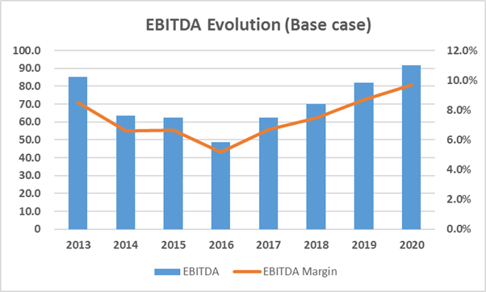
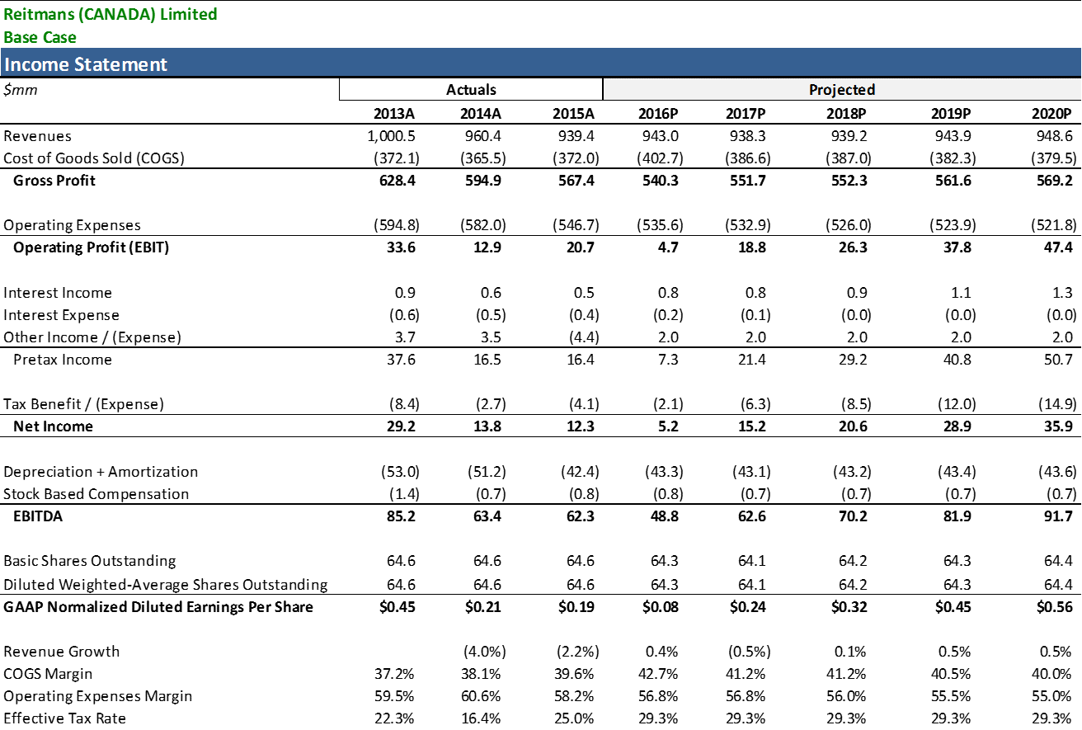
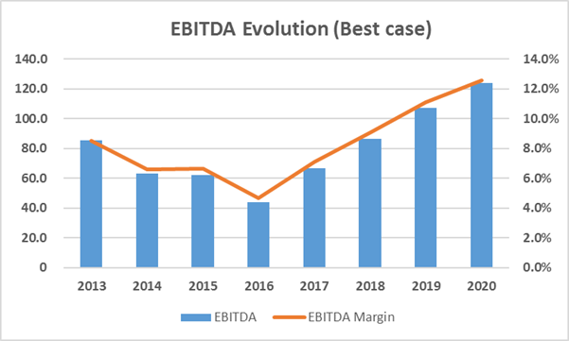
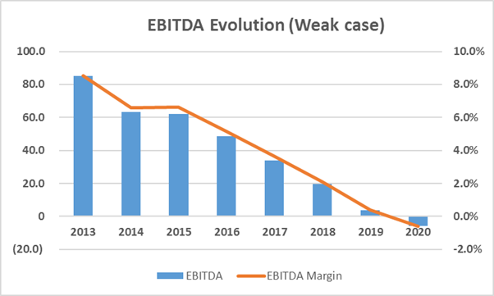
Introduction | Analysis | Valuation | Proposition
Business Operation Overview

Slide 4
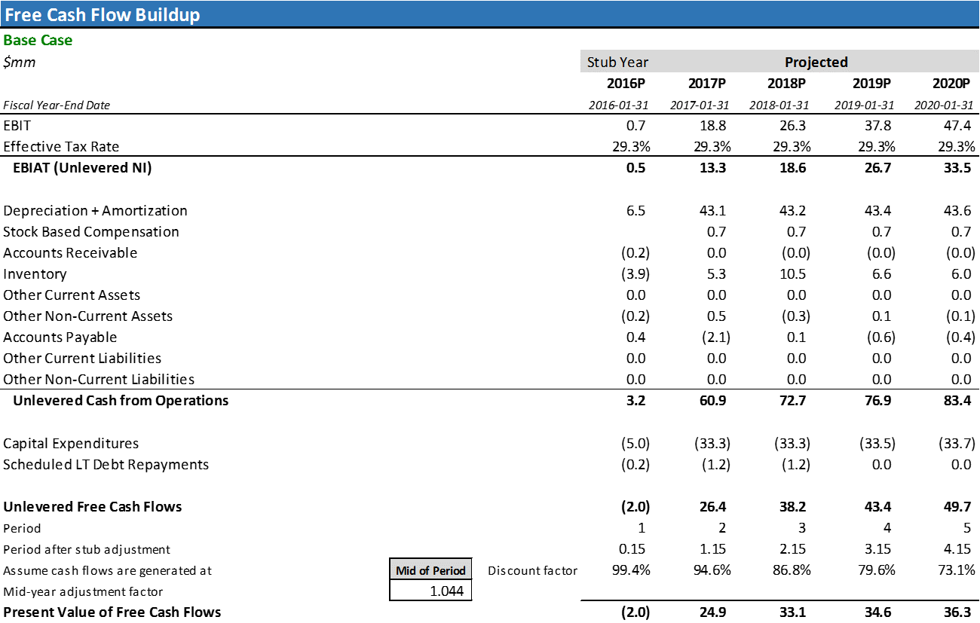
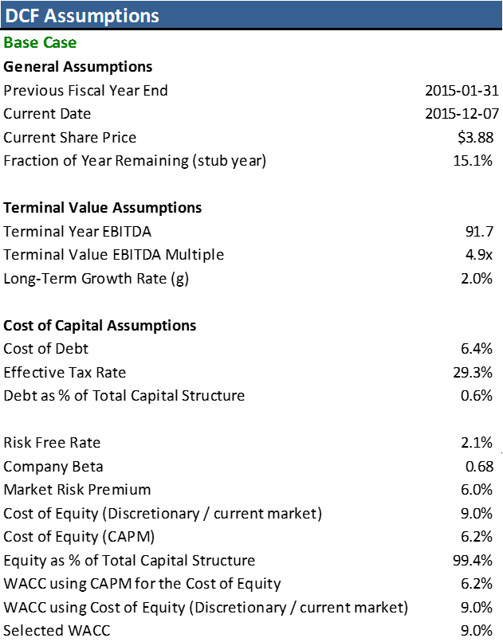
Introduction | Analysis | Valuation | Proposition
Cash Flows Forecast
Due to RET revenue volatility is preferred to use a Ke closer to the one commonly used in the whole market (TSX).

Slide 5
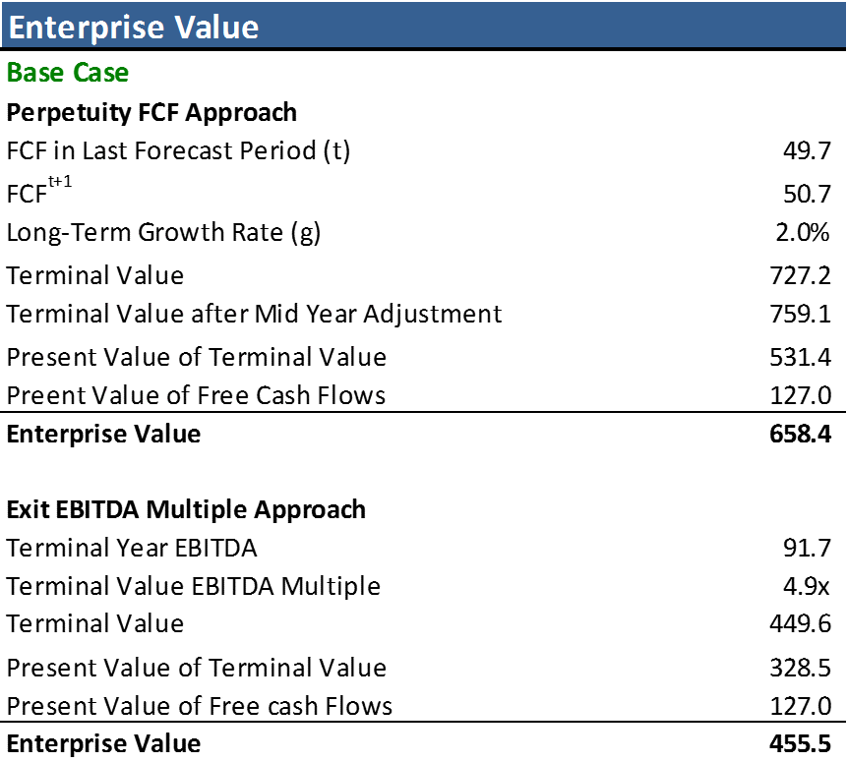
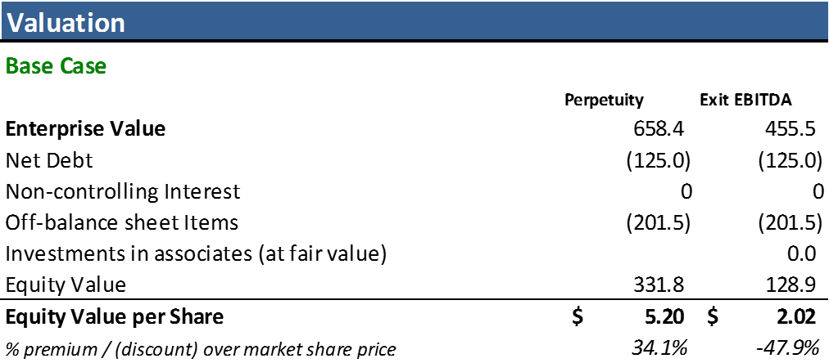
Introduction | Analysis | Valuation | Proposition
Enterprise and Equity Value
Market price = $ 3.88
Although RET has a strong Financial Health, Fierce competition in the market and poor performance on sales suggest the inclusion of Off-Balance Sheet items as a mandatory element in the Equity valuation.
Follows Target consensus share price

Slide 6
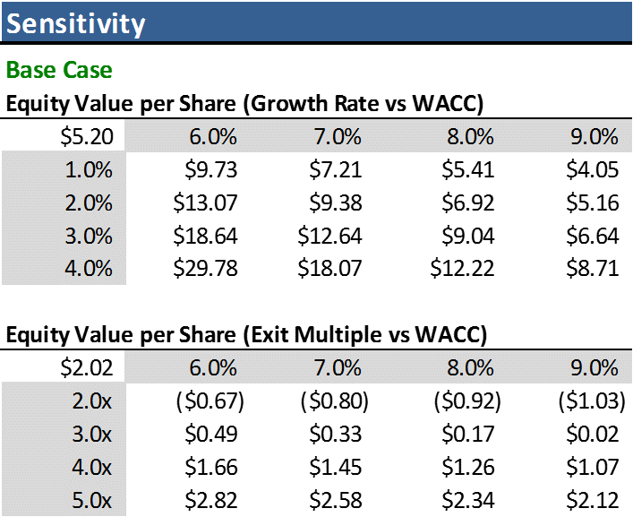
Introduction | Analysis | Valuation | Proposition
The offer
Considerations:
A price of $ 5 CAD per share would be reasonable to pay for a RET Non-Voting share.
This same price we consider includes already a Control Premium, since the spread between the Exit and Perpetuity approach rises questions on the assumption that a perpetual revenue stream will exist for RET based on current performance.
Assumptions on the Terminal Growth rate cause higher variations than those caused by Exit Multiple

