Slide 1
Reitmans Highlights
1926 – Company created – a single store on St-Laurent
1926 – 2000 – Organic growth and acquisitions becoming the largest women’s fashion retailer in Canada (588 stores), still family controlled
2000 – 2010 – Raised its dividends 10 times during this period
2000 – Strategic alliance with Inditex Group of Spain – helped them to open Zara stores in Canada
2002 – Largest acquisition in company’s history, Shirmax Fashions Ltd (175 stores - Adition-Elle, and Thyme Maternity)
2003 - 2007 – Growth year over year, biggest player in the plus size market, completed its only distribution center in Montreal, repaid loans for acquisitions.
2008 – 2015 – Recession, slowed growth and declining revenues, Reitmans never really recovered after the recession
2010 – Announcing Reitmans.com the company’s online buying platform (the rest of the banners will be added from 2010 – 2014). Lagging behind its competitors which added online platforms in the late 2000s.
2011 – Closes the Cassis brand and converts it to other banners, Jeremy Reitman becomes CEO and Chairman of the board
2012 – Partnership with Babies R Us to provide Thyme Maternity apparel in U.S., but closes most of them by the end of 2014 as they are not profitable
2012 – Issues with the distribution centers’ newly installed warehouse management system -> adversely impact 3rd quarter sales
2014 – Plans to close the Smart Set banner and/or convert it to other banners, RW&CO and ELLE magazine launch exclusive holiday dress collection
2015 – Drop in sales and reduced foot traffic continues, posted losses of $7.9M for the first 6 months while e-commerce revenues increasing by 81%, more focus on RW&CO for men with Subban, new HYBA active wear banner, Addition Elle’s Ashley Graham opens the New York fashion week, marketing shift to digital by engaging bloggers and creating capsule collections

Slide 2
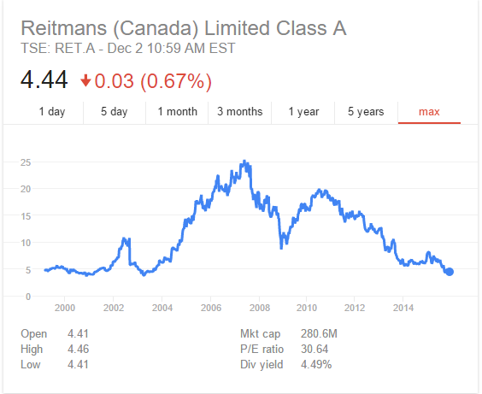
Reitmans Stock history

