Slide 1

Prepared by:
Alexandru Ionita
Gerald Marchel
Oscar Galindo
Simon Faucher
Stephanie Haddad

Slide 2
How to grow in the fast evolving and heavily competitive clothing retail environment?
Introduction | Analysis | Valuation | Proposition

Slide 3
Privatize the firm, enhance brands and optimize supply chain
Introduction | Analysis | Valuation | Proposition
Notes:
Our objective is:

Slide 4
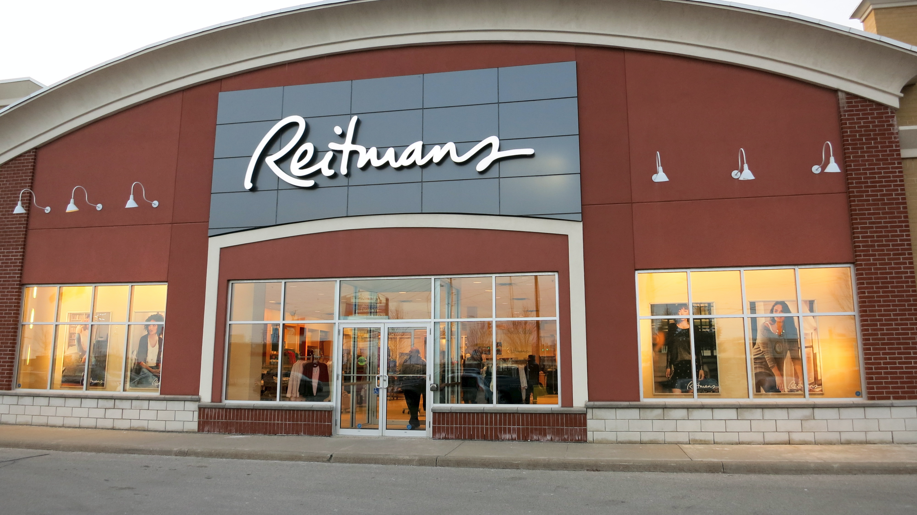
1926 – Company started with a single store on St-Laurent
1926 – 2000 – Organic growth and acquisitions becoming the largest women’s fashion retailer in Canada (588 stores)
2000 – 2010 – Raised its dividends 10 times during this period
2000 – Strategic alliance with Inditex Group of Spain – helped them to open Zara stores in Canada
2002 – Largest acquisition in company’s history, Shirmax Fashions Ltd (175 stores - Adition-Elle, and Thyme Maternity)
2003 - 2007 – Growth year over year, biggest player in the plus size market, completed its only distribution center in Montreal, repaid loans for acquisitions.
2008 – 2015 – Recession, slowed growth and declining revenues, Reitmans never really recovered after the recession
Introduction | Analysis | Valuation | Proposition
A bit of history
Notes:
Highlight the interesting finds regarding organic growth, dividend raise, acquisitions.

Slide 5
2010 – Announcing Reitmans.com the company’s online buying platform. Lagging behind its competitors which added online platforms in the late 2000s
2011 – Closes the Cassis brand and converts it to other banners, Jeremy Reitman becomes CEO and Chairman of the board
2012 – Partnership with Babies R Us to provide Thyme Maternity apparel in U.S., but closes most of them by the end of 2014 as they are not profitable
2012 – Issues with the distribution centers’ newly installed warehouse management system which adversely impact 3rd quarter sales
2014 – Plans to close the Smart Set banner and/or convert it to other banners, RW&CO and ELLE magazine launch exclusive holiday dress collection
2015 – Drop in sales and reduced foot traffic continues, posted losses of $7.9M for the first 6 months while e-commerce revenues increasing by 81%. More focus on RW&CO for men with Subban, new HYBA active wear banner, Addition Elle’s Ashley Graham opens the New York fashion week, marketing shift to digital by engaging bloggers and creating capsule collections
Introduction | Analysis | Valuation | Proposition
A bit of history
Notes:
Highlight the slow decline that started in 2008 and never really stopped. Also talk about the good things that they are doing in 2015 to shake things up.

Slide 6
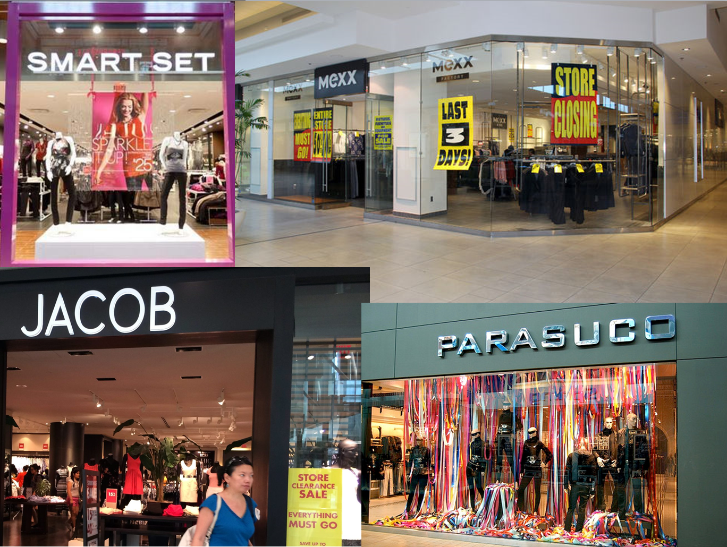
Introduction | Analysis | Valuation | Proposition
Competitive environment
Women Clothing Store Industry in Canada

Slide 7
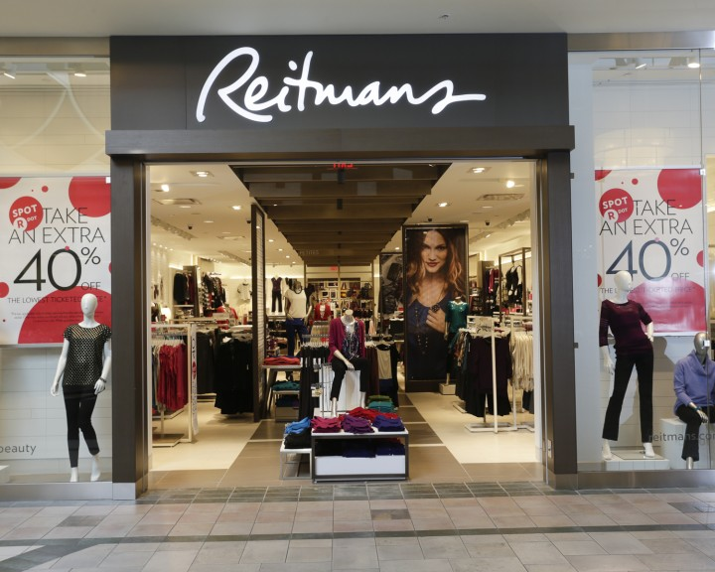
Introduction | Analysis | Valuation | Proposition
Key Statistics
Revenue: $5.6B
Profits: $253.2M
Margins: 4%
Annual Growth: 1.5%
Notes:
Source: IBIS

Slide 8

Introduction | Analysis | Valuation | Proposition
Economic Drivers
Per Capita Disposable Income
Slow growth in the past 5 years
Expected to grow during 2015, creating a potential for discretionary spending
External Competition
Increase in discount department stores & internet-based retailers
Number of adults aged 20 to 64
Expected to increase slowly
World price of cotton
Expected to decrease
Notes:
Source: IBIS

Slide 9
Introduction | Analysis | Valuation | Proposition
Value Chain
Raw Material Producers
Manufacturers
Wholesalers
Retails Stores
Consumers
Notes:
Source: IBIS

Slide 10
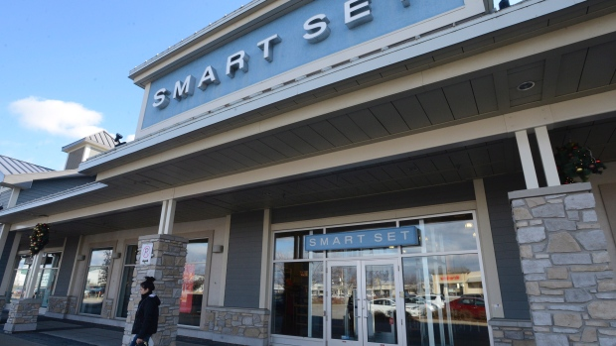
Introduction | Analysis | Valuation | Proposition
Extremely Fragmented Market
Reitman being the largest player
Notes:
Source: IBIS

Slide 11

Introduction | Analysis | Valuation | Proposition
Market Segmentation
Notes:
Source: IBIS

Slide 12

Key Success Factors
Introduction | Analysis | Valuation | Proposition
Attractive product presentation
Establishment of brand names
Areas for improvement
At Reitman’s
Ability to control stock on hand
Proximity to key markets
Up-to-date with fashion trends
Notes:
Source: IBIS

Slide 13
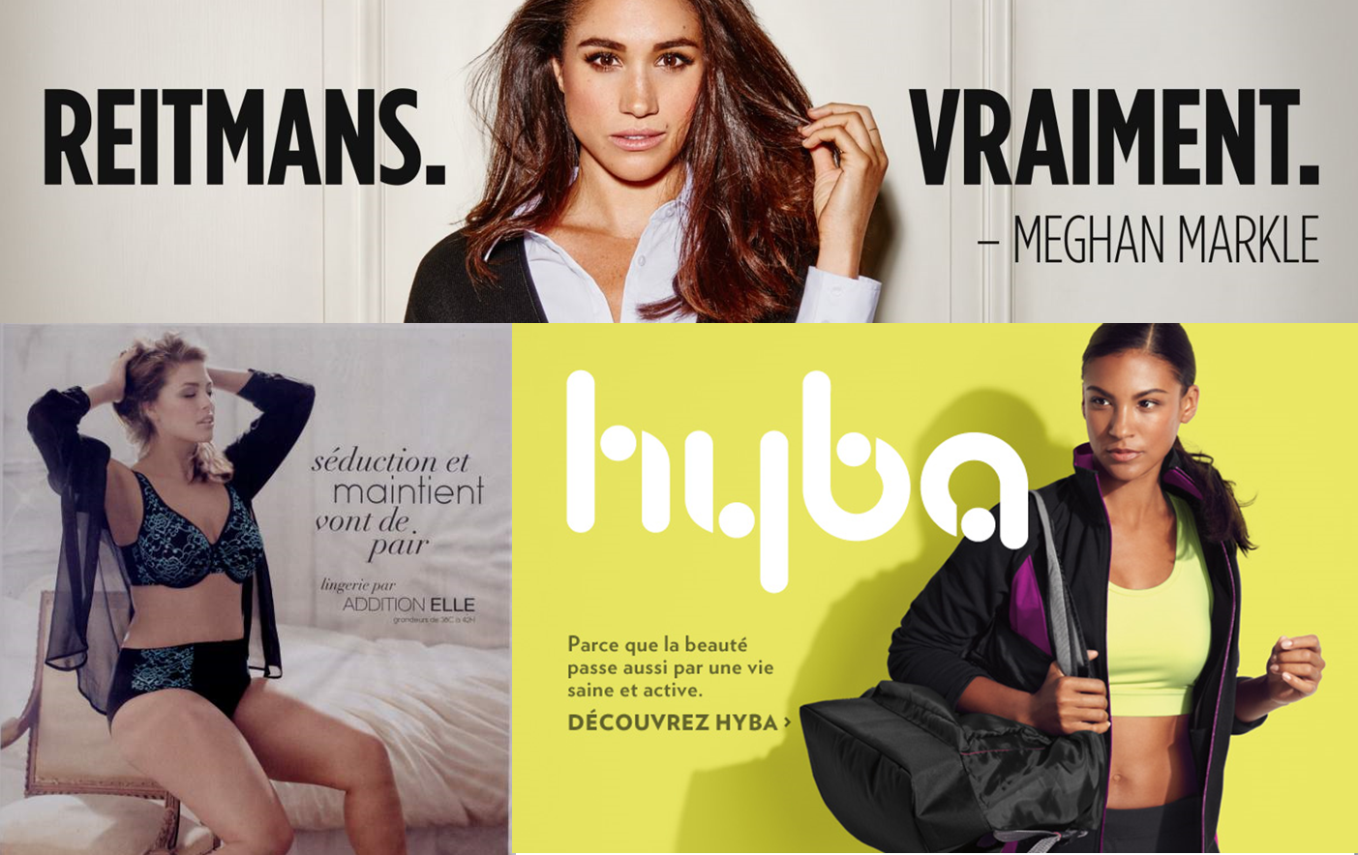
Industry Cost Structure Benchmark
Introduction | Analysis | Valuation | Proposition
Notes:
Source: IBIS

Slide 14
Introduction | Analysis | Valuation | Proposition
Company’s performance
What is not working

Slide 15
Introduction | Analysis | Valuation | Proposition
Bleeding Financials
Steady decline in revenues and an 85% drop in net earnings since 2011
Cost of doing business is increasing since 80% of their products are outsourced from China and bought in US dollars.
Large cash outflows and unsustainable dividend payouts
Inventory write-offs doubled in 2015 compared to the year before
Reitmans’ shares are currently around $3.85, a far cry from the $20 level it was trading in mid-2010

Slide 16

Introduction | Analysis | Valuation | Proposition
Organizational Concerns
Jeremy and Stephen Reitman own 49.9% of the voting through Sherlex Investments Inc. and another 6.7% with certain associates having complete control over the company
Jeremy is CEO and Chairman of the board which is not a corporate governance best practice as Jeremy has control over the company and exercises influence over the board.
Stephen is the company’s President
Aging leaders with no succession plan in sight
Notes:
What we are trying to convey with this slide is that the two Reitman brothers have complete control and could block any sale. However, they are getting older and there are no directly interested heirs for the Reitmans empire, maybe this would be a good opportunity to sell.

Slide 17
Introduction | Analysis | Valuation | Proposition
Organizational Concerns
Every brand has its own management team run by a brand president. Is Reitmans’ business model too complex and fragmented? How efficient are their business operations?
Each management team has a VP Merchandising, VP marketing, VP Planning and Allocation, and VP Sales and Operations. Coincidentally, the two underperforming brands Reitmans and Thyme have gaps in their leadership team. Reitmans lacks a VP merchandising while Thyme lacks a VP Planning and Allocation. Coincidence? Not really. This could explain the inventory write offs.
Leadership lacks a design and purchasing team that would oversee the development of a range of products aimed at a specific type of customer and price bracket. That is crucial since every banner has a different target market.

Slide 18
Introduction | Analysis | Valuation | Proposition
Operational Inefficiencies
More than 80% of products are outsourced to China. Lead time is huge. Risks are high. Costs keep going up as US dollar gets stronger.
One distribution center in Montreal to cater to all 823 stores across Canada. This puts Reitmans at a disadvantage when it comes to market responsiveness. Company has no fail over plan if distribution center is disrupted for any reason.
Poor inventory management system resulting in high inventory costs.
Notes:
Currency hedging was only done recently and only partly helps with the issues arising from sourcing from China.

Slide 19

Introduction | Analysis | Valuation | Proposition
Technology
Failed implementation of a new warehouse management system has led to delays in a major systems development project (“SCORE”) which is supposed to create vertical integration across Reitmans’ supply chain
Lack of data analytics to determine demand and plan accordingly. As a result, hence markdown cost are higher than competition
Reitmans entered the e-commerce world later than most competitors

Slide 20
Introduction | Analysis | Valuation | Proposition
Pricing Strategy
Reitmans has a hybrid pricing strategy that is both competition and cost oriented. This is manifested in their mission statement and their various corporate initiatives aimed at reducing costs.
“We are customer driven, value oriented
and committed to excellence. By promoting
innovation, growth, development and teamwork,
we strive to serve our customers the best
quality/value proposition in the marketplace.”
Their current pricing strategy overlooks customer demand and results in a mismatch between production, supply and demand.

Slide 21

What is working
Introduction | Analysis | Valuation | Proposition
Company’s performance

Slide 22
RW&CO is gaining visibility by signing Subban and his family to promote men’s products
New HYBA active wear banner’s successful introduction in key locations
Addition Elle’s Ashley Graham opens the New York fashion week
Addition Elle’s sales are increasing in Canada as well as in New Zeeland and Europe via E-Commerce
Penningtons is selling well via Amazon.com
Marketing shift to digital by engaging bloggers and creating capsule collections
Introduction | Analysis | Valuation | Proposition
Shaking things up in 2015

Slide 23
How much is Reitmans worth?
Introduction | Analysis | Valuation | Proposition
Valuation

Slide 24
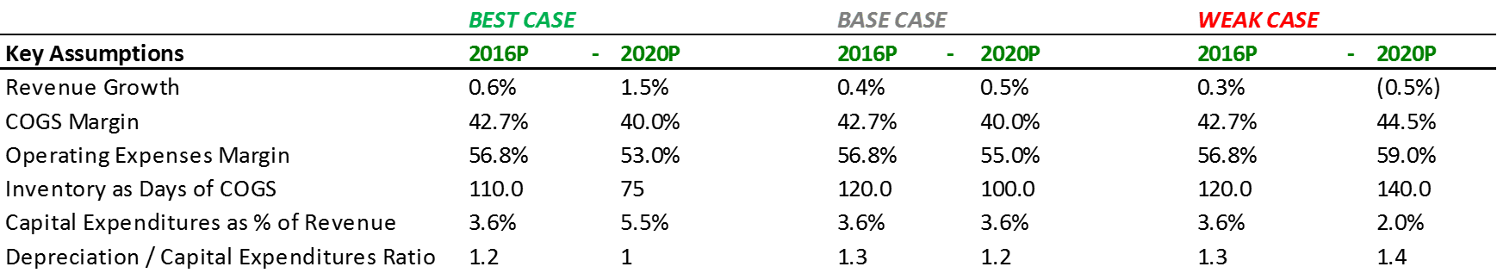
Introduction | Analysis | Valuation | Proposition
Financial Performance Forecast
Scenario Considerations:
Better than expected 2016 4Q boosts sales in the year stub.
More Fashionable banners like Addition Elle, RW&Co and Pennington take the leadership in Organic growth at more than 1% Rapidly offsetting Smartset store Conversion/Closing.
Faster CAD stabilization and good performance of the Global Sourcing Initiative (Hong Kong office) produce COGS improvements.
Improvements in Opex begins only after fiscal 2017 when “SCORE” initiative is finished. No delays and total success is assumed.
Improvements in COGS come from “SCORE” initiative success and Global Sourcing unit causing a full integration of RET supply chain and a subsequent reduction in Inventory to historical efficient levels.
Mgmt. seizes growth opportunities through Capex increases.
Scenario Considerations:
Smartset restructuration continues until mid Fiscal 2018 causing a poor performance in revenues when shading other banners’ results.
Only at the last portion of the Period, CAD currency could stabilize COGS plus some improvements in the Global Source Unit.
Improvement in Opex only attributed to the cost reduction and efficiency programs. Results confirmed so far. “SCORE” initiative impact ignored.
Days Inventory improve until common levels. Global Sourcing initiative impact only included in COGS. Wait and see.
No major reasons to increase Capex since 2016 3Q current revised value over 2015 Mgmt. guidance

Slide 25
Introduction | Analysis | Valuation | Proposition
Financial Performance Forecast
Scenario Considerations:
RET fails to bring an attractive product offer and Fierce competition increase even more than expected. These effects cause additional reduction in number of stores.
Delay in CAD recovery continues affecting COGS
Global sourcing Unit fails to deliver results since China is currently out of TPP bloc and other members could be more attractive. Change in strategy and late entry to suppliers market affect COGS even further.
Opex performance worsened due to delay and failure of “SCORE” initiative. Likely to happen in this kind IT endeavours. Previous failure considered (Warehouse system 2013). No major IT success in recently appointed CIO experience.
“SCORE” and Global Sourcing initiatives failure ultimately affect Inventory performance.
Coherently Capex must be revised

Slide 26
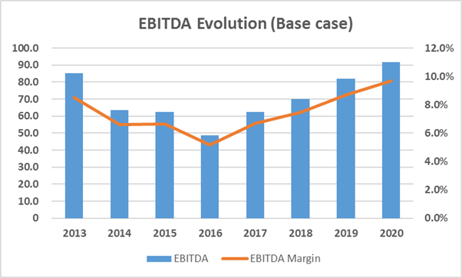
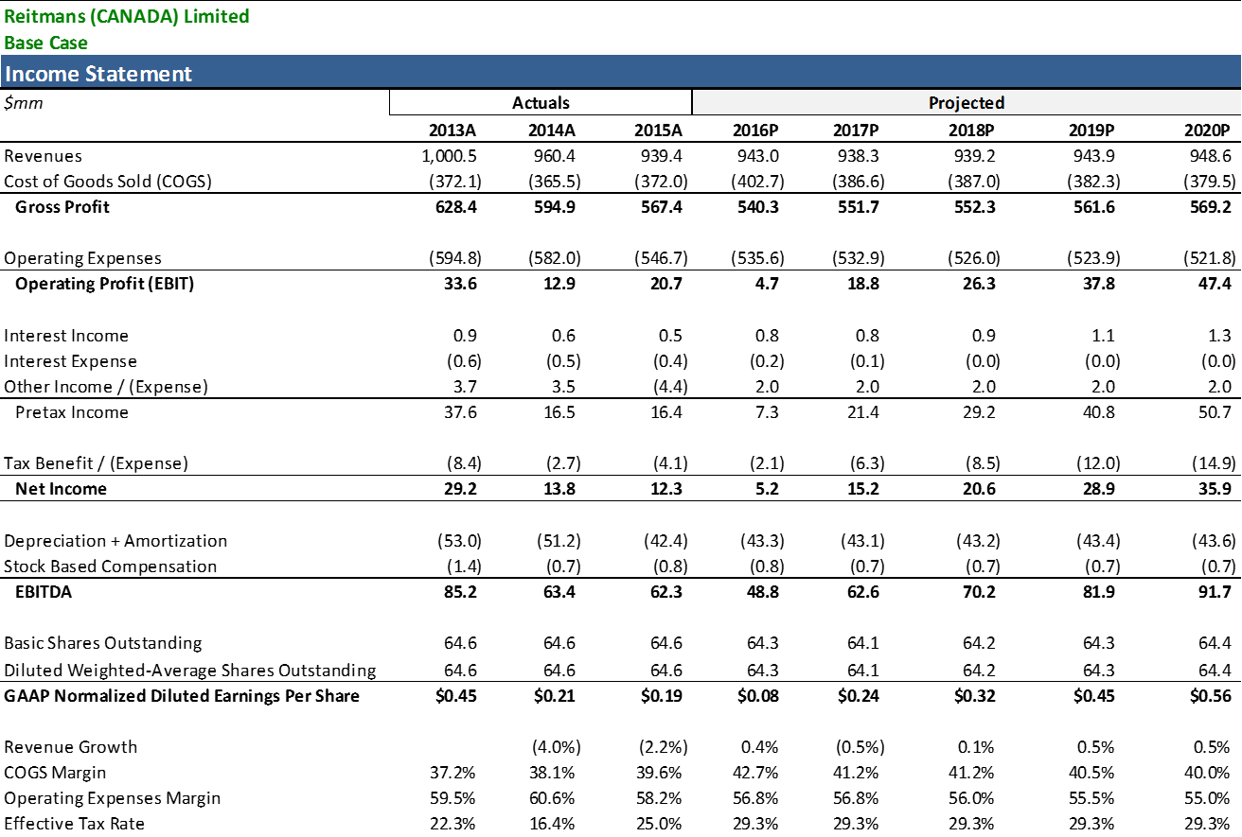
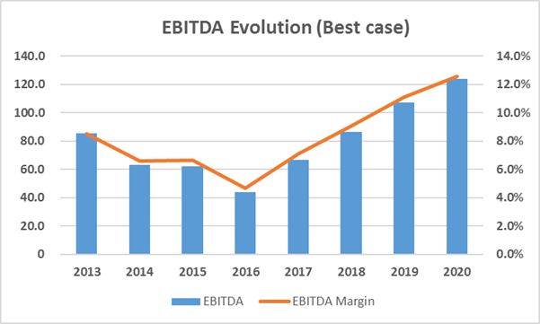
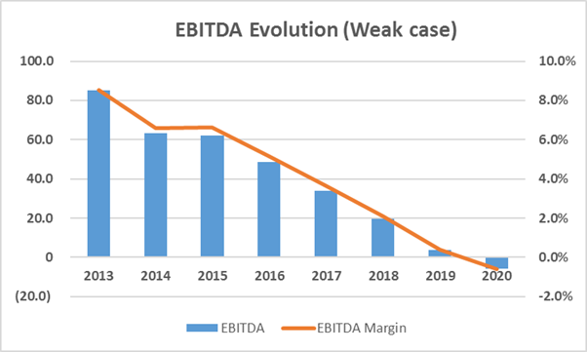
Introduction | Analysis | Valuation | Proposition
Business Operation Overview

Slide 27
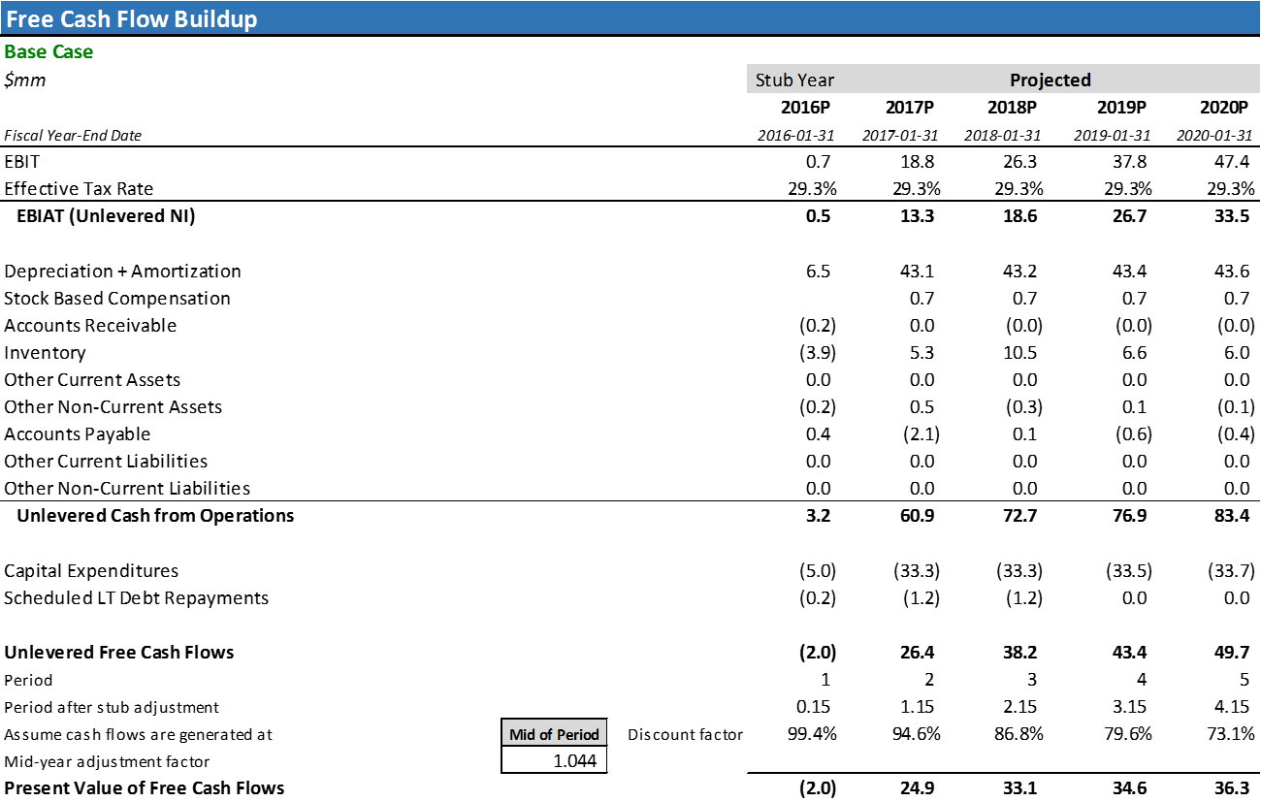
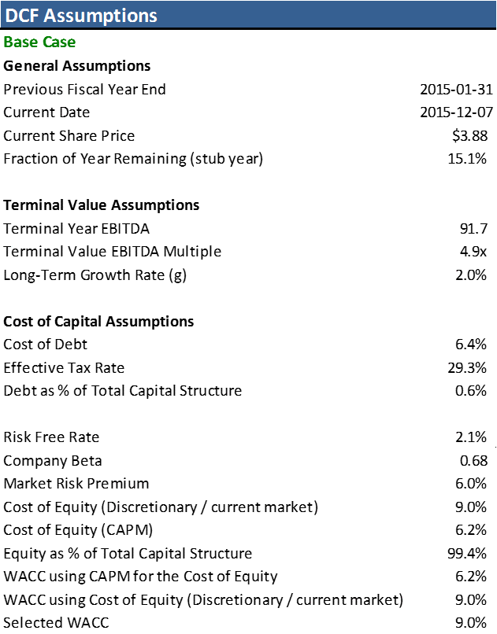
Introduction | Analysis | Valuation | Proposition
Cash Flows Forecast
Due to RET revenue volatility is preferred to use a Ke closer to the one commonly used in the whole market (TSX).

Slide 28
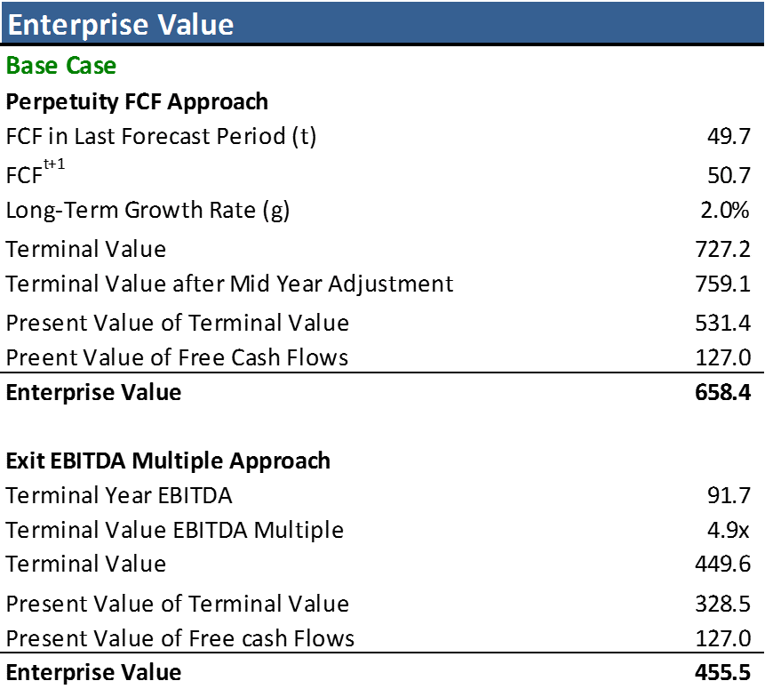
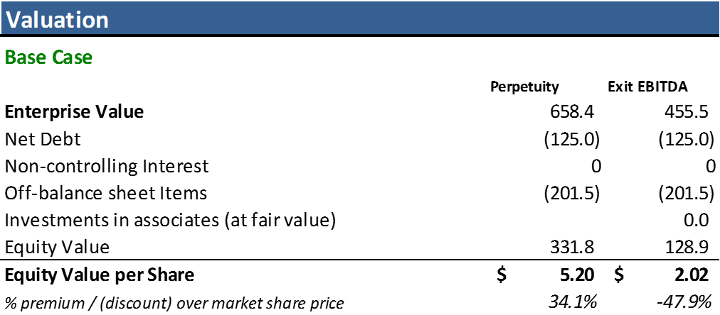
Introduction | Analysis | Valuation | Proposition
Enterprise and Equity Value
Market price = $ 3.88
Although RET has a strong Financial Health, Fierce competition in the market and poor performance on sales suggest the inclusion of Off-Balance Sheet items as a mandatory element in the Equity valuation.
Follows Target consensus share price

Slide 29
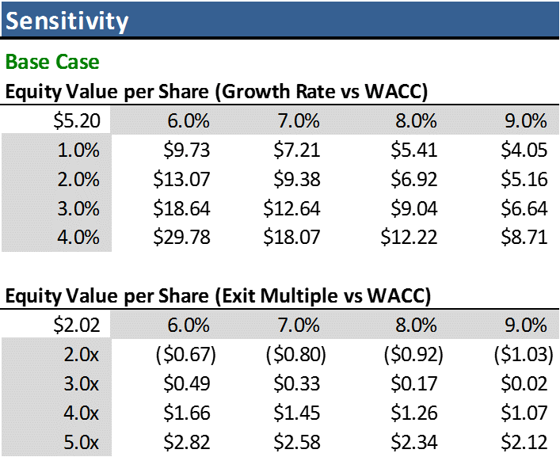
Introduction | Analysis | Valuation | Proposition
The offer
Considerations:
A price of $ 5 CAD per share would be reasonable to pay for a RET Non-Voting share.
This same price we consider includes already a Control Premium, since the spread between the Exit and Perpetuity approach rises questions on the assumption that a perpetual revenue stream will exist for RET based on current performance.
Assumptions on the Terminal Growth rate cause higher variations than those caused by Exit Multiple

Slide 30

Given our expertise and relationships, we will implement the following initiatives without the pressure of being a public firm…
Introduction | Analysis | Valuation | Proposition
How will we create value?

Slide 31
Near-sourcing
Introduction | Analysis | Valuation | Proposition
Most of production will be North American based, with Mexico being the main manufacturer. Why?
Wages are increasing much slower than other economies
Energy cost inflation has been subdued
Shipping to the US/Canada is easier and cheaper from Mexico

Slide 32
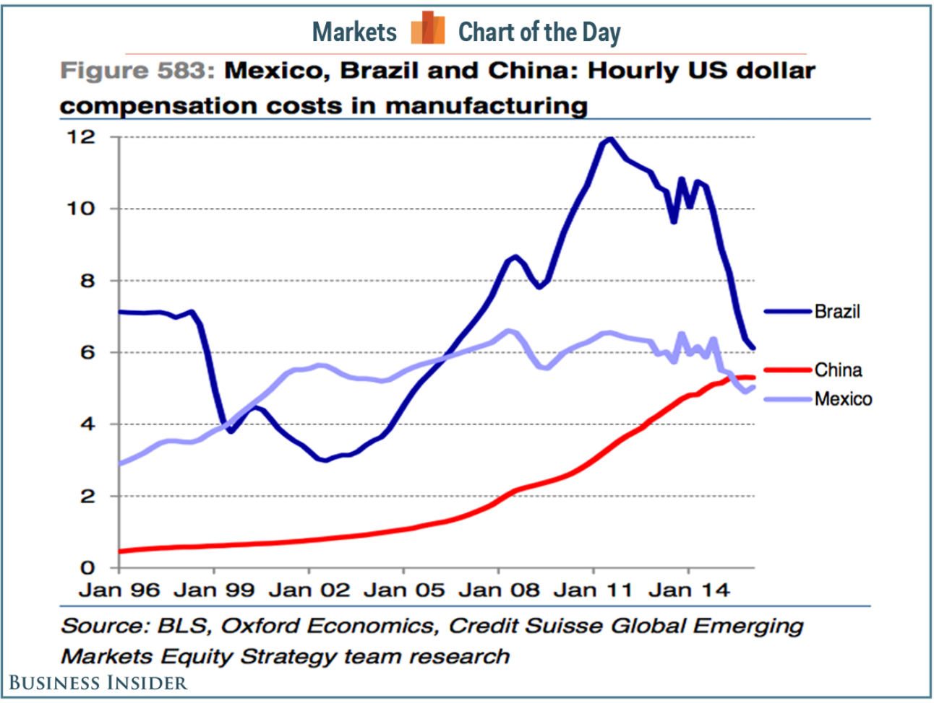
Wages are lower than China…
Introduction | Analysis | Valuation | Proposition

Slide 33
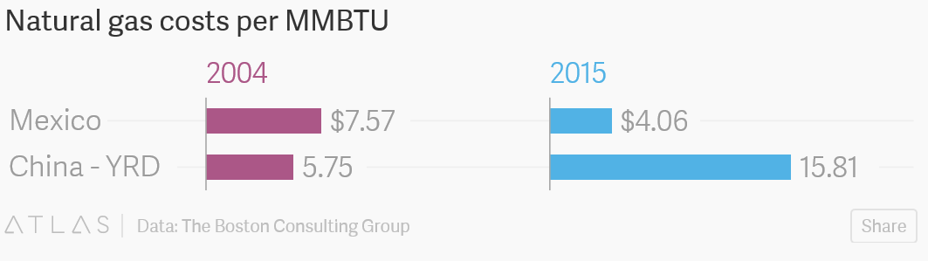
Energy costs are much lower in Mexico…
Introduction | Analysis | Valuation | Proposition

Slide 34
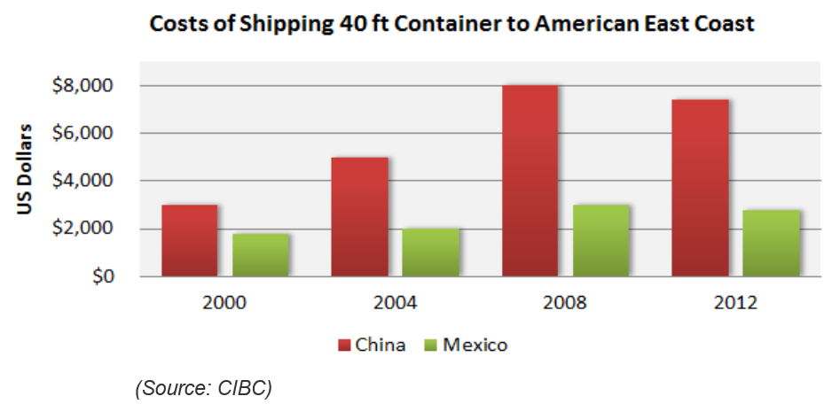
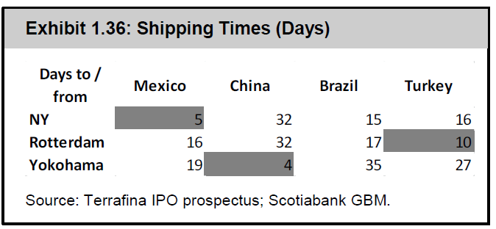
Shipping from Mexico is more efficient…
Introduction | Analysis | Valuation | Proposition

Slide 35
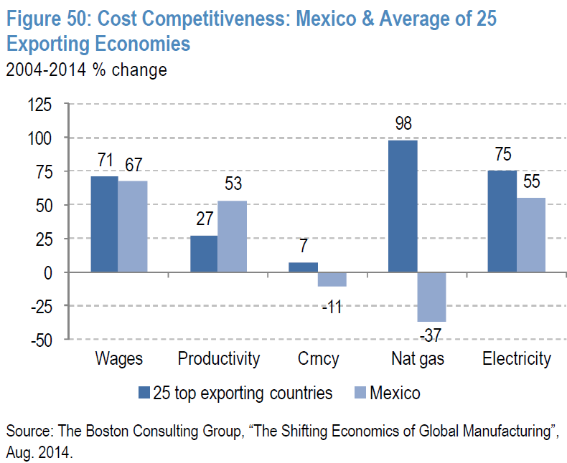
In sum, Mexico is better in most metrics…
Introduction | Analysis | Valuation | Proposition

Slide 36
Near-sourcing benefits
Introduction | Analysis | Valuation | Proposition
React better to consumer’s preferences
Reduce production costs
Reduce inventory levels and shrinkage
Improve product quality

Slide 37
Differentiate brands
Introduction | Analysis | Valuation | Proposition
Focus on positioning brands in the portfolio to compete in a particular niche and limit cannibalization:
Reitmans: focus on clientele 40 years old+
RW&Co: Continue push for younger market
Hyba: Stay course but differentiate design from Lululemon and Lolë – mid-range with more offering in + sizes
Other brands stay the course with focus on better adapting offering to consumer trends

Slide 38
Hybrid strategy
Introduction | Analysis | Valuation | Proposition
We will execute a hybrid strategy across our brands:
Seasonal offerings lasting several months
But also introduce mid-season/fast-fashion items based on local trends

Slide 39
Enhance operational expertise
Introduction | Analysis | Valuation | Proposition
The firm needs to have dedicated design teams but also:
Global Head of Design to coordinate design efforts under common themes
Global Head of Purchasing to improve sourcing efficiency and develop supply chain expertise aided by technological tools

Slide 40

Market the brands as Ethical
Introduction | Analysis | Valuation | Proposition
Products and services that embrace higher ethical standards benefit from higher customer loyalty, higher brand recognition and less price sensitivity:
Products made in North America
“We are Canada” branding with Subban
Our suppliers will need to subscribe to high ethical standards

Slide 41

Thank You

