Slide 1
Prepared by:
Alexandru Ionita
Gerald Marchel
Oscar Galindo
Simon Faucher
Stephanie Haddad

Slide 2
How can the firm survive in the current challenging environment?
Introduction | Analysis | Valuation | Proposition

Slide 3
We want to take the firm private and ensure that the Reitmans name will live on in the clothing industry
Introduction | Analysis | Valuation | Proposition

Slide 4
1926 – Company started with a single store on St-Laurent 1926 – 2000 – Organic growth and acquisitions becoming the largest women’s fashion retailer in Canada (588 stores) 2000 – 2010 – Raised its dividends 10 times during this period 2000 – Strategic alliance with Inditex Group of Spain – helped them to open Zara stores in Canada 2002 – Largest acquisition in company’s history, Shirmax Fashions Ltd (175 stores - Adition-Elle, and Thyme Maternity) 2003 - 2007 – Growth year over year, biggest player in the plus size market, completed its only distribution center in Montreal, repaid loans for acquisitions. 2008 – 2015 – Recession, slowed growth and declining revenues, Reitmans never really recovered after the recession
Introduction | Analysis | Valuation | Proposition
A bit of history
Notes:
Highlight the interesting finds regarding organic growth, dividend raise, acquisitions.

Slide 5
2010 – Announcing Reitmans.com the company’s online buying platform. Lagging behind its competitors which added online platforms in the late 2000s 2011 – Closes the Cassis brand and converts it to other banners, Jeremy Reitman becomes CEO and Chairman of the board 2012 – Partnership with Babies R Us to provide Thyme Maternity apparel in U.S., but closes most of them by the end of 2014 as they are not profitable 2012 – Issues with the distribution centers’ newly installed warehouse management system which adversely impact 3rd quarter sales 2014 – Plans to close the Smart Set banner and/or convert it to other banners, RW&CO and ELLE magazine launch exclusive holiday dress collection 2015 – Drop in sales and reduced foot traffic continues, posted losses of $7.9M for the first 6 months while e-commerce revenues increasing by 81%. More focus on RW&CO for men with Subban, new HYBA active wear banner, Addition Elle’s Ashley Graham opens the New York fashion week, marketing shift to digital by engaging bloggers and creating capsule collections
Introduction | Analysis | Valuation | Proposition
A bit of history
Notes:
Highlight the interesting finds regarding organic growth, dividend raise, acquisitions.

Slide 6
Introduction | Analysis | Valuation | Proposition
Competitive environment
XXX

Slide 7
Introduction | Analysis | Valuation | Proposition
Competitive environment
XXX

Slide 8
Introduction | Analysis | Valuation | Proposition
Company’s performance
What is not working

Slide 9
Introduction | Analysis | Valuation | Proposition
Bleeding Financials
Steady decline in revenues and an 85% drop in net earnings since 2011
Cost of doing business is increasing since 80% of their products are outsourced from China and bought in US dollars.
Large cash outflows and unsustainable dividend payouts
Inventory write-offs doubled in 2015 compared to the year before
Reitmans’ shares are currently around $3.85, a far cry from the $20 level it was trading in mid-2010

Slide 10
Introduction | Analysis | Valuation | Proposition
Organizational Concerns
Jeremy and Stephen Reitman own 49.9% of the voting through Sherlex Investments Inc. and another 6.7% with certain associates having complete control over the company
Jeremy is CEO and Chairman of the board which is not a corporate governance best practice as Jeremy has control over the company and exercises influence over the board.
Stephen is the company’s President
Aging leaders with no succession plan in sight

Slide 11
Introduction | Analysis | Valuation | Proposition
Organizational Concerns
Every brand has its own management team run by a brand president. Is Reitmans’ business model too complex and fragmented? How efficient are their business operations?
Each management team has a VP Merchandising, VP marketing, VP Planning and Allocation, and VP Sales and Operations. Coincidentally, the two underperforming brands Reitmans and Thyme have gaps in their leadership team. Reitmans lacks a VP merchandising while Thyme lacks a VP Planning and Allocation. Coincidence? Not really. This could explain the inventory write offs.
Leadership lacks a design and purchasing team that would oversee the development of a range of products aimed at a specific type of customer and price bracket. That is crucial since every banner has a different target market.

Slide 12
Introduction | Analysis | Valuation | Proposition
Operational Inefficiencies
More than 80% of products are outsourced to China. Lead time is huge. Risks are high. Costs keep going up as US dollar gets stronger.
One distribution center in Montreal to cater to all 823 stores across Canada. This puts Reitmans at a disadvantage when it comes to market responsiveness. Company has no fail over plan if distribution center is disrupted for any reason.
Poor inventory management system resulting in high inventory costs.

Slide 13
Introduction | Analysis | Valuation | Proposition
Technology
Failed implementation of a new warehouse management system has led to delays in a major systems development project (“SCORE”) which is supposed to create vertical integration across Reitmans’ supply chain
Lack of data analytics to determine demand and plan accordingly. As a result, hence markdown cost are higher than competition
Reitmans entered the ecomm world later than most competition

Slide 14
Introduction | Analysis | Valuation | Proposition
Pricing Strategy
Reitmans has a hybrid pricing strategy that is both competition and cost oriented. This is manifested in their mission statement and their various corporate initiatives aimed at reducing costs.
“We are customer driven, value oriented
and committed to excellence. By promoting
innovation, growth, development and teamwork,
we strive to serve our customers the best
quality/value proposition in the marketplace.”
Their current pricing strategy overlooks customer demand and results in a mismatch between production, supply and demand.

Slide 15
What is working
Introduction | Analysis | Valuation | Proposition
Company’s performance

Slide 16
X
Introduction | Analysis | Valuation | Proposition
Valuation

Slide 17
Given our expertise and relationships, we will implement the following initiatives without the pressure of being a public firm…
Introduction | Analysis | Valuation | Proposition
How will we create value?

Slide 18
Near-sourcing
Introduction | Analysis | Valuation | Proposition
Most of production will be North American based, with Mexico being the main manufacturer. Why?
Wages are increasing much slower than other economies
Energy cost inflation has been subdued
Shipping to the US/Canada is easier and cheaper from Mexico

Slide 19
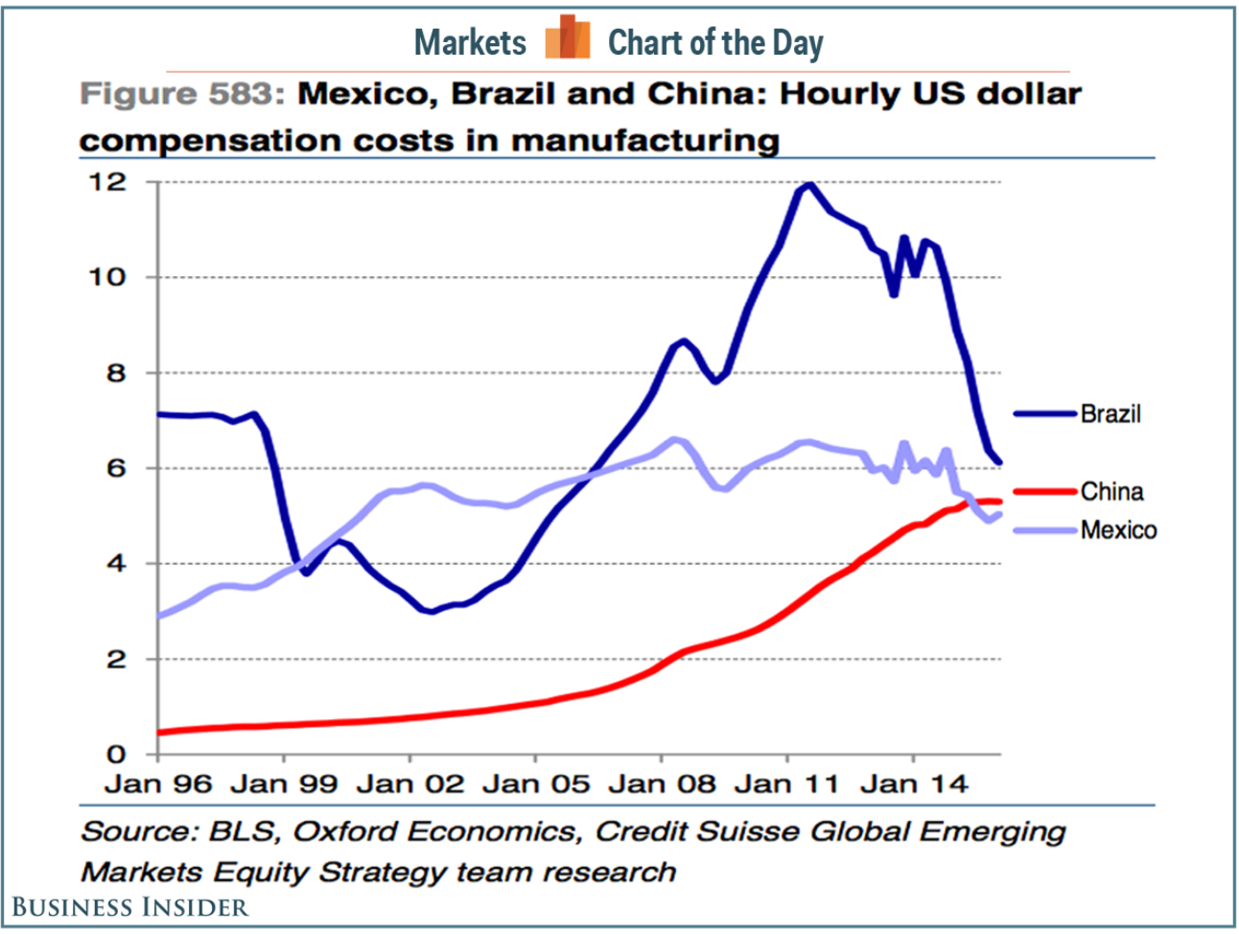
Wages are lower than China…
Introduction | Analysis | Valuation | Proposition

Slide 20
Energy costs are much lower in Mexico…
Introduction | Analysis | Valuation | Proposition

Slide 21
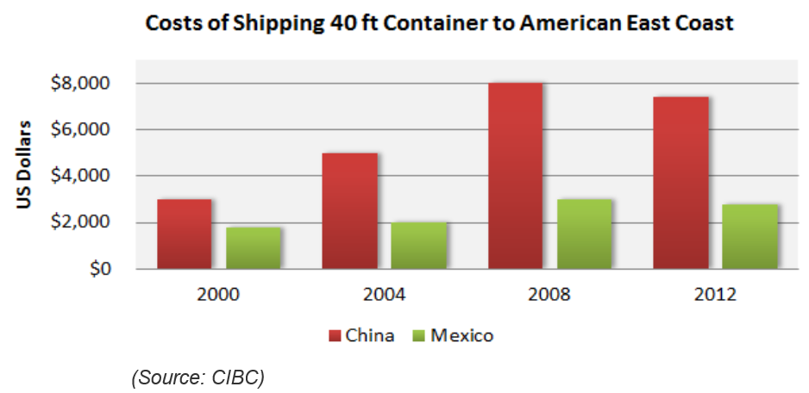
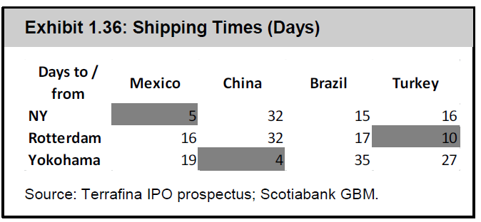
Shipping from Mexico is more efficient…
Introduction | Analysis | Valuation | Proposition

Slide 22
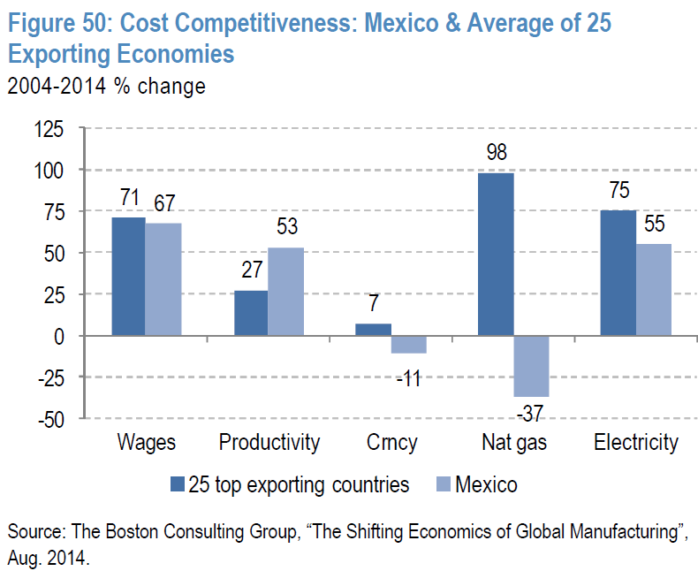
In sum, Mexico is better in most metrics…
Introduction | Analysis | Valuation | Proposition

Slide 23
Near-sourcing benefits
Introduction | Analysis | Valuation | Proposition
React better to consumer’s preferences
Reduce production costs
Reduce inventory levels and shrinkage
Improve product quality

Slide 24
Differentiate brands
Introduction | Analysis | Valuation | Proposition
Focus on positioning brands in the portfolio to compete in a particular niche and limit cannibalization:
Reitmans: focus on clientele 40 years old+
RW&Co: Continue push for younger market
Hyba: Stay course but differentiate design from Lululemon and Lolë – mid-range with more offering in + sizes
Other brands stay the course with focus on better adapting offering to consumer trends

Slide 25
Hybrid strategy
Introduction | Analysis | Valuation | Proposition
We will execute a hybrid strategy across our brands:
Seasonal offerings lasting several months
But also introduce mid-season/fast-fashion items based on local trends

Slide 26
Enhance operational expertise
Introduction | Analysis | Valuation | Proposition
The firm needs to have dedicated design teams but also:
Global Head of Design to coordinate design efforts under common themes
Global Head of Purchasing to improve sourcing efficiency and develop supply chain expertise aided by technological tools

Slide 27
Market the brands as Ethical
Introduction | Analysis | Valuation | Proposition
Products and services that embrace higher ethical standards benefit from higher customer loyalty, higher brand recognition and less price sensitivity:
Products made in North America
“We are Canada” branding with Subban
Our suppliers will need to subscribe to high ethical standards

