Slide 1
Prepared by:
Alexandru Ionita
Gerald Marchel
Oscar Galindo
Simon Faucher
Stephanie Haddad

Slide 2
How can the firm survive in the current challenging environment?
Introduction | Analysis | Valuation | Proposition

Slide 3
We want to take the firm private and ensure that the Reitmans name will live on in the clothing industry
Introduction | Analysis | Valuation | Proposition

Slide 4
Introduction | Analysis | Valuation | Proposition
Competitive environment
XXX

Slide 5
Introduction | Analysis | Valuation | Proposition
Competitive environment
XXX

Slide 6
Introduction | Analysis | Valuation | Proposition
Company’s performance
What is not working

Slide 7
What is working
Introduction | Analysis | Valuation | Proposition
Company’s performance

Slide 8
X
Introduction | Analysis | Valuation | Proposition
Valuation

Slide 9
Given our expertise and relationships, we will implement the following initiatives without the pressure of being a public firm…
Introduction | Analysis | Valuation | Proposition
How will we create value?

Slide 10
Near-sourcing
Introduction | Analysis | Valuation | Proposition
Most of production will be North American based, with Mexico being the main manufacturer. Why?
Wages are increasing much slower than other economies
Energy cost inflation has been subdued
Shipping to the US/Canada is easier and cheaper from Mexico

Slide 11
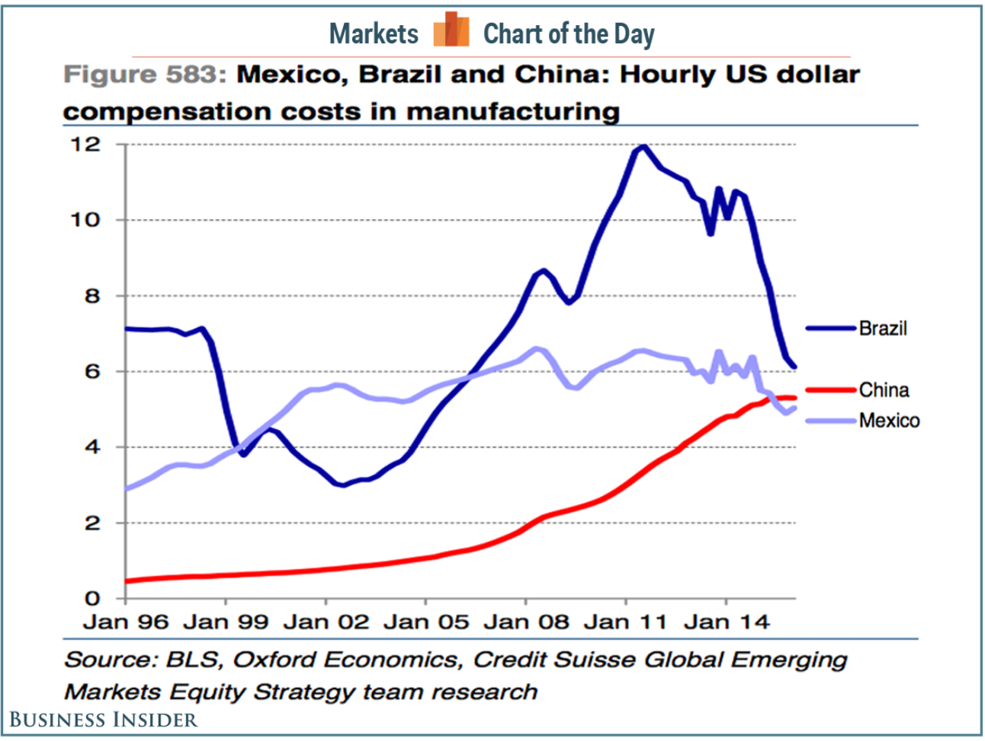
Wages are lower than China…
Introduction | Analysis | Valuation | Proposition

Slide 12
Energy costs are much lower in Mexico…
Introduction | Analysis | Valuation | Proposition

Slide 13
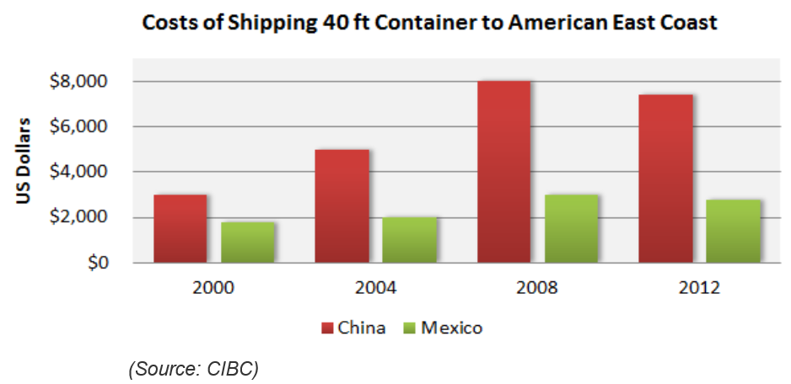
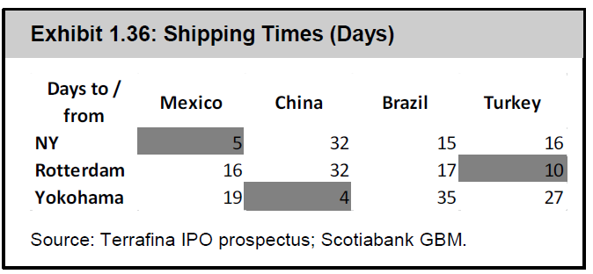
Shipping from Mexico is more efficient…
Introduction | Analysis | Valuation | Proposition

Slide 14
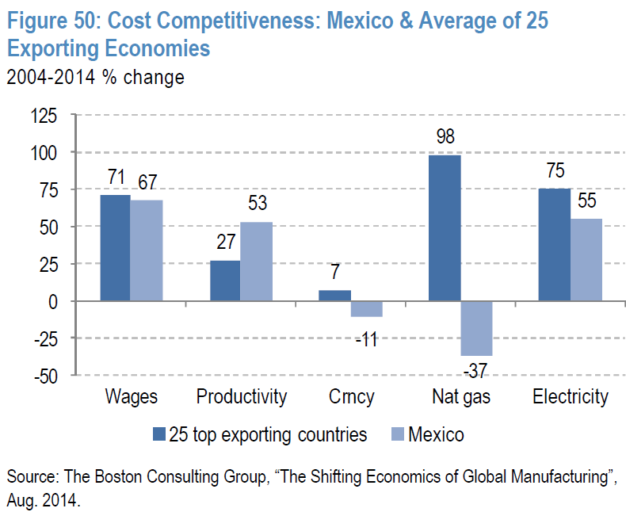
In sum, Mexico is better in most metrics…
Introduction | Analysis | Valuation | Proposition

Slide 15
Near-sourcing benefits
Introduction | Analysis | Valuation | Proposition
React better to consumer’s preferences
Reduce production costs
Reduce inventory levels and shrinkage
Improve product quality

Slide 16
Differentiate brands
Introduction | Analysis | Valuation | Proposition
Focus on positioning brands in the portfolio to compete in a particular niche and limit cannibalization:
Reitmans: focus on clientele 40 years old+
RW&Co: Continue push for younger market
Hyba: Stay course but differentiate design from Lululemon and Lolë – mid-range with more offering in + sizes
Other brands stay the course with focus on better adapting offering to consumer trends

Slide 17
Hybrid strategy
Introduction | Analysis | Valuation | Proposition
We will execute a hybrid strategy across our brands:
Seasonal offerings lasting several months
But also introduce mid-season/fast-fashion items based on local trends

Slide 18
Enhance operational expertise
Introduction | Analysis | Valuation | Proposition
The firm needs to have dedicated design teams but also:
Global Head of Design to coordinate design efforts under common themes
Global Head of Purchasing to improve sourcing efficiency and develop supply chain expertise aided by technological tools

Slide 19
Market the brands as Ethical
Introduction | Analysis | Valuation | Proposition
Products and services that embrace higher ethical standards benefit from higher customer loyalty, higher brand recognition and less price sensitivity:
Products made in North America
“We are Canada” branding with Subban
Our suppliers will need to subscribe to high ethical standards

