Slide 1
Prepared by:
Alexandru Ionita
Gerald Marchel
Oscar Galindo
Simon Faucher
Stephanie Haddad

Slide 2
How can the firm survive in the current challenging environment?
Introduction | Analysis | Valuation | Proposition

Slide 3
We want to take the firm private and ensure that the Reitmans name will live on in the clothing industry
Introduction | Analysis | Valuation | Proposition

Slide 4
Introduction | Analysis | Valuation | Proposition
Competitive environment
XXX

Slide 5
Introduction | Analysis | Valuation | Proposition
Competitive environment
XXX

Slide 6
Introduction | Analysis | Valuation | Proposition
Company’s performance
What is not working

Slide 7
What is working
Introduction | Analysis | Valuation | Proposition
Company’s performance

Slide 8
X
Introduction | Analysis | Valuation | Proposition
Valuation

Slide 9
Given our expertise and relationships, we will implement the following initiatives without the pressure of being a public firm…
Introduction | Analysis | Valuation | Proposition
How will we create value?

Slide 10
Near-sourcing
Introduction | Analysis | Valuation | Proposition
Most of production to be North American based:
Wages
Energy Costs
Mexico is part of free-trade zone

Slide 11
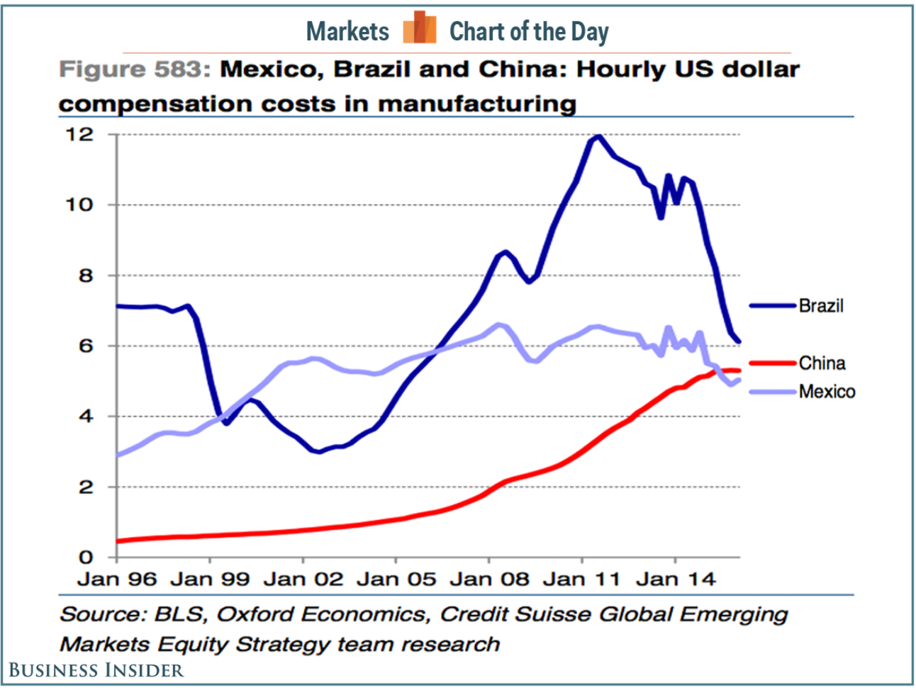
Why Mexico?
Introduction | Analysis | Valuation | Proposition

Slide 12
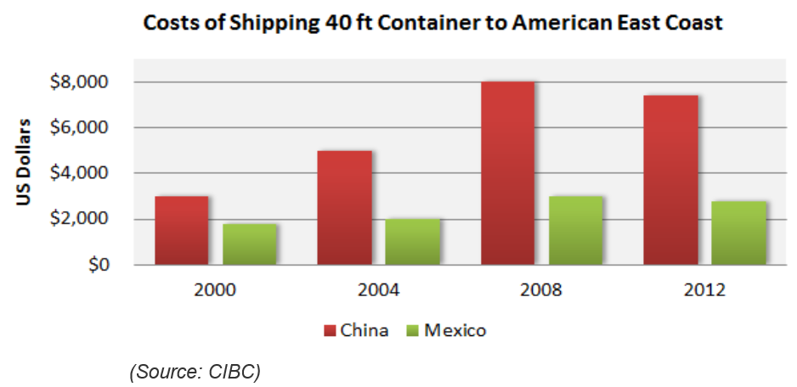
Why Mexico?
Introduction | Analysis | Valuation | Proposition

