Slide 1
H&M
Sales increasing 14 % year
# of store increasing at steady pace of 15%
Profit after tax increased 17 % to 20 Billion SEK ( 3.06 Billion CAD).
Source: Equity Research, Qualitative analysis, Market Line, Wright, Global Data.

Slide 2
History Highlights: Besides the amazing Global Expansion this brand has had and that is not taken in consideration here because it will be useless to recommend that for Reitman, these are the most important Highlights that shows how H&M Competences in its three main channels has been developed progressively. You can see how they link together to ultimately give this company a huge competitive advantage. I wouldn't say that they invented fast fashion, but they mastered every channel so well that they were capable to bring customer what they want (Just to note that H&M sales growth at 14% per year).
1975: First Introduction of Cosmetic Portfolio
1980: Starts Purchasing by catalog bringing the skill in-house . Buyout of Rowell, a mail order company.
2004: Separation of the buying dep. : Production and Buying
2006: First Expansion of the Online sales out of the Nordic Region. Nederland's and Germany
2007: Market diversification and Development: In collaboration with Electronic Arts (EA), launched a stuff pack for the world's biggest video game, Sims 2 H&M Fashion Stuff Pack.
2010: Launched its first range of skincare merchandise with certified organic ingredients
2011: H&M launched its free Android application allowing the users to browse H&M's apparel collections, receive fashion news, as well as videos and exclusive offers.
2013: In-store – On-line Full Integration: The group launched its Shop Online store to offer the same collections online as in-store giving customers access to a range of clothing and accessories.
2014: Early in 2014 we successfully launched H&M Sport, and in the autumn our extended shoe range was gradually launched in selected H&M stores and online, H&M Homme Textiles and Deco
2015: H&M Beauty - a new, broad concept for make-up, body care and hair care with high quality value-for money products in a specially produced design
Crucial For the Business Model
Check Supply Chain Slides

Slide 3
BUSINESS MODEL AND DESCRIPTION
Supply Chain:
The Supply chain seems to be very well integrated:
1.Creation in HQ: Done in team by Designers and buyers. It probably allows to include an optimal cost as a design criteria (Flexibility).
2.Outsource the manufacturing (All of it)
3. Purchase the manufactured product and then does the Distribution of merchandise by Region and then to country depending on Demand. I suppose that Region signals the Fashion Trend taste and the country specific signals the Demand.
Main Channels:
In store: World wide, literally. H&M uses leased premises. We must check if Reitman is using this model which very convenient. It also Uses franchise stores in certain markets (I have no info if in Canada). This guys are very strong and I believe that shopping experience is also a key point for them. You just don’t have a flagship store in 5th avenue if you are not sure of your presence.
On line: Super strong presence. It has total presence of product exhibition online. However Online stores only in 13 countries. Surprisingly Canada doesn’t have online Store. Why? There should be a good reason, this people is not stupid.
Catalogue
MD&A: It seems that H&M has learnd how to tailor its offer in a nice mixture of costing and taste.
Although the increasingly expensive US dollar will affect our sourcing costs, we will make sure that we always have the best customer offering in each individual market, in terms of fashion, quality, price and sustainability, as this is the basis of our business concept.

Slide 4
Some initial ideas to help Reitman (H&M inspired)
Ideas in this section allow Reitman to cope with “Fast Fashion” pace and make one step further:
On the online Channel, make the offering as simple as H&M does but even if the customer is not allowed to buy it online (as in H&M Canada) you can use the RFI technology to tell the customer where exactly the product is located in his or her city. This is one of the most critical info customer is looking for when buying Fast Fashion. You will improve two things, Traffic and Satisfaction. And most important of all H&M does not do that yet.
Ideas in this section only allow Reitman to cope with the “Fast Fashion” pace:
Obviously learn how to create Fast Fashion: Hard but doable. Develop the competence to read demand faster, and create it based on cost and on trends variances. Probably one nice thing to do is to include a very nice staff of designers in the creation department that could have a current understanding of the fashion trends, and altogether with the buyers create the cost optimal collection.
Try to look on Other categories where your instore presence give you the advantage. Eg. Cosmetics, sports (I think they started already), Beauty products. You can do it progressively as H&M did. H&M Beauty was launched only in 900 stores at the beginning and adding 100 per year.
3. Use partnership with Well know designers and creators to bring Value-priced offerings to your customers. You’ll make the Reitman bright name to bright again while giving an affordable product. Ex: Anna De lo Russo (H&M Fashion Director), or “ H&M announces collaboration with Balmain H&M Hennes & Mauritz AB, a clothing company, has announced the collaboration with the Parisian house of Balmain.”
4. Use VIP people and other stars that can help increase your exposure faster. H&M has an history of doing that locally in every country. These are two Global examples : Madonna, David Beckham etc. Reitman is doing it lately with P.K. Subban, he is a star without doubt but, is he also a referent of good fashion?
5. Promote Canadian manufacturing or green products: I though in this as be in the first category at the beginning but the I discovered that H&M has been awarded like 5 years in a row for having the best practices on dignity and wages in its supply chain and with its direct employees. In addition its well recognized green material collection has some market share already. I don’t know how strong could be the argument with this new info in the market. Probably is still strong, but H7M will a have an easy reaction strategy.

Slide 5
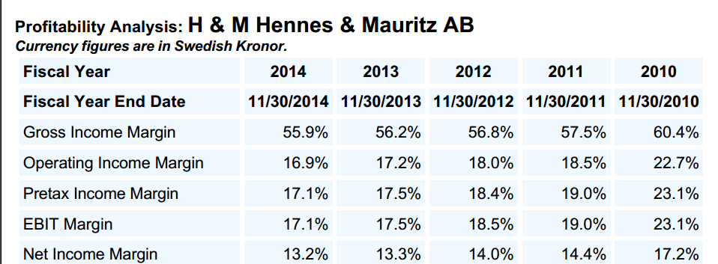
Interesting Findings:
Even if H&M is a model of very well integrated supply chain, we could say that both are beating the Industry. So cost management of Reitman is acceptable so far.
2. Problem for Reitman really relies on the Opex. It seems that the sudden decrease on revenues reduced the on-volume production advantages and the level of sales is not enough to sustain the cost of its operations.
Conclusion: Reitman Really need to improve the product offering. Even if the shopping experience is an added value, customer respond better when the shopping experience is accompanied of very nice Fashion trends in the shelves
Important note:
Both have performed Days inventory
from around 76 days in 2011 to around
100 days in 2015. It seems to be normal.
I was surprised too.

