Slide 1
Samsung / BBRY Pitch Book
Eduard Biller Paul Dawson Mashada Kamal Simon Foucher

Slide 2
AGENDA
1
Deal Overview
2
Industry
3
Target Overview- Blackberry
4
Business Valuation
5
Synergies & Forecast

Slide 3
DEAL OVERVIEW

Slide 4
TERM SHEET
Target- BlackBerry Ltd. (NASDAQ:BBRY) Acquirer- Samsung Electronics Co. Ltd (KRX: 005930)
Purchase Price
Total deal size: $5,659 million Implied price per share: $10.72 Transaction fees: $40 million Reservation price: $15.76
Tax Considerations
Form: Purchase accounting Consideration: 100% cash
Legal Asset purchase Spin-off unused entities
Synergy Value Combined synergy $14.3 billion with payback period of 3-4 years
Deal Overview
Industry
Target Overview
Valuation
Synergy

Slide 5
TERM SHEET
Transaction process requirements
Termination penalties: Cash penalty of $100m plus out of pocket expenses up to $20m Other: No shop clause Shareholder vote: Blackberry and Samsung shareholders must approve the deal. Closing Date: March 1st, 2016 Regulatory: Approval through Industry Canada Act required
Social Issues
Organization structure: Blackberry assets acquired by Samsung. Blackberry dissolved. Executives: Executives responsible for security and R&D retained Board seats: None Headquarters: Canada HQ closed but R&D functions to remain in Canada Name: Blackberry brand kept for marketing purposes Reduction in workforce: 6,000 out of 7,000 total employees. Retain R&D staff.
Deal Overview
Industry
Target Overview
Valuation
Synergy

Slide 6
DEAL RATIONALE
Patents
Thousands (44,000+) of patents
Security
Enterprise level security for their Android-based platform
Competitiveness
Block competitors (Apple and others) from acquiring the most admired enterprise security platform
Deal Overview
Industry
Target Overview
Valuation
Synergy

Slide 7
BIDDING STRATEGY
RECOMMENDED INITIAL BID OF $10.72
Bidding should be bound by the following:
Upper bound of $15.76
Lower bound of $10.72
Blackberry is widely considered to be on the selling block
Current market share may already contain some acquisition premium
Samsung must bid high enough to win over Blackberry shareholders and avoid a bidding war with other acquirers that may jump in
Deal Overview
Industry
Target Overview
Valuation
Synergy

Slide 8
ACCRETION/DILUTION
Since this is essentially an asset purchase, the acquisition of Blackberry will have no immediate impact on EPS
Deal Overview
Industry
Target Overview
Valuation
Synergy

Slide 9
INDUSTRY
Global Mobility and Communication Equipment Manufacturing (CEM)

Slide 10
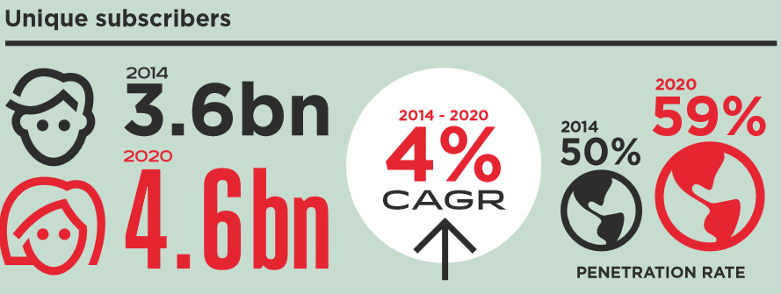
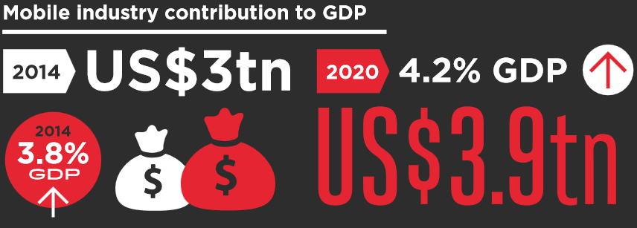
GLOBAL MOBILITY
Industrial trends
10% CAGR industry growth
21% shipments to Chinese market
Duopoly- Apple and Samsung captures 2/3 of revenue
Rise of Chinese manufacturers
Established manufacturers are being squeezed
The importance of intellectual property is paramount
Deal Overview
Industry
Target Overview
Valuation
Synergy
Notes:
The global smartphone market has witnessed extraordinary growth in recent years, with shipments rising by 40% in 2013 to exceed the 1 billion unit threshold and $266 billion in value. However, growth as a whole is slowing down. Total handset market growth of 6 % in 2013 was down from 9 % in 2012 and 13 % in 2011.
Smartphone growth is now heavily dependent on emerging markets, notably China which accounts for mobile phone shipments of 21% of the global total.
The mobile phone industry is a duopoly. Apple and Samsung captured two-thirds of industry revenue, and practically all the profit generated by the top 10 manufacturers. However, both companies are set to face increased margin pressure as competition increases and the collective power of the Android ecosystem continues to close the gap on Apple and Samsung's ability to differentiate.
Disruption from companies such as Amazon, Apple, Google, Microsoft and others with the benefit of supporting ecosystems, along with the growth of Chinese manufacturing, is squeezing a host of phone-makers.
Motorola and Nokia have already been hit; BlackBerry, LG and HTC face continued problems with their margins because they lack advantages in terms of cost, scale, and ecosystem or business model.

Slide 11
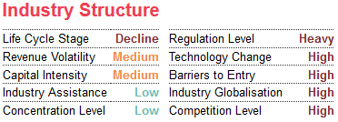
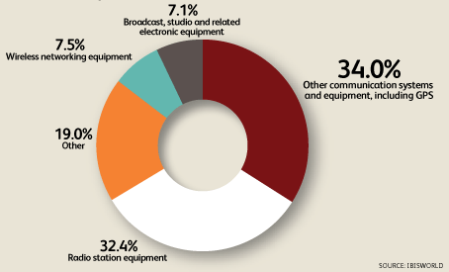
CEM INDUSTRY IN CANADA
Industrial trends
Strong competition
Imports from China increasing at 6.6%
Exports from Canada declining at 9.9%
Industry profit is decreasing
Increasing consolidation
Experiencing increased import penetration
Deal Overview
Industry
Target Overview
Valuation
Synergy
Notes:
The Communication Equipment manufacturing industry in Canada suffered from the global recession and has been slow to take advantage of the global restructuring trend that has been defining electronic manufacturing industries over the past five years.
Over the five years to 2015, revenue decreased an average annual 6.8% to $3.5 billion, declining 2.7% in 2015 alone.
Canadian manufacturers have been slow to embrace this outsourcing movement and have suffered as a result, with profit margins falling to about 9.2% in 2015.
The industry value added (IVA), which is a measure of the industry's contribution to the Canadian economy, is expected to decline at annual rate of 3.3% in the 10 years to 2020

Slide 12
TARGET OVERVIEW
BLACKBERRY

Slide 13
BLACKBERRY OWNERSHIP STRUCTURE
Only 2 concentrated investors
Deal Overview
Industry
Target Overview
Valuation
Synergy

Slide 14
BLACKBERRY BUSINESS
Segment contribution
Revenue trend
Deal Overview
Industry
Target Overview
Valuation
Synergy
Notes:
Revenue from cellphone business declined by almost 50% annually, dragging down its bottom line.
In the company’s fiscal 2015, BlackBerry lost $304 million.
After growing to dominate the corporate market, BlackBerry failed to anticipate that consumers would drive the smartphone revolution.
BlackBerry was blindsided by the emergence of the “app economy,” which drove massive adoption of iPhone and Android-based devices.
They failed to realize that smartphones would evolve beyond mere communication devices to become full-fledged mobile entertainment hubs.
Blackberry’s stock has been dragged down by their hardware division. Its failure to adopt more popular OS running in the industry has been a constant nuisance for the consumers who criticized the phone of lacking apps and functionality.

Slide 15
BlackBerry BUSINESS
Profitability
Liquidity & Solvency
Deal Overview
Industry
Target Overview
Valuation
Synergy

Slide 16
BUSINESS VALUATION
Comparables and Transaction Multiples

Slide 17
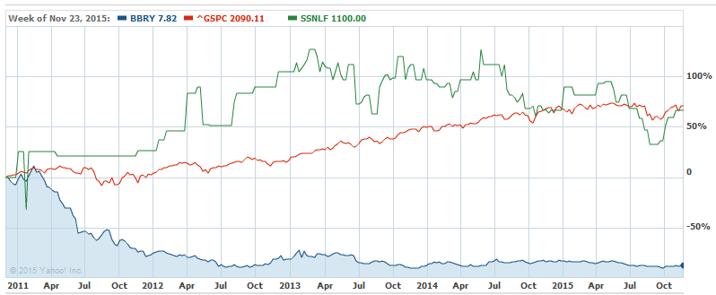
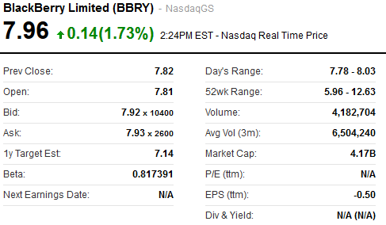
STOCK PERFORMANCE
Deal Overview
Industry
Target Overview
Valuation
Synergy

Slide 18
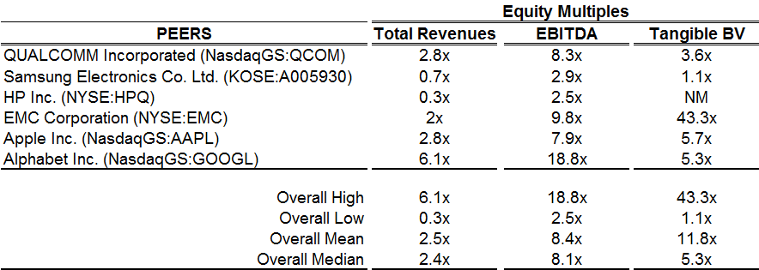
COMPARABLES
Deal Overview
Industry
Target Overview
Valuation
Synergy

Slide 19
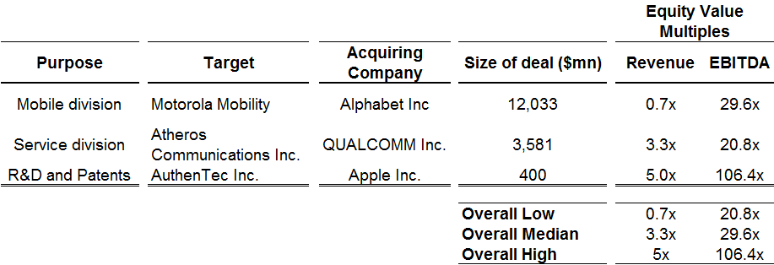
TRANSACTION MULTIPLES
Deal Overview
Industry
Target Overview
Valuation
Synergy

Slide 20
BUSINESS VALUATION
Discounted Cash Flow (DCF)

Slide 21
DCF SCENARIO
In US$ mill
Deal Overview
Industry
Target Overview
Valuation
Synergy

Slide 22
VALUATION SUMMARY
RESERVATION PRICE $15.76
BID PRICE
$10.72
BID PREMIUM
35%
Deal Overview
Industry
Target Overview
Valuation
Synergy

Slide 23
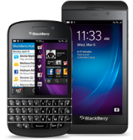
BLACKBERRY INTEGRATION WITH SAMSUNG
Samsung division | Blackberry | Fit with Samsung
Smartphones |  | Scrap it/Sell it
Enterprises |  | Gives a major market share since Android is insecure
Mobile Devices |  | Implementation/Selling possible
Services and Support | Software | Implementation into their android version
R&D | Patents | Major upsides possible, Implementation, royalties or partial sale possible
Deal Overview
Industry
Target Overview
Valuation
Synergy

Slide 24
SYNERGIES AND FORECAST
FOR SAMSUNG

Slide 25
LOSING MARKET SHARE WHILE ANDROID GAINS POPULARITY
Present need to react
Deal Overview
Industry
Target Overview
Valuation
Synergy

Slide 26
SYNERGIES
Top line growth
Bottom line savings
Leverage BBRY’s “secure” reputation and distribution network
Increased sales in enterprise segment
Integrate BBRY’s secured network infrastructure
Decommission expensive (and unsuccessful “KNOX” project
Significantly reduce spending in R&D
Also savings in Sales/Distribution
Deal Overview
Industry
Target Overview
Valuation
Synergy
Notes:
Synergies are expected from both a top line growth and saving perspective

Slide 27
Top line growth
Initial 3B$ sales from enterprise segment
Potential to reach $25B (assuming 10% growth)
At 30% margins, additional profits 1-8B$
Notes:
Assuming 2/3 of BB sales came from enterprise segment; the size of the market can be estimated at at least 18B$ in 2011.
Smartphone market grows at roughly 10% annually
Prorated to 2015, market potential is estimated at $25B
Immediately after acquisition, Samsung will at least have captured BBRY’s existing sales – 3B$

Slide 28
SYNERGIES FROM SAVINGS IN R&D
Retiring KNOX frees 1B$ to re-invest in Sales
Deal Overview
Industry
Target Overview
Valuation
Synergy
Notes:
Samsung’s IT and Mobile division accounts for roughly 50% of Samsung’s revenues
Assuming Capex, R&D and Sales expenses are allocated per business unit as % sales, the IM division spends 10B$ Capex, 6B$ R&D and 5B$ in sales

Slide 29
SUMMARY
 | 2015A | 2016E | 2017E | 2018E | TV
Incremental Revenues | $ 3.0 | $ 5.4 | $ 8.6 | $ 12.1 | $ 20.2
Cogs | $ (2.1) | $ (3.8) | $ (6.0) | $ (8.5) | $ (14.1)
Profits | $ 0.9 | $ 1.6 | $ 2.6 | $ 3.6 | $ 6.0
Transaction cost (6%) | $ (0.4)
Integration Cost | $ (0.5) | $ (0.5)
Savings R&D | $ 1.0 | $ 1.0 | $ 1.0 | $ 1.0 | $ 1.0
Increased sales mkt | $ (1.0)
Impact on EBITDA | $ 0.40 | $ 2.12 | $ 3.59 | $ 4.63 | $ 7.05
Discounted CF (12%) | $ 0.40 | $ 1.96 | $ 3.08 | $ 3.67 | $ 5.18
Looking at a 3-4 year payback period and 14.3B$ NPV
Deal Overview
Industry
Target Overview
Valuation
Synergy

Slide 30
Risks
Regulatory approval
Form consortium with CND PE Firm
FOREX fluctuations since cash deal
CND$ currently extremely favorable
Potential proxy fight with large shareholders
BBRY depreciated to value trap status
Ability to maintain key R&D staff amidst downsizing
BBRY technology already mature
Unable to spin off unused acquired assets (HW division)
Profitable deal regardless

Slide 31
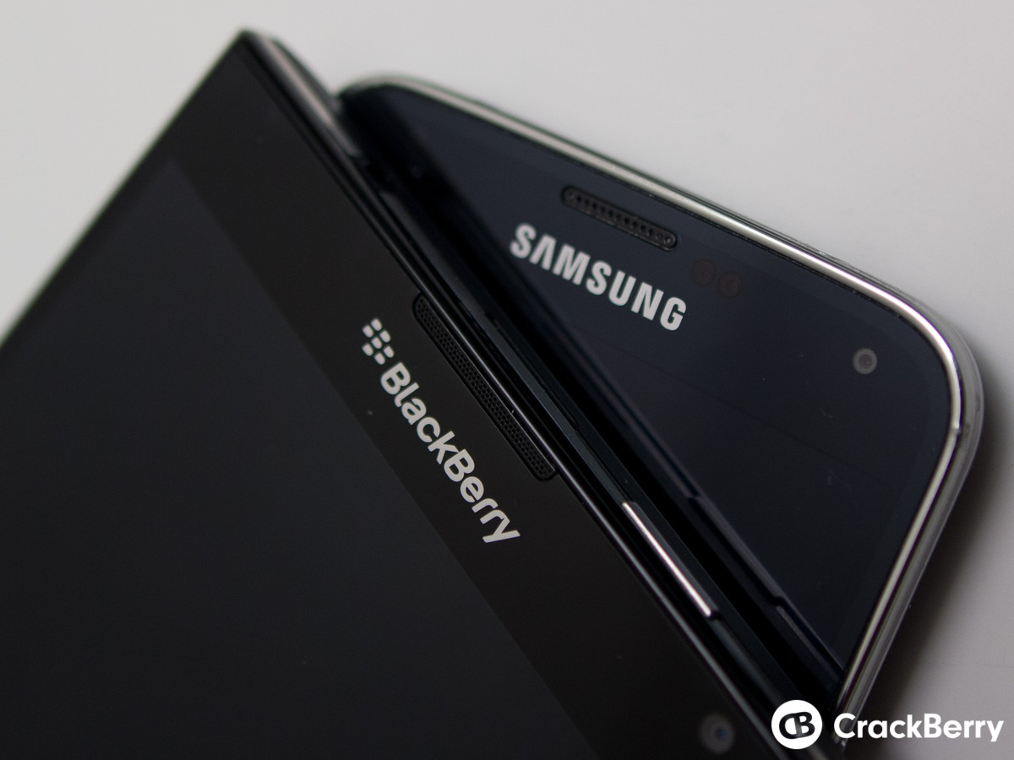
Questions?

Slide 32
LIST OF REFERENCE
http://www.gsmamobileeconomy.com/GSMA_Global_Mobile_Economy_Report_2015.pdf
http://www.lenovo.com/transactions/pdf/CCS-Insight-Smartphone-Market-Analysis-Full-Report-07-2014.pdf
http://0-clients1.ibisworld.com.mercury.concordia.ca/reports/ca/industry/competitivelandscape.aspx?entid=746#IG
http://0-clients1.ibisworld.ca.mercury.concordia.ca/reports/us/industry/default.aspx?entid=746
https://home.kpmg.com/xx/en/home/services/tax/tax-tools-and-resources/tax-rates-online.html
http://pages.stern.nyu.edu/~adamodar/
http://pages.stern.nyu.edu/~adamodar/New_Home_Page/datafile/ctryprem.html
http://www.idc.com/prodserv/smartphone-market-share.jsp

Slide 33
GOOD TECHNOLOGY’S REPORT
iOS significantly outpaced Android in regulated industries such as education (83 percent), public sector (80 percent), and financial services (76 percent).
Android gained wider adoption in less regulated industries, increasing to 47 percent in high tech sectors and 44 percent in energy sectors.
Secure browsing led all app categories for the second quarter in a row, representing 21 percent of all apps deployed by organizations.
Due to the fact that RIM devices use only the BlackBerry® Enterprise Server for corporate email access, Good does not have insight into BlackBerry handset activation trends; and they are not reflected in this report.
Deal Overview
Industry
Target Overview
Valuation
Synergy

Slide 34
EXHIBITS

