Slide 1
Four guys one dream
Tax Postponers | Morgan Raphael Simon Foucher Yusuf Abdulridha Jonathan Suprovici

Slide 2
Key findings

Slide 3
Classic partnership holding structure
KEY FACTS
TAX PLANING
INCOME & TAX
STRUCTURE
Four Guys
Yusuf Traders Ltd
Simon Tours Inc.
Raphael Estate Inc.
Jonathan Jigalo Inc.
Operating Partnership
Holding Corporations
Allows great tax flexibility

Slide 4
One dream – 4 stories
KEY FACTS
TAX PLANING
INCOME & TAX
STRUCTURE
FOUR GUYS LLP
NI For Tax: $620,000
Optional $94,000 CCA Allowance
Yusuf Traders Inc.
CCPC Import/Export Business
<2014; $30,000 NI after Yusuf Salary
Simon Tours Inc.
No risk of insolvency but…
$300,000 expires in 2 years
2015+, expect $250,000 NI
Non-capital losses of other years: $600,000
Raphael
Jonathan Jigolo Inc.
Personally owns a warehouse; vacated in 6 months
Appreciated value of $80,000
Will not sell if there are tax consequences
Website for unemployed men
Amassed a fortune
45 y. old, married, 10 and 18 y. old child
Multiple ways to split income

Slide 5
INCOME &
TAX LIABILITY
Nothing can be said to be certain,
except death and taxes

Slide 6

Business Income for Tax Purposes
KEY FACTS
INCOME & TAX
STRUCTURE
TAX PLANING
Business Income for tax purposes = $620,000
Optional CCA deduction = $94,000
Partnership can choose how to apply to the optional CCA deduction.
Maximum Business Income for tax purposes = $620,000
Minimum Business Income for tax purposes = 620,000 - 94,000 = $526,000

Slide 7


Preference of Partnership Income
KEY FACTS
INCOME & TAX
STRUCTURE
TAX PLANING
Yusuf Traders
Profits of $250,000 + 25% of Partnership Income
No unused business losses
Simon Tours
Zero profits from its own operations
25% of Partnership Income
$600,000 unused business losses
($300,000 expiring in 2 years)

Slide 8
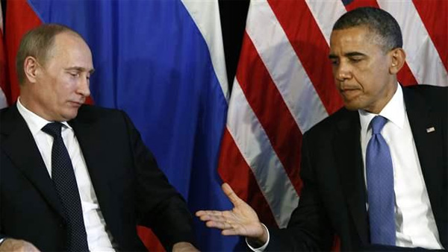
Preference of Partnership Income
KEY FACTS
INCOME & TAX
STRUCTURE
TAX PLANING
Yusuf Traders
Prefer minimum partnership income ($526,000)
Pay less taxes on total income
Simon Tours
Prefer maximum partnership income ($620,000)
Be able to claim more of its unused business losses

Slide 9
Yusuf Traders Tax Liability
KEY FACTS
INCOME & TAX
STRUCTURE
TAX PLANING
Total Partnership Income
 | Minimum | Maximum
Total Partnership Income | 526,000 | 620,000
Small Business Deduction (SBD) eligibility | 500,000 | 500,000
Non-eligible for SBD | 26,000 | 120,000
Yusuf Traders Partnership Income (25%)
 | Minimum | Maximum
Partnership Income | 131,500 | 155,000
Small Business Deduction (SBD) eligibility | 125,000 | 125,000
Non-eligible for SBD | 6,500 | 30,000

Slide 10
Yusuf Traders Tax Liability
KEY FACTS
INCOME & TAX
STRUCTURE
TAX PLANING
Yusuf Traders Total Income and Tax
 | Minimum | Maximum
Partnership Income (SBD eligible) | 125,000 | 125,000
Partnership Income (Non-SBD eligible) | 6,500 | 30,000
Business Income (SBD eligible) | 250,000 | 250,000
Total Income | $381,500 | $405,000
Tax on SBD eligible income [(125,000 + 250,000) * 20%] | $75,000 | $75,000
Tax on non-SBD eligible income [non-SBD eligible income * 37%] | $2,405 | $11,100
Total Tax | $77,405 | $86,100
Tax savings of $8,695 if the partnership decides to use the minimum business income for tax purposes

Slide 11
Optimal corporate structure

Slide 12
Incorporate partnership?
KEY FACTS
TAX PLANING
INCOME & TAX
STRUCTURE
Four Guys
Yusuf Traders Ltd
Simon Tours Inc.
Raphael Estate Inc.
Jonathan Jigalo Inc.
25% Ownership
Not associated (<50%)
Dividend flow tax free
Entitled to full 500k SBD
Company to Company
Already a benefit from the expanded smb

Slide 13
Tax consequence - All shareholders benefit from smb
KEY FACTS
TAX PLANING
INCOME & TAX
STRUCTURE
If taxed immediately on dividend, better with revenue share

Slide 14
Tax consequence – Flow Dividend to shareholder
KEY FACTS
TAX PLANING
INCOME & TAX
STRUCTURE
Collecting personal dividends = short 17k$

Slide 15
Tax consequence – Yusuf / yusuf traders inc
KEY FACTS
TAX PLANING
INCOME & TAX
STRUCTURE
With 250k$ revenues from Traders, Inc, differ 4+ years

Slide 16
Deferral Tax consequence – simon
KEY FACTS
TAX PLANING
INCOME & TAX
STRUCTURE
Short 25k$ and propelled in high tax bracket

Slide 17
Deferral Tax consequence –simon tours inc
KEY FACTS
TAX PLANING
INCOME & TAX
STRUCTURE
Since broke, might not be able to wait 4 years

Slide 18
Deferral Tax consequence – jonathan jigalo inc
KEY FACTS
TAX PLANING
INCOME & TAX
STRUCTURE
4 Guys Inc
Tax free Dividend
Remainder kept in Retained Earnings and Invested
Jonathan Jigalo Inc
Income split
Wife
Salary
Personal Salary
18+ Child
Salary
Income split now and defer tax on rest

Slide 19
Tax consequence - summary
KEY FACTS
TAX PLANING
INCOME & TAX
STRUCTURE
Yusuf
No need for income
Simon
Jonathan
Raphael
Earn Interest
++ After 4Yrs
No need for income
Earn Interest
++ After 4Yrs
Potential to earn interest
Will materialize tax loss
No need for income
Keep $ in Traders Inc
Keep $ in Traders Inc
Broke so Need Income
Income split Wife/Child
Invest rest in Holding Corp
Short 25K$
++ < 4Yrs
¾ partners are better off; most likely incorporate

Slide 20
Tax planning
Tax avoidance (not evasion)
Succession planning

Slide 21
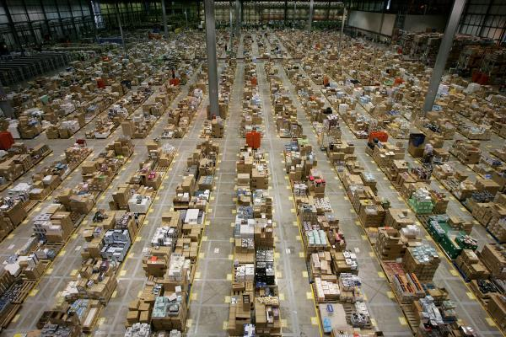
TO TAX OR NOT TO TAX
KEY FACTS
INCOME & TAX
STRUCTURE
TAX PLANING
Raphael warehouse property transfer to the partnership
Asset transfer from Raphael personal ownership into the partnership
Asset transfer must maximize cash flow to Raphael Real Estate Inc.
Facts
The property has appreciated in value by 80 000$ over the original cost
THAT IS THE QUESTION

Slide 22


SOME OPTIONS
KEY FACTS
INCOME & TAX
STRUCTURE
TAX PLANING
Transfer at Fair Market Value (by default)
80 000$ in capital gain
40 000$ is taxable
50% personal tax rate
Additional taxes to be paid by Raphael: 20 000$
Transfer at Cost (97 rollover)
As a partner, Raphael can elect to transfer the property at cost
Tax Free!
Partnership note
97 rollover = Lower cost for tax purposes
CCA claimable on lower amount
97 ROLLOVER FOR THE WIN

Slide 23
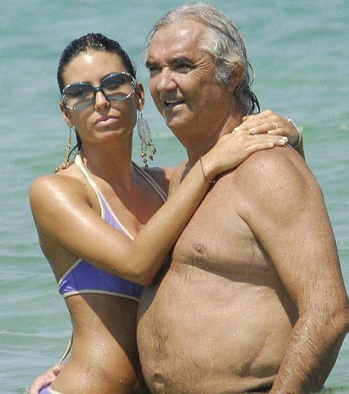

JONATHAN’S PROBLEMS FOR THE RICH
KEY FACTS
INCOME & TAX
STRUCTURE
TAX PLANING
Jonathan’s situation:
45 years old
Filthy rich
Married with an 18 year old swedish model that loves him for his personality and values
Has a 10 year old child
Estate planning objectives:
Protect the assets
Secure his child’s financial future
Solution: TRUST
Jonathan can create a trust
Transfer his assets in the trust (usually at FMV)
Make his child the beneficiary of the trust
The trust will be managed by a trustee
The asset’s value will be protected
TRUST FUNDS COME IN A FEW VARIATIONS

Slide 24
TRUST OPTIONS
KEY FACTS
INCOME & TAX
STRUCTURE
TAX PLANING
Inter Vivos Trust
Created before Jonathan’s death
Highest personal tax rate is applicable to Trust income
Testamentary Trust
Will be created upon Jonathan’s death
Gradual tax rates (potentially lower taxes than Inter Vivos Trust)
Child Beneficiary
Jonathan’s child is 10 years old
The child will only have access to the trust income at the age of 21 years
The trust income attributed to this child will be accumulated until then
Income Beneficiary:
Child has access to trust income only
When property is transferred to beneficiary, considered disposed of at FMV
Capital Beneficiary:
Child has access to trust capital
When property is transferred to beneficiary, considered disposed of at cost

Slide 25

TRUST OPTIONS
KEY FACTS
INCOME & TAX
STRUCTURE
TAX PLANING
Spousal Trust
Spouse is entitled to all income
Assets are protected until spouse’s death
Assets are then distributed to child at FMV
Recommendation
Estate planning activities to occur upon Jonathan’s death
Leave some money for the wife in Jonathan’s will
Transfer all assets in a Testamentary Trust having the child as sole beneficiary
Make the child a Capital and Income beneficiary
Property will be transferred to child at cost amount:
  Capital property - Adjusted Cost Base
  Depreciable property - Undepreciated Capital Cost
Child will receive income at 21 years of age

Slide 26
Q & A

