Slide 1
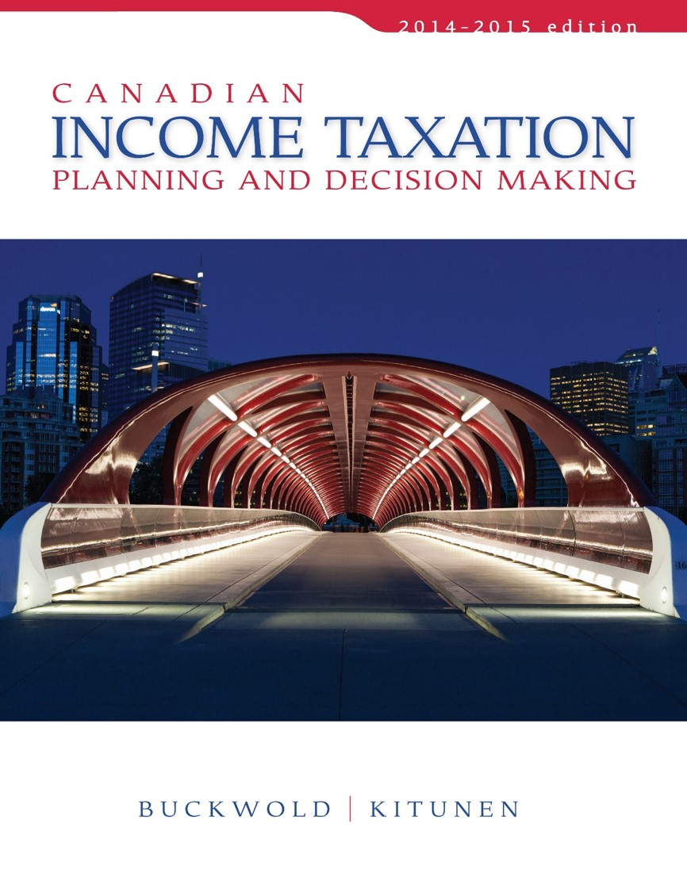
CHAPTER 13:
The Canadian-Controlled Private Corporation
Prepared by
Nathalie Johnstone
University of Saskatchewan
Electronic Presentations in Microsoft® PowerPoint®

Slide 2
The Canadian-Controlled Private Corporation
    Definition and Basic Principles
    Taxation of Income Earned by a CCPC
    Benefits of Incorporation
    Dividend Policy
    Loans to Shareholders
    Limitation of the Small Business Deduction
    Overall Tax Calculation for a CCPC

Slide 3
Definition and Basic Principles
A private corporation that is not controlled by:
  a public corporation or
  a non-resident of Canada.
CCPCs are distinguished in three basic ways:
  rates of tax,
  double taxation, and
  secondary relationships.

Slide 4
Rates of Tax
There are different rates of tax for different levels of income.
First $500,000 of annual active business income is subject to a reduced rate of tax.
  Lower than other corporation and
  Substantially lower than majority of personal tax rates

Slide 5
Taxation of Income Earned by a CCPC
Net income for tax purposes must be allocated into five areas before taxes can be computed:
    Active business income
    Specified investment business income
    Capital gains
    Personal services business income
    Dividends

Slide 6
Active Business Income (“ABI”)
Def’n- business income from any business carried on by the corporation other than:
  a specified investment business and (rents, interest, taxable capital gains and other passive income)
  a personal services business.(an incorporated employee – incorporated after being employed to save taxes)
First $500,000 x 17% - in 2014 (federal tax)
  Referred to as the small business deduction (SBD).
The $500,000 SBD limit is an annual amount;
  if unused, cannot be carried over to other years; gets lost
  If over, accrue income or defer services to average 500k

Slide 7

Specified Investment Business Income
Two arbitrary exceptions:
  Rental income that is derived from the leasing of movable property (vehicles and equipment) is considered to be active business income.
  If company’s primary purpose is to generate income from passive investment. ITA 125(7) - Other property income is considered to be active business income only if the corporation employs more than five full-time employees excluding owner and family to generate that income.

Slide 8
Tax Treatment of Specified Investment Business Income
Disqualified as ABI:
  is not entitled to the SBD or
  the 13% (2010) special reduction.
In addition a special refundable tax of 6 2/3% must be paid.
This special refundable tax is fully refundable to the corporation upon payment of dividends.
There as an incentive to motivate companies to pay out dividend
Main reason why incorporate to hold investment income is protection against creditors

Slide 9
Tax Treatment of Specified Investment Business Income
All property income subject to high tax rate is entitled to a tax refund of 26 2/3%.
Means when a corporate tax rate = 44 2/3%
Effective Tax rate =
(38%+6 2/3% -26 2/3%) = 18%

Slide 10
Combined Tax on Property Income
Corporate income (rent, interest, etc) |  | $1,000
Corporate Tax @ 38% |  | (380)
Special Refundable Tax @ 6 2/3% |  | (67)
Potential refund when paying dividend @ 26 2/3% x $1,000 |  | 267
Total Available for dividend |  | $820
Shareholder income (dividend) |  | $ 820
Tax (net of tax credit) |  | (287)
Total after tax cash |  | $ 533
Total tax paid
Corporation | $180
Shareholder | 287 | $467
Total combined tax rate |  | 47%

Slide 11
Capital Gains
Company does not get 17% on Cap Gain (ONLY ON ACTIVE BUSINESS INCOME)
Taxable capital gains treated the same as specified investment business income.
Capital Dividend: IT IS TAX FREE
  Other half of the capital gain that was not taxed and is currently sitting in RE.
  a mechanism to avoid double taxation on capital gains,
  Pay it out ASAP since net gain-losses, to avoid risk of making a loss on the market – would eat up tax free amnt
  An election is required

Slide 12
Cash 1000
Tax payable (40% of 500) = 200
SHE: 800
  Capital Dividend Account (CDA) $500 (can be paid tax free)
  Regular RE Account: $300 (When paid will be taxed by Share Holder)
  Better to pay early since any capital gain will come eat up CDA, but may be difficult since requires to liquidate assets

Slide 13
Personal Services Business (“PSB”) Income
A PSB is a business that provides services,
  person providing the services is a specified shareholder(owns >10% shares) of the corporation, and
  The relationship between the person providing the services and the entity receiving the services is of an employment nature.
Not eligible for the SBD on that income, and
Faces significant restrictions on deductions. (same deductions allowed as regular employee)
If no previous No employment relationships = business income is ABI instead of PSB

Slide 14
Dividends
Company has to pay Part 1 and Part IV taxes
Taxable Canadian dividends received by a CCPC are subject to PART IV TAXES.
The amount of Part IV taxes depends on the degree of ownership.

Slide 15
Dividends Received from
Non-Connected Corporations
Non-connected if:
Non-Connected Dividends received are taxed at 33 1/3% (Part IV tax) – of actual dividends received but this tax is fully refundable upon the payment of dividends
Private Corporations
Includes dividends received from public corporations
< 10% voting shares
Other Corp

Slide 16
Dividends Received from
Connected Corporations
Connected if:
Connected Dividends not subject to Part IV tax, unless
Paying corporation receives a refund of its Part IV tax,
  Receiving Corporation pays Part IV tax equal to its % of refund.
  Holding company if connected pay taxes equivalent to operating company’s dividend refund (If refund is 0, pay 0)
Private Corporations
Includes dividends received from public corporations
> 10% voting shares
Other Corp

Slide 17
Benefits of Incorporation
The major benefits of incorporating are:
    Tax deferral
    Employment benefits
    Flexibility in family ownership
    Stabilization of annual income

Slide 18
Tax Deferral –
The Small Business Deduction
Incorporating as a CCPC permits access to the SBD on ABI.
  benefit is a tax deferral – second level of tax on corporate distribution to the shareholder or when the shares are sold.
  Deferring tax on ABI has two basic advantages:
    Increased cash flow - lower taxes means more can be reinvested, resulting in greater ultimate ROI.
    Increased cash flow at early stages of a business reduces risk of failure.
Shareholder
2nd level
of tax
CCPC - ABI

Slide 19
Employment Benefits
Shareholder:
  who participates in the management, and
  is entitled to receive compensation as an employee.
Employment Benefits paid to owner/manager:
  are fully deductible from the employer’s income
  May or may not be taxable to the employee (Give the non-taxable employee benefits- RPP, Medical, non-cash gifts…..etc.. From Chapter 4)

Slide 20
Other Benefits
Flexibility in Family Ownership/Legitimate Income Splitting
    Bringing in family member as shareholders and employees – better income splitting opportunities.
Ability to utilize the $800,000 Capital gains deduction
Estate planning opportunity to reduce taxes on death
Stabilization of Annual Income
  two-tier system of taxation, gives the shareholder the right to choose when the second level of tax will occur.
  Flexibility permits the owner to fully utilize the progressive tax rates imposed on individuals.

Slide 21
Primary Disadvantages of Incorporating
Higher costs (lawyer, accounting fees..)
Primary disadvantage relates to the utilization of losses:
  Losses are locked within the corporation
  cannot be offset against income earned by the shareholder

Slide 22
Benefits of Incorporating Investments
The incorporation of investment income and capital gains does not result in substantial tax advantages for the individual.
Investments are taxed at the high corporate rate
no substantial tax deferral occurs since:
Corporate tax Personal
rate tax rates
BUT SHOULD STILL CONSIDER DOING FOR ASSET PROTECTION
Approx. =

Slide 23
Dividend Policy
Distributions – Dividends versus Salary:
A CCPC managed by its shareholder can distribute income by salary or dividends.
  The optimum combination and the timing of the payments depends on:
    nature of the corporate income as well as
    both personal and corporate income levels.
  -Difficult to establish a single policy→RULE OF THUMB→Salary to reduce NI of corp <$500k, rest as dividends. BUT
  Keep in mind that if shareholder wants to accumulate RRSP, then only salary gives eligibility to RRSP

Slide 24
Loans to Shareholders
Permitted to loan funds to shareholders provided:
Shareholder is also an employee and
loan is advanced due to the employment relationship, for the following purposes:
    To assist acquiring a personal residence.
    To acquire treasury shares in the corporation. (if bank needs you to have higher invested equity in the company)
    To acquire an automobile to be used in performing employment duties.
    Total benefit amount will not be a benefit. Any other reason to take $ out, need to repay within next 2 balance sheet.

Slide 25
Loans to Shareholders
Loans for the above purposes have no tax consequences (except low rate benefit),
  provided that the repayment terms are reasonable.
There is no requirement that the loan bear interest;
  However If no interest or low interest is charged employee/shareholder will have a taxable employment benefit = (CRA prescribed rates – Rtae charged) x Loan balance (See Chapter 4)

Slide 26
Loans to Shareholders
Loans for other reasons (then those mentioned):
  must be repaid within one taxation year of the year in which the advance was made; otherwise
  Full amount of the loan will be taxable to the shareholder as business income.
    If these loans are later repaid, a deduction from income is permitted in the year of repayment.

Slide 27
Loans to Shareholders
S/H loan of $50,000 made in Jan 1, 2013 by INC. whose year end is December.
1) Loan is to buy a car at 0 interest. Repayable $10,000 every Feb starting 2014.
Benefit in 2013 = 1% x 50,000 = $500 employment income
Benefit in 2014 = 1% x 40,000 = $400 employ inc. etc….
2) Loan is to buy furniture at 0 interest. S/H repays the full amount in January, 2016
Consequences:
S/H 2013 Income inclusions $50,000
S/H 2016 Income deduction $50,000 (lose on TVM; should repay full amount in 2014 to avoid income inclusion)
Deduction not allowed if considered a series of loans! (revolving loan)

Slide 28
Limitation of the Small Business Deduction
Associated Corporations
  Two or more corporations must share the SBD of $500,000 income limit.
  Owners can allocate this limit in any proportion desired

Slide 29
Associated Corporations
Shareholder or
group of shareholder
Corp A
>50%
voting
>50%
voting
>50%
voting
Corp B
Corp C
Corp D

Slide 30
Associated Corporations
Two Corporations are associated if:
One of the corporation controlled the other corporation
A
60%
B
60%
C

Slide 31
Overall Tax Calculation for a CCPC
Aggregate investment income:
  Canadian and foreign net property income:
    interest,
    rents,
    royalties,
    less related expenses
  net taxable capital gains (gains minus losses) for the current year less any net capital losses from other years claimed in the current year.
  Dividends from taxable Canadian corporations are excluded from the definition.

Slide 32
Refundable Dividend Tax on Hand (RDTOH)
The RDTOH is designed to accumulate the eligible tax refund that occurs when dividends are paid to shareholders.
The potential refund consists of all Part IV taxes paid by the corporation plus 26 2/3% of all investment income earned.

Slide 33
RDTOH
Balance BOY |  |  | XX
ADD:
 | Part IV Tax Paid |  | XX
 | 26 2/3% X Investment income |  | XX
LESS | Dividend refund of last year |  | (XX)
Balance at end of year |  |  | XX
DIVIDEND REFUND = LESSOR OF:
1/3 X DIVIDENDS PAID OR
ENDING BALANCE IN RDTOH

Slide 34
Problem 13-10: what you should know from chapter
Donation removed than added since dividend is capped at 75% NI.
Canadian dividend is removed since taxzed at different rate (section IV)
[should put on crib sheet]

