Slide 1
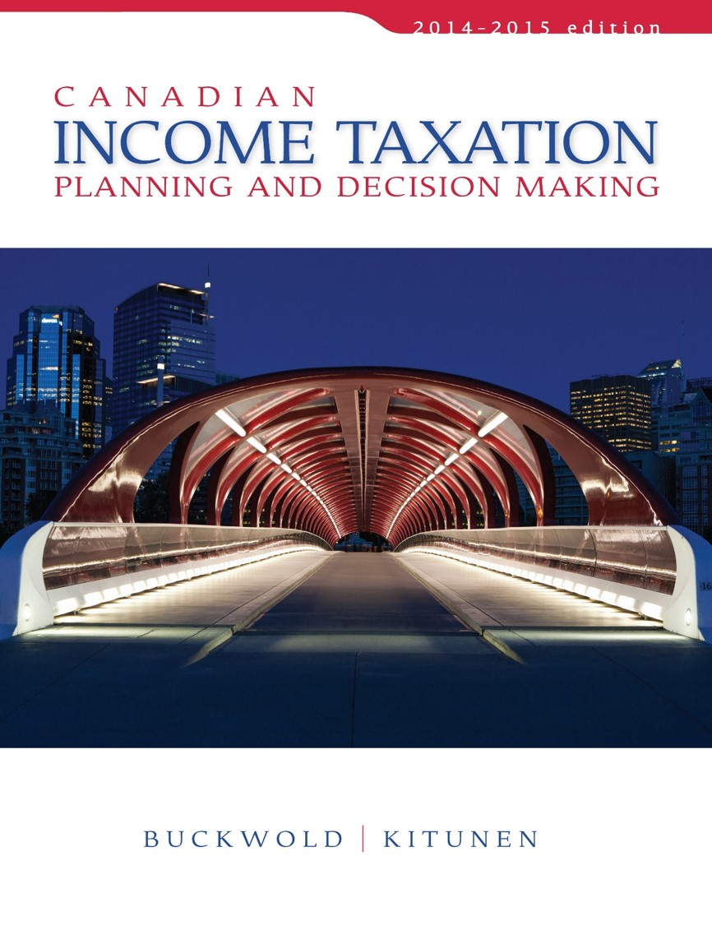
CHAPTER 12:
Organization, Capital Structures, and Income Distributions of Corporations
Prepared by
Nathalie Johnstone
University of Saskatchewan
Electronic Presentations in Microsoft® PowerPoint®

Slide 2
ONLY need to know about rollover for exam

Slide 3
Organization, Capital Structures, and Income Distributions of Corporations
Corporate Capitalization – Debt or Equity
Transferring Assets to a Corporation
Corporate Distributions to Shareholders

Slide 4
Corporate Capitalization – Debt or Equity
Creating a Corporation
must have a capital base for the purposes of acquiring assets and conducting business.
Capital base contributed can be in the form of debt (shareholder loan) or equity (additional share capital).
Debt→ Interest OR Equity → Dividends
Equity - Share
Shareholder
Corporation
Cash or Assets

Slide 5
Corporate Capitalization by Shareholder Debt
Return on investment:
  Shareholder loans may bear interest or no interest
  Interest paid by the corporation is deductible by Corp. for tax purposes.
  Principal amount of debt can be repaid to the shareholder with no tax consequences to either party
Loss of investment
  A loss incurred on shareholder debt is a capital loss,
    only one-half is deductible only against capital gains for tax purposes.
  If the debt was made to a small business corporation,
    the capital loss becomes a business investment loss and one-half of the loss can be offset against all other sources

Slide 6
Corporate Capitalization by Shareholder Debt
An example
Corp X is subject to tax of 25% and earns business income of $1,000 before the payment of interest. S/H loan of $10,000 can have 10% interest or none. S/H personal income tax rate is 45%.
What is the combined tax rate with and without paying interest on the Shareholder loan?

Slide 7
Corporate Capitalization by Shareholder Debt – an example
10% interest
Corporation:
Business Income $1,000
Interest paid (1,000)
Income for tax purposes 0
Corporate tax 0
Shareholder (individual)
Interest Income $1,000
Personal Tax $450
Combined Tax $450
No interest
Corporation:
Business Income $1,000
Interest paid (0)
Income for tax purposes $1,000
Corporate tax 250
Shareholder (individual)
Potential Dividend $ 750
Personal Tax $210
Combined Tax $460

Slide 8
Corporate Capitalization by Share Capital
Return on investment
  Share capital provides a return in form of dividends.
  Dividends are
    not deductible by the corporation and
    are taxable to the individual shareholder.
Loss of investment
  A loss on a share capital investment is normally a capital loss,
    of which one-half is recognized for tax purposes.

Slide 9
Corporate Capitalization by Share Capital
Return of capital – two forms
Sale of Shares to Other Shareholders:
  Capital Gain (Loss) = SP – Cost. Only ½ is deductible but only against capital gains
Sale of Shares Back to the Corporation:
    Referred to as a “share redemption” or “buy-back.”
    Tax consequences →Taxable Dividend = Redemption proceeds received less paid in share capital
    *Option 1 is better since less taxes involved.

Slide 10
Sale of Shares
Back to the Corporation
S/H #1
S/H #2
50%
Value $50,000
50%
Value $50,000
Before
Corporation
PUC $ 10,000
R/E 90,000
$100,000

Slide 11
Sale of Shares
Back to the Corporation
S/H #1
50%
Value $50,000
After
Corporation
PUC $ 5,000
R/E 45,000
$ 50,000

Slide 12
Sale of Shares
Back to the Corporation
Reduction of Paid-up Capital (“PUC”):
PUC can be return without redeeming shares. The tax treatment varies:
  Public corporation- ITA 84(4.1), 53(2)(a):
  return of capital considered a taxable dividend for the entire payment.
  Private company – can return full PUC – 1$ tax free. Only issue is when selling shares, Average Cost Base

Slide 13

Transferring Assets to a Corporation (Section 85)
Transfer of assets constitutes a sale and disposition.
Fair Value > purchase price = tax implications.
Existing or proposed shareholder can transfer an asset at:
  FMV or
  at an elected value,
    normally equal to the asset’s cost for tax purposes.

Slide 14
Transfer of Assets at Fair Market Value
Gains are recognized.
Resulting income depends on nature of the asset:
  Capital gain,
  recapture of CCA, or
  Normal business income.
Corporation:
  Assets acquired at FMV increases the tax cost that may,
    reduce the taxes payable by the corporation.

Slide 15
Transfer at Fair Market Value
An example (Note –ignore depreciation; only business assets)
Original Cost = $100,000 UCC = $60,000
FMV = $90,000 S/H tax rate = 45%
Corporation tax rate = 25%
Shareholder Corporation
POD $90,000 Capital Cost $90,000
UCC (60,000) Original UCC (60,000)
Tax. Inc. $30,000 Additional Ded. $30,000

Slide 16
Election to Transfer Assets at Tax Values
The Act permits assets to be transferred to a corporation at their tax cost.
Permitted even though the transfer price for legal purposes may be at FMV.
ITA 85(1) - Called a “rollover”
  shareholder’s personal taxable income is rolled over to the corporation but not eliminated.
  (from a person to a company. The company owes you cost of all assets via demand note (company owes you $ tax free revenue for you) plus shares which have market value of difference between FMV and rollover value).rol Can pick the transfer price; goal to sell at > to trigger a capital gain to offset carry forward capital losses. Every asset transferred needs note (cost) and FMV to determins the acquisition cost of the share

Slide 17
The elected amount can never be less that the non-share consideration received (cash or debt)

Slide 18
Election to Transfer Assets at Tax Values
Election limitations
  Corporation can pay in form of share or non-share consideration.
  Tax-Free transfer:
    Consideration must include some shares,
    non-share consideration:
      cannot be > elected value.
i.e. cash, note receivable, debt

Slide 19
Election to Transfer Assets at Tax Values
Tax implications:
  defers tax to the shareholder at the time of the transfer.
  There will be future tax implications.

Slide 20

Applying the Election Option
ITA 85(1.1) - Assets eligible for transfer at tax cost are:
  Capital property,
    depreciable and
    non-depreciable
  Inventory
  Eligible capital property
  Resource property

Slide 21
Election to Transfer Assets at Tax Values
Use of the election:
  Proprietorship to Corporation - where the proprietor becomes the shareholder.
Corporation

Slide 22
Election to Transfer Assets at Tax Values
Transfer assets from parent to new or existing subsidiary.
Parent
Corporation
Sub
Corporation

Slide 23
Election to Transfer Assets at Tax Values
Transfer assets from one sister corporation to another within the corporate group.
Parent
Corporation
Sub A
Corporation
Sub B
Corporation

Slide 24
Election to Transfer Assets at Tax Values
A corporation or an individual can sell assets to an unrelated third party and defer tax by using the election.
  Seller must become shareholder of purchasing corporation.

Slide 25
Corporate Distributions to Shareholders
Corporate distributions consist of either accumulated profits or the return of capital.
Stock dividends
  Involve the issuing of additional shares in lieu of a cash.
  Corporation no tax or cash implications.
  Shareholder normal taxable dividend.

Slide 26
Corporate Distributions to Shareholders
Special Distributions of CCPC
  Capital Dividend distributions:
    Life insurance proceeds (tax free to beneficiary company; have company pay your premiums and make it benificiary)
    Non-taxable portion of capital gain.
  Requires a special election

Slide 27
Corporate Distributions to Shareholders
Distributions Other than Cash
  A corporation can pay a dividend by transferring ownership of corporate assets to the shareholder (“dividend in kind”)
  Corporation: Asset Value > tax cost,
      Disposal = FMV results in taxable income.
  Shareholder: Taxable dividend = FMV of the asset received (ITA 52(2)).

Slide 28
Corporate Distributions to Shareholders
Wind-up of a Corporation
  A corporation can end its existence by:
    disposing of all its assets,
    meeting its debt obligations, and
    distributing all its earnings and capital to the shareholders.
  Corporation deemed to sell assets at FMV (ITA 84(2))

Slide 29
Tax Planning Checklist
At the outset, shareholders organizing a corporation must decide how to capitalize the corporation SHARES VS DEBT in terms of:
Return on Investment→ Interest or dividends?
Loss of capital→ Capital loss or Business Investment loss?
Repatriation of capital → Capital gain or Dividend income
When there are several corporations under common control and some make profits while other makes losses, it is important that steps be taken to offset losses against profits, so that less overall taxes are paid by the group of companies (Rollover, reorganizations)

