Slide 1
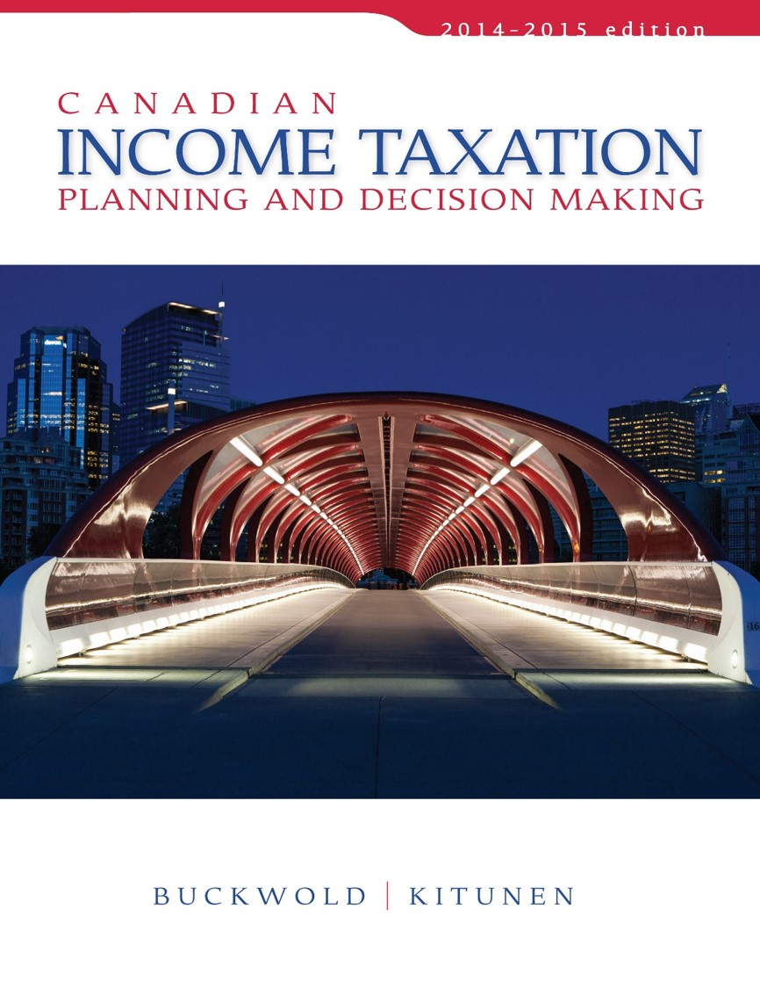
CHAPTER 11:
Corporations—An Introduction
Prepared by
Nathalie Johnstone
University of Saskatchewan
Electronic Presentations in Microsoft® PowerPoint®

Slide 2
Corporations – An Introduction
Relationship between the Corporation and Its Shareholders
Determination of Taxable Income
Calculation of Corporate Tax
The Integration of Corporate and Individual Taxation

Slide 3
Relationship between a Corporation and it’s shareholder
The Primary Relationship
Shareholder contributes cash or other property in exchange for shares.
Shareholders realize a return on investment through dividends or through a capital gain when they sell their shares at a profit.
Contribute Cash
Corporation
Shareholder
ROI

Slide 4
The Secondary Relationships
Secondary relationship:
  creditor,
  supplier,
  employee,
  customer, or
  lessor,
Tax consequences and cash flows between the parties are different from those in the primary relationship.

Slide 5
Primary and Secondary Relationships
Difference between the two relationships centres on the tax treatment of income flows:
  Primary relationship:
    dividends paid by the corporation are not deductible, but are taxable to the recipient.
  Secondary relationships:
    payments such as salaries, interest, and rents are deductible and taxable to the recipient.

Slide 6
Determination of Taxable Income
A corporation’s taxable income is:
Net income for tax purposes - special deductions
    Donations to charitable organizations (Donation max at 75% of NI only for companies; if company has loss can’t carry forward).
    Net capital losses (Loss on selling of assets – shares, land, building) only deductible if had a capital gain; only usable up to capital gain
    Non-capital losses (Business losses from other years)
    Dividends from taxable Canadian corporations
    Dividends from foreign affiliates

Slide 7
Loss Carry-Overs
ITA 110.1(1)(a) – same as with individuals
Net capital losses:
  can be carried back three years and forward indefinitely
  Used only against taxable capital gains.
Non-capital losses:
  can be carried back three years and forward twenty years
  Used against any other source of income.

Slide 8
Change in Control – ITA 111(4),(5),(5.4)
Ownership can change when shares are transferred or sold.
The carry-forward of unabsorbed losses may be attractive to acquiring shareholders
  if they can use those losses .
Change in beneficial ownerships:
  restricts the use of the non-capital losses and
  Eliminates the net-capital losses.

Slide 9
Change in Control
Capital losses carry forward - expired
Non-capital losses resulting from business operations are restricted as follows:
  Must Carry On Business industry In Which Losses Occurred
  Reasonable Expectation Of Profit
  Losses can only be deducted against business income earned by same or similar business.

Slide 10
Change in Control
ITA 249(4) - Deemed year end – at the date of change in control.
  Purpose is to recognize unrealized losses to that they can’t be transferred to the acquirer while in the books.
  Materializes any operating losses making them subject to the restrictions.
  Side effect is to age carry forward losses by one year
  ITA 111(5.1),(5.2) - Depreciable property, eligible capital property, and other capital property are deemed to be sold at FMV if:
  FMV < tax cost

Slide 11
Loss in Corporate Groups
Shareholders
Corporation A
Profits $100,000
Corporation B
Loss ($400,000)
Corporation C
Profits $50,000
Corp A – profits $100,000
Corp B – loss (400,000)
Corp C – profit 50,000
Net loss for group $(250,000)

Slide 12
Dividends received by Cdn. Corporations
Dividends are deducted from taxable income if:
  received from a taxable Canadian corporations
  Received from a foreign affiliate corps. (where the Canadian corp. owns at least a 10% in Foreign Corp.
Generally dividends flow tax-free if received from an active business private company owned by the receiving company .
Private corporations may be subject to a temporary – Part IV tax on dividends received from Public Cos. (Chapter 13).
Individual shareholder only taxed when dividends are eventually paid by the company.

Slide 13
START OF EXAM STUFF

Slide 14
Calculation of Corporate Tax
Two basic categories for tax purposes:
  ITA 89(1) - Public corporations
    Canadian residence and shares are traded on a stock exchange.
  ITA 89(1), 125(7)(b) - Canadian-controlled private corporations (CCPCs)
    Canadian residence
    Not a public corporation, and
    Not controlled by non-residents of Canada.

Slide 15
Determination of Tax for Corporations

Slide 16
Determination of Tax for Corporations
Federal Tax
 | Primary |  | 38%
 | Less Abatement for provincial tax |  | (10%)
 |  |  | 28%
 | Refundable tax on passive investment income |  | 6 2/3%
 | LESS
 | Small Business Deduction (First 500k$, ) | 17% | 11% (First 500k)
 | Special Reduction / General Rate Deduction (Not available investment income) | 13% | 15% (>500k non Inv) 34% (>500k inv)
 | Manufacturing and Processing Deduction (M&P) | 13% | 15% (>500k Mfg)
 | Federal Tax Credits
 |  | 13-17%

Slide 17
Federal Tax
The primary federal tax is 38% to the corporation’s taxable income – ITA 123(1).
Then, reduced by the provincial abatement of 10% - ITA 124(1). (for operations in Canada; the 10% given since company will pay provincial tax)
Federal tax may be increased or reduced further based on specific types of income earned by certain corporations.

Slide 18
Special Reduction
General Rate Reduction - applies to particular types of income:
  Public corporations:
    Federal tax is reduced by 13% of the corporation’s taxable income not subject to manufacturing and processing activities.
  CCPC:
    Federal tax is reduced by 13% on active business income:
      Above the annual Small business limit (the 17%) and
      Not eligible for the M&P reduction

Slide 19
Refundable Tax on Investment Income (Interest, foreign dividends, royalties, residential rent)
ITA 123.3 - Applies only to the investment income of a CCPC.
  Additional tax is 6 2/3% of investment income (motivation to syphon $ out of the company – pay salaries and dividends. Tax helps prevents companies to hoard $$s; no 17% allowable on investment income)) and
  Fully refundable to the corporation when dividends are paid.

Slide 20
Small Business Deduction – ITA 125(1)
Available only to CCPCs; not public corps.
Deduction permits the normal federal tax rate to be reduced by 17% for the first $500,000 of annual active business income of the corporation.
(Passive = residential and passive dividend income)
(the rest is at 13% with special reduction)
Small business
federal tax rate
= (38% - 10% - 17%) = 11%

Slide 21

NOT EXAM
Manufacturing and Processing Deduction
ITA 125.1(1) - Profits from manufacturing and processing activities
Public Corporations - rate reduction of 13%.
CCPCs – same rate reduction
  only on annual manufacturing profits in excess of the SBD limit described previously.

Slide 22
NOT EXAM
Provincial Tax
Just FYI – Not examinable
Nova Scotia 16% (3)
Nunavut 12% (4)
Ontario 11.3% (4.5)
P.E.I. 16% (0)
Quebec 11.9% (8)
Saskatchewan 12% (2)
Yukon 15% (4)
Alberta 10% (3)
BC 11% (2.5)
Manitoba 12% (0)
New Brunswick 12% (4.5)
Newfoundland 14% (4)
Labrador 14% (4)
NW Territories 11.5% (4)

Slide 23
The Integration of Corporate and Individual Taxation
Corporations are taxed on their profits separate from their shareholders.
After-tax corporate profits are distributed in the form of a dividend,
  tax is again payable on the dividends received.
Two-tier system creates the possibility of double taxation. But if shareholder leave retained earnings in corp. the individual’s tax is deferred

Slide 24
The Integration of Corporate and Individual Taxation
Special provisions are designed to reduce the possibility of double taxation.
  Attempts to ensure equal tax treatment that regardless of the structure used to run the business.
Dividend tax credit attempts to integrate the personal and corporate tax
Dividends Eligibel/Non-Eligible:
  Eligible: From income that didn’t benefit the SBD
  Non-Eligible: From income that did benefit the SBD

Slide 25
Plan to sell – stop dividends
No dividend = share value increases
1000$ of after tax corporate Income
  Dividend: 28% (Eligible) - 35% (Non Eligible)
  Capital gain ½ marginal personal rate 46%/2=23%
Capital gains can also benefit the once in a lifetime capital gain Exemption on Canadian business shares (LCGE)

Slide 26
Dividend Tax Credit
Public Corporation - example
Corporate Taxable Income $ 1,000
Corporate Taxes - 25% (250)
Net Cash (paid out in Dividends) $750
Dividends received by Shareholder -Eligible $750
Tax Rate ( Federal and provincial) 28% (210)
After Tax Cash to Individual $540
Total tax paid on $1,000
Corporate $250
Individual 210
Total $460
Effective tax rate is 46% - if the individuals tax rate is 45% as in this example. Double tax = 1%

Slide 27
Dividend Tax Credit
CCPC example
Corporate Taxable Income $ 1,000
Corporate Taxes - 15% (150)
Net Cash (paid out in Dividends) $850
Dividends received by Shareholder -non-eligible $850
Tax Rate ( Federal and provincial) 35% (298)
After Tax Cash to Individual $552
Total tax paid on $1,000
Corporate $150
Individual 298
Total $448
Amount of double taxation is nil.

Slide 28
The Integration of Corporate and Individual Taxation
In a public corporation, double taxation on returns to the owner is automatic.
In a CCPC, double taxation may or may not occur depending on the nature of the income.
Corporate tax and tax on distributions has a significant impact on:
  Dividend policy
  Equity structures
  Form of business organization

Slide 29
Steps to prevent loss carry forward to expire
Steps to boost income deferring discretionary items
Don’t claim CCA – UCC will be greater in future years
Salaries to shareholders – don’t pay. If $ required, reimburse shareholder loans
SH loans – don’t charge interest
AFDA – don’t claim (or any other allowances)

Slide 30
Tax Planning Checklist
Shareholders of private corps. Should consider maintaining some secondary relationships with their company→creditor, lessor, employee, in order to alter the amount and timing of tax payable.
When a change in the controlling shareholder is being considered, the treatment of loss carry-over should be reviewed to ensure than no loss is lost.
Consider intercorporate tax free dividends in the dividend policy

