Slide 1
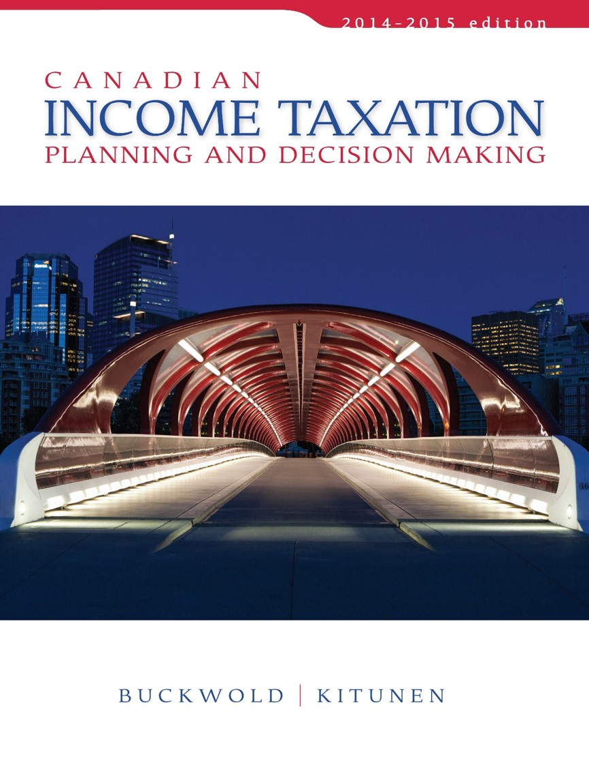
CHAPTER 10:
Individuals: Determination of Taxable Income and Taxes Payable
Prepared by
Nathalie Johnstone
University of Saskatchewan
Electronic Presentations in Microsoft® PowerPoint®

Slide 2
Individuals: Determination of Taxable Income and Taxes Payable
    Determination of Taxable Income
    Loss Carry-Overs
    Loss Utilization – Impact on Decision Making
    The Capital Gain Deduction
    Calculation of Tax for Individuals
    Special Adjustments to the Tax Calculation
    Final Returns of Deceased Taxpayers

Slide 3
Taxable Income Formula - revisited
Net income for tax purposes:
a) Employment Income
Business Income
Property Income
Other items
Plus
b) Net Capital Gains- ITA 3(b)(i)(B)
Less
  Other items of deductions
  Less
  Aggregate of losses from Employment
Business, Property and ABILS
= Net Income for tax purposes

Slide 4
Taxable Income Formula
Net income for tax purposes XXX
Less
Special Reductions:
  Stock Options deduction –ITA 110(1)(d),(d.1) (XXX)
  Home Relocation loan deduction (XXX)
  Losses not utilized in other years
  ITA 111 (XXX)
  Social Assistance, Worker’s compensation
  and amounts exempt by treaty. (XXX)
  Lifetime capital gain deduction
  ITA 110.6 (XXX)
= Taxable Income

Slide 5
Loss Carry-Overs
If you have a loss in the current year, you can carry it over to other years to reduce income and taxes.
Net Capital Losses:
  Loss on sale of capital properties
    can be carried back three years and
    forward indefinitely BUT only deductible against capital gains
Non Capital Losses:
- Loss From business, property and employment
    can be carried back three years and forward twenty years - used against any source of income

Slide 6
Farm Losses and Restricted Farm Losses
NOT EXAMINABLE
Farm losses - chief source of income is farming or fishing.
Farm losses are treated the same as business losses.

Slide 7

Loss Utilization – Impact on Decision Making
The risk of loss expiration:
  can be minimized by creating taxable income or
  reduce deductible expenses, thereby
  permitting a greater amount of the loss carry-over to be used.

Slide 8
The Capital Gain Deduction
Final step is to apply the capital gain deduction.
Lifetime Capital Gain Deduction is available only for
  Qualified small business corporation shares and
  qualified farm property.
  Deduction is one-half of $800,000 after 2013
  – ITA 110.6(4)
    deductible from taxable income.
The deduction is discretionary.

Slide 9
The Capital Gain Deduction
A small business corporation is:
  a private corporation that is Canadian-controlled and
  that uses all or substantially all of its assets (at least 90%) to conduct an active business.
Qualified farm property includes:
  real property,
  eligible capital property used in farming business,
  share of a family farm corporation, and
  Interest in a farm partnership.

Slide 10
Income tax is imposed by the federal and provincial governments:
    Federal tax - % of taxable income
    Provincial tax - % of taxable income

Slide 11
Determination of Tax for an Individual

Slide 12
Primary Federal Tax
Progressively higher tax rates to higher levels of annual income.
Each rate of tax is applied separately to the portion of the individual’s income that falls within the applicable range.

Slide 13
V. Calculation of Tax for Individuals
Taxable Income Range (2014) | Rate
Up to $43,953 | 15%
$43,954 to 87,907 | 22%
$ 87,908 to 136,270 | 26%
Over $ 136,270 | 29%

Slide 14
First Category of Federal Tax Credits
Basic
    15% x $11,138= $1,671
Spouse or equivalent to spouse
    15% x $11,138 = $1,671
Reduced by 15% of the spouse’s net income.
Child Credit
  A credit of $338 (15% of $2,255) for each child:

Slide 15
First Category of Federal Tax Credits
CPP and EI
  15% x CPP and EI contributions
Medical expenses
  15% x qualified medical expenses exceeding:
    either 3% of the taxpayer’s net income, or
    $2,171 whichever is less.

Slide 16
First Category of Federal Tax Credits
Employment Credit
  Employed individuals = 15% x $1,127= $169
Public Transit Pass
  15% of monthly cost for unlimited travel
    Local busses, streetcar, subway, commuter train and ferries
Children’s Fitness Credit
  15% of fees paid up to $500 for
    Physical activity program
Children’s arts tax credit
  15% of fees paid up to $500
    Artistic, cultural, recreational activities.

Slide 17
First Category of Federal Tax Credits
Caregiver
    Provide in-home care for::
      a parent or grandparent who is 65 or older, or
      dependent relative who is infirm
$680 tax credit against federal tax.
    Reduced by 15% of the dependent’s income in excess of $15,472.

Slide 18


First Category of Federal Tax Credits
Tuition fees
  attend a university, college, or other certified post-secondary institution = 15% x tuition fees paid.
Education amount and textbook credit
  Full-time students – 15% x $465 x months FT
  Part-time education – 15% x $140 x months PT
    The unused portion is transferable - up $750 (15% x $5,000) annually to a spouse, parent, or grandparent.
      Less any credits used by student.
    Alternatively, the student may keep the unused credit and carry it forward indefinitely.

Slide 19
First Category of Federal Tax Credits
Student loan interest
  Entitled to deduct 15% x interest paid on student loans.
  Only on interest on loans under:
    Canada Student Loan Program and
    Provincial student loan programs.
  The credit may be claimed in the year of interest payment or in any of the following five years.

Slide 20
First Category of Federal Tax Credits
Charitable donations
  15% x first $200 of annual contributions and
  29% x the remainder.
  Unused Donations can be carried forward for 5 years
Additional tax credit of 25% for first time donor:
  40% (15% + 25%) on first $200
  54% (29% + 25%) on remaining
First-time home buyer’s credit
  Maximum Credit = 15% x $5,000.
  To claim cannot have owned a home in the past

Slide 21
First Category of Federal Tax Credits
Dividend tax credit – Eligible Corporations(mostly public companies
  Equal to 15% (6/11 x 38%) of the taxable amount of dividends received from Canadian corporations.
Dividend tax credit – Non-Eligible Corporations(mostly private companies)
  Equal to 11% (13/18 x 18%) of the taxable amount of dividends received from Canadian corporations.

Slide 22
Second Category of Federal Tax Credits
Political contributions
  Based on a graduated scale.
  Max. of $650/year
ITA 126 - Foreign tax credit
Investment tax credits
Logging tax credit
Labour-sponsored fund credit

