Slide 1
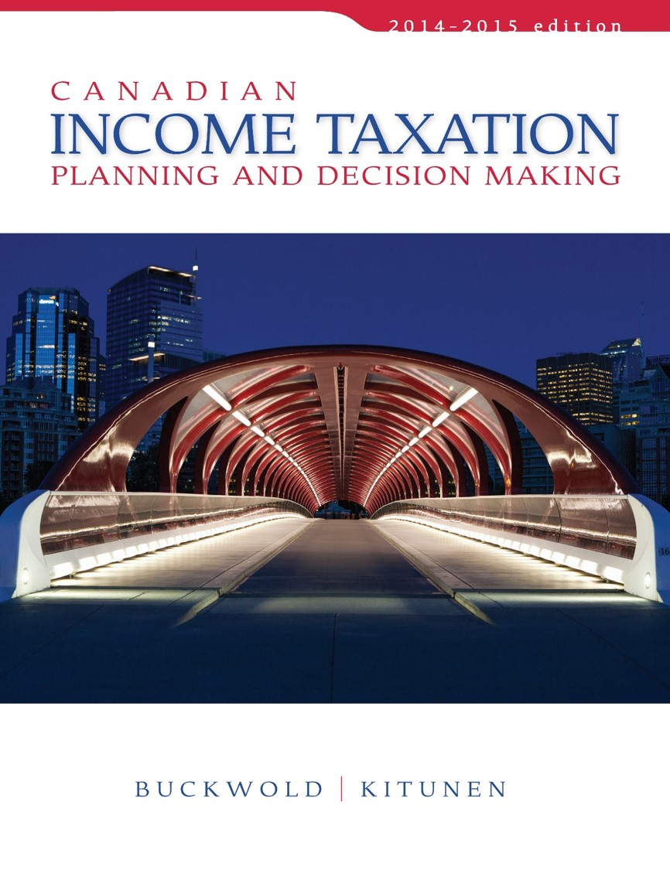
CHAPTER 9:
Other Income, Other Deductions, and Special Rules for Completing Net Income for Tax Purposes
Prepared by
Nathalie Johnstone
University of Saskatchewan
Electronic Presentations in Microsoft® PowerPoint®

Slide 2
Other Income, Other Deductions, and Special Rules for Completing Net Income for Tax Purposes
Other Sources of Income
Other Deductions
Registered Retirement Savings Plans
Pooled Registered Pension Plans
Registered Education Plans
Tax Free Savings Accounts
Special Rules for Net Income Determination

Slide 3
Other Sources of Income
RRSP
Major sources of other income:
    RRSP and RRIF Benefits
    Pension benefits from employer’s pension plan
    OAS, CPP, EI
    DPSP benefits
    Foreign pension benefits
    Retiring allowances
    Scholarship, fellowships, bursaries
    Support payments

Slide 4
Other Sources of Income
Scholarships, fellowships, or bursaries:
  not taxable if student can claim the education tax credit, otherwise,
  are exempt only to the extent of $500 annually.
Research grants:
  Total grant less expenses is taxable.
Support payments from a former spouse:
  taxable providing received as periodic payments and are pursuant to a court order or written agreement.

Slide 5
What items are not subject to tax under the Canadian tax system?
Lottery winnings
Receipt of a gift
Receipt of an inheritance
Life insurance proceeds on the death of an individual
Profits from betting or gambling,
    when conducted for pleasure or enjoyment
Proceeds from accident, disability, sickness, or income maintenance insurance policies ITA 6(1)(f),
    if the employee has paid all of the premiums.

Slide 6
Other Deductions
Major items included are:
  RRSP contributions – ITA 60(i), 146
  ITA 60(b) - Support payments to a former spouse, if
    Periodic and
    By virtue of a court order.
  Fees/expenses for objection or appeal of a tax assessment ITA 60(o).
  Moving expenses
  Child care expenses – lower income spouse-ITA 63

Slide 7
Moving Expenses
Deductible if
  incurred for relocation to commence a business or employment,
    in another part of Canada,
  to attend a university or other post-secondary school,
  to the extent of income earned in the new location.
Eligible if new residence location is at least 40 kilometres closer to the new work location than the previous residence.
Carry forward unclaimed portion and deduct in following year.

Slide 8

Moving Expenses
Deductible expenses include:
    Travel costs,
    Transportation and storage of belongings,
    Temporary board and lodging (up to 15 days),
    Costs of cancelling a lease for the old residence,
    Selling costs of the old residence,
    Legal fees and land transfer taxes,
    Cost of maintaining a vacant former residence within limits,
    Cost of revising legal documents, etc.

Slide 9
Child Care Expenses
Includes:
  the cost of babysitting, day care, or lodging at a boarding school,
  children 16 years of age or less,
  If incurred so taxpayer could pursue employment, business, or research activities.
Limits:
  $4,000 per child 7 to 16, $7,000 per child under 7 or
  2/3 of the taxpayer’s earned income for the year.
Lower income spouse claims

Slide 10
Registered Retirement Savings Plans “RRSP”
Private, tax-sheltered retirement program
Investments in an RRSP:
  Are not taxed until withdrawn, therefore
  Generate higher return because they permit investment of pre-tax earnings.
Individuals not belonging to an RPP or DPSP:
Annual limit is equal to-
    18% of the individual’s prior year’s “earned income,”
    up to a maximum of $24,270 (for 2014).
Unused portion (contribution room) can be carried forward indefinitely

Slide 11
RRSP Investment Opportunities
Restricted to certain types of investments.
Qualified investments includes:
  cash deposits in banks or other financial institutions,
  term deposits,
  government-insured or guaranteed bonds,
  bonds and debentures of public corporations,
  shares of public corporations,
  mutual finds, and
  mortgages on real estate.

Slide 12
Investment through an RRSP
In an RRSP
Invest $6,000
Earn 10% / year 600
Tax Payable in interest 0
After year 1 $6,600
Year 2 interest 660
Plus tax savings from contributing to the RRSP, which is a deduction=
6,000 x 45% = $2,700
Outside an RRSP
Invest $ 6,000
Earn 10% / year 600
Tax Payable @ 45% (270)
Value Yr 1 $ 6,330
Year 2 interest 633
$27 less

Slide 13
Contribution Room– an example
Annual limit for 2014 lesser of:
Salary – 2013 $140,000 x 18% $25,200
2014 limit $24,270
If no carry forward amount… Total contribution limit is $24,270 in 2014.

Slide 14
RRSP – Over-contribution
Contributions exceeding the annual limit are subject to a penalty tax of 1% per month on excess-ITA 146(8.2).
Permitted to over-contribute up to $2,000.
Over-contribution can be carried forward and deducted in a future year.

Slide 15
Retirement Options
Mandatory to convert RRSP funds to a retirement income vehicle in year reach age 71.
Retirement income can begin the following calendar year.
Failure to convert by age 71 will result in the full amount of the plan will be taxable.

Slide 16
Spousal RRSP
An individual can contribute all or any part of his/her contribution limit to the RRSP of a spouse.
Contributor - entitled to tax deduction.
Allows for income splitting:
  Allows for income to be taxed in the spouse’s hand rather than that of the contributor.
Limitations – withdrawals from the spousal plan within two taxation years of the contribution year are included in the contributor’s income.

Slide 17
IV. Pooled Registered Pension Plans
Similar to an RPP:
  but with greater flexibility for individuals and employers
  Employers can deduct contributions
  Employees not taxed until withdrawn
Attractive to small business employers and self-employed individuals.

Slide 18
Registered Education Savings Plans
Primary purpose is to provide funding for post secondary education.
Can contribute to an RESP prior to child turning 31 years old.
$50,000 lifetime contribution limit
Earn income on tax deferred basis.
  Income only (NOT PRINCIPAL) is taxed when funds are withdrawn from the plan. Taxable to child NOT Parent
Contributions are not tax deductible

Slide 19

RESP and the CESG
Canada Education Savings Grant CESG
  Children under 18 can receive the grant
    Annually – 20% of contribution up to $2,500– max grant $500
    Lifetime – maximum grant $7,500
  Child must pursue post-secondary education
    If not, CESG must be returned

Slide 20
Tax-Free Savings Accounts (TFSA)
Preferential treatment on investment returns
Contributions are limited to $5,500 (2013 and later, $5,000 for prior years) per year
  Can contribute individual and/or spouses plan
    Combined contribution is $11,000
  Not tax deductible
  Can be carried forward indefinitely
Earnings and Withdrawals
  Tax free

Slide 21
Death of a Taxpayer
NOT EXAMINABLE
Tax implications triggered by death are as follows:
  Income from all sources is accrued up to the date of death.
  All capital property that was owned by the deceased is deemed to have been sold at fair market value – ITA 70(1)-(5).
  Executors are given control of the assets.
    Once liabilities are satisfied, the assets are either sold or transferred to beneficiaries.

