Slide 1
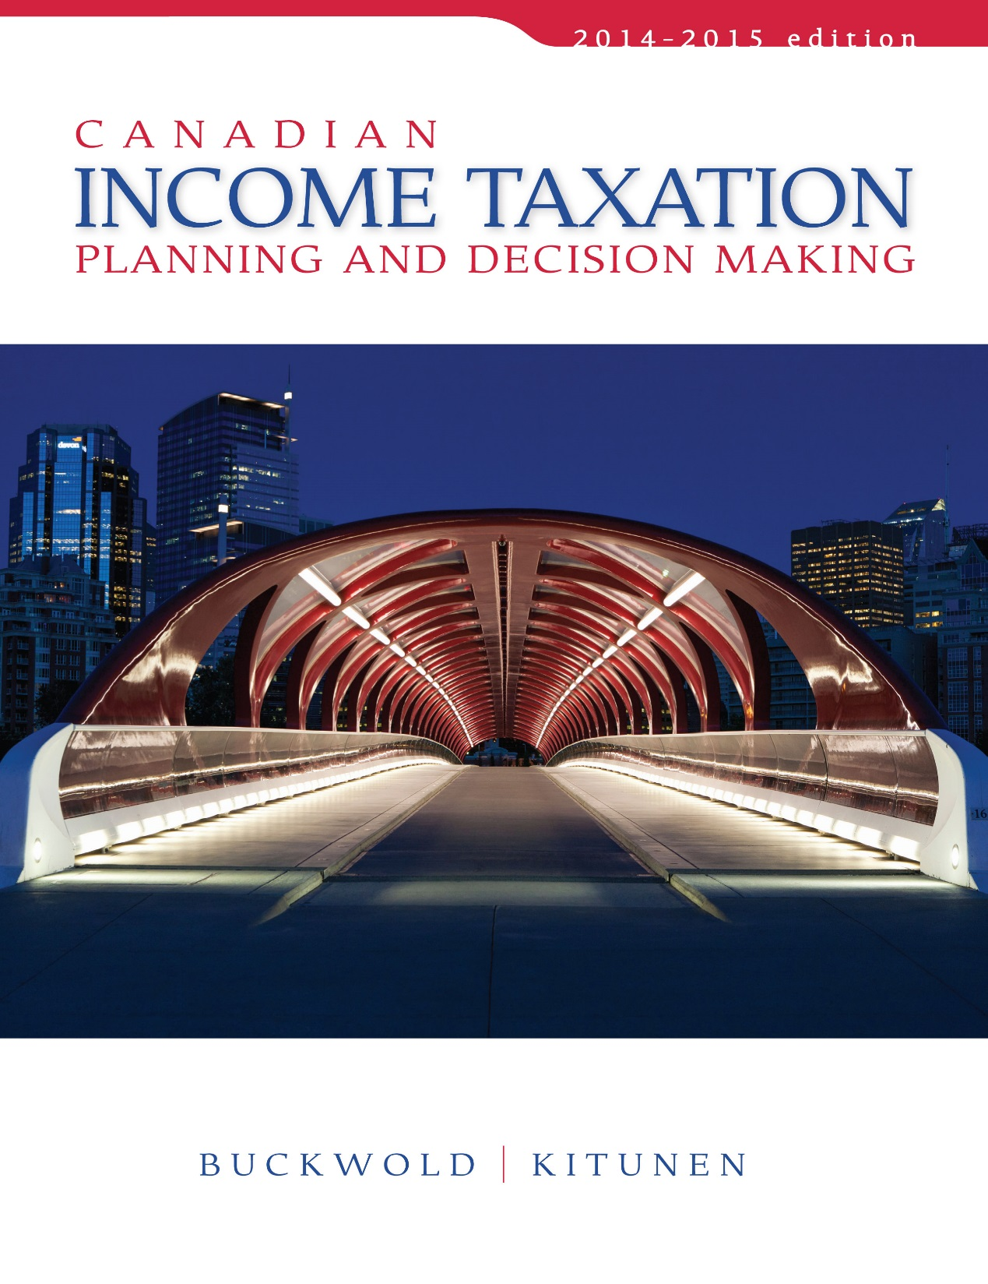
CHAPTER 5:
Income from Business
Prepared by
Nathalie Johnstone
University of Saskatchewan
Electronic Presentations in Microsoft® PowerPoint®

Slide 2
Income from Business
Business Income VS Capital Gain
General Rules for Determining Business Income
Exceptions to the General Rules

Slide 3
1. Business Income versus Capital
[did you intend to flip it and make profit? Show that you went to the trouble and tried to market it]
Depending on the reason for acquisition & use:
    the gain or loss on the sale can be either:
      a business activity or
      a capital transaction.
Distinction between the two sources is important:
    Capital transaction have preferential treatment.
    Business income fully taxable.
    Business losses can offset other income.

Slide 4
Intended Use
Capital treatment can be distinguished from business treatment by employing the following guidelines:
Acquired for
Long-term
Benefit
X
Acquired for
resale
Capital
treatment
Business
treatment
Sometimes difficult to determine primary intention.

Slide 5
General Rules for Determining Business Income
Business income for tax purposes is the profit from the business. GAAP is good starting point – adjustments are made when certain items are treated differently for tax purposes.
Net Income per F/S ( GAAP) XXX
Add:
  Income excluded from accounting income XXX
  Non-deductible expenses XXX
  Unreasonable amounts XXX
  Taxable capital gains XXX XXX
Deduct:
  S. 20 expenses specifically allowed (XXX)
Net income from a business for tax purposes XXX

Slide 6
General Limitations to Business Profit Determination
Expenses are deductible only if the following conditions are met: [need to pass all of them]
    ITA 18(1)(a) - Income Earning Purpose Test.
    ITA 18(1)(b) - Capital Test. [capital expense – claim depreciation]
    ITA 18(1)(c) - Exempt Income Test. [only charities]
    ITA 18(1)(e) - Reserve Test. [reserve for AFDA from AR]
    ITA 18(1)(h) Personal Expense Test. []most common cause of failing]
    ITA 67 - Reasonableness Test.

Slide 7
1. Income Earning Purpose Test
Must be incurred for the purpose of gaining, producing, or maintaining income from business.
Expenses incurred in carrying
on a business activity with an
expectation to profit.
Primary test for the deductibility of expenses.

Slide 8
2. Capital Test
Cannot deduct items of capital nature.
      long-term or enduring benefit.
Main reason for limiting expenditures of capital nature:
  Remove flexibility and estimates.
  Can deduct using uniform system – Capital Cost Allowance (“CCA”).

Slide 9
3. Exempt Income Test
An expense is not deductible even though it was incurred to earn income, if the income that is expected to be generated is itself not taxable revenue.

Slide 10
4. Reserve Test
No reserves are deductible for tax purposes.
However, exceptions are permitted.

Slide 11
5. Personal Expense Test
No deductions are permitted for a taxpayer’s personal or living expenses except for those travel expenses incurred away from home in the course of carrying on business.

Slide 12
6. Reasonableness Test
An outlay or expense is deductible only if reasonable in the circumstances.
Even if meets the other general criteria for deductibility, still subject to the reasonability test.
Designed to combat Abuse and confine business expenses to those incurred in the income-earning process.

Slide 13

Expenses Denied
ITA 18(1)(l) - Use of recreational facilities and club dues
    No deduction permitted for the use or maintenance of a yacht, a camp, a lodge, or a golf course, unless part of normal business.
    Also denies all expenses incurred as membership fees or dues in any club.
ITA 18(1)(n) - Political contributions
    No political contributions are deductible by companies
ITA 19 - Advertising Expenses [Why would you hire a foreigner to advertise to Canadians – want to encourage local use]
    Advertising in a non-Canadian newspaper or broadcasting undertaking cannot be deducted if the advertising is directed primarily at a Canadian market.

Slide 14

Expenses Denied
ITA 18(1)(r) - Allowance for an Automobile
  Limits the allowable amount to the prescribed amount.
  Maximum Allowance that can be deducted by an employer is $0.54 for first 5,000 km, and $0.48 for each additional km.
  Limitation applies only allowance is tax-free.
  If allowance is taxable, the employer can deduct the full amount, provided that it is reasonable.

Slide 15
Expenses Denied
[need to capitalize costs – only claim against profit at sale]
Interest and property taxes on idle land:
  Land is idle if:
    it is vacant and is not being used to generate income, or
    if it is being held primarily for resale or development.
  Related interest costs and property taxes are deductible
    to the extent that income is generated from that land- ITA 18(2),(3).
  Any unused balance is added to the cost of the land
    the amount initially denied can be deducted against the sale proceeds when sold ITA 53(1)(h),10(1.1).

Slide 16

Expenses Denied
ITA 18(3.1)-(3.7) Soft Costs - Certain costs during construction period
    Legal and accounting fees,
    Interest costs,
    Mortgage costs,
    Property taxes, and
    Promotional expenses
  that relate to the construction project.
Costs are instead added to the cost of the building and deducted through CCA.

Slide 17
Expenses Denied
ITA 18(12) - Work space in home not permitted unless one of the following conditions is met:
  The space is “the individual’s principal place of business.” or
  If first condition not met
    used exclusively for the purpose of earning income from business, and
    used on a regular or continuous basis for meeting clients, customers or patients of the individual.”

Slide 18
Expenses Denied
Work space in home (continued)
  Permitted expenses include a proportionate amount of the home’s common expenses:
    Maintenance cost (heating, home insurance, electricity, cleaning material),
    Mortgage interest,
    Property taxes,
    Capital Cost Allowance
  Total expenses cannot exceed business income for the year.
  Excess can be carried forward indefinitely.

Slide 19
Expenses Denied
Meals and entertainment
  ITA 67.1 - Amount permitted is limited to 50% of actual costs incurred.
  One of the exceptions (100% deduction):
    cost of food, beverage, and entertainment events generally available to all employees (limited to six “occasional events” per year).

Slide 20
Expenses Denied
Costs of an automobile
  ITA 13(7)(g) - Cost for purposes of claiming a deduction for CCA cannot exceed $30,000 (exclusive of any GST and PST).
  ITA 67.2 - The interest cost on money borrowed to acquire a vehicle cannot exceed $300/month.
  ITA 67.3 - The deduction for a leased automobile cannot exceed $800/month.
Unpaid Remuneration
  Not deductible unless paid within 180 days after the business year end
  [claim deduction on balance sheet, put in as AP, if not paid within 180 days next year need to re-do statement and pay tax on it]

Slide 21
Expenses Permitted
Section 20 of the Act lists approximately 40 specific items that are permitted as deductions even though, according to the six general limitations, they do not normally qualify.

Slide 22
Expenses Permitted
ITA 20(1)(c) - Interest
  Interest paid is generally deductible EXCEPT: interest paid to CRA on late payments, interest paid on vacant land, interest paid on personal loans (home mortgage, RRSPs)
ITA 20(1)(e) - Financing Expenses for business
  Permitted as a deduction – equally over five years.
  Include the cost of registering a mortgage, appraisal fees for financing, selling commissions, and finder’s fees.

Slide 23
Expenses Permitted
ITA 20(1)(l) - Reserves for doubtful debts and bad debt expense
Can claim a reserve on amounts receivable if:
  it is anticipated that they won’t be collected,
  reserve is reasonable and
  that the debt, when established, created income for the taxpayer.

Slide 24
Expenses Permitted
ITA 20(1)(cc) - Representation expenses:
    fully deductible.
    Can elect to deduct equally over 10 years.
ITA 20(1)(dd) - Site Investigation:
    Allowed even when site is not acquired.
ITA 20.01 - Private Health Services Plan:
    Deductible for all employee but limits to:
      $1,500 for owners and spouses,
      $750 per child.
ITA 20(1)(q) – Registered Pension Plans:
    Must be paid within 120 days of business year end

Slide 25
Expenses Permitted
Expenses deductible on a cash basis
  Convention expenses - Limited to two conventions in a year.
  Landscaping
  Representation fees
  Site investigation fees
  Utility service connections
  Investment counsel fees

Slide 26
Treatment of Inventories
The Act permits closing inventory to be valued using one of two methods:
    Value each item of inventory at lower of:
      Cost or Market -ITA 10(1).
    Value all items of inventory at their market value – Reg. 1801.
All inventory flow methods are acceptable EXCEPT FIFO
Must use the same valuation method from year to year unless a change is approved by the CRA.

Slide 27
Tax Planning Checklist
The sale of property may be treated as a business or a capital transaction. When acquiring property anticipate its tax treatment and plan for the best possible outcome in the event the property is sold
Don’t forget the $$ restrictions on certain items when purchasing or leasing (car cost for CCA-Max $30k, Lease cost $800/mth, Interest on car loan $300/mth
Identify expenses or revenue items where the company have discretion as to when and how much to deduct or include in income for tax purposes
  CCA
  SR+ED
  Interest on money borrowed to acquire depreciable property
  Allowable reserves

