Slide 1
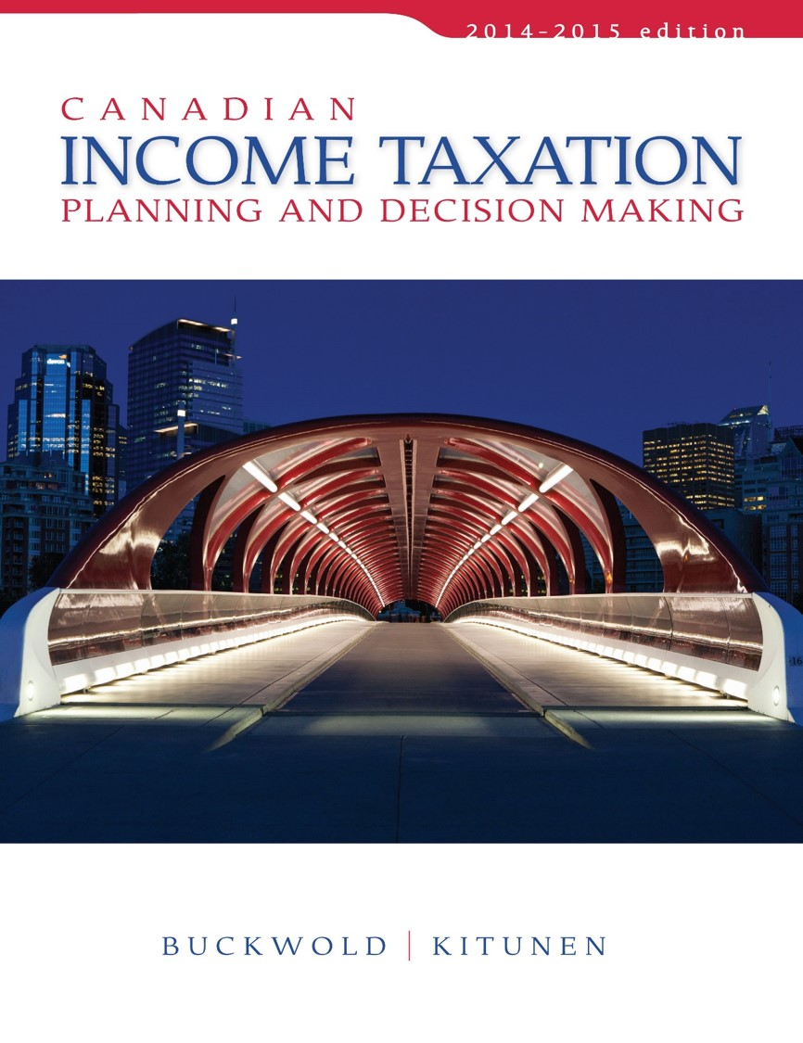
CHAPTER 14:
Multiple Corporations and Their Reorganization
Prepared by
Nathalie Johnstone
University of Saskatchewan
Electronic Presentations in Microsoft® PowerPoint®

Slide 2
Chapter Fourteen - Multiple Corporations and Their Reorganization
Corporate Reorganizations
Holding Corporations and Intercorporate Investments

Slide 3
Corporate Reorganizations
Can occur within a related group of companies having similar S/H
Can occur among independent business entities
Mom, Dad
& Kids
New Co
Corp A
Corp B
Corp A
Corp B

Slide 4
Corporate Reorganizations
Current tax policy provides that when a reorganization occurs,
may elect a form of transaction that does not result in any immediate tax consequences
This election defers the taxes related to the disposition.

Slide 5
1. Corporate Reorganizations
PURPOSE?
To utilize losses of one company before expiry. (ITA 85(transfer of assets at cost, few chapters before – transfer instead of sell at FMV, 87(merger aka amalgamation; 2 old disappear and new one is formed), 88(1)(winding up of subsidiary and parent) )
To transfer assets with accrued gains with NO tax consequences. (ITA 85).
To enable a company to qualify for the $800k Super Cap. Gain deduction. (ITA 85, 86). Example – trigger tax consequence: sell operating to newly created holding @800k cap gain. ACB of op shares is 800k$. Section 85 only works to roll over form person to company, not person to person
To eliminate unnecessary companies (ITA 87, 88(1) )
To put into effect an estate plan for succession (ITA 85, 86) – roll over to estate company, set preferred shares @800k. At death, liable for assets at FVM, but preferred shares have a fixed price therefore no tax because FMV = 800k even if company is worth millions. To preserve control, make preferred shares voting.
To bring in a new shareholder. (ITA 85, 86). If company os wothh 800k. Rollover assets into preferred shares worth 800k. Issue 2 new common shares at 1$ each, old shareholder buys 1 new common and new shareholder buys second common at 1$. Moving forward, 2 shareholders at 50%/50%.

Slide 6
Asset Transfers (ITA 85)
simplest form of reorganization
does not involve the restructuring of the corporations
permitted to transfer either all of its activities or only a specified part of its activities.
involves an actual sale of property.
Assets or business segment
Corp A
Corp B
Cash or Note Payable etc.

Slide 7
Asset Transfers
The transfer price can be determined in two basic ways:
The transfer price of assets can automatically be deemed equal to the FMV. [ITA 69(1)]
If the corporations so elect, an agreed transfer price can be chosen that is usually equal to the cost for tax purposes. [ITA 85(1)] SO NO TAX CONSEQUENCES

Slide 8
Asset Transfers
Alternatives are available for each asset transferred:
means that some assets may be transferred at FMV and others at an agreed lower value.
The choice of methods depends on:
the circumstances of the parties and
the reasons for the transfer.

Slide 9
Asset Transfers [preferred for estate freeze]
Within a corporate group, assets can be transferred vertically or horizontally.
A horizontal transaction
A vertical transaction
Shareholder
Shareholder
Transfer
Div 2
Corp X
Div 1
Div 2
Corp X
Div 1
Div 2
Corp Y
Transfer Div 2
Corp Y

Slide 10
Amalgamations (ITA 87) [preferred because simpler than asset transfer; no need to get shit evaluated]
Involves complete merging of assets, liabilities
and shareholdings of two or more corporation
Shareholders A
Shareholders B
New AB Corp
Old Corp A
Old Corp B

Slide 11
Amalgamations
All former corporations cease to exist and a new corporation is born.
In effect, amalgamated corporations have:
disposed of their assets to a new corporation, and
all of the shareholders have disposed of their shares in exchange for shares of the new corporation.
Corporate amalgamations can be vertical or horizontal.

Slide 12
Amalgamations Tax Treatment
Can be tax-free provided certain conditions are met:
The predecessor corporations are deemed to have sold their assets to the new corporation at their tax values i.e. cost and depreciated values ).
The shareholders are deemed to have sold their former shares at tax cost
New shares have cost base equal to old cost base.
Providing no change in controlling shareholder…no restriction on use of losses carried forward (i.e. amalgamated company can now utilize past losses of predecessor companies.

Slide 13
Amalgamations Tax Treatment
Conditions for a tax-free amalgamation [ITA 87(1)]:
All of the corporations must be Canadian corporations.
All assets and liabilities of the old corporations must become assets and liabilities of the new corporation.
All of the shareholders of the old corporations must become shareholders of the new corporation.

Slide 14
Wind-up of a Subsidiary (ITA 88 (1)
Shareholder
Corporation A
Parent
Step 1
Transfer assets
To Parent
Step 2
Terminate
Subs existence
Corporation B
Subsidiary

Slide 15
How to choose
87 amalgamation
Afterwards brand new company with both parent and child asset
More expensive because costs of dissolving 2 companies and lawyer costs of creating new entity
88.1 windup
Afterwards, only parent company, SH of parent own shares of parent with child assets
Chose because cheaper

Slide 16
Wind-up of a Subsidiary
The tax treatment of a wind-up is similar to that of an amalgamation.
In most cases no tax occurs on the transfer of assets transfer price = tax values of assets transferred.
any tax accounts of the subsidiary become available to the parent. [ITA 88(1)]
Tax free only if the parent company owns at least 90% of each class of the subsidiary company’s shares.

Slide 17
Reorganization of Share Capital (ITA 86)
Purpose – same as 85
Typically redemption of shares triggers a dividend tax treatment – this is only the case if redeemed for money.
May wish to alter the nature of their interest in a corporation without changing the amount of dollar capital invested.
Shareholders are permitted to exchange all shares of a particular class of shares on a tax-deferred basis [ITA 86]:
All parties must maintain a continued interest in the corporation.

Slide 18
Reorganization of Share Capital
Before
After
New
Shareholder
Shareholder
Shareholder
Common
Shares
$10
Pref. Shares
$100,000
Common Shares
$100,000
Corporation
$100,000
Corporation
$100,010

Slide 19
Reorganization Procedures and Case Analysis
Define the problem in the existing structure
Define the desired objective
Choose and test one of the reorganization techniques
Determine whether immediate and future tax implications satisfies the problem.
Are any new problems created?
Choose another method if problems is not solved to satisfaction.

Slide 20
Holding Corporations and Intercorporate Investments
An individual who owns shares in one or more business corporations can choose to interpose a corporation between himself/herself and the operating corporations.
The interposed corporation is referred to as a “holding corporation.”

Slide 21
Holding Corporations and Intercorporate Investments
Shareholder
Holding
company
Operating
company

Slide 22
Tax Treatment of Intercorporate Dividends
Private Companies:
Received from non-connected corporations subject to Part IV tax (33 1/3%) (Chap 13)
Received from connected corporations, no Part IV tax unless the paying corporations receives an RDTOH refund. (Chap 13)

Slide 23
Dividend Reinvestment
Primary benefit of establishing a holding corporation is that it permits the shareholder to receive dividends from the operating company, possibly free of tax, for reinvestment.

Slide 24
Holding Companies and Corporate Acquisitions
A holding corporation can also be extremely useful as a vehicle for acquiring shares in an active business corporation:
- when there are shareholders with different interests
- useful as a means to minimize tax on the sale of shares of a corporation.
- especially when the purchaser uses borrowed funds to make the purchase.
Provides tax-free cash flow to purchasing corp. which allows for quicker repayment of the loan

