Slide 1
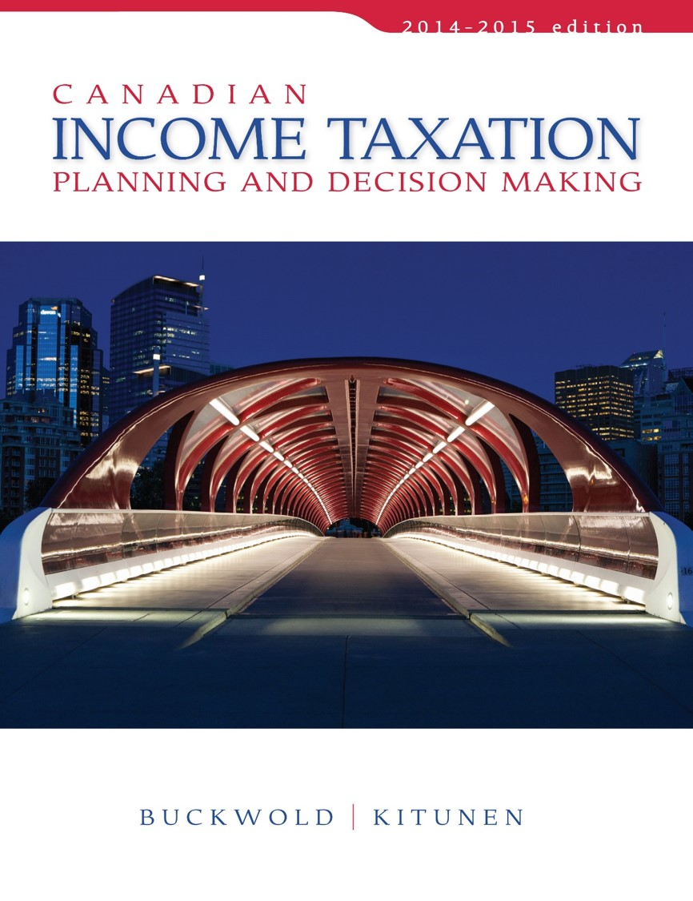
CHAPTER 19:
Business Acquisitions and Divestitures—Tax-Deferred Sales
Prepared by
Nathalie Johnstone
University of Saskatchewan
Electronic Presentations in Microsoft® PowerPoint®

Slide 2
Business Acquisitions and Divestitures – Tax-Deferred Sales
Tax-Deferred Sales and Acquisitions
Sale of a Closely Held Corporation

Slide 3
Tax-Deferred Sales and Acquisitions
Distinguished from a taxable sale by the nature of the payment received for the property:
A taxable sale involves the payment of cash, or a deferred payment of cash secured by notes bearing interest.
A tax-deferred sale involves payment in the form of shares issued by the purchasing corporation.

Slide 4
Tax-Deferred Sales and Acquisitions
Reasons to accept a greater risk by receiving shares rather than cash or other secure assets:
Want to participate in the future growth of the business.
Want to enhance its after-tax return on investment.
Purchaser may not have sufficient cash to make the acquisition, or perhaps no other acceptable buyers are present.

Slide 5
Tax-Deferred Sales and Acquisitions
Alternative courses of action are available:
A sale of assets at an elected transfer price equal to the assets’ tax values.S85 Rollover
A sale of the shares at an elected transfer price equal to the tax value of the shares. S85 Rollover
An amalgamation of two or more corps. S 87
A reorganization of share capital. S 86

Slide 6
Corporate Structure - Prior to acquisition
Shareholder X
Shareholder Y
Y-ACB – Shares $ 100,000
Y-FMV of Shares $500,000
Y-ACB Assets $ 400,000
Y-FMV Assets $ 700,000
Buyer
Corporation
Seller
Corporation
Notes:
These facts are to be used in the next few examples… selling shares, selling assets, share reorganization

Slide 7
Sale of Assets
Use section 85 rollover
Tax deferred if Sell price = tax costs S85
Can be done even though the actual selling price for legal purposes is equal to the assets’ FMV.
The vendor achieves a tax deferral and the potential for increased returns,
but also assumes an additional risk by accepting shares of the purchaser corporation as payment.

Slide 8
Sale of Assets
Advantage is that the purchase can be achieved with a minimum of cash and debt,
because of the requirement that shares be issued as part of the payment terms.
Disadvantage to the purchaser is:
Cost base of the assets = transfer price elected

Slide 9
Corporate Structure – after acquisition of assets
From example situation above – sale of assets
Shareholder X
Shareholder Y
Sell asset - $700,000
Elect at $400,000
Buyer
Corporation
Seller
Corporation
Debt and/or Cash $400,000
Shares $300,000

Slide 10
Structure after acquisition
Ask for the cost base as cash, difference up to FMV ask for shares.
Transaction is not taxable since company Y id deemed to have sold assets at 400k
X with Y’s assets:
ACB 400
FMV 700
Y’s balance sheet
Cash 400$
Shares of X with ACB 300k$

Slide 11
Sale of Shares
Sale of shares - can obtain a tax deferral by using the same elective provisions as for an asset sale.
Similar advantages and disadvantages as a tax-deferred sale of assets.

Slide 12
Sale of Shares
Tax Deferred Sale of Shares
Shareholder X
Shareholder Y
Share FMV $400,000
Tax costs nil
Buyer
Corporation
Cash or debt $100,000
Seller
Corporation

Slide 13
After the sale of shares
Buyer owns the seller’s assets + goodwill
Y is shareholder of X, which own’s Y’s previous shit
Max cash transfer is cost base (if shares, max 100$)
Y owns shares in X worth FMV of 400k$ (presumably)

Slide 14
Amalgamation [ITA 87(1)-(4)]
Combines a share sale with an asset sale,
Shareholder of former corporations exchange their shares for shares of the new corporation, and
all of the former corporations transfer their assets to the new corporation.
NO TAX CONSEQUENCE for amalgamation. Share value stays the same; cost base unchanged.
X Co
Shareholders
X Co
Shareholders
Amalgamated
XY Co
X Co
Y Co

Slide 15
Share Reorganization (No sale)
Seller company value shares and convert to preferred at FMV
A tax-deferred through a reorganization of share capital. [ITA 86(1)-(3)]
New shareholder enters as a common shareholder with nominal share; value of new common shares is 0$
Current
Shareholders
New
Shareholders
Common Shares
FMV $500,000
ACB $100,000
Pref. Shares
FMV $500,000
ACB $100,000
Common Shares
FMV – nominal
ACB - nominal
Operating Co

Slide 16
Conclusion
All tax-deferred acquisitions have similar results for both vendor and purchaser.
Vendor defers tax on the sale by accepting payment, in the form shares;
that vendor incurs greater risk.
Purchaser assumes the disadvantage of a lower cost base;
But reduces cash or debt requirements of acquisition by using shares.

Slide 17
Conclusion
Considerable flexibility in structuring a business divestiture and acquisition.
The choice of method will depend on the needs of the vendor and purchaser.
The decision-making process must involve examining each of the alternatives in terms of both its immediate and its long-term impact.

