Slide 1
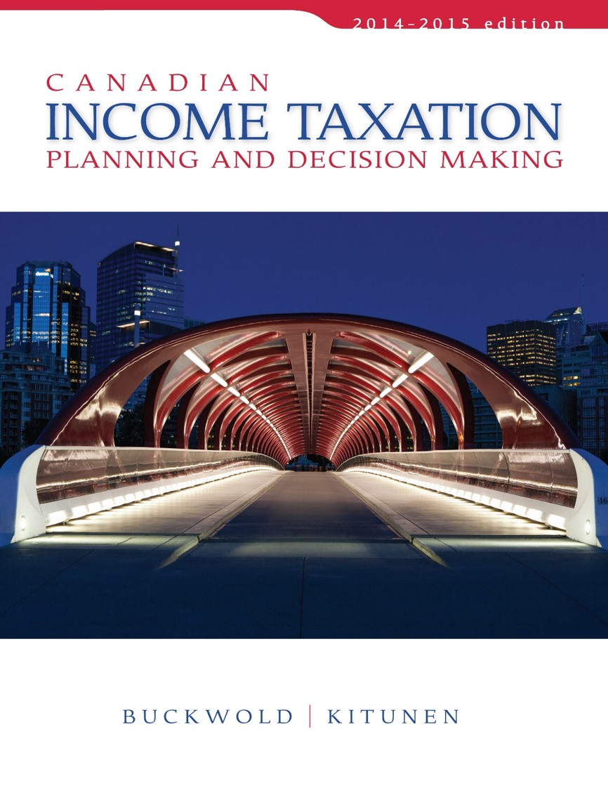
CHAPTER 18:
Business Acquisitions and Divestitures—Assets versus Shares
Prepared by
Nathalie Johnstone
University of Saskatchewan
Electronic Presentations in Microsoft® PowerPoint®

Slide 2
Business Acquisitions and Divestitures – Assets versus Shares
Assets versus Shares
Implications for the Vendor
Implications for the Purchaser
The Relationship between Asset Price and Share Price
The Decision to Purchase
Summary and Conclusion

Slide 3
Business Acquisitions and Divestitures – Assets versus Shares
Price paid for a business is influenced by tax considerations.
  Real proceeds = Selling Price – tax Cost
  Vendor may accept a lesser purchase price if vendor can reduce of defer the after-tax costs.
    If after-tax value is the same or greater than expected
  A purchaser that can reduce the tax payable on the income stream acquired may be prepared to pay a higher price.

Slide 4
Assets versus Shares
Acquisitions and divestitures can take two forms:
  The sale of specific business assets, or
  The sale of share of a corporation that owns those specific assets.
Tax implications of these alternatives has a significant effect on the purchaser and the vendor.

Slide 5
Business Acquisitions and Divestitures – Assets versus Shares
Shareholder X
Shareholder Y
Sell shares
For Sale Corporation
Buyer Corporation
Sell assets

Slide 6
Implications for the Vendor
Sale of Assets
The sale of specific assets by a corporation usually results in two levels of tax.
The following must be established:
    The amount of tax payable by the corporation, and the timing of the payment of tax.
    The amount of tax payable by the shareholder, and when that tax may occur.

Slide 7
Sale of Assets
When a corporation sells assets:
  Sale of Capital property results in a capital gain
  Sale of Depreciable may result in business income (loss) (recapture or terminal loss)
Amount of tax payable depends on the type of Corporation:
  A public corporation pays high tax on all income
  CCPC may be eligible for the small business deduction

Slide 8
When winding down a company, all cash in accounts needs to be paid as a dividend.

Slide 9
Exam questions
Company, cost base, come up with at cash in the company
Calcualte AT cash at the end of the day in shareholder
Given numbers, calculate tax consequence for vender and buyer
Called a wind up (88.2-closing the business)

Slide 10
Sale of Assets
Amount and timing of tax for the corporation can be determined with certainty
The second level of tax on distribution to the shareholder can be deferred. Company effectively became a holding company to defer taxes that can be sued for future investments
  If business continues after asset sale until wound-up
Then the after-tax proceeds on sale of assets can by kept in the corporation for future investment

Slide 11
Sale of Shares
Easier
Involves the sale of one asset – Shares - and usually results in one level of tax.
  Sale of shares results in the complete sale of the corporation
    no tax consequences result to the corporation itself.

Slide 12
Sale of Shares
Only tax consequence is a capital gain
Dream situation – SMB is very active (90% assets active). To prepare, look at company and ID if active or passive asset (know purchase and FMV); attempt to divest passive assets prior to be eligible for 800k. Purify = add all FMV of active assets/total FMV; if 90%+, eligible. If not, to purify, sell off passive assets and pay down debt (liability doesn’t impact active assets)
Sale of shares is a capital transaction – only 50% of the gain is taxable.
Individual shareholders may be eligible for the $800,000 capital gain deduction
  If corporation qualifies as a QSBC. YOU GOTTA PURIFY BEFORE SALE.
If vendor, preferable to do this – sell shares and claim 800k$

Slide 13
III. Implications for the Purchaser (better to buy assets than shares)
If buy shares, say 1.5M, locked value until disposal and capital gain (0 CCA on historical cost). Also, if assets are already depreciated in shares, less CCA since assets already depreciated.
If buy asset 1.5M, and depreciate.
Purchase of Assets
Important feature - purchaser can deduct all or a portion of the purchase price by claiming CCA.
  the cost base of each asset for tax purposes is equal to the price paid.
  Provides higher deduction than if purchase shares

Slide 14
Purchase of Assets
Purchaser and seller may find it easy to agree on a total purchase price but
Purchaser will want to allocate high values to depreciable property.
Vendor will want the opposite in order to minimize tax on the sale

Slide 15
Purchase of Shares
Only the shares have changed ownership
  the corporation continues without interruption.
    Assets remain at their tax values… even though FMV is higher
    CCA continues from same tax base

Slide 16
Purchase of Shares
After-tax cash profits following a share purchase will usually be lower
  Purchaser simply takes over the tax position of the vendor corporation.
  Purchaser may be liable for tax if or when assets are sold in the corporation
Purchaser will attempt to pay a lower price for the shares than would pay for the assets
Use in negociations

Slide 17
The Relationship between Asset Price and Share Price
Tax impact of an asset sale is different from that of a share sale,
  both in the amount of tax payable and the timing of the tax payment.
Must recognize that the form of the transaction affect the price attached to the sale of a business.
The degree to which the price varies cannot be measured with certainty.

Slide 18
The Relationship between Asset Price and Share Price
Any negotiated price has some risk with respect to the tax impact.
Risk can be diminished if both parties understand the tax consequences that would result from an assumed worst-case scenario..

Slide 19
The Relationship between Asset Price and Share Price
Vendor --- worst-case scenario is most likely an asset sale
  vendor corporation pays tax on the sale of its assets and
  distributes all of its earnings.

Slide 20
The Relationship between Asset Price and Share Price
Purchaser --- worst-case scenario would involve a purchase of the shares and
  immediately afterwards, a sale of all of the assets of the newly acquired corporation.
  Not benefit from premium goodwill immediately
Both scenarios would result in full tax liability for the respective parties.

Slide 21
Establishing the Worst-Case Scenario
Worst-Case scenario is critical to vendors
  establishes a minimum share price in relation to an asset price.
Presumably a vendor would not accept a share price that is below this minimum.
Provides the purchaser a starting point from which to begin negotiations.

Slide 22
The Decision to Purchase
Three major tax issues must be examined:
  Future rates of Tax
  Asset Price vs. Share Price - Impact of Cash Flow
  Potential Tax Liability after Share Acquisition

Slide 23

Future Rates of Tax
May differ considerably from the rate that was applicable before the acquisition:
  Eligibility for SBD is associated may change.
Value of a business to the vendor may well be different from its value to the purchaser.
It is important for the purchaser to anticipate the post-acquisition tax rates as part of its acquisition strategy.

Slide 24
Asset Price or Share Price – Impact on Cash Flow
Acquisition must provide an acceptable rate of return.
Compare the anticipated future after-tax cash flows on a net present value basis with the required purchase price.
Analysis should be completed for both alternatives to determine which provides the highest result.

Slide 25
If the company can’t be purified (no debt to pay off, for example a single bond that sale of passive assets can’t cover), left with selling individual assets.
Let company become an investment company
keep $ in company, possible to pay yourself 25k$/year if it is the only income you have.

Slide 26
Potential Tax Liability After Share Acquisition
Might be able to buy cheaper if buying the shares
A share acquisition results in the buyer assuming the tax position of the vendor corporation.
Risk of hidden liabilities (have lawyer draft agreement saying that you are not responsible for unpaid sales and payroll taxes – those are worst since govt can seize assets)
Additional tax may arise if dispose of all or some of its assets
Must try to anticipate future events relating to the assets that are held within the acquired corporation, and
  decide if the risk requires a further discounting.

Slide 27
Summary and Conclusion
Sale of Assets
Vendor
  Creates taxable income
  Second level of tax on distribution
Purchaser
  Obtains a higher cost base for each asset
  Higher cost base increases after-tax profits due to higher CCA.

Slide 28
Summary and Conclusion
Sale of Shares
Vendor
Sells a single asset – simpler
Results in capital gain – taxed at 50%
  May be eligible for $800,000 capital gains exemption
Purchaser
Assumes tax status of vendor corporation
No increase in cost base – no change in future tax savings from CCA
  ***********BASS***********
  Buy assets sell shares

