Slide 1
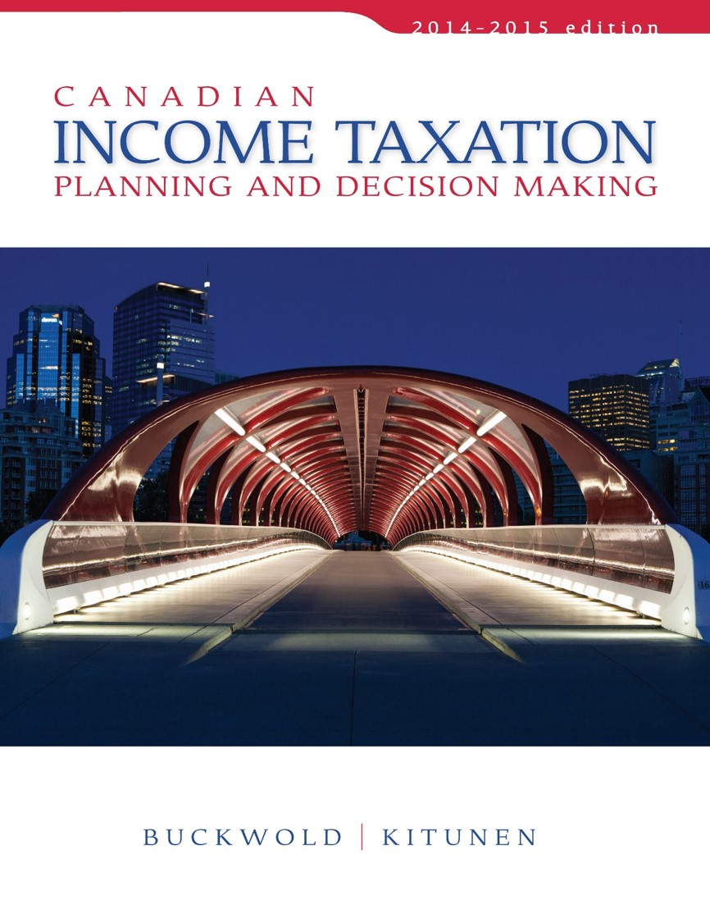
CHAPTER 17:
Trusts
Prepared by
Nathalie Johnstone
University of Saskatchewan
Electronic Presentations in Microsoft® PowerPoint®

Slide 2
Trusts
The Trust Entity
Tax Treatment of Trusts
The Use of Personal Trusts
The Use of Commercial Trusts

Slide 3
The Trust Entity
Definition of a Trust:
Trust not defined in The ACT.
  Merely outlines the tax treatment of the income
A trust is “a legal arrangement whereby a person transfers property to another person to hold for the benefit of one or more persons”
Trustee
Beneficiary
Trust
Settler
Assets

Slide 4
Definition of a Trust
Trust does not have status of a legal person
Format closer to a partnership
  Existence is created by trust documents
    Outline the obligations of the trust
  Different – income can be taxed in the trust or allocated to beneficiaries for taxation.
  Allocation is discretionary.
Beneficiaries – can be capital or income beneficiaries

Slide 5
Types of Trusts
ITA 108(1):
Inter Vivos
Testamentary (upon death)
In Lifetime
On Death
Commercial
Commercial
Personal
Personal
Purchased
Not Purchased

Slide 6
IN vivo Trust(settler is still alive)
  used to protect assets
  maybe creditors. Assets in
  Trust are no longer yours.
  Pay taxes today on asset FMV Except is benificary is wife
Testamentary trust: once youre dead.
  Tax consequence transferred to your benificiary

Slide 7
Types of Trusts
Personal:
  Used for estate and tax planning
  Taxed at highest tax rate
Commercial:
  Traded on the stock exchange
  Examples include mutual funds (mutual fund is a trust), REITs and royalty trusts
  Not taxed at 29%

Slide 8
Tax Treatment of Trusts
Considered an Individual (Taxed like a person)
Represents a separate entity
Taxable in Canada if resident in Canada any time in the year
  Residency established by residency status of trustee(s).
    Multiple trustees – who exercises control and to what extent.

Slide 9
Determination of
Taxable Income and Tax
Use the net income formula (Chapter 3) LESS amounts distributed to beneficiaries
Trust files a separate tax return (T3) (T1 is person, T2 is corporation, T3 trust)

Slide 10
Determination of
Taxable Income and Tax
Trust may allocate after tax income and accumulate funds on behalf of minor children:
  Created for minor children and income is accumulated on their behalf until 21 years of age.

Slide 11
Determination of
Taxable Income and Tax
Taxation of Testamentary and Inter Vivos:
Inter Vivos:
  Highest personal tax rate (29% federal) to avoid ppl setting up trust to shift income to save tax
Testamentary:
  Gradual rates available to individuals
Both trusts have access to the DTC, FTC, political, investment and donation tax credits

Slide 12
Income Allocation and Beneficiaries
Trust may designate the source and characteristic of income:
  Capital gains – eligible for capital gains deduction.
  Taxable Dividends – allocated as Eligible or Non-eligible for purposes of the DTC.
May allocate to Beneficiaries in different proportion.
  Overall allocation must be equitable.
  When income distributed, do like partnership income and split in categories since different tax tratment

Slide 13
21 Year Rule
Trust have limited life:
  Deemed to sell assets on its 21st anniversary
  Means assets deemed sold at FMV, includes:
    Capital property
    Depreciable property
    Land that is inventory
    Resource Property
Exception is a spousal trust
Can’t roll assets out of a trust

Slide 14
Transaction with Settlors and Beneficiaries
Income Beneficiary – has right to the income
  Property is deemed to be disposed of at FMV
  For ppl you don’t trust
Capital Beneficiary – has right to the capital
  Property is deemed to be disposed at Cost
  Same treatment if Beneficiary has both income and capital interest.
  Beneficiaries assume the tax position.
  For ppl you trust to perpetuate assets

Slide 15
Spousal Trusts
Spousal trust
  Spouse is entitled to receive all the income and
  No other person can use or receive the capital of the trust until spouse’s death
Common use – to ensure spouse is taken care of until death but preserve assets for the children.

Slide 16
Spousal Trusts
Three unique features:
  Property transferred into trust at cost.
  21 year rule is waived for the 1st 21 year anniversary.
  Upon death of spouse – assets are deemed to be disposed of at FMV

Slide 17
Other Trusts
→Tax Deferred Income Trust Plans:
RPP, RRSP, DPSP, RRIF, RESP
Income earned is Not taxable and hold income for future distribution to beneficiaries
Only taxable when amounts are withdrawn or distributed to beneficiary
→Investment Trusts
Mutual funds, REIT, Income trust, Royalty trust
All annual income must be allocated to unit holders/beneficiaries are is TAXABLE

Slide 18
The Use of Personal Trusts
Estate Freeze
Kids
Mom
and
Dad
Subscribe for
Common shares
Transfer common shares
For preferred shares
Family Co

Slide 19
The Use of Personal Trusts
Administrative Benefits:
Provide a vehicle to manage property for those who cannot.
Provide direction on how to use the property
Preserve the asset
Hold property for future grandchildren

Slide 20
The Use of Commercial Trusts
Purpose - allow smaller investors to:
  Participate in variety of investments
  Spread risk
  Gain access to professional investment management

