Slide 1
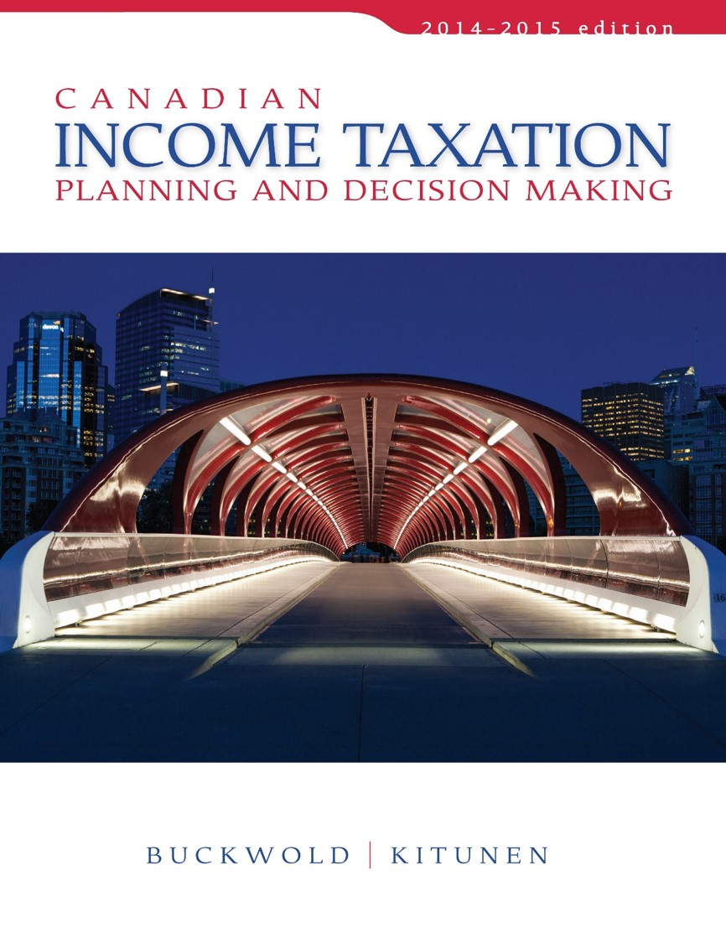
CHAPTER 15:
Partnerships
Prepared by
Nathalie Johnstone
University of Saskatchewan
Electronic Presentations in Microsoft® PowerPoint®

Slide 2
Partnerships
The Standard Partnership –
Definition and Format
Taxation of Partnership Operations
Partnership Structure –
Impact on Decision Making

Slide 3
Partnerships
Different alternative structures for a business activity includes:
  Partnerships
    Useful for individuals who practice together in a profession and small business enterprise
    Also used to form part of a business structure of large public and private corporations.

Slide 4
Partnerships
A partnership is a self-contained entity holding assets, liabilities, and partner’s equity.
Partner 1
Partner 2
Partner 3
Partner 4
Partnership

Slide 5
Very Important to have a Partnership Agreement
A partnership is created by the execution of a partnership agreement.
The partnership agreement outlines:
    Each partner’s required contributions to the entity.
    The format and rules for decision making and the management of the partnership’s business affairs.
    How profits or losses are to be shared by the participating partners.

Slide 6

Sharing of Operating Results
Profits or losses are usually shared:
  as a function of capital contributions, or
  the degree of effort or participation in the business process, or
  Both of the above.
The sharing of profits and losses is a function of the partnership agreement.

Slide 7
Partner Liability
Standard partnership is a separate functioning entity for management purposes.
It is not a protected legal entity that is separate from the affairs of the partners.
  All obligations and debts incurred are the responsibility of each partner
  All negligent activities performed by them, are the full responsibility of each partner.
Each partner is jointly and severally liable for all partnership activities.
  Can be limited under certain circumstances. (LLCs)

Slide 8

Taxation of Partnership Operations
Not a taxable entity
Income earned or losses incurred by the partnership are allocated to the partners:
  in accordance with the agreed sharing ratio,
  for inclusion in each partner’s income for tax purposes.
Income is allocated for tax purposes regardless of whether actually distributed to the partners.

Slide 9
Taxation of Partnership Operations
ITA 96(1) (a) to (c)
Income earned or losses incurred is determined as if the partnership were a separate taxable entity.
Can earn business income, property income, and capital gains;
  all of these are determined according to the normal rules.
Income allocated retains its source and characteristics when included in the partner’s income.
Split the income since different tax treatment per income type

Slide 10
Income Allocation – an example
Type of Activity | Partnership | 60% partner | 40% partner
Business Income | $500,000 | $300,000 | $200,000
Manufacturing loss | (100,000) | (60,000) | (40,000)
Interest Income | 10,000 | 6,000 | 4,000
Dividend Income | 40,000 | 24,000 | 16,000
Rental Income | 100,000 | 60,000 | 40,000
Net Capital Gains | 20,000 | 12,000 | 8,000
 | $570,000 | $342,000 | $228,000

Slide 11
The Partnership Interest
A partner is considered to own a partnership interest whenever that partner has rights and obligations created by being party to a partnership agreement.
The partnership interest is a tradable asset
  can be bought and sold.
Usually treated as capital property for tax purposes;
  disposition results in a capital gain or loss.

Slide 12
The Partnership Interest
Usually created when the participants contribute capital in the form of cash or assets in return for a partnership interest.
Can become a partner by:
    Purchasing a departing partner’s interest,
    Acquiring a portion of the interest of each remaining partner; or,
    Contributing cash or assets to the partnership in return for a new partnership interest.

Slide 13
The Partnership Interest
Existing partners can depart or diminish their percentage of participation by:
    Selling all or a portion of their partnership interest to a new partner or existing partner(s); or,
    Withdrawing their capital directly from the partnership treasury.

Slide 14
Acquiring a Partnership Interest
Partners A and B want to admit a third partner, C
  Can purchase a portion of A and B partnership interest, or
  Can purchase net partnership interest…thereby increasing the partnership net worth
Before:
A
B
$50,000
$50,000
Partnership
Net worth
$100,000

Slide 15
Acquiring a Partnership Interest
Acquiring from Partners
Acquiring new interest
A
B
C
A
B
C
$33,333
$33,333
$33,333
$50,000
$50,000
$50,000
Partnership
Net worth
$100,000
Partnership
Net worth
$150,000

Slide 16
Adjusted Cost Base (ACB) of Partnership Interest
Original investment $100,000
Allocation of Partnership
Income 20,000
ACB after Allocation $120,000
If sold there would be a capital gain of:
Selling price let’s say was $150,000
Capital gain = $150,000-$120,000 = $30,000
½ is taxable to that individual partner

Slide 17
Partnership Interest - ACB
Every partner has his own ACB
Additions to the ACB (most common)
  Partner's contribution of capital
  Partner’s share of income from the partnership (every year add NI to ACB). Increase ACB by NI to ensure not to pay capital gain on it and be double taxed
  Partner’s share of Capital Dividends received by the partnership.
  Partner’s share of the net proceeds of life insurance
Deductions from ACB ( most common)
  Partner’s share of loss
  Partner’s share of charitable gifts or political contributions (decrease ACB since benifited from tax savings from original donation)
  Partner’s drawings (will slap you in the face with capital gain in the future)
Notes:
.

Slide 18
Transactions with Partners and Reorganizations
Can use section 85 to rollover assets to partnership (section 97)
Partner
Sold
At FMV
Or
Elect at Cost using tax free rollover
Sold
At
FMV
Partnership
Asset FMV $25,000

Slide 19
Transactions with Partners and Reorganizations
A partnership is considered to be a separate entity for purposes of holding assets.
Transactions between partners and the partnership are automatically taken place at FMV.
HOWEVER A partner can elect to transfer property into a partnership at Cost (I.E TAX FREE ROLLOVER) [ITA 97(1)].
BUT when a Partnership transfers its assets to a partner, it can only be sold at FMV.

Slide 20
Transactions with Partners and Reorganizations
For exam – new business venture: better to incorporate, partnership. If capital intensive and generate losses, better to have partnership since loss not locked up in corp (open, generate loss on you then when profitable incorporate and rollover assets)
The choice of a partnership form of organization is not binding on the participants.
A partnership can be converted into a corporation in which the former partners are shareholders.
A partnership can elect to convert itself into a corporation without immediate tax consequences [ITA 85(2)].

Slide 21
Small Business Deduction and Private Corporate Partners
Active Income earned by a partnership can be entitled to use the SBD by a CCPC partner.
The active business income earned by the partnership that is eligible for the SBD is limited to $500,000 annually (whole income of partnership maxes at 500k, disadvantage of partnership)

Slide 22
Other decision criteria for corp or partnership
800k cap gain lifetime deduction for individual
(person owning share of corporation involved in active business)
Partner who sells partnership interest is not eligible for 800k$ cap gain

Slide 23
SBD and
Private Corporate Partners
Partnership earns $600,000 in ABI. Structure of partnership is:
Each owns 50% How is the partnership income taxed?
Corporate Partner
1
Corporate Partner
2
ABC Partnership

Slide 24
SBD and
Private Corporate Partners (y being member of partnership, max 500k for whole partnershoiP
 |  | Allocation
 | Partnership | CP # 1 | CP #2
Eligible for SBD if partners Qualify | $500,000 | $250,000 | $250,000
Not eligible for SBD | 100,000 | 50,000 | 50,000
Total | $600,000 | $ 300,000 | $300,000

Slide 25
Partnership Structure – Impact on Decision Making
Must consider these four fundamental tax issues:
  What will be the tax cost on the annual operating profits generated from the new venture?
  If operating losses are expected during the start-up phase, how and when can such losses be utilized against other sources of income of the venture itself or of the participating parties? (Don’t want capital losses since only 50% deduction and applicable against cap gains)
  What will the tax implications be if the venture fails and is either terminated or sold off at a loss?
  How will the capital invested and the accumulated profits be returned to the investor? (how can you get your money back – want capital gain because 50%)
  If natural to make losses first few years, want tpartnership to get business losses first few years

