Slide 1


Fiat Chrysler
Merger
Presentation to the Board of Directors
Philippe Boivin
Tarek ElChaarani
Simon Foucher
Jonathan Suprovici
Caroline Vennes
Jonathan Yeh

Slide 2
AGENDA
1
Company & Industry Analysis
2
SWOT
3
Historical Profile
4
Business Valuation
5
Alternatives & Recommendation

Slide 3
COMPANY & INDUSTRY ANALYSIS
3

Slide 4
Brief History of Chrysler:
1930-1935:
‘’Detroit’s Engineering Company’’
2008-2009: Financial Difficulties & Bankruptcy Protection
1955-1962: Sleek Designs
1980’s:
The minivan
1920
1930
1940
1960
1970
1980
1990
2000
2014
1950
1946-1954: Integration of novel technology
1987: Acquisition of the Jeep brand
1920-1924:
Company creation
2010: Reinvigoration of the Chrysler Brand:
‘’Imported from Detroit’’
1960’s & 1970’s: Unique product development and branding
4

Slide 5
U.S. Automotive Industry Analysis
Strong local and international competition
Impact of macro-economic conditions and fuel-prices
Power of Labor Unions (United Automobile Workers)
Federal regulation
Governmental support
Production in Canada and Mexico
Environmental considerations
5

Slide 6
* SWOT *
6

Slide 7
SWOT analysis
STRENGTHS: Brand name and reputation: attractive to U.S. customers Strong focus on customer (CCO) Operations: mini-van segment (since 1983) Strong owner loyalty Other brands (ex: Jeep at 31% of all sales) | WEAKNESSES: Limited market reach: 90% of sales in U.S. Small and declining market share Management problems & lack of experience No sustainable/ economic friendly solutions Limited number of products/ models Quality problems International Sales Weak economies of scale High debt Significant Pension Plan deficit: $10.5B Potentially damaged reputation
OPPORTUNITIES: Strategic partnership with Fiat International & emerging markets New technologies Acquisition synergies | THREATS: Decreasing interest rates Sensitivity to U.S. macro-economic conditions Intense competition Changes in consumer tastes and preferences Production overcapacity = consolidations Regulations: safety & emission standards, fuel efficiency Increase in oil prices
7

Slide 8
HISTORICAL PROFILE
8

Slide 9
History of Fiat Ownership (2009 – present)
April 12, 2011
Jan 5, 2012
April 30, 2009
2nd Performance Event
30% (+5%)
June 3, 2011
3rd Performance Event
58.5% (+5%)
Fiat-Chrysler Merger
20%
Buy US Treasury Shares
52% (+6%)
Jan 11, 2011
July 21, 2011
1st Performance Event
25% (+5%)
April 21, 2011
Buy CDN Shares
53.5% (+1.5%)
Equity Call Option
46% (+16%)
Present
Acquire remaining
41.5% (VEBA)
9

Slide 10
Composition of Board of Directors
Board member | Representation
Sergio Marchionne | Fiat
Alfredo Altavilla | Fiat
Léo W. Houle | Fiat
John B. Lanaway | Fiat
Erickson N. Perkins | VEBA
Ruth J. Simmons | Independent
Douglas M. Steenland | Independent
Ronald L. Thompson | Independent
Stephen M. Wolf | Fiat
Independent
* BoD (VEBA) is considering pushing forward with an IPO
10

Slide 11
VALUATION
11

Slide 12
Valuation
Standard Approaches:
Discounted Free Cash Flow (5-year + TV)
Trading Comps
Precedent Transactions

Slide 13
Valuation
Standard Approaches:
Discounted Free Cash Flow
(5-year + TV)
Trading Comps
Precedent Transactions

Slide 14
Valuation: DCF
Top Down Approach to Financial Forecast
Vehicle Sales Y / Y Growth by Region
Chrysler Market Share
Chrysler Vehicle Sales

Slide 15
Valuation: DCF
Vehicle Sales Y / Y Growth by Region
  Focus on U.S. given 75%-80% of sales

Slide 16
Valuation: DCF
Chrysler Market Share Slightly Increasing

Slide 17
Valuation: DCF
Chrysler Vehicle Sales
2009: 1.3 million
2010: 1.5 million
2011: 1.9 million
2012: 2.2 million
LTM to September 2013: 2.3 million
2013: 2.4 million
2018: 3.7 million

Slide 18
Valuation: DCF
Other Major Assumptions to Financial Forecast
Revenue / Vehicle Sold:
  $29,076 in LTM, ramping up to $31,500 in 2018
Gross Margin stable at 16%
Tax rate:
  18.4% in LTM, ramping up to 35.0% in 2018
Stable Balance Sheet metrics
  Payables, receivables, etc.

Slide 19
Valuation: DCF
Major Assumptions
to WACC
Step 1: Cost of Debt

Slide 20
Valuation: DCF
Major Assumptions to WACC:
Step 2: Capital Structure

Slide 21
Valuation: DCF
Major Assumptions to WACC:
Step 3: Management Estimates of WACC
2010: 15.0% - 15.3%
2011: 14.4% - 16.5%
2012: 16.0% - 16.5%

Slide 22
Valuation: DCF
Major Assumptions to WACC:
Step 4: Cost of Equity / Implied Beta
Implied Beta is high @ 3.6 however equity investment would remain very risky

Slide 23
Valuation: DCF

Slide 24
Valuation: DCF
Equity Value
Major influence on model

Slide 25
Valuation
Standard Approaches:
Discounted Free Cash Flow (5-year + TV)
Trading Comps
Precedent Transactions

Slide 26
Valuation: Trading Comps
U.S. and International Comps

Slide 27
Valuation: Trading Comps
U.S. Comps More Relevant
Chrysler sells 75%-80% of vehicles in North America
Company will however benefit from alliance with Fiat
Went with 4.25x, similar to Ford
Further upside potential as company reduces leverage and / or improve profitability

Slide 28
Valuation: Trading Comps
Sensitivity

Slide 29
Valuation
Standard Approaches:
Discounted Free Cash Flow (5-year + TV)
Trading Comps
Precedent Transactions

Slide 30
Valuation: Precedent Transactions
Three Historical Transactions

Slide 31
Valuation
Summary of Three Approaches

Slide 32
Valuation
Considerations to Valuation
Treatment of Pension Deficit
Value of Control Premium
  Transaction in the works since 2009
Fiat SpA alliance going forward

Slide 33
RECOMMENDATION
33

Slide 34
Board of Director’s Duties
Fiduciary Duty
  Care: Must act in good faith for the company's best interest
  Loyalty: Protect the interests of the corporation/refrain from conduct which would injure the corporation or shareholders
Revlon duty (Applies if a takeover is imminent)
  Must make reasonable effort to obtain the highest value for a company
34
Notes:
http://www.dypadvisors.com/2011/08/22/fiduciary-duties-of-board-of-directors-basics/#sthash.UKcXBLDM.dpuf
http://www.investopedia.com/terms/r/revlon_rule.asp

Slide 35


Obvious legal conflict of interest
Pay the Lowest Price
Fiduciary
Duty
3
4
1
Get the highest bid
Revlon
Duty
Form an independent committee
35

Slide 36
Recommendation
Still in a conflict of interest between fiduciary duties to:
  Chrysler: Pay as little as possible for buy back
  Shareholders: Get as much as possible for sale
Recommend shareholders to accept anything between
  Low: $3.9B
  High: $4.1B
Set range to ensure acting in total neutrality
36

Slide 37
Review of consideration structure
Chrysler Shareholders
(VEBA)
Cash from Chrysler
(Buyback)
Consideration from Fiat (Takeover)
Ensure cash from Chrysler’s RE doesn’t impact operations
37

Slide 38
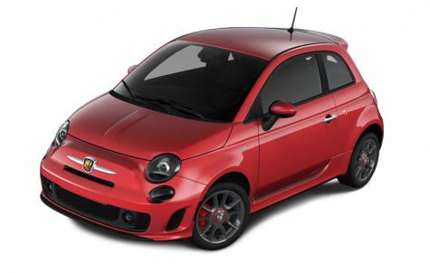
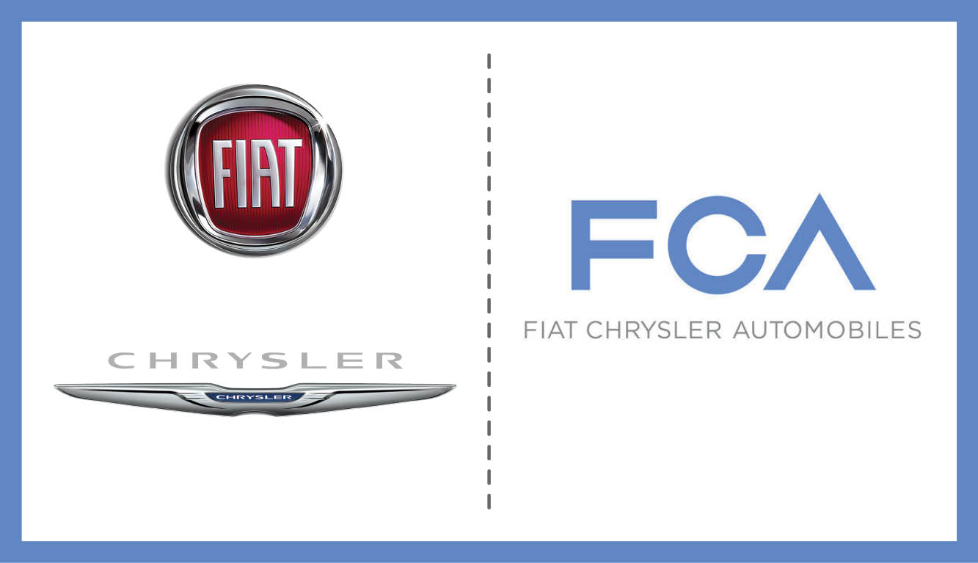
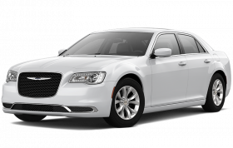
Questions?
38

